Slide 1
Turning Point

Slide 2
Communication Media
Let every worker in the Master’s vineyard study, plan, devise methods (increase innovation), to reach people where they are. We must do something out of the common course of things. We must arrest attention (move faster). We must be deadly in earnest. – Ev. 122

Slide 3
Communication Media
Let the workers for GOD manifest tact and talent, and originate devices by which to communicate light to those who are near and to those that are far off (stay connected). – Ev. 206

Slide 4
Communication Media
GOD will guide HIS messengers in the adoption of new methods to arrest the attention of men, and convince their judgement (get personal). HE will give skill and understanding in the use of effective illustrations to arrest the attention of people. – The Gospel Herald, Dec. 1, 1901

Slide 5
Digital Highway
Isaiah 43:18, 19
¹⁸ Remember ye not the former things, neither consider the things of old.
¹⁹ Behold, I will do a new thing; now it shall spring forth; shall ye not know it? I will even make a way in the wilderness, and rivers in the desert.
Romans 9:25 – 28
²⁵ As he saith also in Osee, I will call them my people, which were not my people; and her beloved, which was not beloved.
²⁶ And it shall come to pass, that in the place where it was said unto them, Ye are not my people; there shall they be called the children of the living God.
²⁷ Esaias also crieth concerning Israel, Though the number of the children of Israel be as the sand of the sea, a remnant shall be saved:
²⁸ For he will finish the work, and cut it short in righteousness: because a short work will the LORD make upon the earth.

Slide 6
Reality 2018 - 9

Slide 7
Four important criteria we cannot ignore today:
we need to increase innovation, (devise methods)
move faster, (arrest attention)
stay connected (communicate), and
get personal (convince).
Clifford de Witt, Chief Innovations Officer at Microsoft

Slide 8
Our world looks like this:
Today’s world is a self sufficient,
You need to speak the language if you want to be heard, cellphonese,
You will mostly be granted 8 seconds to capture their attention,
They desire less face-to-face communication, and
They want to communicate using technology platforms of their choice. (WhatsApp, Viber, Line, WeChat, Telegram, etc.)

Slide 9
Allan Raiz, CEO of RAIZCORP.COM –
Digital and Social trends
changes the way in which we
consume content.

Slide 10
.
1 - Immersion

Slide 11
.
1 – Immersion
2 – Interactivity

Slide 12
.
1– Immersion
2 – Interactivity
3 – Ultra-personalization

Slide 13
.
1– Immersion
2 – Interactivity
3 – Ultra-personalization
4 – Curation

Slide 14
.
The potency and efficacy of traditional EVANGELISM must now come under scrutiny, our relationship with DIGITAL TECHNOLOGY and its instant content platform must be unfolded and developed, this approach will present and open EVANGELISTIC AVENUES with the unmissable opportunity to connect with audiences and participants like never before that will lead to baptism – Gideon Pelser

Slide 15
Highlighting Micro Moments
High Touch
Personalised content will be more and more significant – it will maintain loyalty and position the presenter as a
trusted source.

Slide 16
Turning Point
1 - We need to be aware of these trends,
2 - So as to plan how to compete in this digital environment to spread the everlasting gospel and come up with a model of evangelism that works.
This is the Turning Point -
- Cell Phone Evangelism
- CDE
- Digital Church

Slide 17
3 - Digital Church
Sabbath Opening
Sabbath School Program
Sabbath Closing
Sabbath School Background Study
Prayer Meeting
Study Questions

Slide 18
WE WANT -- IMPACT?
Broadcast
Baptism

Slide 19
Worldwide Reach

Slide 20
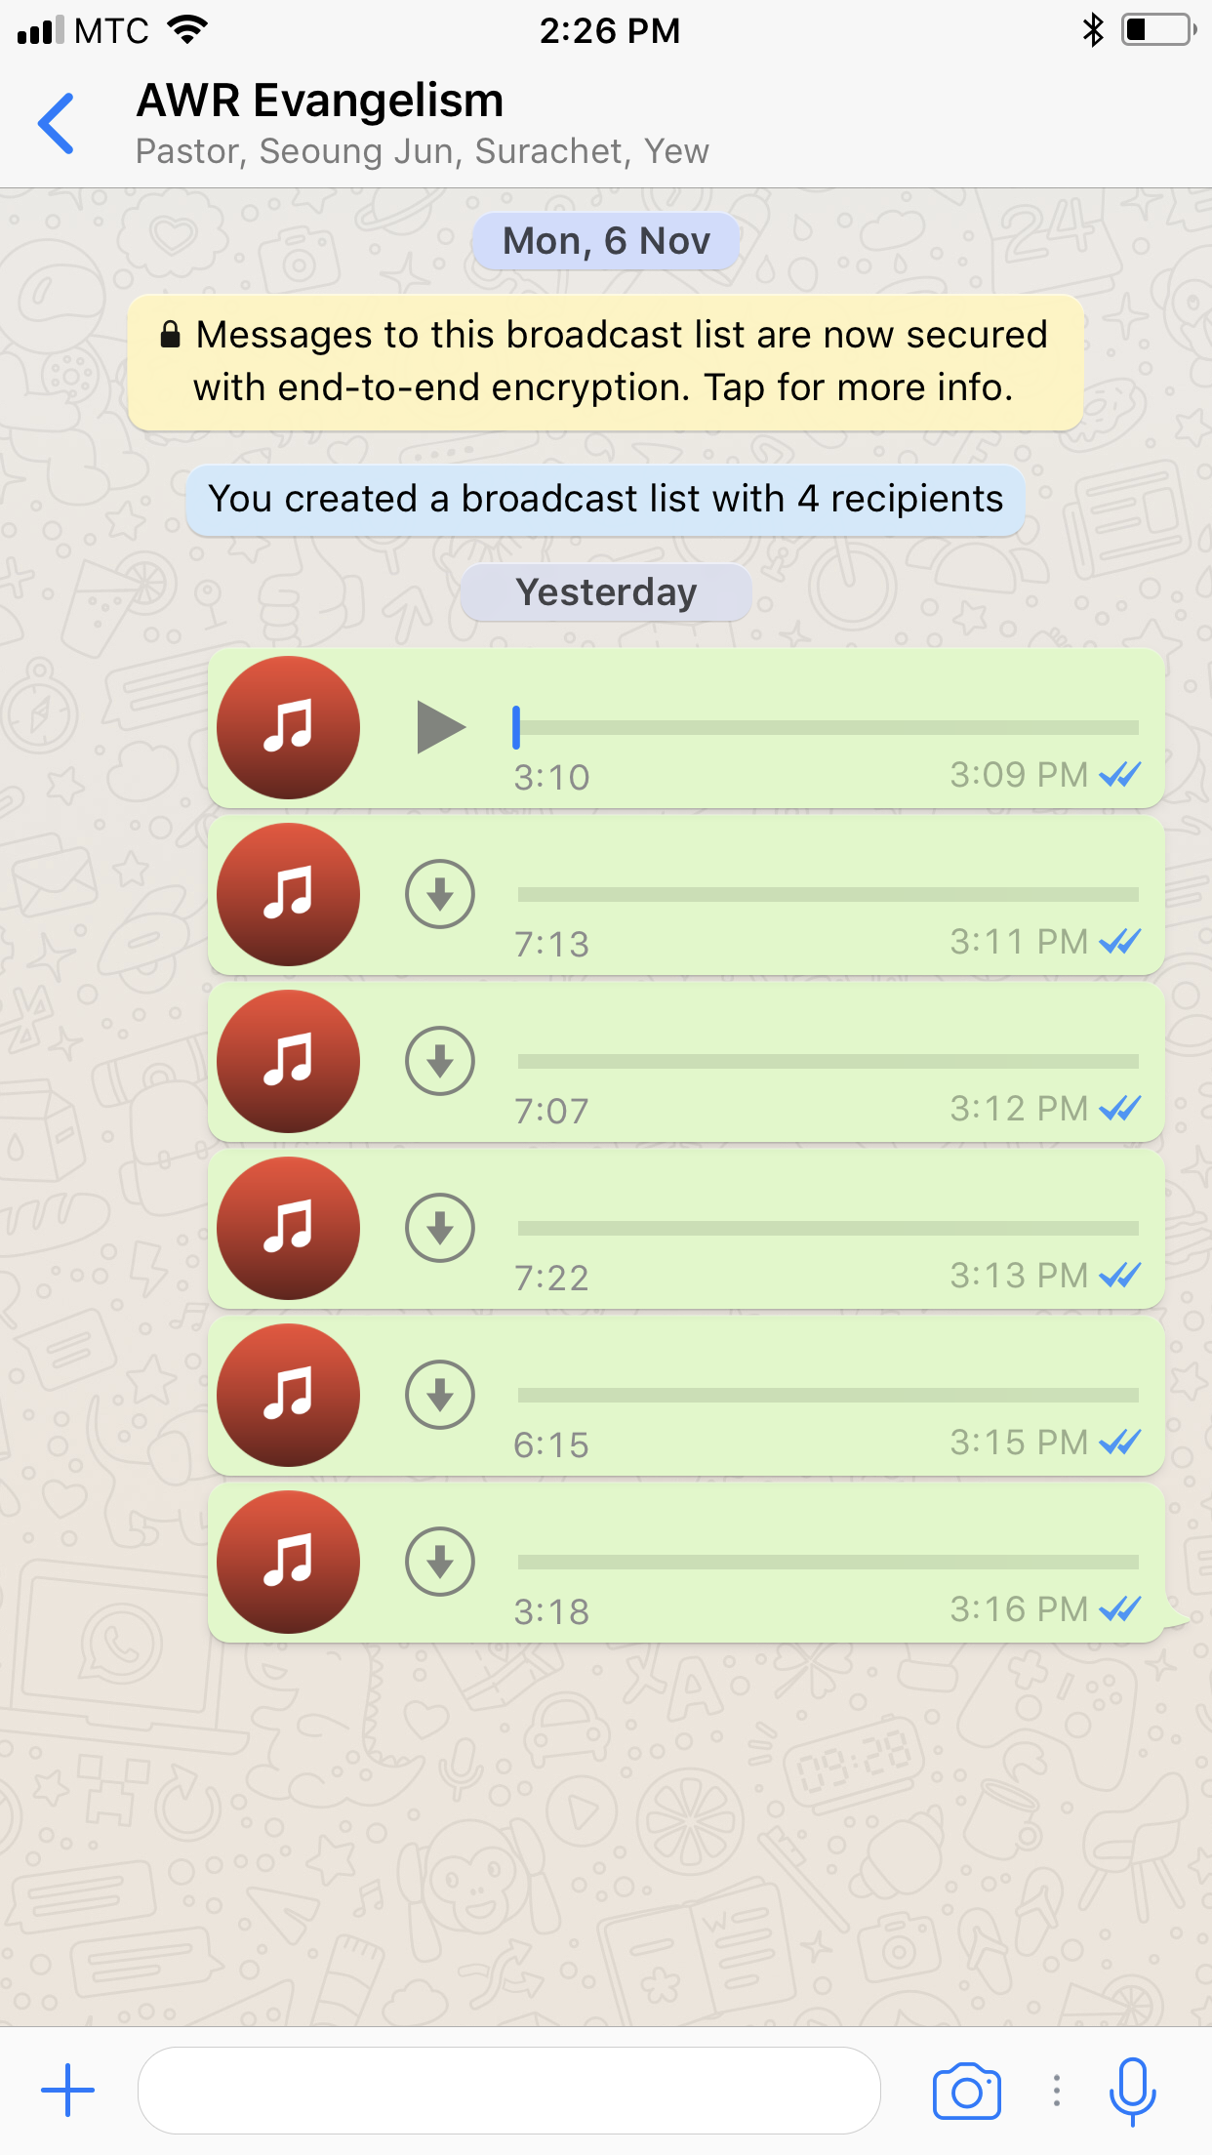
Cell Phone Evangelism
Reaching People where they are.
Speaking their language
Allowing them their technology platform of choice.
Staying connected.
Getting personal.
While respecting their time.
Place your screenshot here

Slide 21
.
Matthew 28:19, 20
Go therefore and make disciples of all the nations, baptizing them in the name of THE FATHER and of THE SON and of THE HOLY SPIRIT, teaching them to observe all things that I have commanded you.

Slide 22
.
.
.

Slide 23
.
The Development Phase

Slide 24
.
In THIS modern TIME –
IF YOU WANT TO REACH SOMEONE –
THERE IS NO MORE EFFECTIVE
WAY THAN REACHING HIM ON HIS
CELL PHONE
Notes:
.

Slide 25
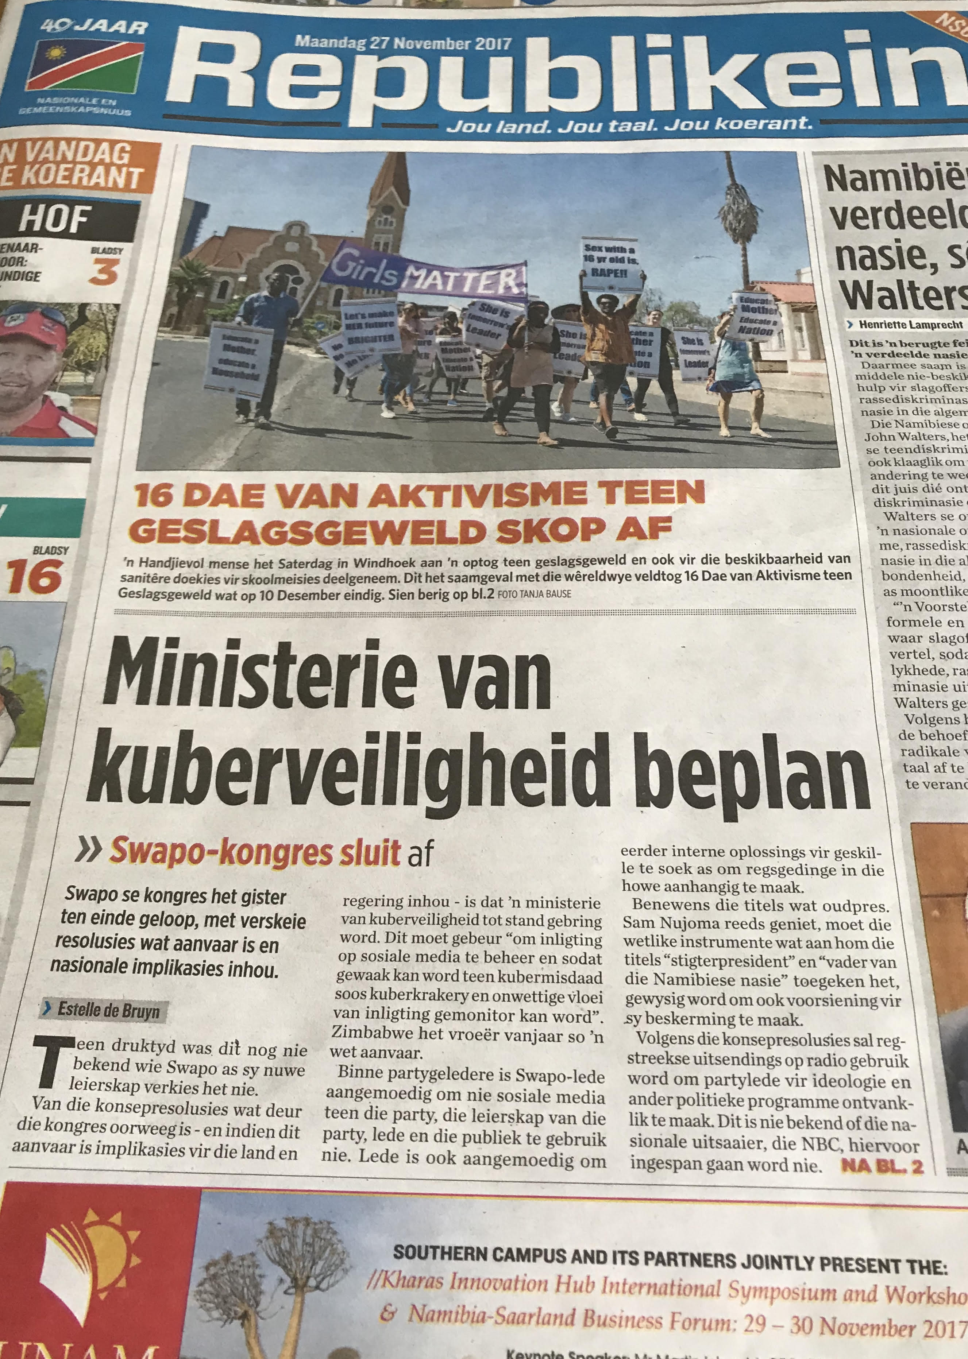

Slide 26
.
Nepal: Law Criminalizing Evangelism, Conversions to Christianity Goes Into Effect 18 Aug 2018
Place your screenshot here

Slide 27
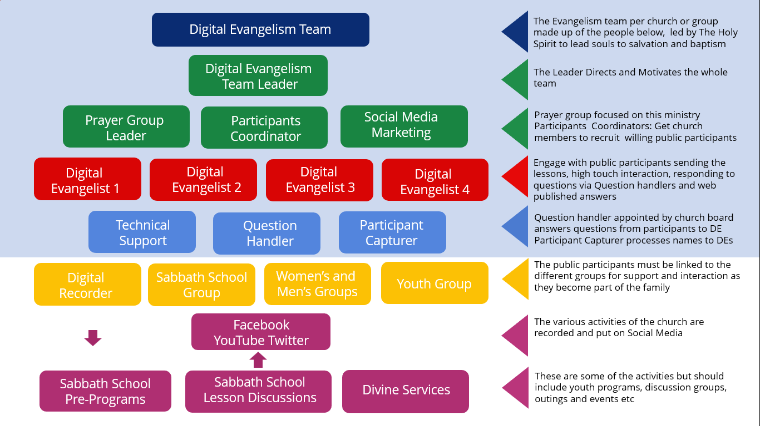
.
Nepal: Law Criminalizing Evangelism, Conversions to Christianity Goes Into Effect 18 Aug 2018
Place your screenshot here

Slide 28
.
“The work of God in this earth can never be finished until the men and women comprising our church membership rally to the work and unite their efforts with those of ministers and church officers” (Testimonies 9, p. 117)
.
Notes:
.

Slide 29
.
“Not upon the ordained minister only rests the responsibility of going forth to fulfil this commission …. It is a fatal mistake to suppose that the work of soul-saving depends alone upon the ORDAINED (ministry) … GOD will send forth into HIS vineyard many who have not been dedicated to the ministry by the laying on of hands.”
Acts of the Apostles, 110
.
Notes:
.

Slide 30
.
“We are nearing the close of this earth’s history. We have before us a great work – the closing work of giving the last warning message to a sinful world.
There are men who will be taken from the plow, from the vineyard, from various branches of work, and sent forth by the LORD to give this message to the world.”
Evangelism, 48
.
Notes:
.

Slide 31
.
.
Notes:
.

Slide 32
.
Matthew 28:16-20
16 Then the eleven disciples went away into Galilee, to the mountain which JESUS had appointed for them.
17 When they saw HIM, they worshiped HIM; but some doubted.
18 And JESUS came and spoke to them, saying, “All authority has been given to ME in heaven and on earth.
.
.
Notes:
.

Slide 33
.
19 Go therefore and make disciples of all the nations, baptizing them in the name of THE FATHER and of THE SON and of THE HOLY SPIRIT,
20 teaching them to observe all things that I have commanded you;
and lo, I am with you always, even to the end of the age.”
Amen.
.
.
Notes:
.

Slide 34
.
.
Notes:
.

Slide 35
.
Nepal: Law Criminalizing Evangelism, Conversions to Christianity Goes Into Effect 18 Aug 2018
Place your screenshot here

Slide 36
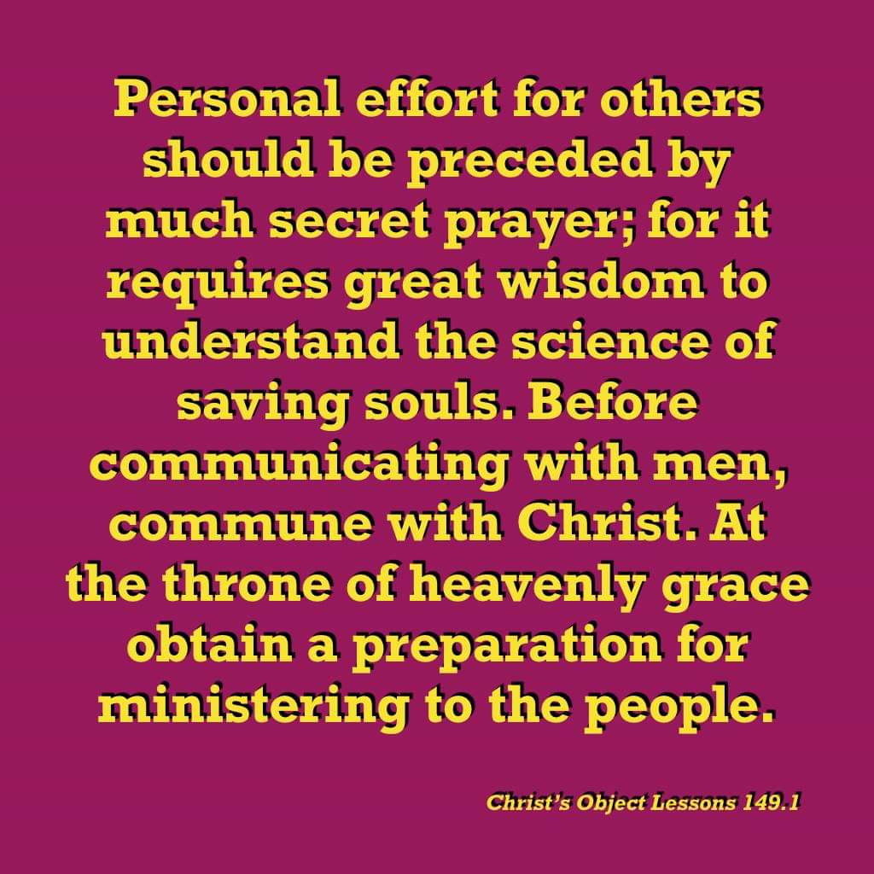
.
“The work of God in this earth can never be finished until the men and women comprising our church membership rally to the work and unite their efforts with those of ministers and church officers” (Testimonies 9, p. 117)
.
Notes:
.

