Slide 1
“Products are created in a factory, but Brands are created in the mind”
Walter Landor
The pioneer of branding and consumer research
techniques widely used to this day

Slide 2
Where are we as SDA’s Positioned
.

Slide 3
our most globally recognized element
.

Slide 4
.

Slide 5
Change is the law of life – those who only look to the past or present – are certain to miss the future – JFK
.

Slide 6
Re-Positioning Seventh-day Adventists
.

Slide 7
Digital Age
.

Slide 8
It’s never been easier to speak up

Slide 9
Complexity demands new tools
The average person is bombarded with 5000 brand messages each day
1440 – 3.5x
We only have a few seconds to leave a lasting impression

Slide 10
It’s never been easier to speak up
It’s never been harder to be heard

Slide 11
Investigative Judgement
AWR
The Millennium
Second Coming of Jesus
Jesus
Global Youth Day
The Godhead
Hope Chanel
The Beasts of Daniel & Revelation
The Sabbath
Adventurers
A Prophetic Movement
The Pioneers
The Sanctuary
Ellen White
The Remnant
The Spirit of Prophecy
Present Truth
Redemption
Stewardship
The New Earth
The Health Message
Pentecost
The Great Controversy
Salvation
Justification by Faith
1844
Three Angels Message
Pathfinders
William Miller
Vespers
Potluck lunch
Sabbath School
Adventist World

Slide 12
Investigative Judgement
AWR
The Millennium
Second Coming of Jesus
Jesus
Global Youth Day
The Godhead
Hope Chanel
The Beasts of Daniel & Revelation
The Sabbath
Adventurers
A Prophetic Movement
The Pioneers
The Sanctuary
Ellen White
The Remnant
The Spirit of Prophecy
Present Truth
Redemption
Stewardship
The Health Message
The New Earth
Pentecost
The Great Controversy
Salvation
Justification by Faith
1844
Three Angels Message
Pathfinders
William Miller
Vespers
Potluck lunch
Sabbath School
Adventist World

Slide 13
Our Promise
.

Slide 14
Our Promise
Positioning Seventh-day Adventists

Slide 15
The symbol, like all symbols, functions much more as a container for attributed meaning - than as a theological statement.
It is we, Seventh-day Adventist members,
who give this symbol meaning.
It is important that our most globally recognized element continues to be easily recognized.

Slide 16
Investigative Judgement
AWR
The Millennium
Second Coming of Jesus
Jesus
Global Youth Day
The Godhead
Hope Chanel
The Beasts of Daniel & Revelation
The Sabbath
Adventurers
A Prophetic Movement
The Pioneers
The Sanctuary
Ellen White
The Remnant
The Spirit of Prophecy
Present Truth
Redemption
Stewardship
The Health Message
The New Earth
Pentecost
The Great Controversy
Salvation
Justification by Faith
1844
Three Angels Message
Pathfinders
William Miller
Vespers
Potluck lunch
Sabbath School
Adventist World

Slide 17
ONE THING

Slide 18
What happens when a brand doesn’t keep their promise?
People distance themselves from the brand because they can no longer trust it.

Slide 19
Social
Media
Radio, TV, Publications, etc.
Schools
Hospitals
Websites
Phone
Calls
Local Churches
Every Church Member
Every Touchpoint

Slide 20
Our Previous Brand Promise ???

Slide 21
A People of Hope

Slide 22
It’s not about your brand
When communicating a
brand promise,
the person you are serving must
be the main focus of all communication.

Slide 23
The promise checklist
Must focus on the "customer“ - not the brand
Must be delivered through every touchpoint
Must include the essence of the brand and the reason for its existence
Must reflect the original intent of the founders
People within the organization must identify with the promise

Slide 24
Investigative Judgement
AWR
The Millennium
Second Coming of Jesus
Jesus
Global Youth Day
The Godhead
Hope Chanel
The Beasts of Daniel & Revelation
The Sabbath
Adventurers
A Prophetic Movement
The Pioneers
The Sanctuary
Ellen White
The Remnant
The Spirit of Prophecy
Present Truth
Redemption
Stewardship
The Health Message
The New Earth
Pentecost
The Great Controversy
Salvation
Justification by Faith
1844
Stewardship
Pathfinders
William Miller
Vespers
Potluck lunch
Sabbath School
Adventist World

Slide 25
Our Promise
What is it ?

Slide 26
We can help you
Understand the Bible
to find freedom, healing and hope in JesUS

Slide 27
Every person must understand the truth for themselves
1
No brainwashing
No manipulation
No coercion

Slide 28
We can help you
Understand the Bible
to find freedom, healing and hope in JesUS

Slide 29
Beyond cognitive Bible Studies
2
The promise is not that we will ‘teach’ the Bible but that we will help everyone understand it.
We must invite them to take time off work and spend a Sabbath with our family so they can understand it.
Without Jesus-like relationships no-one can understand the Bible.

Slide 30
We can help you
Understand the Bible
to find freedom, healing and hope in JesUS

Slide 31
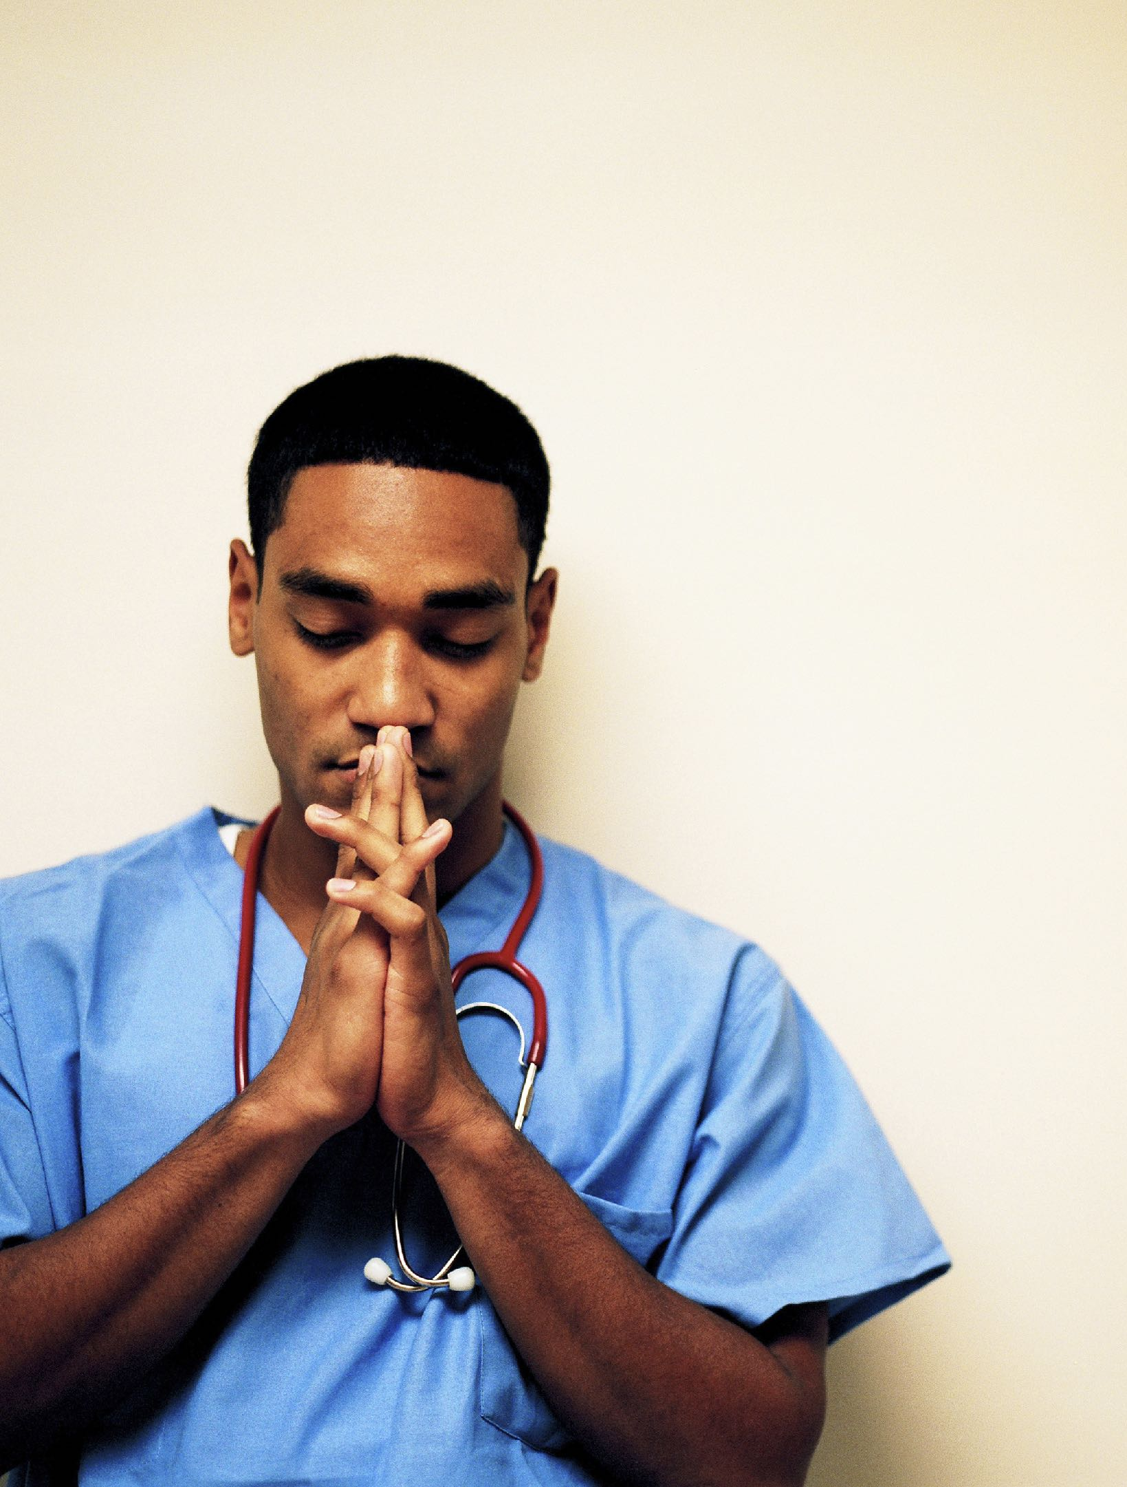
We don’t bring freedom, healing and hope
3
People can only find freedom, healing and hope in JESUS when they understand the Bible.
God will use our schools, hospitals and churches to deliver on His promise.
God will use YOU to deliver on His promise.
Our promise, however, is helping them understand the Bible so they can know JESUS for themselves.

Slide 32
We can help you
Understand the Bible
to find freedom, healing and hope in JesUS

Slide 33
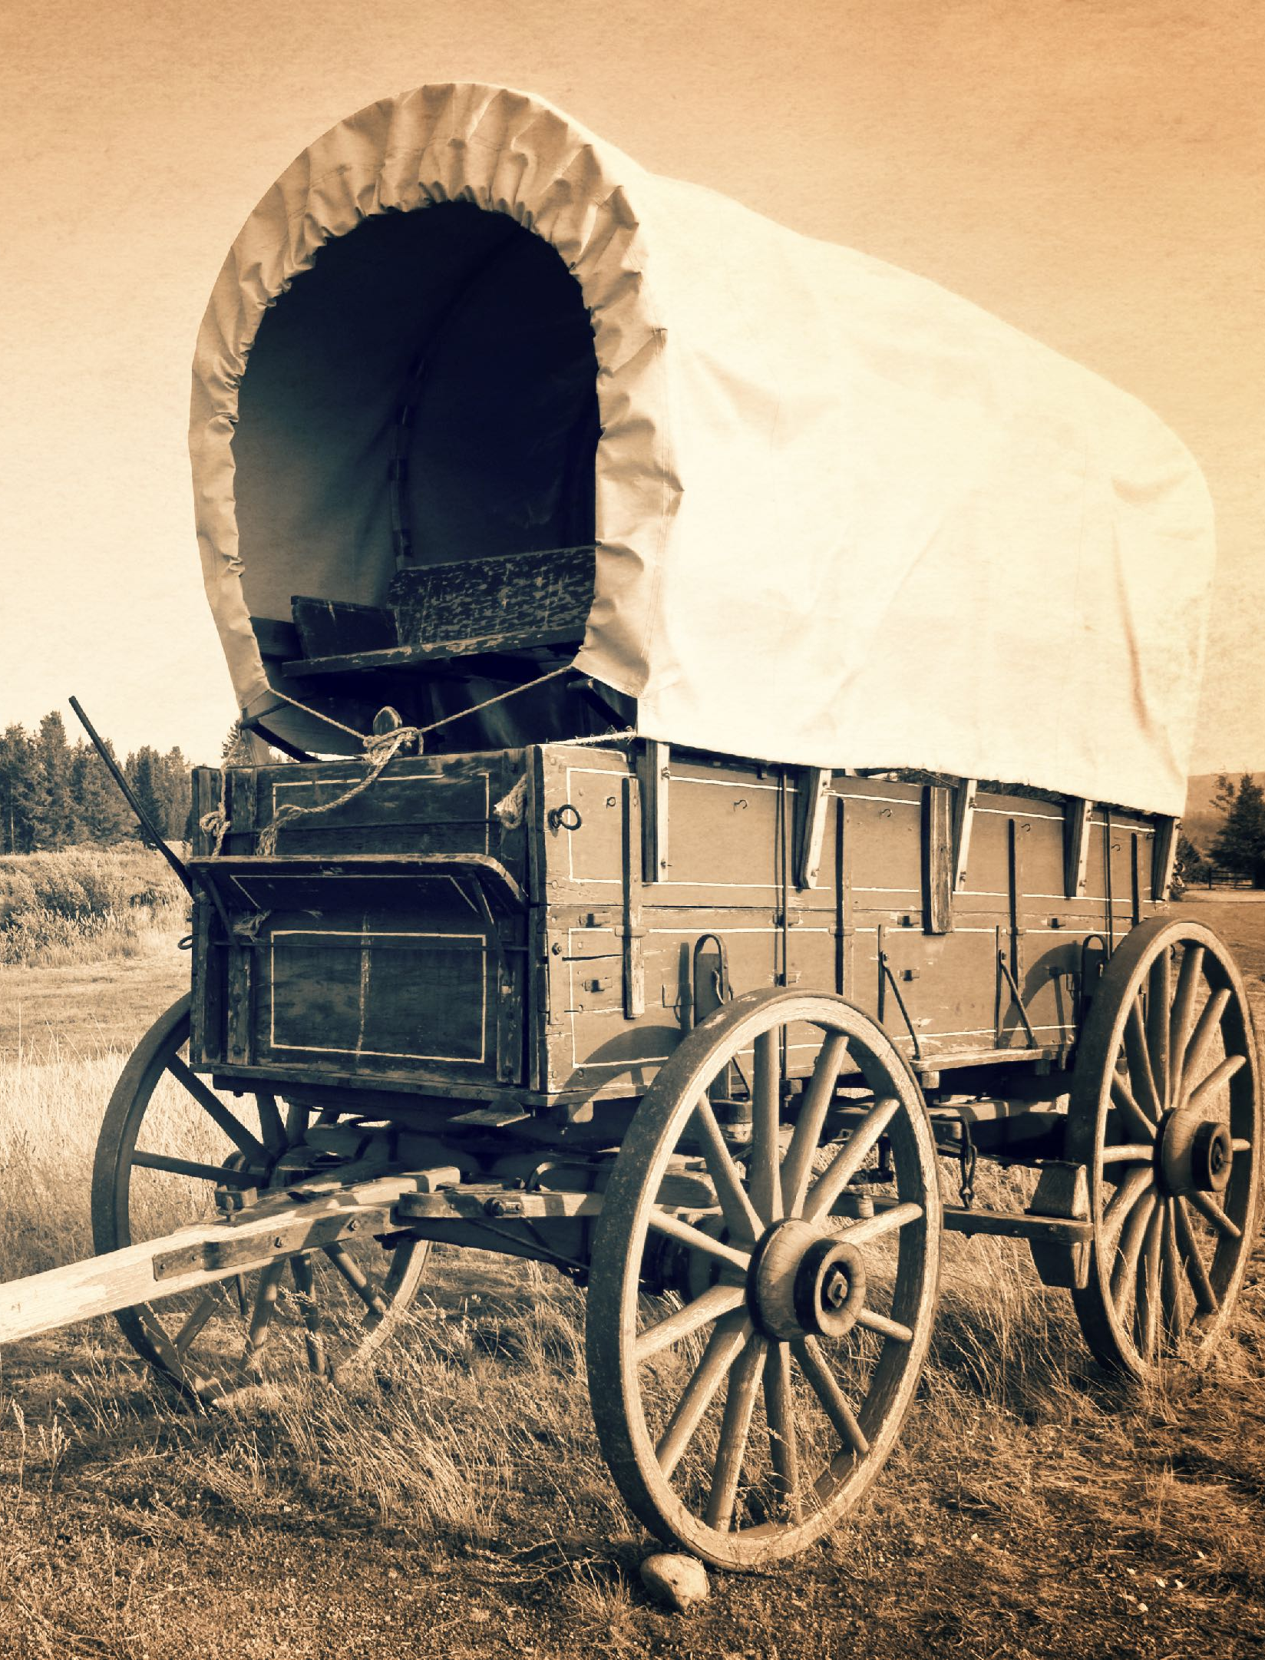
Our pioneers were fulfilling this promise even before we had a name
4
The Adventist Movement, before and after the great disappointment has existed to help people understand the Bible.
This happened through Bible studies and an invitation to a community that lived what they had learnt.

Slide 34
We can help you
Understand the Bible
to find freedom, healing and hope in JesUS

Slide 35
Our promise is for every human being, including our own members
5
Every Seventh-day Adventist is in a constant search to understand the Bible more and more.
This promise is not just for future members.
This promise is for future members.
But this promise is for current members as well.

Slide 36
We can help you
Understand the Bible
to find freedom, healing and hope in JesUS

Slide 37
We are already delivering on this promise
6
Every touchpoint is already fulfilling this promise.

Slide 38
Social
Media
Radio, TV, Publications, etc.
Schools
Hospitals
Websites
Phone
Calls
Local Churches
Every Church Member
Every Touchpoint

Slide 39
We can help you
Understand the Bible
to find freedom, healing and hope in JesUS

Slide 40
Freedom, Healing and Hope
7
Freedom reflected through our schools
and doctrines, especially Salvation and the Sabbath.
- The Sabbath points us to JESUS
- The Sabbath - is quality time with GOD.
- An eternal sign, & reminder we were made
in the image of GOD for an eternal purpose.
- HE set it aside as a reminder of who HE is
- Sign of GOD's creative power
- To rest and reconnect with GOD.
- Sabbath is a memorial of Creation.
- It’s time for worshipping GOD.
- Family Time.
- Quality time uninterrupted by work and
secular concerns.
- Time made holy by our Creator so we can
grow in HIS presence and grow in HIS love.
- YOUR assurance of HIS power to recreate.
- Sign of True Freedom.

Slide 41
Freedom, Healing and Hope
7
Healing reflects the health message, forgiveness and community development.
Forgiveness causes PEACE and HAPPINESS – through the removal of grievances and blame toward others – and thereby protect yourself from self-destructive hurt.
Forgiveness causes healing
– Healing creates confidence in a creative, forgiving and loving GODLY POWER.
Hope reflects our belief that GOD will send JESUS soon to come fetch us.
- reflects our belief that GOD will put the world back together.

Slide 42
We can help you
Understand the Bible
to find freedom, healing and hope in JesUS

Slide 43
“This is what we do…”
8
People can find other organizations that may provide a much better contemporary worship, immediate healing services, entertaining youth events and other activities.
But if they are hoping to truly understand the Bible, they must look for Seventh-day Adventists.

Slide 44
We can help you
Understand the Bible
to find freedom, healing and hope in JesUS

Slide 45
Both contemporary and traditional Adventists are already delivering on this promise
9

Slide 46
We can help you
Understand the Bible
to find freedom, healing and hope in JesUS

Slide 47
We must get better at it
10
We must continue to develop the absolute best tools for helping people understand the Bible.
Every new technique and technology must be employed to fulfill this promise.
Every Adventist entity must create experiences that lead members and visitors alike to a deeper understanding of Jesus and the Bible.

Slide 48
We can help you
Understand the Bible
to find freedom, healing and hope in JesUS

Slide 49
Provides focus to relational ministries
11
Local churches all over the world are building relationships with the community and their friends. Many have been waiting for years for them to ask spiritual questions. That doesn’t happen often.
This promise provides a simple invitation for everyone willing to discover new depth to the Bible.

Slide 50
We can help you
Understand the Bible
to find freedom, healing and hope in JesUS

Slide 51
The promise checklist
Must focus on the customer, not the brand
Must be delivered through every touchpoint
Must include the essence of the brand and the reason for its existence
Must reflect the original intent of the founders
People within the organization must identify with the promise

Slide 52
We can help you
Understand the Bible
to find freedom, healing and hope in Jesus

