Slide 2
Connect 4 change
Connect 4 mission
Notes:
AND IN THIS CONVENTION… I WOULD LIKE TO APPRECIATE THE SSD (PASTOR GINGING AND THE THEMVE-GIDEON-SURACHET AWR) HAS DESINGED THIS GREAT PROGRAM… AND THEY HAVE CHOSEN THE THEME.. CONNECT FOR CHANGE.. CONNECT FOR MISSION.
THIS IS TO REMIND US, THE VERY CORE OF WHY THE COMMUNICAITON MINISTRIES EXIST?.

Slide 3
GC Communication Strategic Plan – 2015-20

Slide 4
1. How to prepare a Church bulletin

Slide 5
2. How to share the news of the Church

Slide 6
3. How to become the spokesperson of the Church

Slide 7
4. How to prepare and maintain the church board

Slide 8
5. How to use the Social Media in the local Church

Slide 9
6. How the photography team can capture the church life

Slide 10
7. How develop and work to make the church look good online

Slide 11
8. Legal Aspects of communication

Slide 12
9. Public relations

Slide 13
10. Media relations

Slide 14
11. Crisis – how proceed when the unexpected happen.

Slide 15
TRIPLE M
MESSENGER
MEDIA
MESSAGE

Slide 16
"Are you the one who was to come, or should we expect someone else?" (Luk 7:18 NIV)

Slide 17
TRIPLE M
MESSENGER
MEDIA
MESSAGE

Slide 18
1. MESSENGER
“But they questioned why, if this new teacher was the Messiah, He did nothing to effect John’s release. How could He permit His faithful herald to be deprived of liberty and perhaps of life? ”{DA 214.2}

Slide 19
WHAT KIND OF MESSENGER ARE WE?
THE CHALLENGE OF WORKLOAD
THE CHALLENGE OF TIME FRAME GIVEN
THE CHALLENGE OF THE SUFFERING
THE CHALLENG OF THE LIFE AT RISK

Slide 20
John The Baptist
“Like the Saviour’s disciples, John the Baptist did not understand the nature of Christ’s kingdom. He expected Jesus to take the throne of David; and as time passed, and the Saviour made no claim to kingly authority, John became perplexed and troubled. . {DA 215.2}

Slide 21
TRIPLE M
MESSENGER
MEDIA
MESSAGE

Slide 22
"Are you the one who was to come, or should we expect someone else?" (Luk 7:18 NIV)

Slide 23
²¹ At that very time Jesus cured many who had diseases, sicknesses and evil spirits, and gave sight to many who were blind. (Luk 7:21 NIV)

Slide 24
2. MEDIA
²² So he replied to the messengers, "Go back and report to John what you have seen and heard: (Luk 7:22 NIV)

Slide 25
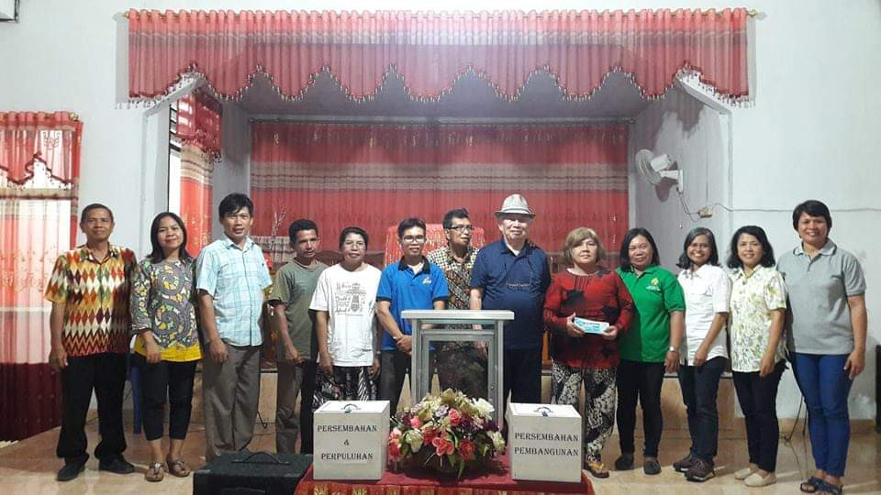

Slide 26
2. MEDIA
²² So he replied to the messengers, "Go back and report to John what you have seen and heard: (Luk 7:22 NIV)

Slide 27
Connect 4 change
Connect 4 mission

Slide 28
3. MESSAGES
⁵ The blind receive sight, the lame walk, those who have leprosy are cured, the deaf hear, the dead are raised, and the good news is preached to the poor. (Mat 11:5 NIV)

Slide 29
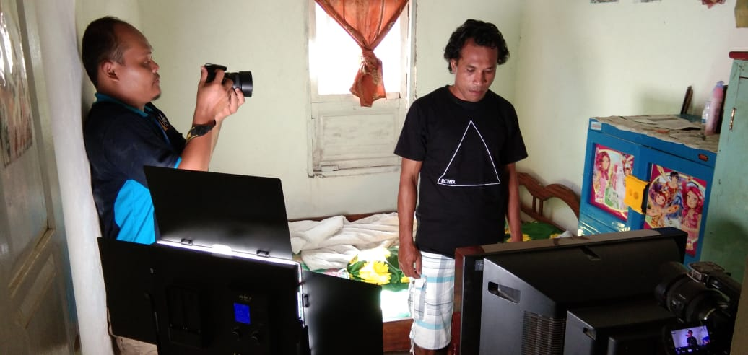
MR. DOLAN

Slide 30
