Slide 1

Slide 1
Tips For Great Storytelling
Tanya Muganda
GC Children’s Ministries
Notes:
Whenever the opportunity arises encourage pastors to set aside time every sabbath morning for the children’s story.
While it is best for the pastor to do this part of the service for the children, others can participate also.
The following Guidelines should be helpful to both pastors and laity who are willing to make the children feel special by devoting a portion of the church service just to them.
Whenever the story is given to a church member, give them the list of guidelines to go by.
Include on the handout the date for the story.
Call them on the telephone the week they are to give their story to remind them.

Slide 2

#1 choose a story you like and can enjoy telling
Select a story that is right for the occasion
Notes:
#1 is to choose a story you like and can enjoy telling
Select a story that is right for the occasion
Illustration
When you prepare your Bible story, list all the sensory experiences from the story. If your story is about Paul and Silas in jail, think about the smells, sights, sounds, feelings, and tastes. Weave these sensory connections into your facial and body gestures to make the story come alive.

Slide 3

Slide 3
#2
HAVE A DEFINITIVE TEACHING OBJECTIVE
Notes:
2. Have a definitive teaching objective
Example
When you prepare your Bible story, list all the sensory experiences from the story. If your story is about Paul and Silas in jail, think about the smells, sights, sounds, feelings, and tastes. Weave these sensory connections into your facial and body gestures to make the story come alive.

Slide 4

#3
Be sure it Is appropriate to the age and experience of your audience
Notes:
3. Be sure it Is appropriate to the age and experience of your audience.
Example
Look for ways to connect with kids’ everyday experiences by emphasizing certain aspects of a story.
A pastor once told a story of the prodigal son to an urban Bible club. He explained that the boy wasted all his money on things like video games and candy. Another teacher who told his story in a rural setting emphasized how the son ate pig food. (https://childrensministry.com)

Slide 5

Slide 5
#4
Most children who come to listen are Beginners through primary age. Choose a story that appeals to ages between 3 – 7.
Notes:
4. Most children who come to listen are cradle roll through primary age. Choose a story that appeals to ages between 3 – 7.
Illustration
One man described Goliath as someone more than 2 feet taller than Michael Jordan. He got everyone’s attention.

Slide 6

Slide 6
#5
Choose a story that will help a child to grow spiritually and in character. That means it will be “grace” oriented.
Know the sermon topic and choose a story that will lead the children into listening to the pastor.
Notes:
5. Choose a story that will help a child to grow spiritually and in character. That means it will be “grace” oriented.
Know the sermon topic and choose a story that will lead the children into listening to the pastor.

Slide 7

#6. Choose stories that children can identify with.
Avoid stories that are gruesome, fairy tales, or beyond their years of experience such as World War II stories.
Notes:
6. Choose stories that children can identify with.
Avoid stories that are gruesome, fairy tales, or beyond their years of experience such as World War II stories.

Slide 8

Slide 5
#7. Request children to listen for an answer, a special word, an event or person that is connected to your story or that had a similar experience.
Notes:
7. Request children to listen for an answer, a special word, an event or person that is connected to your story or that had a similar experience.

Slide 9
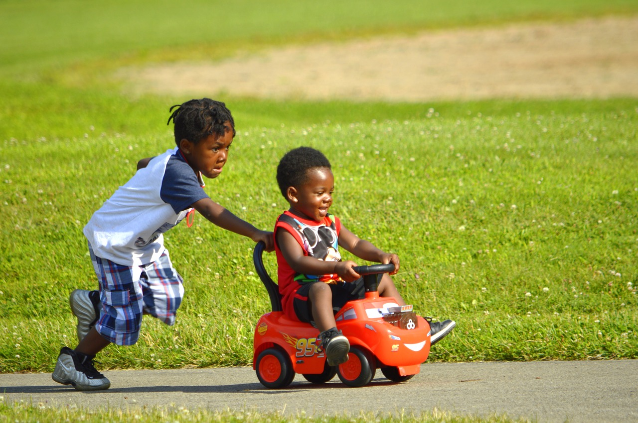
Slide 6
#8. The best sources to consider are personal experiences: ”When I was a little _____,” and the Bible.
Notes:
8. The best sources to consider are personal experiences: ”When I was a little _____,” and the Bible.

Slide 10

Slide 7
#9. Use the Bible
  Use one key scripture.
  Use familiar versions with words the children can understand
  Repeat the verse as often as is appropriate. It can be at the beginning, the end and within the context of the story.
  Let a child read the verse when appropriate
  Encourage them to repeat it with you
Notes:
Use the Bible
Use one key scripture
Use familiar versions with words the children can understand
Repeat the verse as often as is appropriate. It can be at the beginning, the end and within the context of the story.
Let a child read the verse when appropriate
Encourage them to repeat it with you

Slide 11

Slide 1
In preparing your story, decide on one thing you want the children to know (your aim) and what you want to see them do about it (your application.)
Focus your story to the end.
Avoid “tacked on” or unnatural moral endings.
Notes:
In preparing your story decide on one thing you want the children to know (your aim) and what you want to see them do about it (your application.)
Focus your story to the end.
Avoid “tacked or” or unnatural moral endings.

Slide 12

Slide 5
#10. The length of story should not exceed 5-7 minutes
  Use the first minute to direct their attention. This can be done by visual aids, body language or your voice.
  Establish and maintain eye contact from the very beginning.
  Avoid side comments to the adults.
Notes:
The length of story should not exceed 5-7 minutes
Use the first minute to direct their attention. This can be done by visual aids, body language or your voice.
Establish and maintain eye contact from the very beginning.
Avoid side comments to the adults.

Slide 13


#11. Use as many sensory modes as is appropriate
Let them see, hear, touch, taste and smell.
It is not necessary to use all of them in one story.
Notes:
11. Use as many sensory modes as is appropriate.
Let them see, hear, touch, taste and smell.
It is not necessary to use all of them in one story.
For example:
You can use this approach with a variety of stories, from Jesus telling his disciples to let the children come to him (the disciples tell the parents, “No, No, No,” complete with shaking heads and fingers) to Jesus calming the sea (make motions and sounds for the rocking boat, the waves, being afraid, then being still). (https://childrensministry.com)

Slide 14

Slide 1
#12 Use a microphone whenever possible
This avoids discipline problems because they cannot hear.
It allows the adults to hear, too.
They can benefit from the story.
Notes:
#12. Use a microphone whenever possible.
This avoids discipline problems because they cannot hear.
It allows the adults to hear, too.
They can benefit from the story.

Slide 15

The Planning Stages
The beginning
Is to get _____________________
Is to set the _____________ of the story
Should be very________________
_______________ into the middle section
Use ____________, _____________ or
______________
Notes:
The Planning Stages
The beginning
Is to get __attention_________________
Is to set the ____scene___________ of the story
Should be very ____short____________
_Leads or moves__ into the middle section
Use a __picture an object or an action_____.

Slide 16

The Middle
Gives the _________________
Moves the story in a _________ of events.
Builds _____________
Leads to a point where an __________ or ______________ must be made.
Notes:
The Middle
Gives the ____details________________________
Moves the story in a ____series_______________of events
Builds the ________suspense_________________
Leads to a point where an ____action___________ or ___decision___ must be made.

Slide 17

The End
Shows the _________ of the decision of action.
Draws a ___________.
Elicits a ___________.
__________!
Notes:
The End
Shows the __result____ of the decision or action
Draws a ___conclusion________________.
Elicits a ____response________.
Stop_________!

Slide 18
Prepare and deliver
Read the story as many times as necessary to make a picture of the series of events in your mind
Visualize the characters and how they act
Plan how you will begin
Make brief Outline of action and events
Plan exactly how you will end
Think your story through from beginning to end, visualizing it in your mind
Prepare visual aids & learn to use them effortlessly
Practice telling it without notes
Notes:
Prepare and deliver
Read the story as many times as necessary to make a picture of the series of events in your mind.
Visualize the characters and how they act.
Plan how you will begin
Make a brief Outline of the action and events
Plan exactly how you will end.
Think your story through from beginning to end, visualizing it in your mind
Prepare any visual aids and learn to use them effortlessly
Practice telling it without notes.

Slide 19

Telling The Story
___________________the story as you tell it.
Use your ________ and __________ expressions to portray your character’s emotions or reactions.
Use ____________________ between characters.
Only use ___________________ that will give meaning to the story.
Keep it _________. Keep it ___________.
___________ in the eyes of those you are telling the story to.
Notes:
Telling the story
_Live_________the story as you tell it.
Use your _____voice__________ and ________facial________ expressions to portray your character’s emotions or reactions.
Use _______conversation dialog_____between characters.
Only use ___visuals, facts, moving__that will give meaning to the story.
Keep it ___simple______. Keep it ___moving________.
__Look___in the eyes of those you are telling the story to.

Slide 20


A Page of No, No’s
Avoid
  Personal mannerisms and repetitive statements except as they enhance the story.
  Correcting yourself
  Adding facts you forgot
  A too loud or too soft voice except where it impacts the story.
Notes:
A page of No, No’s
Avoid
Personal mannerisms and repetitive statements except as they enhance the story.
Correcting yourself
Adding facts you forgot
A too loud or too soft voice except where it impacts the story.

Slide 21

A Page Of No, No’s
Avoid
  Constant referral to notes
  Looking around everywhere but at your audience
  Tacking on unnatural endings
  Talking down to your audience
  Reading the story (except in rare circumstances)
Notes:
A page of No, No’s
Avoid
Constant referral to notes
Looking around everywhere but at your audience
Tacking on unnatural endings
Talking down to your audience
Reading the story (except in rare circumstances)

Slide 22

Slide 4
Children can accept Jesus at a very early age, even though they do not act on this decision until later.
Do not hesitate to end your story by asking for a decision to accept Christ.
We must give the children the opportunity to accept Him by asking them directly.
Notes:
Children can accept Jesus at a very early age, even though they do not act on this decision until later.
Do not hesitate to end your story by asking for a decision to accept Christ.
We must give the children the opportunity to accept Him by asking them directly.

Slide 23

Some resources to look at
Children’s stories and object lessons, Marvin Hunt
Great Stories for kids, Jerry D. Thomas
Secrets of the Forest, Colleen L. Reece
The Cat in the cage, and other great stories for kids, Jerry d. Thomas
Guide’s greatest stories, Randy Fishell
The kim, kari and kevin story book, kay kuzma
Amazing stories from the bible, miracle stories from the bible, Professor Appleby and Maggie b, ruth redding brand and Charles mills
Through children’s eyes, ben F. freudenburg (CPH)
Clip and tell, lois keffer (group)
Quick children’s sermons 2, (group)
6 minute messages for children, Donald Hinchey (group)
Notes:
Some Resources To Look At
Children’s stories and object lessons, Marvin Hunt
Great Stories for kids, Jerry D. Thomas
Secrets of the Forest, Colleen L. Reece
The Cat in the cage, and other great stories for kids, Jerry d. Thomas
Guide’s greatest stories, Randy Fishell
The kim, kari and kevin story book, kay kuzma
Amazing stories from the bible, miracle stories from the bible, Professor Appleby and Maggie b, ruth redding brand and Charles mills
Through children’s eyes, ben F. freudenburg (CPH)
Clip and tell, lois keffer (group)
Quick children’s sermons 2, (group)
6 minute messages for children, Donald Hinchey (group)

Slide 24
Guidelines for children’s story for church services and
Telling a great story by Barbara L. Manspeaker

