Slide 1

FIVE MISTAKES PARENTS MAKE WITH THEIR ADOLESCENTS
Saustin Sampson Mfune
Notes:
FIVE MISTAKES PARENTS MAKE WITH THEIR ADOLESCENTS

Slide 2
Adolescence is the transitional period between childhood and adulthood.
Notes:
Adolescence is the transitional period between childhood and adulthood.
Though this period is usually associated with teenage years, its physical, psychological and cultural expressions may begin much earlier and end later. Years 9-13 are often referred to as pre-teen or “tween” years.

Slide 3

Characteristics of Adolescents (up to 14)
Their reasoning skills and logical thinking are getting more and more in focus and are able to understand abstract ideas.
They hate to be treated as a child and as a non- entity.
They tend to be very critical and have a questioning attitude.
Notes:
Characteristics of Adolescents (up to 14)
Their reasoning skills and logical thinking are getting more and more in focus and are able to understand abstract ideas.
They hate to be treated as a child and as a non-entity.
They tend to be very critical and have a questioning attitude.

Slide 4
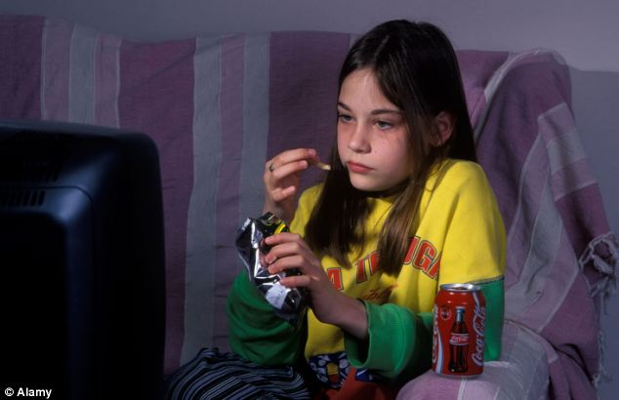
4. They look up to celebrities and heroes.
5. They tend to be creative thinkers.
6. They have ‘yo-yo’ emotions – one moment they are happy and the other they are mad/angry.
Notes:
4. They look up to celebrities and heroes.
5. They tend to be creative thinkers.
6. They have ‘yo-yo’ emotions – one moment they are happy and the other they are mad/angry.

Slide 5

7. Less affection shown to parents.
8. Temper tantrums.
9. Greatly influenced by peers.
10. Self conscious and very sensitive to criticism.
11. Unorganized.
12. Sleep less hours.
13. Sibling rivalry.
14. Plus many more.
Notes:
7. Less affection shown to parents.
8. Temper tantrums.
9. Greatly influenced by peers.
10. Self conscious and very sensitive to criticism.
11. Unorganized.
12. Sleep more hours.
13. Sibling rivalry.
14. Plus many more.

Slide 6

These physical and psychological developments in the pre-teen and early teen years cause lots of challenges and stress for many leaders and parents.
Notes:
These physical and psychological developments in the pre-teen and early teen years cause lots of challenges and stress for many leaders and parents.

Slide 7
During this period, parents and leaders ought to handle the adolescents with love, patience and care. Why? Because this is the time these young people are cementing their crucial decisions regarding their Christian choices planted in them during their younger years.
Notes:
During this period, parents and leaders ought to handle the adolescents with love, patience and care. Why? Because this is the time these young people are cementing their crucial decisions regarding their Christian choices planted in them during their younger years.
Unfortunately many parents and leaders make mistakes which ends up driving the young people away from church.

Slide 8

Unfortunately, many times due to frustration, stress and probably lack of spiritual maturity on the part of parents and leaders, mistakes are made which can be fatal to the Spiritual development of the fledgling minds. Here are some failures we should not exhibit as we prayerfully deal with the adolescence.
Notes:
Unfortunately, many times due to frustration, stress and probably lack of spiritual maturity on the part of parents and leaders, mistakes are made which can be fatal to the Spiritual development of the fledgling minds. Here are some failures we should not exhibit as we prayerfully deal with the adolescence.

Slide 9
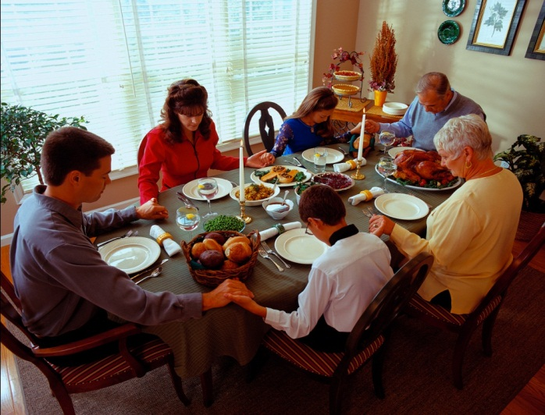
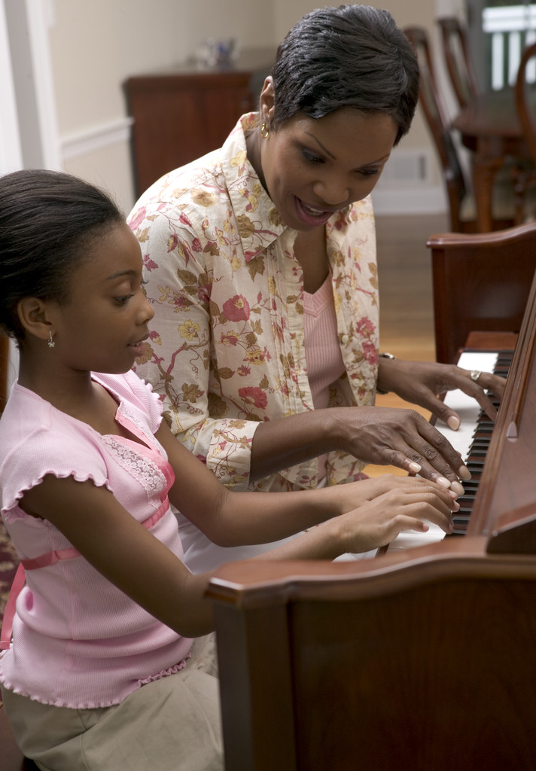
1.
Failure to model Christian values
Notes:
1. Failure to model Christian values

Slide 10

Modeling is not a strategy to be applied in a given situation. It is a way of life.
Notes:
Modeling is not a strategy to be applied in a given situation. It is a way of life.
Roger L Dudley, Passing on the Torch. P.177.

Slide 11
“When adolescents see Christian values modelled by adults, they are stimulated to think through those values and choose the values because they see what Christian values look like.”
Roger Dudley, Passing On The Torch, 177
Notes:
Roger Dudley in his book Passing on The Torch pages 177 writes that when adolescents see Christian values modelled by adults, they are stimulated to think through those values and choose them because they see what Christian values look like.

Slide 12
Remember:-
1. Values are caught rather than taught.
2. You are the thrower and the adolescents are catchers.
3. You are the teleprompter and they are reading on your life’s screen of your daily living.
BE CAREFUL OF HOW YOU LIVE!
Notes:
Remember:-
Values are caught rather than taught.
You are the thrower and the adolescents are the catchers.
3. You are the teleprompter and they are reading on your life’s screen of your daily living.
BE CAREFUL OF HOW YOU LIVE!
Examples of living inconsistent values:
If you go late to Church on Sabbath but run around like crazy to make sure that you don’t get late for work, the value caught by your children is that work is more important than Sabbath worship.
If your dress to kill for other occasions and dress casually for church, the value caught by your children is that church is not all that important.
When in your home you don’t miss watching your TV shows but can miss family worship, the message caught by your children is that worship is less important.
If you put all kinds of items into the pages of the Bible, the value transmitted to children is that the Bible is just an ordinary book.
If your children see you read your newspaper daily but you read your Bible occasionally, the value caught is that the Bible is less important.
If you talk ill of the church, preacher, church administrator, church policies, other tribes and races in front of your children, you would have taught your children not to respect other people, the church and its policies.

Slide 13

2.
Failure To Be A Consistent Model
Notes:
2. Failure to be a Consistent Model

Slide 14
Modeling is one thing and to be a consistent model is another thing.
Notes:
Modeling is one thing and to be a consistent model is another thing.
For example, when in your home you have a ‘yo-yo’ pattern of worship, today you have worship and tomorrow you don’t, your adolescents are likely to grow into adulthood not valuing prayer.

Slide 15

Many parents in their anger tell their teens, for example, that they are short tempered because they inherited short tempered genes. In essence, the parents have just communicated to their children that Jesus has no power to transform somebody.
Notes:
Many parents in their anger tell their teens, for example, that they are short tempered because they inherited short tempered genes. In essence, the parents have just communicated to their children that Jesus has no power to transform somebody.

Slide 16
3.
Failure To Admit when You have over reacted and you know that you are wrong .
Notes:
3. Failure To Admit when You have over reacted and you know that you are wrong .
None of us is perfect. We all make mistakes. Exercise patience with adolescents.

Slide 17

No human being is perfect. Parents and teachers make mistakes. When you realize that you have made a mistake, apologize to the adolescent.
Notes:
No human being is perfect. Parents and teachers make mistakes. When you realize that you have made a mistake, apologize to the adolescent.
When I was about 15 years old and my brother was 13, my dad was annoyed with my brother over something. We had been warned several times to stop doing what we were doing but my brother kept doing the same thing over and over. My dad lost his cool and he beat him badly. A few hours later, my dad felt bad for what he had done that he called us and apologized for overreacting. This act made us respect him more than before. And we did our best to obey our parents so that we don’t have to make them over react and force them to apologize to us.

Slide 18
God set an example on this matter so that we can learn from Him. The story is recorded in the book of Numbers 14:11-20
Notes:
God set an example on this matter so that we can learn from Him. The story is recorded in the book of Numbers 14:11-20
In Numbers 14:11-20, the Israelites rebelled against Caleb and Joshua and God told Moses that He would destroy all the Israelites and raise a new people. Moses 'reasoned' with God and requested Him not to do so because He would be misunderstood by other nations. God agreed and He 'changed' His mind. God did this for two reasons. (a) To test the character of Moses. (2) To teach us that it is not beneath one’s dignity to admit when a mistake has been done. It does not mean that God had made a mistake, but He did this for our lesson.

Slide 19

4.
Failure to give honest answers to honest questions and not comfortable to discuss what feels uncomfortable to you.
Notes:
4. Failure to give honest answers to honest questions and not comfortable to discuss what feels uncomfortable to you.
Why can’t I wear earrings? Is dancing a sin and if it is sin, what makes it to be a sin? Why can't I wear short skirts? What's wrong with makeup? What's wrong with premarital sex because everybody is doing it?

Slide 20

If you don’t have answers, don’t just dismiss the adolescent and label them as rebels. Ask for help.
Notes:
If you don’t have answers, don’t just dismiss the adolescent and label them as rebels. Ask for help.
If you find that you don’t have answers, talk to your Pastor to help you. You can arrange time for him to talk to the adolescents. Or ask an experienced and dedicated youth leader to help you. But don’t just brush their questions aside or become angry and label them as rebels.

Slide 21

5
Failure to know that the adolescent is at a developmental stage of faith known as searching faith.
Notes:
5. Failure to know that the adolescent is at a developmental stage of faith known as searching faith.

Slide 22

As children grow, they move from what is termed experienced faith, to belonging faith to searching faith when they want answers for internalizing their faith.
Notes:
As children grow, they move from what is termed experienced faith, to belonging faith to searching faith when they want answers for internalizing their faith.
Since they are at a searching faith stage, you need to demonstrate to them what faith looks like. They need to see you reading your Bible, and praying. They need to hear stories of faith and the blessings you receive when you trust the Lord. They need their questions answered regarding God, the validity of the Bible, trusting in God’s leading, etc. It is important for young people to make faith personal. They will not be saved through your faith experience but through developing their own experience with Jesus.

