Slide 1
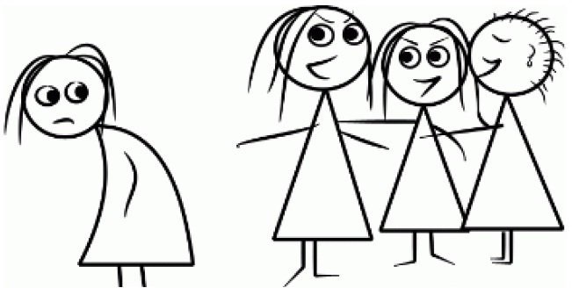
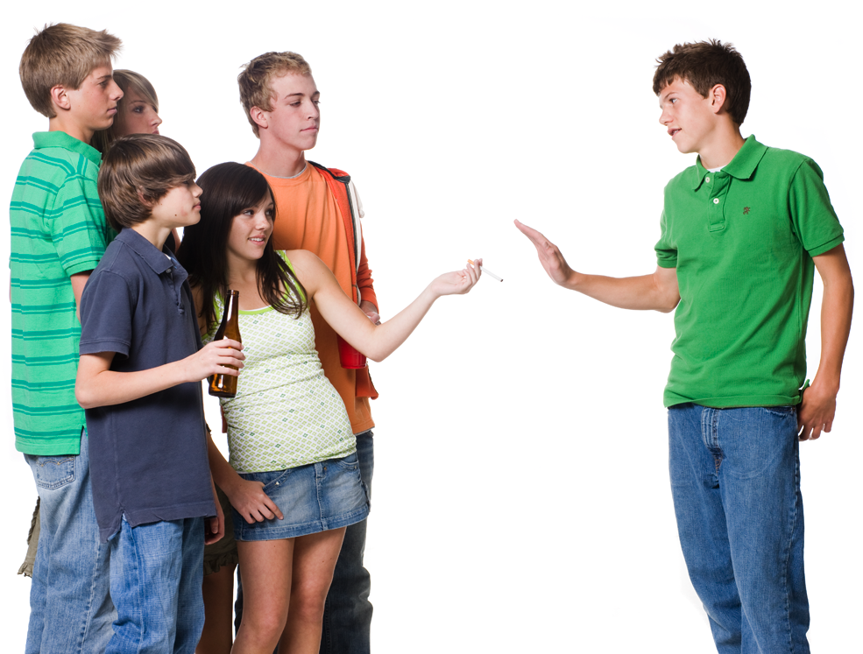
Helping Children & Teens Deal with peer pressure
Linda Mei Lin Koh
GC Children’s Ministries
Notes:
HELPING CHILDREN & TEENS DEAL WITH PEER PRESSURE
"Come on! ALL of us are cutting math. Who wants to go take that quiz? We're going to take a walk and get lunch instead. Let's go!" says the coolest kid in your class. Do you do what you know is right and go to math class, quiz and all? Or do you give in and go with them?
As you grow older, you'll be faced with some challenging decisions. Some don't have a clear right or wrong answer — like should you play soccer or field hockey? Other decisions involve serious moral questions, like whether to cut class, try cigarettes, or lie to your parents.
Making decisions on your own is hard enough, but when other people get involved and try to pressure you one way or another it can be even harder. People who are your age, like your classmates, are called peers. When they try to influence how you act, to get you to do something, it's called peer pressure. It's something everyone has to deal with — even adults. Let's talk about how to handle it.

Slide 2
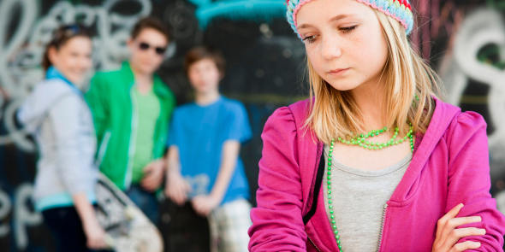
Defining Peer Pressure
Peers influence your life, even if you don't realize it, just by spending time with you. You learn from them, and they learn from you. It's only human nature to listen to and learn from other people in your age group.
Notes:
Defining Peer Pressure
Peers influence your life, even if you don't realize it, just by spending time with you. You learn from them, and they learn from you. It's only human nature to listen to and learn from other people in your age group.

Slide 3
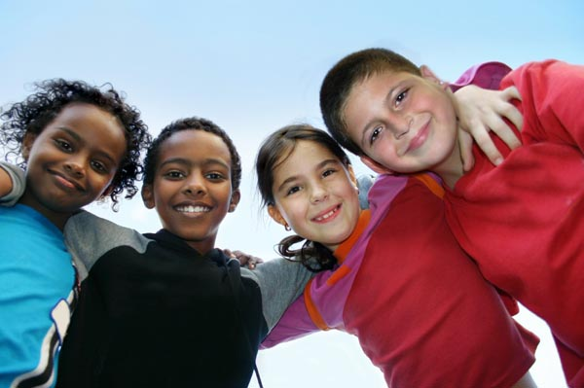
Positive influence
Peers Can Have A Positive Influence On Each Other. Maybe someone In Science Class Taught You how To Remember names of Planets, Or Someone Taught You A Cool Trick With The Ball.
You Might Admire A Friend Who Is Always A Good Sport And Try To Be More Like Him Or Her.
Maybe You Got Others Excited About Your New Favorite Book, And Now Everyone's Reading It.
Notes:
POSITIVE INFLUENCE
Peers can have a positive influence on each other. Maybe another student in your science class taught you an easy way to remember the planets in the solar system, or someone on the soccer team taught you a cool trick with the ball.
You might admire a friend who is always a good sport and try to be more like him or her.
Maybe you got others excited about your new favorite book, and now everyone's reading it. These are examples of how peers positively influence each other every day.

Slide 4
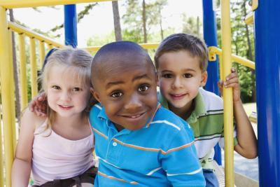
NEGATIVE
INFLUENCE
Sometimes peers influence each other in negative ways.
For example, a few kids in school might try to get you to skip class with them, your soccer friend might try to convince you to be mean to another player and never pass her the ball,
a kid in the neighborhood might want you to shoplift with him.
Notes:
NEGATIVE INFLUENCE
Sometimes peers influence each other in negative ways.
For example, a few kids in school might try to get you to skip class with them, your soccer friend might try to convince you to be mean to another player and never pass her the ball,
A kid in the neighborhood might want you to shoplift with him.

Slide 5
Why Do People Give in to Peer Pressure?
they want to be liked, to fit in
they worry that other kids might make fun of them if they don't go along with the group.
Some are curious to try something new that others are doing.
The idea that "everyone's doing it" can influence some kids to leave their better judgment, or their common sense behind.
Notes:
Why Do People Give in to Peer Pressure?
Some kids give in to peer pressure because they want to be liked, to fit in, or because they worry that other kids might make fun of them if they don't go along with the group.
Others go along because they are curious to try something new that others are doing.
The idea that "everyone's doing it" can influence some kids to leave their better judgment, or their common sense behind.

Slide 6
Walking Away From Peer Pressure
It is tough to be the only one who says "no" to peer pressure, but you can do it.
Paying attention to your own feelings and beliefs about what is right and wrong can help you know the right thing to do.
Inner strength and self-confidence can help you stand firm, walk away, and resist doing something when you know better.
Notes:
Walking Away From Peer Pressure
It is tough to be the only one who says "no" to peer pressure, but you can do it.
Paying attention to your own feelings and beliefs about what is right and wrong can help you know the right thing to do.
Inner strength and self-confidence can help you stand firm, walk away, and resist doing something when you know better.

Slide 7
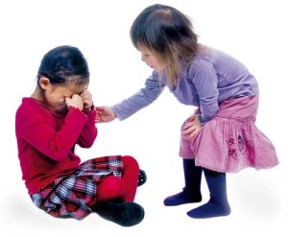
It can really help to have at least one other peer, or friend, who is willing to say "no," too.
This takes a lot of the power out of peer pressure and makes it much easier to resist.
It's great to have friends with values similar to yours who will back you up when you don't want to do something.
Notes:
It can really help to have at least one other peer, or friend, who is willing to say "no," too.
This takes a lot of the power out of peer pressure and makes it much easier to resist.
It's great to have friends with values similar to yours who will back you up when you don't want to do something.

Slide 8
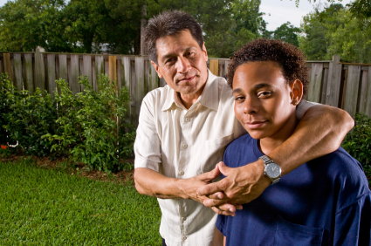
You've probably had a parent or teacher advise you to "choose your friends wisely."
Peer pressure is a big reason why they say this. If you choose friends who don't use drugs, cut class, smoke cigarettes, or lie to their parents, then you probably won't do these things either, even if other kids do.
Try to help a friend who's having trouble resisting peer pressure. It can be powerful for one kid to join another by simply saying, "I'm with you — let's go."
Notes:
You've probably had a parent or teacher advise you to "choose your friends wisely."
Peer pressure is a big reason why they say this. If you choose friends who don't use drugs, cut class, smoke cigarettes, or lie to their parents, then you probably won't do these things either, even if other kids do.
Try to help a friend who's having trouble resisting peer pressure. It can be powerful for one kid to join another by simply saying, "I'm with you — let's go."

Slide 9
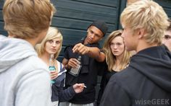
there are still things you can do. You can simply stay away from peers who pressure you to do stuff you know is wrong.
You can tell them "no" and walk away. Better yet, find other friends and classmates to pal around with.
If you continue to face peer pressure and you're finding it difficult to handle, talk to someone you trust. Don't feel guilty if you've made a mistake or two. Talking to a parent, teacher, or school counselor can help you feel much better and prepare you for the next time you face peer pressure.
Notes:
there are still things you can do. You can simply stay away from peers who pressure you to do stuff you know is wrong.
You can tell them "no" and walk away. Better yet, find other friends and classmates to pal around with.
If you continue to face peer pressure and you're finding it difficult to handle, talk to someone you trust. Don't feel guilty if you've made a mistake or two. Talking to a parent, teacher, or school counselor can help you feel much better and prepare you for the next time you face peer pressure.

Slide 10
Powerful, Positive Peer Pressure
Peer pressure is not always a bad thing.
For example, positive peer pressure can be used to pressure bullies into acting better toward other kids.
If enough kids get together, peers can pressure each other into doing what's right!
Notes:
Powerful, Positive Peer Pressure
Peer pressure is not always a bad thing.
For example, positive peer pressure can be used to pressure bullies into acting better toward other kids.
If enough kids get together, peers can pressure each other into doing what's right!

Slide 11
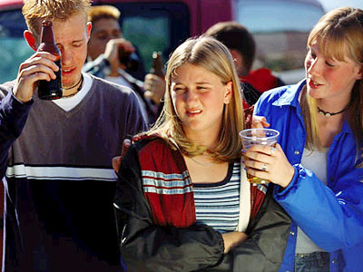
What Can I Do if I Want to Say No to Peer Pressure?
Peer pressure occurs when other kids your age push you to do something that:
• you don’t want to do
• makes you uncomfortable
• you know will get you in trouble
You may feel that if you don’t go along, they will laugh at you or not be your friends.
Notes:
What Can I Do if I Want to Say No to Peer Pressure?
Sometimes it is hard to say no to friends. Often it is easier to “go along” with someone’s idea than to let people know how you really feel. Peer pressure occurs when other kids your age push you to do something that:
• you don’t want to do
• makes you uncomfortable
• you know will get you in trouble
You may feel that if you don’t go along, they will laugh at you or not be your friends.

Slide 12
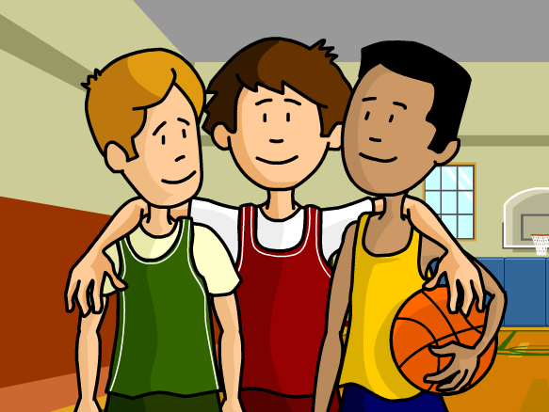
WAYS TO SAY “NO” TO PEER PRESSURE
TRY SHARON SCOTT’S 10 WAYS OF SAYING NO
Notes:
There are ways to say no to peer pressure that will help you get out of the situation. The trick is to practice these when you’re alone, or with your parents or someone you trust. Then, when you need to use one of these, you will be more comfortable doing so.

Slide 13
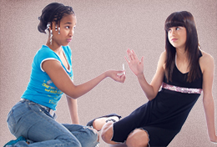
1. Just say no
In some situations, just saying no without a lot of arguing and explaining is the best response. Just make sure your “no” is a strong and determined one.
Notes:
JUST SAY NO.
In some situations, just saying no without a lot of arguing and explaining is the best response. Just make sure your “no” is a strong and determined one.

Slide 14
2. Give a reason why it’s a bad idea.
Say no, and explain why you feel this way. Maybe you can’t go to the party because it’s not worth the chance of being grounded. Maybe you don’t want to drink because you know someone who is an alcoholic and you can see how drinking has messed up his/her life.
Notes:
GIVE A REASON WHY IT’S A BAD IDEA.
Say no, and explain why you feel this way. Maybe you can’t go to the party because it’s not worth the chance of being grounded. Maybe you don’t want to drink because you know someone who is an alcoholic and you can see how drinking has messed up his/her life.

Slide 15
3. Make a Joke
Humor is a great way to change the topic and the mood. It can take the attention away from you.
Notes:
MAKE A JOKE.
Humor is a great way to change the topic and the mood. It can take the attention away from you.
For example, “Wow, you want me to spray paint the walls of the school tonight? I don’t even know how to paint my picture in third grade!”
“You must be joking! I will be having smoke coming out of my ears!

Slide 16
4. Make an excuse why you can’t
Maybe you have something else to do, you have to be somewhere at a specific time, or your mom will punish you. It doesn’t matter what excuse you use, just stick to it.
Notes:
MAKE AN EXCUSE WHY YOU CAN’T.
Maybe you have something else to do, you have to be somewhere at a specific time, or your mom will punish you. It doesn’t matter what excuse you use, just stick to it.
“Sorry, guys, I have to be at my grandpa’s birthday party tonight. No exception!

Slide 17
5. Suggest a different activity
By thinking of something better to do, you’re offering everyone an “out.” You just might be surprised who might take you up on it.
Notes:
SUGGEST A DIFFERENT ACTIVITY.
By thinking of something better to do, you’re offering everyone an “out.” You just might be surprised who might take you up on it.
“How about playing basketball instead of throwing stones at the school windows?”

Slide 18
6. Ignore the suggestion
Pretend you didn’t hear it, and change the topic to something else. Act like you don’t think the idea was even worth discussing.
Notes:
IGNORE THE SUGGESTION.
Pretend you didn’t hear it, and change the topic to something else. Act like you don’t think the idea was even worth discussing.

Slide 19
7. Repeat yourself if necessary
Sometimes you’ll be asked over and over again. Stick to your decision, don’t be talked into doing something you don’t want to.
Notes:
REPEAT YOURSELF IF NECESSARY.
Sometimes you’ll be asked over and over again. Stick to your decision, don’t be talked into doing something you don’t want to.
“Did you not hear me? My answer is NO!”

Slide 20
8. Leave the situation
If you think the others are going to do something you don’t want to be involved in, just leave.
You can make up an excuse, or you can say nothing at all.
If you lead the way, others may follow.
Notes:
LEAVE THE SITUATION
If you think the others are going to do something you don’t want to be involved in, just leave. You can make up an excuse, or you can say nothing at all. If you lead the way, others may follow.

Slide 21
9. Thanks, but no thanks
You can be polite, but you still aren’t interested. You can say, “It’s something I’m just not into.”
Notes:
THANKS, BUT NO THANKS.
You can be polite, but you still aren’t interested. You can say, “It’s something I’m just not into.”

Slide 22
10. The power of numbers
Talk to your closest friends about how you feel.
Then you can support each other.
Agree up front that you will stick together
Notes:
THE POWER OF NUMBERS.
Talk to your closest friends about how you feel. Then you can support each other and Agree up front that you will stick together

Slide 23
More Tips
The Walk-Away rule. Analyze your relationship with this person. If you know you cannot walk away from the relationship at any time, break it. That's right. Break it. Yes, it'll hurt, but walking away is the last line of defense against anyone. If you cannot do it, you've lost your last line of defense. The only reason why this would not apply is if you absolutely trust a person, and you know it isn't just hormones making you trust that person.
Notes:
MORE TIPS
The Walk-Away rule. Analyze your relationship with this person. If you know you cannot walk away from the relationship at any time, break it. That's right. Break it. Yes, it'll hurt, but walking away is the last line of defense against anyone. If you cannot do it, you've lost your last line of defense. The only reason why this would not apply is if you absolutely trust a person, and you know it isn't just hormones making you trust that person.

Slide 24
Do not be harsh when you speak, just be firm and soon your friends will begin to respect your decisions.
Peer pressure is testing your will to refuse something you don't want to do. A true friend will take no for an answer and not try to make you do something you don't want to do.
Notes:
Do not be harsh when you speak, just be firm and soon your friends will begin to respect your decisions.
Peer pressure is testing your will to refuse something you don't want to do. A true friend will take no for an answer and not try to make you do something you don't want to do.

Slide 25
Some warnings
Watch out for those friends who are bent on doing the wrong stuff and are controlling. You are better off without them at all.
If you don’t know/trust this person, just leave. Nobody can pressure you to do things you don’t like if you aren’t even there.
Notes:
Warnings
Watch out for those friends who are bent on doing the wrong stuff and are controlling. You are better off without them at all.
If you don't know/trust this person, just leave. Nobody can pressure you to do things you don't like if you aren't even there!!

Slide 26
Learn. Learn about the myths people use to pressure others into harmful behavior.
Find out what their morals are before you hang out with them.
If they are into things you feel uncomfortable with, steer clear of them
If they try to pressure you into something you don't want to do they’re not a good friend.
Notes:
Learn. Learn about the myths people use to pressure others into harmful behavior.
Find out what their morals are before you hang out with them.
If they are into things you feel uncomfortable with, steer clear of them
If they try to pressure you into something you don't want to do they’re not a good friend.

Slide 27
teaching your child to think about negative peer pressure
Make a point of discussing your day and your child's day during a drive home or while doing homework, working on a hobby, or completing household chores together.
Use a conversational approach in talking about how you handled negative influences at work or talking about the possible consequences of choices that you or your child are considering.
Notes:
Teaching Your Child to Think About Negative Peer Pressure
Make a point of discussing your day and your child's day during a drive home or while doing homework, working on a hobby, or completing household chores together.
Use a conversational approach in talking about how you handled negative influences at work or talking about the possible consequences of choices that you or your child are considering.
The best way to teach your child to think for himself in dealing with negative peer pressure is to spend regular time with him before a problem occurs. Help him identify his own personal goals, interests, and the things that are most important to him. Demonstrate positive ways to think about pressure situations by modeling and talking about interactions with others.

Slide 28
What Can I do if I want to say no to peer pressure
https://www.ed.gov.nl.ca/edu/k12/safeandcaring/students/peerpressure.html
How to Say No and Keep Your Friends
Sharon Scott & Rick Murnane

