Slide 1
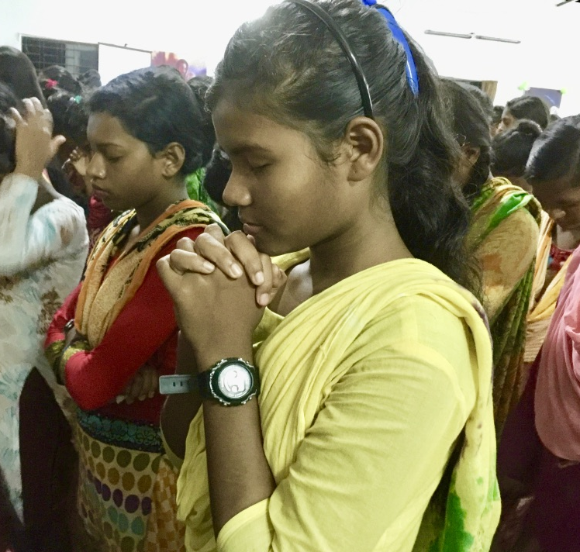
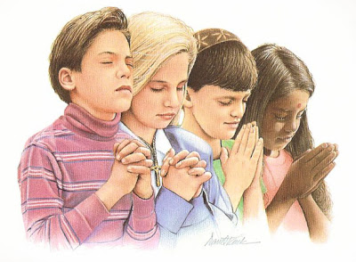
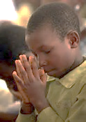
Teaching children to pray without ceasing
Linda Mei Lin Koh, GC Children’s Ministries
Notes:
Teaching Children to Pray Without Ceasing Adapted from Children’s Ministry Magazine, August 3, 2013.

Slide 2
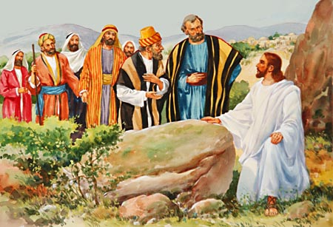
How can we teach children to pray without ceasing?
“Once Jesus was in a certain place praying. As he finished, one of his disciples came to him and said, “Lord, teach us to pray, just as John taught his disciples” (Luke 11:1)
Notes:
How Can We Teach Children To Pray Without Ceasing?
“Once Jesus was in a certain place praying. As he finished, one of his disciples came to him and said, “Lord, teach us to pray, just as John taught his disciples” (Luke 11:1)

Slide 3
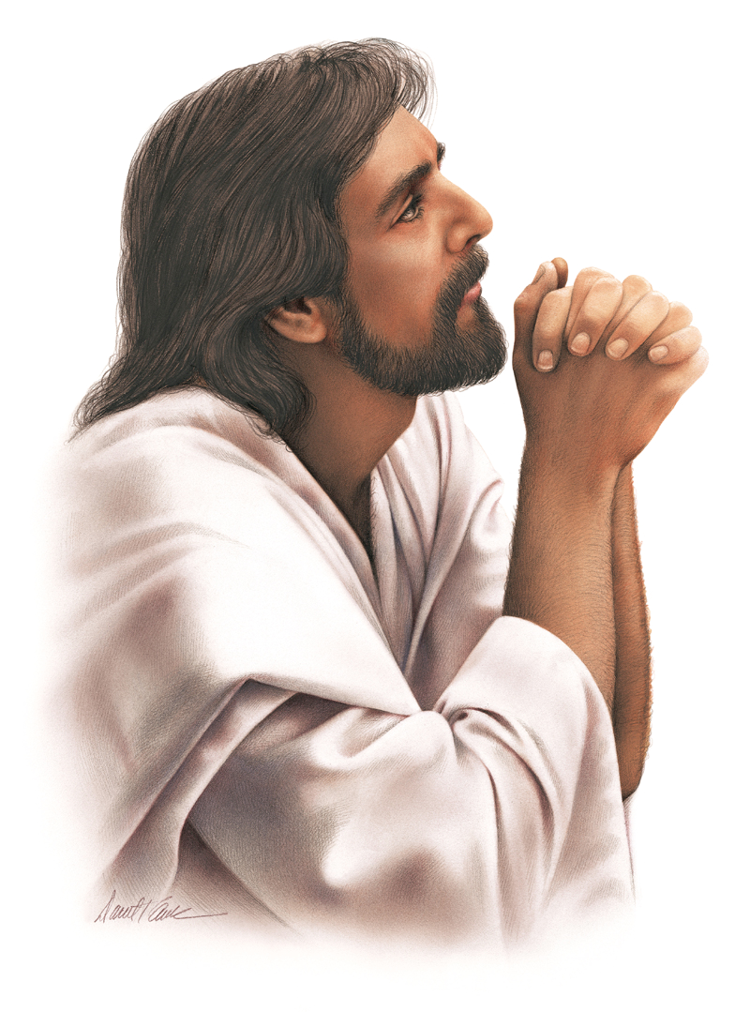
“Teach us to pray.” Even the grown men who followed Jesus needed instruction in prayer.
How much more must we teach our kids to pray! And to pray constantly!
First Thessalonians 5:17, says, “Never stop praying.” That can seem like a daunting task for a child (or for an adult)
Notes:
“Teach us to pray.” Even the grown men who followed Jesus needed instruction in prayer.
How much more must we teach our kids to pray! And to pray constantly!
First Thessalonians 5:17, says, “Never stop praying.” That can seem like a daunting task for a child (or for an adult)
Let’s look at some principles of Prayer.

Slide 4
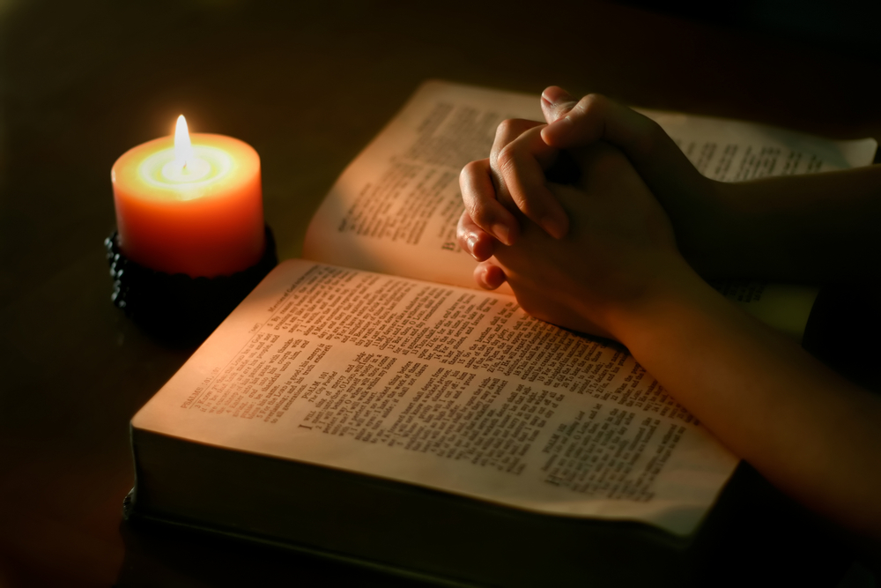
1. Prayer is an attitude
Praying constantly is an attitude. It’s an awareness that God is here.
Notes:
1. PRAYER IS AN ATTITUDE
Praying constantly is an attitude. It’s an awareness that God is here.
Examples
God is ever in my thoughts. I am ever talking to him in my mind as I go about my day, “ says Annie Meier, who leads behind-the-scenes prayer for various ministries at Elmbrook Church in Brookfield, Wisconsin.
Renee Gray-Wilburn, author of the PrayerKids! Prayer card, “Praying for My Brothers and Sisters,” says, “It means to never go long without making a mental connection with God and by doing our best to be aware of his presence.”
It’s a constant God-consciousness,” says Arlyn Lawrence, co-author of the book Prayer-Saturated Kids and former contributing editor of Pray! Magazine.

Slide 5
This doesn’t mean we’re solely focused on God and nothing else throughout the day.
But much like breathing occurs even as we go about our lives, we can also sense God’s presence with us regardless of our circumstances.
Notes:
This doesn’t mean we’re solely focused on God and nothing else throughout the day.
But much like breathing occurs even as we go about our lives, we can also sense God’s presence with us regardless of our circumstances.

Slide 6
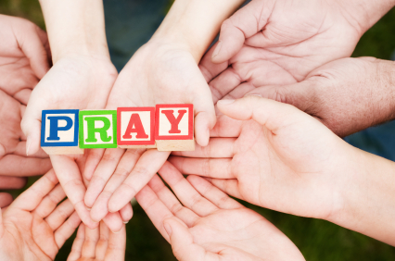
Awareness of God’s Presence
Teach kids to have a better awareness of God’s presence throughout their day.
Form pairs. Tell kids they’ll also need to count how many times they take a breath as they each tell their partner everything they’ve eaten so far today.
After two minutes, ask kids how they did.
Notes:
Awareness of God’s Presence
Teach kids to have a better awareness of God’s presence throughout their day.
Form pairs. Tell kids they’ll also need to count how many times they take a breath as they each tell their partner everything they’ve eaten so far today.
After two minutes, ask kids how they did.

Slide 7
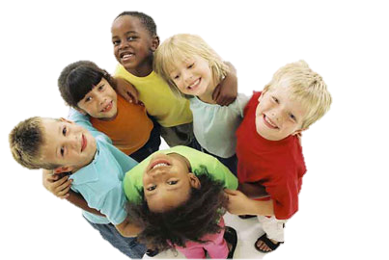
Try the activity again, only this time, tell them they don’t need to count their breaths.
After two minutes, ask:
* “How did counting or not counting impact how you breathed?
* How is breathing like or unlike God’s presence ?
* How does God’s constant presence affect the way you pray?”
Notes:
Try the activity again, only this time, tell them they don’t need to count their breaths.
After two minutes, ask:
* “How did counting or not counting impact how you breathed?
* How is breathing like or unlike God’s presence ?
* How does God’s constant presence affect the way you pray?”

Slide 8
Tell kids that just like air is always flowing through us, God is always with us. We can feel His presence even while we do other things.
Notes:
Tell kids that just like air is always flowing through us, God is always with us. We can feel His presence even while we do other things.

Slide 9
2. Prayer is a routine
Our prayer attitude is shaped by regular times with God.
Kids can learn to pray regularly “by being encouraged to begin their days with a simple prayer inviting the Holy Spirit to walk and talk to them all day long.
And, then, to finish each day before bed with a time of prayer reflecting upon how they felt the Holy Spirit walk and talk with them that day.”
Notes:
2. PRAYER IS A ROUTINE
Our prayer attitude is shaped by regular times with God.
Kids can learn to pray regularly “by being encouraged to begin their days with a simple prayer inviting the Holy Spirit to walk and talk to them all day long.
And, then, to finish each day before bed with a time of prayer reflecting upon how they felt the Holy Spirit walk and talk with them that day.”

Slide 10
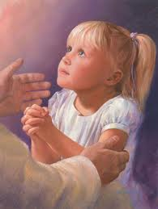
Teaching kids to establish regular times to “check-in” with God about the events of their day can remind them to pray and to experience the things they’ve prayed about.
By establishing routine times to talk to God – not out of obligation but out of love – kids can learn to pray without ceasing.
Notes:
Teaching kids to establish regular times to “check-in” with God about the events of their day can remind them to pray and to experience the things they’ve prayed about.
By establishing routine times to talk to God – not out of obligation but out of love – kids can learn to pray without ceasing.

Slide 11
Help kids practice a prayer routine with this rewind/fast forward activity. Have kids rewind their minds to the beginning of their day.
Tell the kids to pantomime in fast motion all the things they did before they left the house that morning.
When you say, “Freeze” , kids must freeze in their pantomime and think about what was on their mind as they were in that moment earlier in the day. Then, holding their frozen position, have kids silently pray about what was on their minds.
Notes:
Help kids practice a prayer routine with this rewind/fast forward activity. Have kids rewind their minds to the beginning of their day.
Tell the kids to pantomime in fast motion all they things they did before they left the house that morning.
When you say, “Freeze” , kids must freeze in their pantomime and think about what was on their mind as they were in that moment earlier in the day. Then, holding their frozen position, have kids silently pray about what was on their minds.

Slide 12
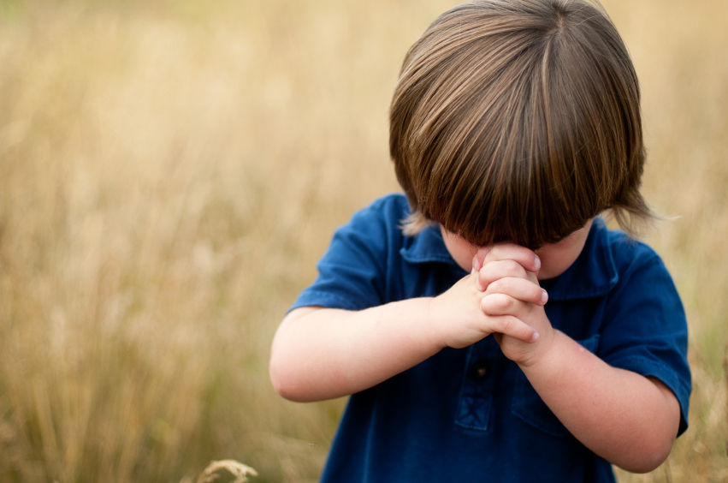
3. Prayer is a first response
Because God is always with us, God’s always listening to our prayers.
When faced with a crisis or tough decision, we can turn to God before trying anything else.
“Prayer is always my first response and not my last resort.” This is an important concept to teach kids.
Notes:
3. PRAYER IS A FIRST RESPONSE
Because God is always with us, God’s always listening to our prayers.
When faced with a crisis or tough decision, we can turn to God before trying anything else.
“Prayer is always my first response and not my last resort.” This is an important concept to teach kids.

Slide 13
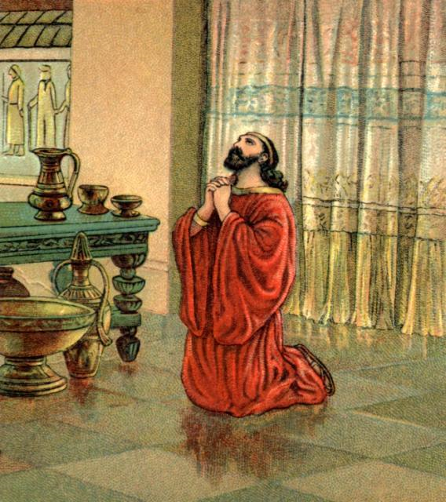
Kids can be trained to make prayer the first thing they do when they need help or when someone they know needs help.”
Nehemiah was a great example of this concept. In Nehemiah 1:4, after hearing about the destruction of Jerusalem, Nehemiah’s immediate response was prayer, weeping, and fasting for days.
In Nehemiah 2:4, even as he formed his response to the king, Nehemiah said a quick silent prayer for God’s help.
Notes:
Kids can be trained to make prayer the first thing they do when they need help or when someone they know needs help.”
Nehemiah was a great example of this concept. In Nehemiah 1:4, after hearing about the destruction of Jerusalem, Nehemiah’s immediate response was prayer, weeping, and fasting for days.
In Nehemiah 2:4, even as he formed his response to the king, Nehemiah said a quick silent prayer for God’s help.

Slide 14
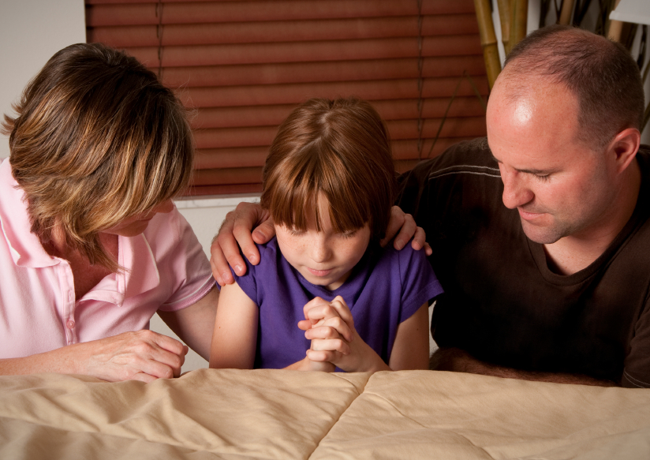
Teach kids about making prayer a first response.
Have kids form pairs and play a word association game.
You supply the first word: problem
Notes:
Teach kids about making prayer a first response.
Have kids form pairs and play a word association game.
You supply the first word: problem

Slide 15
Activity
Have the first partner in each pair say the first word that comes to mind after hearing problem; then have the second partner respond with the first word that comes to mind after hearing the partner’s word.
Have partners go back and forth for about two minutes. Then ask: “What’s the first thing you think to do when you have a problem? When you have a decision to make? When you’re happy about something?”
Remind kids that God wants us to turn to him first about anything and everything.
Notes:
Activity
Have the first partner in each pair say the first word that comes to mind after hearing problem; then have the second partner respond with the first word that comes to mind after hearing the partner’s word.
Have partners go back and forth for about two minutes. Then ask: “What’s the first thing you think to do when you have a problem? When you have a decision to make? When you’re happy about something?”
Remind kids that God wants us to turn to him first about anything and everything.

Slide 16
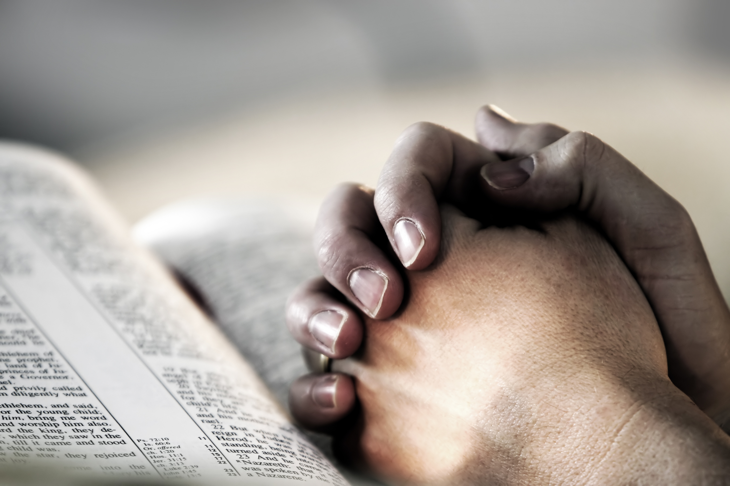
4. Prayer involves the bible
“The word and prayer are inextricably bound together, not separate activities as we like to think of them” For one to grow in prayer, one must grow in reading, studying, and meditating on the Word.
The Bible has a lot to do with prayer. The Bible helps build a better prayer vocabulary, teaches how to pray for God’s will, and what to pray for.
Scripture builds kids’ confidence in their prayers and helps them practice it.
Notes:
4. PRAYER INVOLVES THE BIBLE
“The word and prayer are inextricably bound together, not separate activities as we like to think of them” For one to grow in prayer, one must grow in reading, studying, and meditating on the Word.
The Bible has a lot to do with prayer. The Bible helps kids build a better prayer vocabulary, teaches them to pray for God’s will, and can teach them about things to pray for that they may not have thought of, such as wisdom.
Scripture builds kids’ confidence in their prayers and helps them practice it.

Slide 17
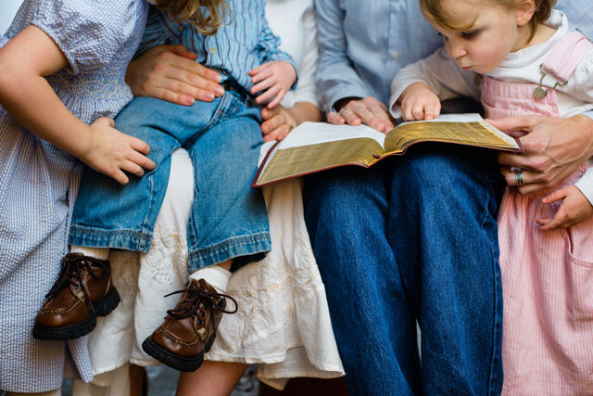
Let kids practice praying using the Bible as a guide.
Form groups of four.
Give each child in a group a verse to look up, and then have kids pray in their groups, using the verses they looked up as a launching point.
For example, Psalm 138 begins, “I give you thanks, O Lord, with all my heart,” so kids could pray, “I give you thanks, O Lord, with all my heart for my family, friends, school, church,” and so on.
Notes:
Let kids practice praying using the Bible as a guide.
Form groups of four.
Give each child in a group a verse to look up, and then have kids pray in their groups, using the verses they looked up as a launching point. For example, Psalm 138 begins, “I give you thanks, O Lord, with all my heart,” so kids could pray, “I give you thanks, O Lord, with all my heart for my family, friends, school, church,” and so on.

Slide 18
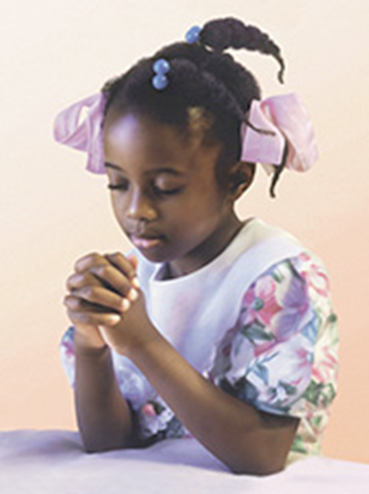
Use these verses: Psalm 138:1; Habakkuk 3:19; Psalm 142:5; Psalm 86:1; and Psalm 75:1.
Kids can simply read the verse or read it and add their own prayer.
Encourage kids to read the psalms whenever they need help praying.
Notes:
Use these verses: Psalm 138:1; Habakkuk 3:19; Psalm 142:5; Psalm 86:1; and Psalm 75:1.
Kids can simply read the verse or read it and add their own prayer.
Encourage kids to read the psalms whenever they need help praying.

Slide 19
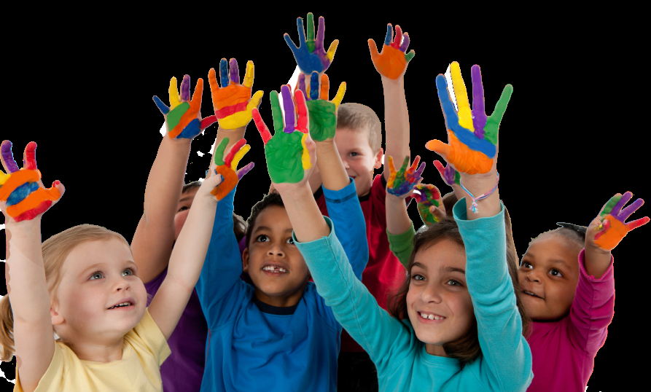
5. Prayer is listening to God
Kids should be taught that prayer is a dialogue, not a monologue. Just like sheep listen to the shepherd’s voice in John 10, we can help train kids’ ears to recognize different ways God speaks.
It’s important that kids understand that God isn’t a vending machine. We can go to Him with anything on our hearts, but prayer is also letting him speak to us through everyday parts of life.
Notes:
5. PRAYER IS LISTENING TO GOD.
Kids should be taught that prayer is a dialogue, not a monologue. Just like sheep listen to the shepherd’s voice in John 10, we can help train kids’ ears to recognize different ways God speaks.
It’s important that kids understand that God isn’t a vending machine. We can go to Him with anything on our hearts, but prayer is also letting him speak to us through everyday parts of life.
Having a constant ear for God’s voice is part of praying without ceasing. One tangible way kids can listen for God’s voice is to write their questions to him in a prayer journal, then listen for his answer and record it.

Slide 20
Having a constant ear for God’s voice is part of praying without ceasing. One tangible way kids can listen for God’s voice is to write their questions to him in a prayer journal, then listen for his answer and record it.
Notes:
Having a constant ear for God’s voice is part of praying without ceasing. One tangible way kids can listen for God’s voice is to write their questions to him in a prayer journal, then listen for his answer and record it.

Slide 21
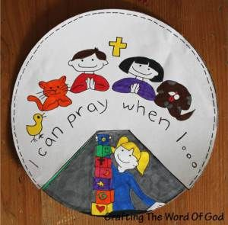
Teach Kids to pray
Help kids understand how to hear God’s voice. Ask, “What does God’s voice sound like?” (It’s okay if kids say they don’t know, but encourage any and every answer.)
Share with the kids what God’s still small voice sounds like to you.
Tell kids they’re going to practice listening to God because prayer is a two-way communication. We talk and listen.
Notes:
Teach Kids to Pray
Help kids understand how to hear God’s voice. Ask, “What does God’s voice sound like?” (It’s okay if kids say they don’t know, but encourage any and every answer.)
Share with the kids what God’s still small voice sounds like to you.
Tell kids they’re going to practice listening to God because prayer is a two-way communication. We talk and listen.

Slide 22
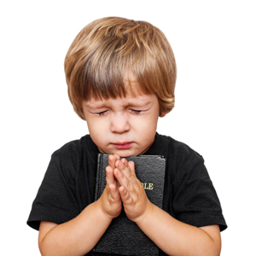
Have kids find a place in a room to sit away from others. Have them silently read Psalm 23 and then choose one verse to talk to God about. Perhaps there are things they need that they don’t have.
Encourage them to ask God about that. Or perhaps they need guidance and can ask God to speak about that.
After they’ve chosen a verse, encourage them to ask God a question and then wait silently for him to speak. Let kids know that God may speak just one word or give them an image in their minds. Have kids write whatever they hear.
Notes:
Have kids find a place in a room to sit away from others. Have them silently read Psalm 23 and then choose one verse to talk to God about. Perhaps there are things they need that they don’t have.
Encourage them to ask God about that. Or perhaps they need guidance and can ask God to speak about that.
After they’ve chosen a verse, encourage them to ask God a question and then wait silently for him to speak. Let kids know that God may speak just one word or give them an image in their minds. Have kids write whatever they hear.

Slide 23
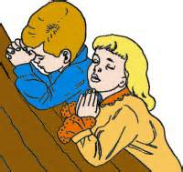
Allow five minutes, then discuss what kids heard and what it was like to listen for God’s voice.
Encourage kids who may not have heard anything that listening to God takes practice and isn’t magical.
God wants us to learn to wait for him to speak. Encourage them to try this several times this week.
Notes:
Allow five minutes, then discuss what kids heard and what it was like to listen for God’s voice.
Encourage kids who may not have heard anything that listening to God takes practice and isn’t magical.
God wants us to learn to wait for him to speak. Encourage them to try this several times this week.

Slide 24
6. Prayer is for others
We can pray for other people. When we’re driving, we could pray for people in the cars we pass. Kids can pray for people they walk past in school. Or more personally, they can pray for friends and loved ones.
Help kids know what and who to pray for by giving them prayer projects.
When kids see how God works in others’ lives according to prayer, they’ll see that prayer makes a difference and are motivated to keep praying!
Notes:
6. Prayer is for others
We can pray for other people. When we’re driving, we could pray for people in the cars we pass. Kids can pray for people they walk past in school. Or more personally, they can pray for friends and loved ones.
Helping kids know what and who to pray for by giving them prayer projects.
When kids see how God works in others’ lives according to prayer, they’ll see that prayer makes a difference and are motivated to keep praying!

Slide 25
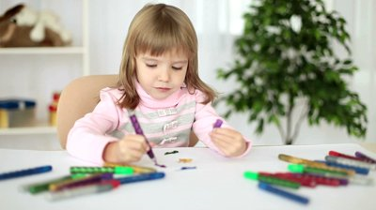
Using pens or markers, have kids draw a target with six circles. Then have them fill in the target with prayer projects using pencils.
In the outer circle, have them write a country to pray for; in the next circle, a family in their neighborhood. The rest of the circles can represent people in their lives-perhaps a teacher at school, then a friend, then a family member. In the center have kids write something they’d like to pray for themselves.
Encourage kids to pray for the people they listed for one or two weeks, then erase them and write any answers to prayer. They can then fill in new countries, families, and so on.
Activity
Notes:
Activity
Using pens or markers, have kids draw a target with six circles. Then have them fill in the target with prayer projects using pencils.
In the outer circle, have them write a country to pray for; in the next circle, a family in their neighborhood. The rest of the circles can represent people in their lives-perhaps a teacher at school, then a friend, then a family member. In the center have kids write something they’d like to pray for themselves.
Encourage kids to pray for the people they listed for one or two weeks, then erase them and write any answers to prayer. They can then fill in new countries, families, and so on.

Slide 26
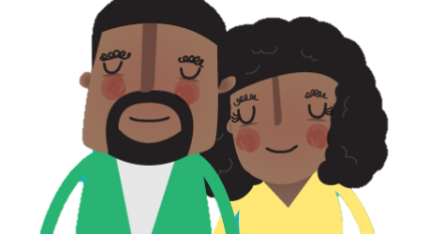
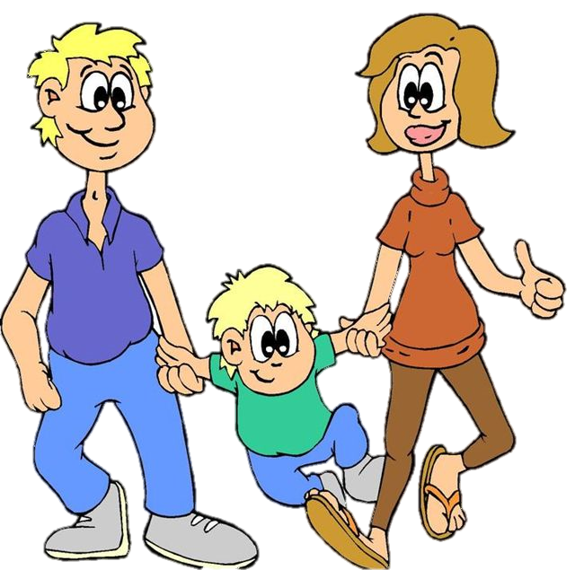
7. Prayer is modeled
The best way to challenge kids to pray is to challenge parents- and even yourself – to pray more.
When it comes to teaching prayer, you can’t bring kids to a place you haven’t been to yourself.
When children see adults praying, they have it modeled for them. They see that God answers prayer; they’re motivated and challenged to pray.
Notes:
7. PRAYER IS MODELED
Thebest way to challenge kids to pray is to challenge parents- and even yourself – to pray more.
When it comes to teaching prayer, “you can’t bring kids to a place you haven’t been to yourself.”
When children see adults praying, they have it modeled for them. They see that God answers prayer; they’re motivated and challenged to pray.

Slide 27
This one’s really about you.
If you want to teach your kids to never stop praying, you’ve got to never stop praying.
Regularly share with your kids how you’re seeing God at work through your prayers.
Notes:
PRAYER IS ‘TALKING TO GOD’
This one’s really about you.
If you want to teach your kids to never stop praying, you’ve got to never stop praying.
Regularly share with your kids how you’re seeing God at work through your prayers.
Brother Lawrence, a 17th century monk, wrote about his experiences dwelling in God’s presence as a constant part of his life.
He advised, “The soul’s eyes must be kept on God, particularly when something is being done in the outside world. Since much time and effort are needed to perfect this practice, one should not be discouraged by failure.
Although the habit is difficult to form, it is a source of divine pleasure once it is learned.

Slide 28
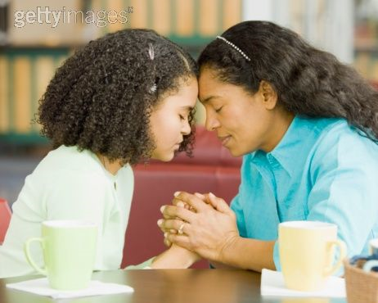
So begin with yourself.
Ask God to help you keep your eyes on him at all times.
Let your kids see the impact God’s presence has on your life.
Notes:
So begin with yourself.
Ask God to help you keep your eyes on him at all times.
Let your kids see the impact God’s presence has on your life.

