Slide 1

POSITIVE DISCIPLINE by
Saustin Sampson Mfune
GC CHM Associate Director
Notes:
POSITIVE DISCIPLINE

Slide 2

The words discipline and punishment are often used interchangeably by many people but in principle they refer to different things.
Notes:
The words discipline and punishment are often used interchangeably by many people but in principle they refer to different things.

Slide 3
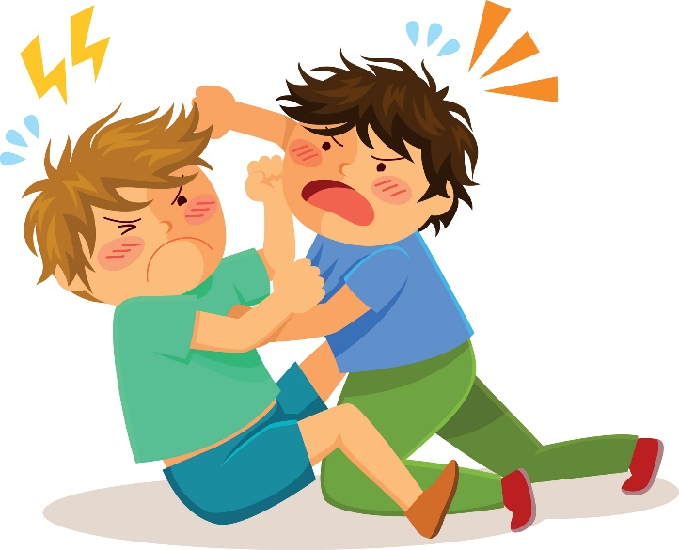
Discipline is proactive while punishment is reactive. Usually, punishment is administered after something wrong has happened.
Notes:
Discipline is proactive while punishment is reactive. Usually, punishment is administered after something wrong has happened.
Discipline – Proactive
Punishment - Reactive

Slide 4

Many times even if our intentions are to discipline, we find ourselves reverting to punishment.
Notes:
Many times even if our intentions are to discipline, we find ourselves reverting to punishment.
A mother once told us her experience. Her daughter did something which really annoyed her. She told herself that she would not do anything negative. But because she was extremely annoyed, she ended in slapping her daughter because she failed to control herself. She felt bad afterwards.

Slide 5

The intentions of this presentation is to discuss ten principles which can help leaders and parents to discipline positively.
Notes:
The intentions of this presentation is to discuss ten principles which can help leaders and parents to discipline positively.

Slide 6
1
WHEN A CHILD MISBEHAVES, FIND OUT WHAT CAUSES THE MISBEHAVIOUR
,
Notes:
1. WHEN A CHILD MISBEHAVES, FIND OUT WHAT CAUSES THE MISBEHAVIOR

Slide 7
Naomi Aldort states that children want to behave well. If they fail to do so, usually there is a valid reason for their missing the mark.
Notes:
Sizer, quoting Naomi Aldort, the author of the book “Raising our Children, Raising Ourselves,” says that children want to behave well. If they fail to do so, usually there is a valid reason for their missing the mark.
It’s a parent’s duty to find out what makes the child behave that way. Aldort explains that many times, once the cause is identified and removed, the child behaves differently. For example, sometimes the child will keep slapping his sibling in order to get your attention because you may have been busy with other things for a long time. The tendency is to scream, “Stop hitting your sister.” But Aldort says, if you “correct your own behavior, that will satisfy the child’s need” and the behavior will disappear.

Slide 8


2
GIVE THEM OPTIONS
Whe
Notes:
2. GIVE THEM OPTIONS

Slide 9
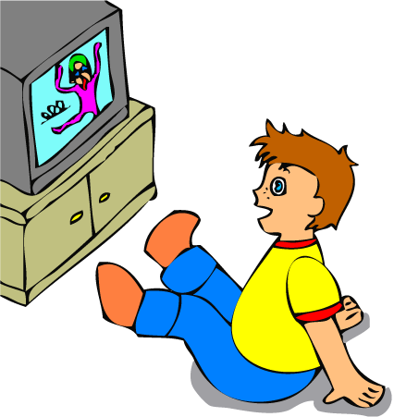



Let’s say your child likes watching TV more than doing his/her home work. Experts advise not to say to your child, “Do your homework. Don’t just watch TV.” Kersey writes that to discipline positively is to say something like this; “When you have finished your homework, then you may watch TV.” She observes that this approach has three advantages. It teaches children to be:-
Responsible
Accountable
Obedient
Notes:
Let’s say your child likes watching TV more than doing his/her home work. Experts advise not to say to your child, “Do your homework. Don’t just watch TV.” Kersey writes that to discipline positively is to say something like this; “When you have finished your homework, then you may watch TV.” She observes that this approach has three advantages. It teaches children to be:-
Responsible
Accountable
Obedient

Slide 10

3
Don’t Bribe
Notes:
3. Don’t Bribe

Slide 11

Some parents when a child is misbehaving, they bribe the child. The bribing may be like this; “If you stop running around, I will buy you ice cream.” This approach sends a wrong message to the child. The message you send to the child is that if you are good, you get nothing, but if you trouble mom a little, you are offered a reward.
Notes:
Some parents when a child is misbehaving, they bribe the child. The bribing may be like this; “If you stop running around, I will buy you ice cream.” This approach sends a wrong message to the child. The message you send to the child is that if you are good, you get nothing, but if you trouble mom a little, you are offered a reward.

Slide 12
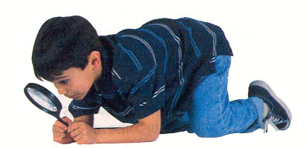
4
Incompatible Alternative Principle – the principle of redirecting
Notes:
4. Incompatible Alternative Principle – the principle of redirecting

Slide 13

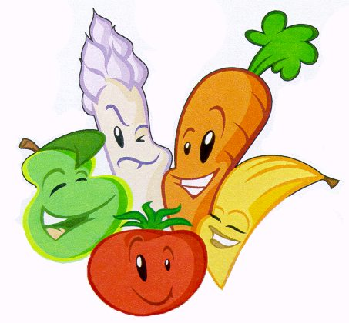
A child is redirected to do something that he can’t do while misbehaving. For example, you are shopping in a grocery shop and your child keeps running all over. The thing many parents do naturally is to shout something like this; “Stop. You are going to hurt yourself.”
Redirect: - “Can you help me pick apples or carrots?”
The suggested behavior is not compatible to running around.
Notes:
This principle suggests that you redirect the energy of your child by offering two alternative positives that are not compatible with inappropriate behavior. For example, say to your child, “On that shelf there are cereals and over there are apples. Would you like to help mummy by choosing cereals or apples?” The suggested behavior is not compatible to running around.

Slide 14

5
Talk About Them Positively to Others
Notes:
5. Talk About Them Positively to Others

Slide 15

Let’s say you had taken your child to a dentist, when you return home report to the family how positively the child behaved.
Notes:
Let’s say you had taken your child to a dentist, when you return home report to the family how positively the child behaved.

Slide 16

6
There are times you need to focus on controlling yourself and not your child
Notes:
6. There are times you need to focus on controlling yourself and not your child

Slide 17

Dr Katherine C. Kersey, in her book “The 101s: A Guide to Positive Discipline,” states that model the behavior you want to see in your child.
Notes:
Dr. Katherine explains that it is advisable not to do anything in front of children that you don’t want them to imitate. Children are copy cats. You will sometimes notice when they are playing, one will say, “I will be daddy and the other will say I will be mommy.” To your shock, you will hear the child who is imitating you scream, “Stop it or else…” Parents should remember that screaming at the child will beget a screaming child. It is important to model the behavior you want in your child. If you want your child to be patient, model patience. And be a consistent model. Inconsistency confuses a child. CONTROL YOURSELF SO THAT YOU DON’T MODEL WRONG BEHAVIOUR.

Slide 18
7
Give Attention to the Behavior you like - not the behavior you don’t like.
Notes:
7. Give Attention to the Behavior you like - not the behavior you don’t like.

Slide 19

Kersey writes that sometimes children misbehave because they want attention. Hence, it is advisable to sometimes give a cold shoulder to those actions you don’t approve.
Notes:
Giving a cold shoulder is what Kersey refers to as “Rain on the grass, not on the weeds” principle. If your child likes to throw tantrums and whine, ignore the behavior. You could even walk away. Your child will soon learn that this style of communicating is not acceptable.

Slide 20
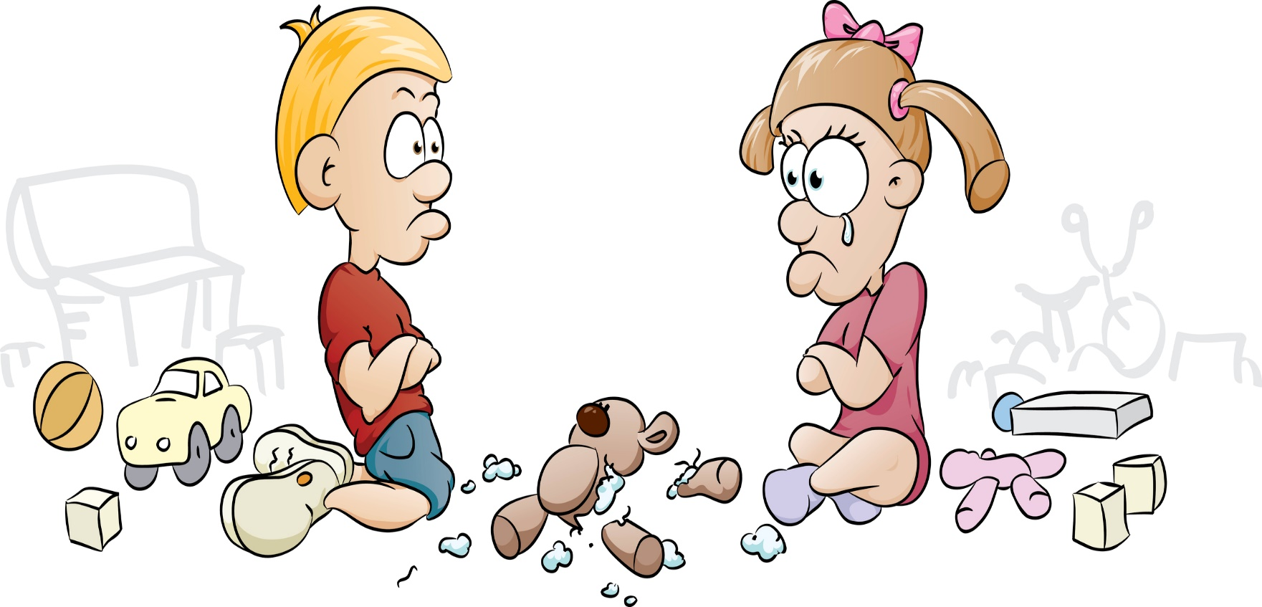
8
Privacy Principle
Notes:
8. Privacy Principle

Slide 21

When your child misbehaves in public, take her aside and talk to her privately. Don’t embarrass her in public.
Notes:
When your child misbehaves in public, take her aside and talk to her privately. Don’t embarrass her in public.
When one is humiliated, will not listen to whatever you are saying.

Slide 22


9
Talk With them, Not to Them Principle
Notes:
9. Talk With them, Not to Them Principle

Slide 23

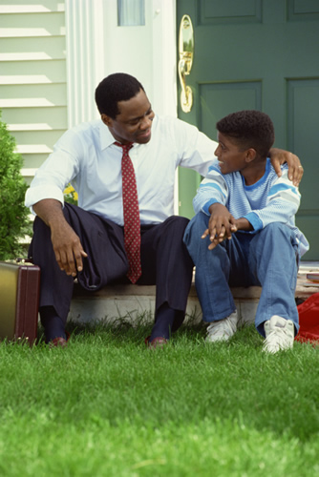
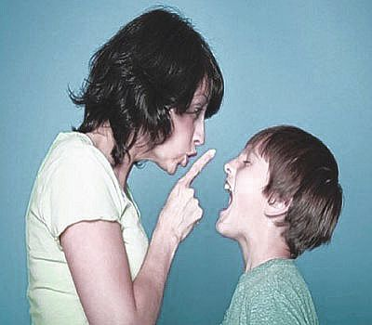
Don’t preach to children. Focus on two-way communication. Listen to your child as well as talk. Don’t confuse your child by saying, “Answer me when I talk. Don’t just stand there looking at me as if I am an alien from space.” Then when your child talks back, you end up shouting, “Don’t answer me when
I am talking.” This will totally confuse your child.
Notes:
Don’t preach to children. Focus on two-way communication. Listen to your child as well as talk. Don’t confuse your child by saying, “Answer me when I talk. Don’t just stand there looking at me as if I am an alien from space.” Then when your child talks back, you end up shouting, “Don’t answer me when I am talking.” This will totally confuse your child.

Slide 24
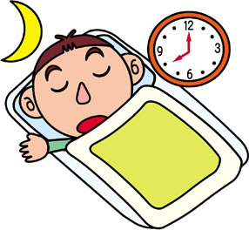
10
Positive Closure Principle
Notes:
10. Positive Closure Principle
As you put your child to bed, tell her that she is special and very much loved. Remind her the good things she did during the day and that you are looking forward to another good day tomorrow. And with your face smiling, give her a ‘good-night-and-sleep-tight’ kiss.

