Slide 1

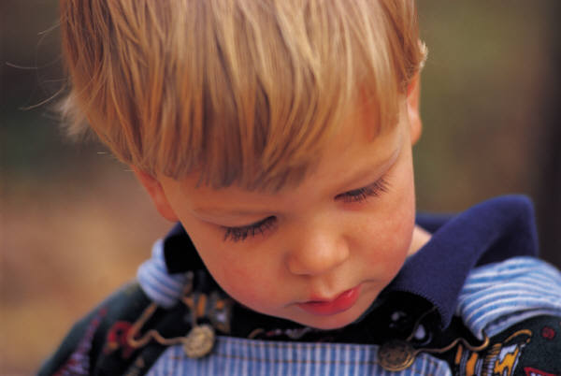
Sharing The Gospel With Your Children
Notes:
SHARING THE GOSPEL WITH YOUR CHILDREN
Many Christian parents face a paradox: How can some children hear the good news of the Bible and believe, while others hear the same message and remain unaffected? While the process of faith may be miraculous, it is not entirely mysterious. Jesus explained it in His parable of the sower (Matthew 13:1-23). Teaching received without understanding kills the yield. Faith with shallow roots withers and dies. Distractions, worries and desires for other things choke the word. But one who hears the Word and understands it bears fruit.
How can we help our children receive the Word and bear fruit? Jesus’ parable inspires several practical planting tips.

Slide 2
1. Focus On Understanding
Concentrate on helping kids really understand God’s Word and its relevance today.
Help them learn how to apply it in their lives.
Notes:
1. Focus on Understanding
Concentrate on helping kids really understand God’s Word and its relevance today.
Help them learn how to apply it in their lives.
Many parents and teachers attempt to impart faith primarily through the transfer of Bible facts.
Those seeds will not likely take root unless kids truly understand the meaning of the facts.
Sabbath school worksheets often use fill-in-the-blanks and word puzzles to drill children on their factual knowledge.
But unscrambling the word forgiveness in a puzzle is far less important than understanding the meaning of forgiveness.
Hearing is not enough. Reading is not enough. Memorizing is not enough – unless your goal is to produce a Bible “Jeopardy” champion.

Slide 3
2. Let Them Experience The Message
Help them experience the concept of grace, involve your family in giving to others without expecting anything in return.
Encourage kind words as mentioned in Ephesians 4:29. Invite family members to write or draw kind notes to one another.
Do not let any unwholesome talk come out of your mouths, but only what is helpful for building others up according to their needs, that it may benefit those who listen.
- Ephesians 4:29 (NIV)
Notes:
2. Let Them Experience the Message
Help them experience the concept of grace, involve your family in giving to others without expecting anything in return.
Encourage kind words as mentioned in Ephesians 4:29. invite family members to write or draw kind notes to one another.
People remember and are affected by vivid experiences. When Jesus wanted His disciples to learn about servanthood, He got down on His knees and washed their feet. You can be sure those disciples never forgot that faith lesson! You can do the same with your children.

Slide 4

3. Use Teachable Moments
When kids are enveloped in emotion-packed situations, they are the most ready to grow.
Notes:
3. Use Teachable Moments
When kids are enveloped in emotion-packed situations, they are the most ready to grow.

Slide 5

Use Teachable Moments
When circumstances provoke feelings of fear, sadness, anger, exhilaration, awe or wonder, be prepared to help them see how God is working.
When Johhny is scared may be the opportune time to teach about God’s presence.
Notes:
Use Teachable Moments
When circumstances provoke feelings of fear, sadness, anger, exhilaration, awe or wonder, be prepared to help them see how God is working.
When Johnny is scared may be the opportune time to teach about God’s presence.

Slide 6
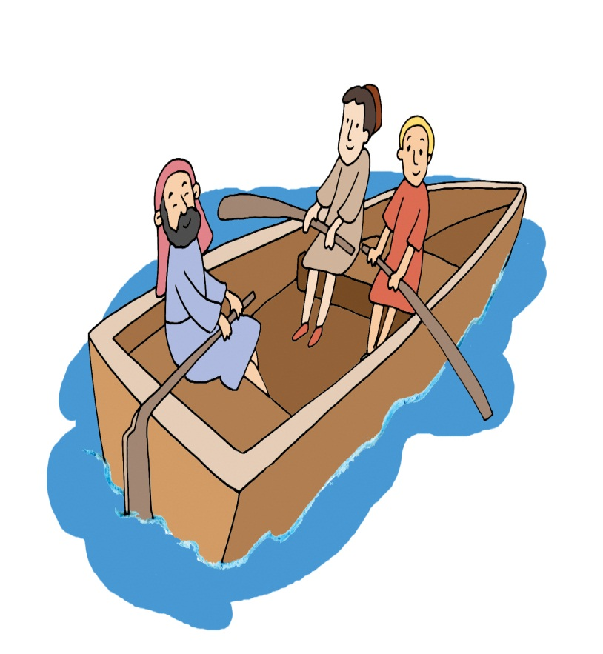
Use Teachable Moments
Jesus took advantage of teachable moments often, such as during the storm on the lake and with those who threatened to stone the adulterous woman.
Notes:
Use Teachable Moments
Jesus took advantage of teachable moments often, such as during the storm on the lake and with those who threatened to stone the adulterous woman.

Slide 7

4. Reinforce Long-term Retention
We can help move more of God’s message into long-term memory through “interval reinforcement,” review or use of the message repeatedly over time.
Notes:
4. Reinforce Long-term Retention
We can help move more of God’s message into long-term memory through “interval reinforcement,” review or use of the message repeatedly over time.
Some information we quickly forget. Other things we remember a lifetime.
If the brain registers information just once, less than 10 percent of the message is likely to be remembered after 30 days.

Slide 8
Reinforce Long-term Retention
If the brain registers information just once, less than 10 percent of the message is likely to be remembered after 30 days.
Notes:
Reinforce Long-term Retention
If the brain registers information just once, less than 10 percent of the message is likely to be remembered after 30 days.
Some information we quickly forget. Other things we remember a lifetime.

Slide 9

Reinforce For Long-term Retention
If there are 6 exposures to the information over 30 days, 90 percent of the message is likely to be retained.
Notes:
Reinforcement for Long-term Retention
If there are six exposures to the information over 30 days, 90 percent of the message is likely to be retained.

Slide 10
Reinforce Long-term Retention
If you want your kids to understand God as Creator, repeat the message frequently – when you drive through the mountains, when you witness a sunset, when you visit the zoo and when you marvel at the wonder of the human body.
Notes:
Reinforce Long-term Retention
If you want your kids to understand God as Creator, repeat the message frequently – when you drive through the mountains, when you witness a sunset, when you visit the zoo and when you marvel at the wonder of the human body.

Slide 11

5. Avoid Bribes
Many well-intentioned parents and teachers attempt to grow their kids’ faith through the enticing rewards; “Learn this verse and get a ribbon.” “Go to Sabbath school and get a cookie.”
It may seem harmless but bribing kids actually sets up a distraction.
Notes:
5. Avoid Bribes
Many well-intentioned parents and teachers attempt to grow their kids’ faith through the enticement of rewards. “Learn this verse and get a ribbon.” “Go to Sabbath school and get a cookie.”
It may seem harmless, but bribing kids actually sets up a distraction.

Slide 12

Avoid Bribes
The “do this and get that” approach causes kids to focus more on the “that” than the “this.”
Notes:
Avoid Bribes
The “do this and get that” approach causes kids to focus more on the “that” than the “this.”

Slide 13

Avoid Bribes
Jesus never said, “If you do unto others what you want them to do to you, you get a lollipop,” or “If you feed My sheep, you get a Twinkie.”
Notes:
Avoid Bribes
Jesus never said, “If you do unto others what you want them to do to you, you get a lollipop,” or “If you feed My sheep, you get a Twinkie.”

Slide 14
6. Employ Delight
Your kids will learn more when they enjoy the process. Make learning about God fun!
Notes:
6. Employ Delight
Your kids will learn more when they enjoy the process. Make learning about God fun!
Some parents and teachers wince at this suggestion. Few people gain a love for anything that is marinated in drudgery.

Slide 15
Employ Delight
No one ever accused Jesus of being dull or boring
  He turned water into wine for the wedding in Cana
  He told Peter to find cash for the temple tax by catching a fish and pulling out a coin from its mouth.
Notes:
Employ Delight
* No one ever accused Jesus of being dull or boring
-- He turned water into wine for the wedding in Cana
-- He told Peter to find cash for the temple tax by catching a fish and pulling out a coin from its mouth.
Delightful! So, make faith learning delightful.

Slide 16

Make faith learning delightful!
Notes:
Make faith learning delightful!

Slide 17
What Crop Are You Plotting with Your Kids
Jesus concludes His parable: “The one who received the seed that fell on good soil is the man who hears the word and understands it. He produces a crop, yielding a hundred, sixty or thirty times what was sown” ( Matthew 13:23)
Notes:
Jesus concludes His parable: "The one who received the seed that fell on good soil is the man who hears the word and understands it. He produces a crop, yielding a hundred, sixty or thirty times what was sown" (Matthew 13:23).
What crop are you plotting with your kids?

