Slide 1
19 Inexpensive Decorating Ideas for Sabbath School
Linda Mei Lin Koh, GC Children’s Ministries
Notes:
Decorating your Sabbath School classroom to be an exciting learning environment for kids can be tough on a limited budget. Here are 19 ideas that’ll cost you next to nothing…
Ugh… the bleak walls. The boring layout. The stale carpet. The blank bulletin boards. You have a job ahead of you – transforming your Sunday school classroom into an exciting learning environment that kids will flock to. But just as you let your imagination roll, reality reminds you that (of course) there’s always The Budget to consider.
You can transform your room on a tight budget – here are 19 ideas that’ll cost you next to nothing and make your students say, “Wow!”.

Slide 2
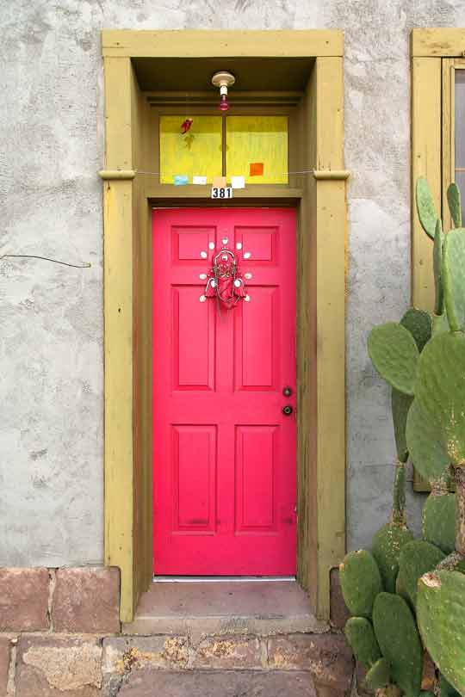
1. Dynamic Doors
Notes:
Dynamic Door
Color the door of the room with paint, or with crepe paper to make it attractive.
Hang child-friendly pictures to make it attractive.

Slide 3
Don’t just decorate your door, make it part of the big picture! Use butcher paper for a temporary scene or latex paint for a permanent scene.
For example, re-create John 20:1-9 by making your door the tomb entrance.
Make your door the opening to the tomb, and create the scene outside the tomb on the walls. Then write the verse above your door.
Doors
Notes:
Doors
Don’t just decorate your door, make it part of the big picture! Use butcher paper for a temporary scene or latex paint for a permanent scene.
For example, re-create John 20:1-9 by making your plans door the tomb entrance.
Make your door the opening to the tomb and create the scene outside the tomb on the walls. Then write the verse above your door.

Slide 4
Choose an event from the Bible and illustrate it on your classroom door – storyboard-style.
For example, depict four scenes from Noah’s Ark.
Leave the conclusion a mystery, and tease visitors with a sign that says, “What happened next? Come in to find out!”
Doors
Notes:
Doors
Choose an event from the Bible and illustrate it on your classroom door – storyboard-style.
For example, depict four scenes from Noah’s Ark.
Leave the conclusion a mystery, and tease visitors with a sign that says, “What happened next? Come in to find out!”

Slide 5
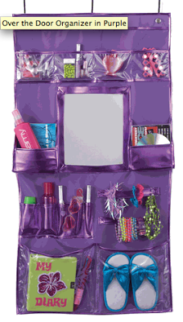
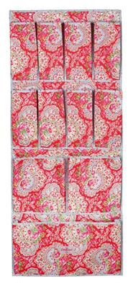
2. Back Pockets
Storage is often an issue in classrooms, especially those prone to clutter. So purchase (www.spacesavers.com) or sew a hanging over-the-door pocket bag.
To sew the pocket bag, you’ll need a 7x2 foot piece of durable fabric.
Cut out pockets of different fabrics in varying shapes and sizes, and sew them on the larger piece.
Notes:
Back Pockets
Storage is often an issue in classrooms, especially those prone to clutter. So purchase (www.spacesavers.com) or sew a hanging over-the-door pocket bag.
To sew the pocket bag, you’ll need a 7x2 foot piece of durable fabric.
Cut out pockets of different fabrics in varying shapes and sizes, and sew them on the larger piece.

Slide 6
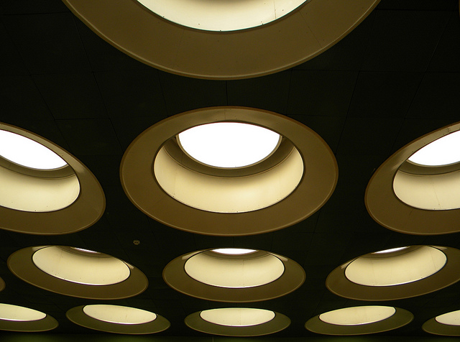
3. Creative Ceilings
Notes:
3. Creative Ceilings

Slide 7
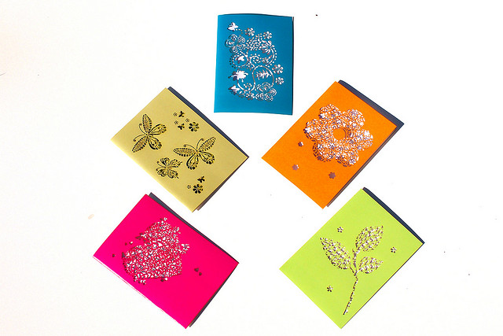
Ceilings
Have kids lend a hand – and character – to this fun ceiling decoration.
Create a handprint border around the top of the wall or the ceiling using several different colors of tempera paint.
Notes:
Ceilings
Have kids lend a hand – and character – to this fun ceiling decoration.
Create a handprint border around the top of the wall or the ceiling using several different colors of tempera paint.

Slide 8
Ceiiing decorated with PVC Pipes
Notes:
Ceiling Decorated with PVC Pipes

Slide 9
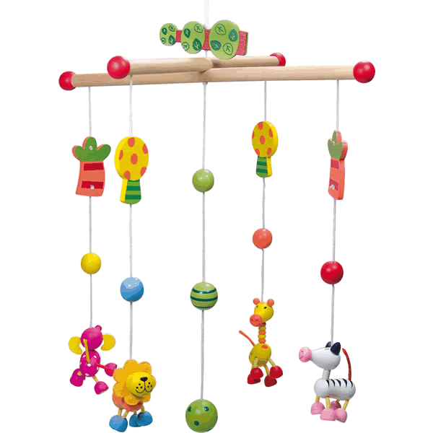
4. Mobiles
Mobiles are an easy way to liven up an drab room, and they make a creative class project.
Notes:
4. Mobiles
Mobiles are an easy way to liven up an drab room, and they make a creative class project.
Have children help to make some mobiles to hang up in the room.

Slide 10
5. Captivating Walls
Notes:
5. Captivating Walls

Slide 11
Wall Colors Galore
Trade the institutional white on your walls for something more contemporary.
A trip to a home improvement store will give you an idea of the vast range of cheery color combinations available.
Recruit parents or preteens to help as you give your room a face-lift.
Notes:
Wall Colors Galore
Trade the institutional white on your walls for something more contemporary.
A trip to a home improvement store will give you an idea of the vast range of cheery color combinations available.
Recruit parents or preteens to help as you give your room a face-lift.

Slide 12
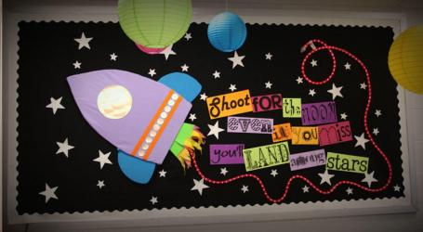
6. Go Dark
Dramatic colors can add depth and interest to your room, and they make the perfect back-ground to display kids’ art projects.
You don’t want to paint every wall and the ceiling magenta, but a single dark wall with a display at the back of the room is inviting and will draw people into your room.
Notes:
6. Go Dark
Dramatic colors can add depth and interest to your room, and they make the perfect background to display kids’ art projects.
You don’t want to paint every wall and the ceiling magenta, but a single dark wall with a display at the back of the room is inviting and will draw people into your room.

Slide 13
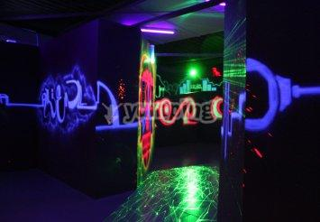
7. All Aglow
Glow in the dark paint and stickers are less obvious way to spice up your room, but kids love them.
You can design a biblical skyline or scene, then decorate the walls and ceiling with stars.
Kids will be captivated as you dim the lights to read passages from the Bible.
Notes:
7. All Aglow
Glow in the dark paint and stickers are less obvious way to spice up your room, but kids love them.
You can design a biblical skyline or scene, then decorate the walls and ceiling with stars.
Kids will be captivated as you dim the lights to read passages from the Bible.

Slide 14
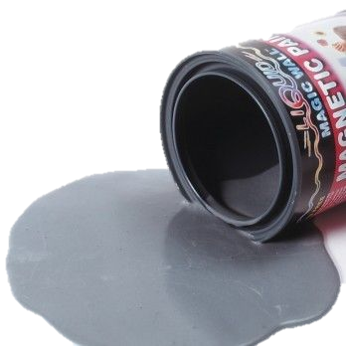
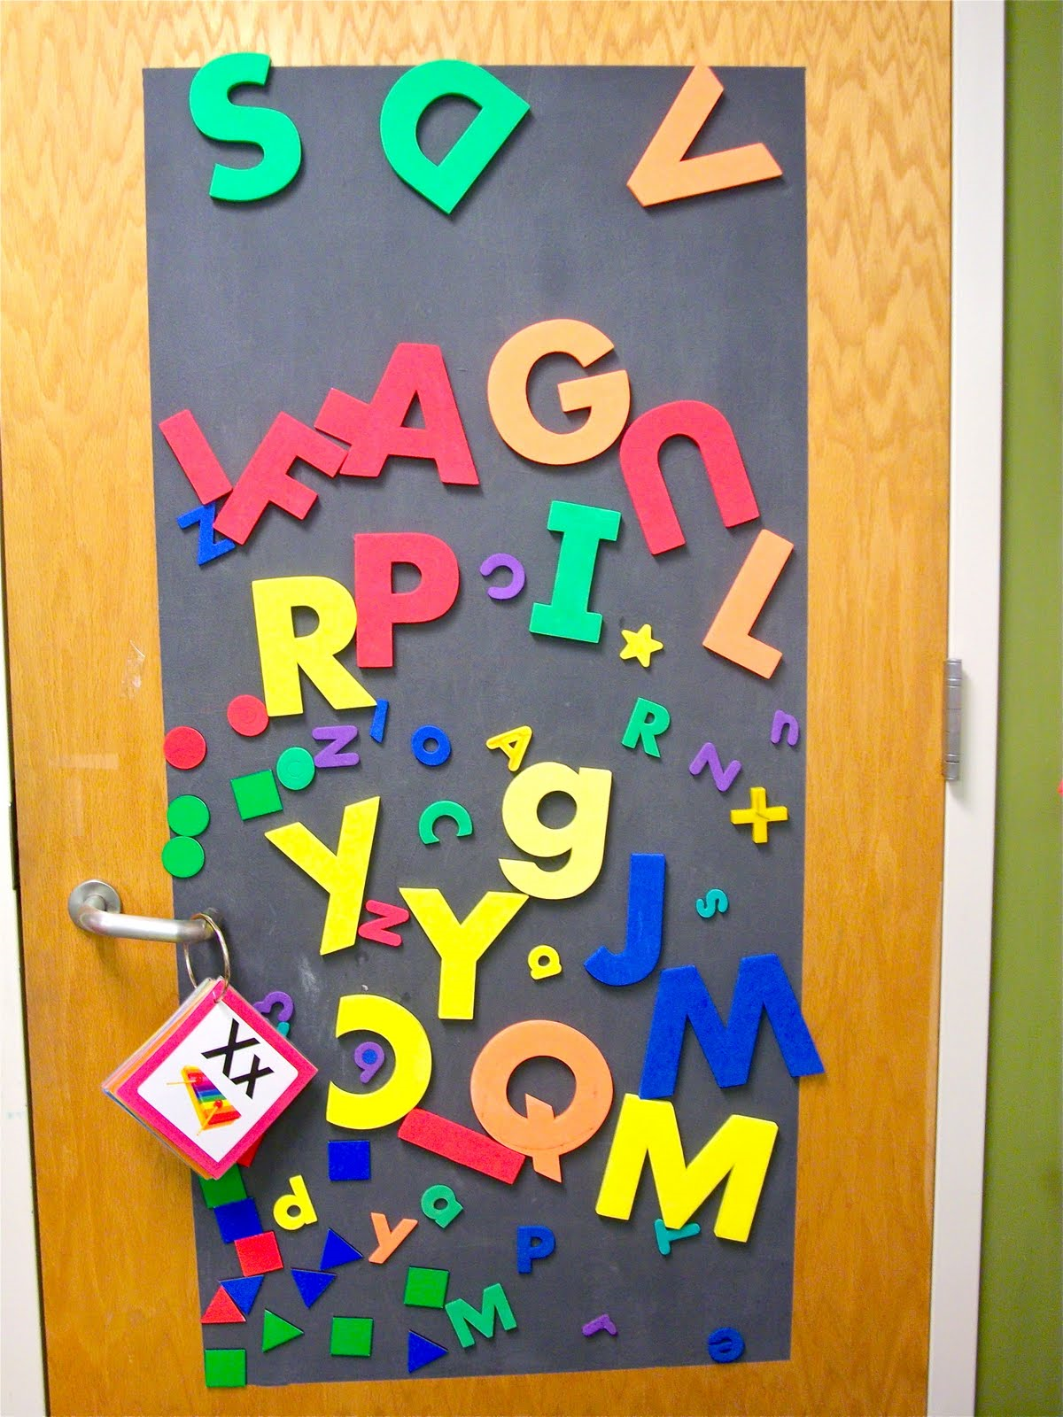
8. Sticky Stuff
What will they think of next? Magnetic paint is a unique addition to the painting palette – and you can cover it with your color of choice.
Consider “striping” your room with the paint.
You can easily attach pictures, art projects, and decorations with magnetic sheets.
Notes:
8. Sticky Stuff
What will they think of next? Magnetic paint is a unique addition to the painting palette – and you can cover it with your color of choice.
Consider “striping” your room with the paint.
You can easily attach pictures, art projects, and decorations with magnetic sheets.

Slide 15
9. Murals
Murals never go out of style, and they’re always a fun, cooperative effort.
You’ll need an artistic person to create the outlines of the mural, but just about anyone with a paintbrush can fill in the rest.
Or bring your classroom to life with a custom-painted mural from
www.wackyworld.tv or www.painteroffun.com.
Notes:
9. Murals
Murals never go out of style, and they’re always a fun, cooperative effort.
You’ll need an artistic person to create the outlines of the mural, but just about anyone with a paintbrush can fill in the rest.
Or bring your classroom to life with a custom-painted mural from www.wackyworld.tv or www.painteroffun.com.

Slide 16
10. Winning Windows
Notes:
Winning Windows
Dress up your window with real potted plants or artificial ones.
Colorful curtains can be eye-catching and appealing.

Slide 17
11. PVC Surprise
PVC piping (available at home improvement stores) is cheap, light, and versatile.
To make curtain rods, cut sections just longer than the width of your windows.
Drape each section with fabric or cover the pipe itself with glue and fabric.
Notes:
11. PVC Surprise
PVC piping (available at home improvement stores) is cheap, light, and versatile.
To make curtain rods, cut sections just longer than the width of your windows.
Drape each section with fabric, or cover the pipe itself with glue and fabric.

Slide 18
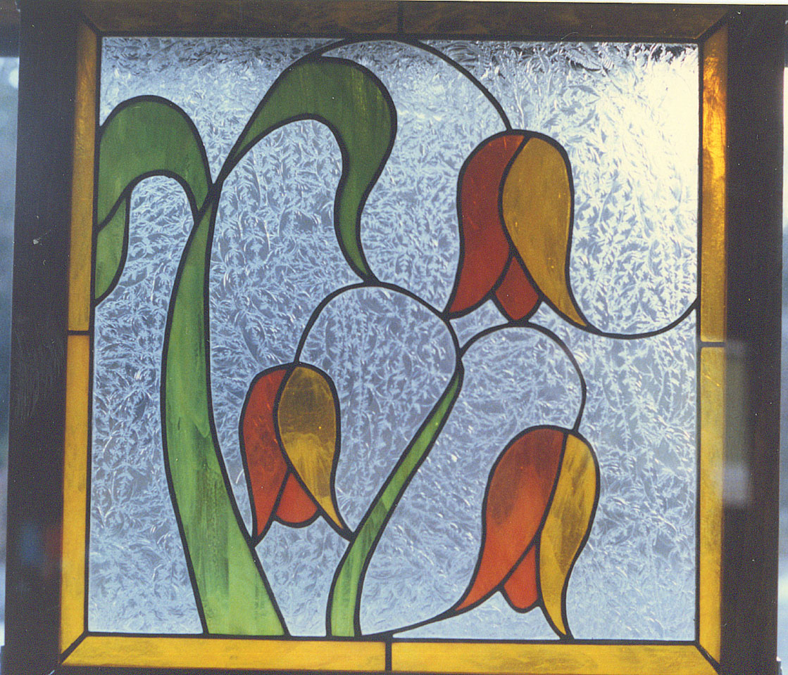
12. Stain Glass
Windows are wonderful, but sometimes what’s going on outside them distracts kids.
If you want to keep the light but lose the distraction, “stain” your glass. For stained glass kits, go to www.dickblick.com.
Notes:
12. Stain Glass
Windows are wonderful, but sometimes what’s going on outside them distracts kids.
If you want to keep the light but lose the distraction, “stain” your glass. For stained glass kits, go to www.dickblick.com.

Slide 19
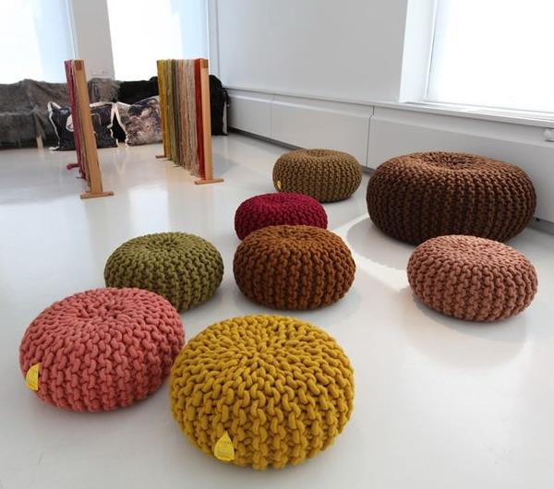
13. Fantastic Floors
Notes:
13. Fantastic Floors
Use colorful throw cushions or bean bags to brighten the floors.
Place colorful tiles that appeal to children.

Slide 20
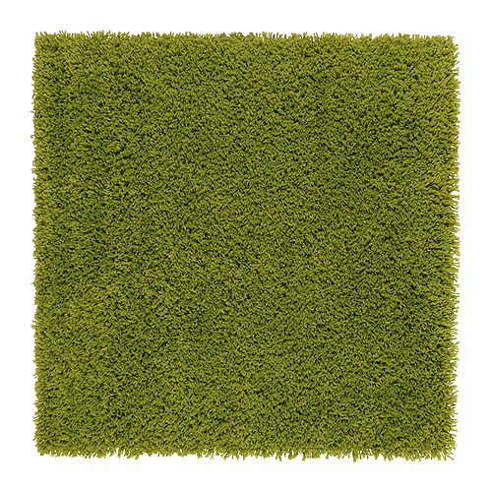
14. Remnants and Rugs
Cover worn-out carpet or soften tile with carpet remnants or inexpensive rugs.
Breaking up a basic floor with rugs also breaks up the room.
You can create a cozy story time area or designate an activity area with varied carpets.
Notes:
Remnants and Rugs
Cover worn-out carpet or soften tile with carpet remnants or inexpensive rugs.
Breaking up a basic floor with rugs also breaks up the room.
You can create a cozy story time area or designate an activity area with varied carpets.

Slide 21
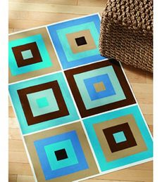
15. Paint me a Path
If your floor is forgettable, make it memorable with a new paint job (uncarpeted floors only).
You can go wild with wacky designs and tons of color, or you can stay sane with a single sublime shade.
Notes:
Paint Me a Path
If your floor is forgettable, make it memorable with a new paint job (uncarpeted floors only).
You can go wild with wacky designs and tons of color, or you can stay sane with a single sublime shade.

Slide 22
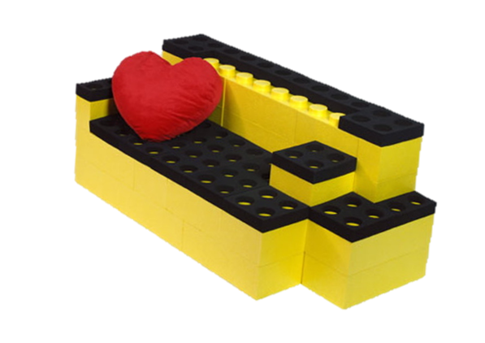
16. Funky Furniture
Notes:
16. Funky Furniture

Slide 23
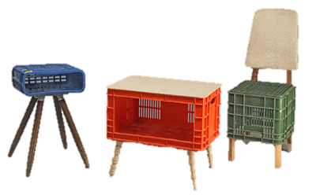
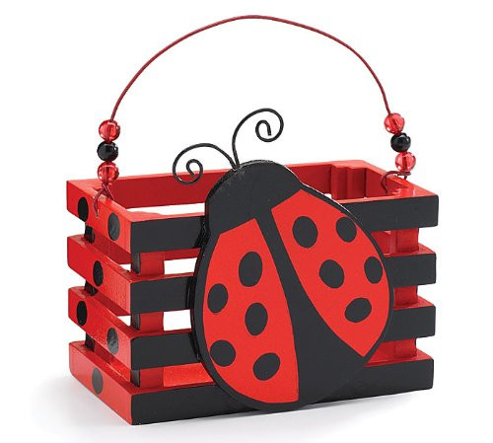
Crates
Crates can do double duty as storage and bench seating. You can spray paint older crates to spruce up their appearance, or cover them with fabric.
To make benches, simply cut a piece of plywood to cover the crates.
Notes:
Crates
Crates can do double duty as storage and bench seating. You can spray paint older crates to spruce up their appearance, or cover them with fabric.
To make benches, simply cut a piece of plywood to cover the crates.
Glue foam to one side of the plywood, and finish the bench top by covering it with fabric. Staple the fabric to the bottom of the bench top with a staple gun.

Slide 24
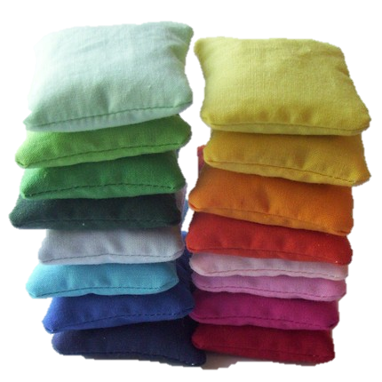
Mini Beanbags
Beanbags don’t have to cost a lot. Visit a thrift store and stock up on pillowcases.
Stock up plastic foam packing peanuts.
Stuff each pillowcase full of plastic foam peanuts, then sew shut the open end of the pillowcase to make a mini beanbag. These are great for kids ages 3 and up to lie or sit on during story time or activities.
Easy for games and cleanup.
Notes:
Mini Beanbags
Beanbags don’t have to cost a lot. Visit a thrift store and stock up on pillowcases.
Stock up plastic foam packing peanuts.
Stuff each pillowcase full of plastic foam peanuts, then sew shut the open end of the pillowcase to make a mini beanbag. These are great for kids ages 3 and up to lie or sit on during story time or activities.
Easy for games and cleanup.

Slide 25
17. Tables and Chairs
Erase the bland look of classroom furniture with brightly colored fabric, eg. cut tablecloths from remnants of fabric, new shower curtains, and oversize table cloths.
If your chairs could use improvement, go to the thrift store and buy more pillowcases. Have kids decorate the pillowcases with fun designs and pictures. Slide the pillowcases over the backs of the chairs and tie large ribbons around the bases of the chair backs.
Notes:
17. Tables and Chairs
Erase the bland look of classroom furniture with brightly colored fabric, eg. cut tablecloths from remnants of fabric, new shower curtains, and oversize table cloths.
If your chairs could use improvement, go to the thrift store and buy more pillowcases. Have kids decorate the pillowcases with fun designs and pictures. Slide the pillowcases over the backs of the chairs and tie large ribbons around the bases of the chair backs.

Slide 26
18. Puppet Alley
PVC works wonders for puppet stages. Stock up on sections of PVC pipe and several corner connectors.
You can interchange the sections to fit your stage needs, then drape fabric over the piping for curtains.
Notes:
18. Puppet Alley
PVC works wonders for puppet stages. Stock up on sections of PVC pipe and several corner connectors.
You can interchange the sections to fit your stage needs, then drape fabric over the piping for curtains.

Slide 27
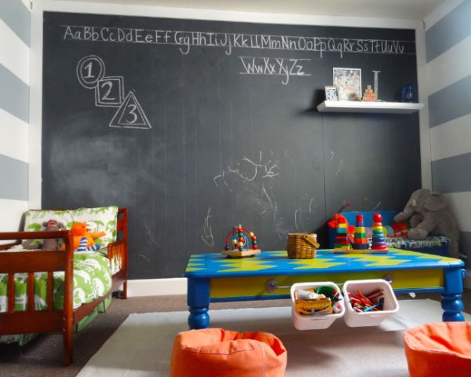
19. Focal Teaching Point
Every classroom comes with a place to write, such as a chalkboard, dry erase board, or flip board. But if you’d like to expand your wall-writing options, apply chalkboard paint to an entire wall.
Notes:
19. Focal Teaching Point
Every classroom comes with a place to write, such as a chalkboard, dry erase board, or flip board. But if you’d like to expand your wall-writing options, apply chalkboard paint to an entire wall.

