Slide 1
How To Reach Digital Natives With The Gospel
Notes:
How do we keep today’s digital natives from “powering down” the minute they walk into your room?
Recently Children’s Ministry leader, Jennifer Hooks casually observed a mixed-age ministry program in a small church she visited, and something caught her eye. She noticed something about the kids that she didn’t think she’d ever really seen before–though she was sure she’d witnessed the same thing previously.
Five-year-old Kira followed her teacher around the room, toting a DVD and endlessly imploring the teacher to get the remote so she could watch her favorite Christian video. Eleven-year-old Maria fiddled with her iPhone, playing games, texting friends, and running new apps she’d downloaded, while 8-year-old Jordan played with his dad’s new Flip phone, making goofy videos of the kids and then replaying them for laughs. Two other kids sat huddled together at the room’s lone computer playing a Christian video game and lamenting the lack of an Internet connection so they could play with others online.
So what struck her about this small group of kids? It wasn’t the abundance of media and tech gadgets in a humble ministry. What she really saw for the first time was how all the kids–from the youngest to the preteen–were naturally integrating all the technology at hand into their casual experiences that evening.
We used to say that today’s kids were “wired.” While this is still true, we need to add “wireless” and “unplugged” to the mix. Kids are connected to technology everywhere they are–whether it’s at a home computer or walking down the street texting. Today’s kids are uniquely adept at and equipped for our technological global existence–much more so than many of us adults leading them.
A conundrum has been developing in public education that’s left a majority of professional educators truly at a loss: They watch as students, who outside of class quickly master every technological advance unveiled, walk into their classrooms and glaze over, check out, or “power down” because the lecture-based style is so outdated and undeveloped that it’s rendering the classroom experience irrelevant.
The common refrain of students who’ve been interviewed about the topic is essentially, “I’m bored stiff when I go to class.” Many say they feel they must turn off their brains when they walk into classes because their teachers don’t understand how they learn best. Students today are rejecting the lecture-based classroom. “My teachers just talk and talk and talk,” kids say. “It’s not Attention Deficit–I’m just not listening” one classic T-shirt reads.
So many educators, while loaded with expertise, knowledge, professionalism, and dedication to their calling, are frustrated when it comes to connecting with their students in real and meaningful ways because technology has in essence rewired their students’ brains. This digital divide is a generational issue that’s arisen essentially unforeseen out of the technological age we live in–and it holds implications for our children’s ministries.
For those of us navigating the church halls every week seeking to equip our kids with a relational knowledge of God, it’s more important than ever to open our minds–and hearts–to the reality of kids’ unique wiring and capabilities. Even if we ourselves don’t navigate emerging technology with the casual dexterity our kids do, we can learn to become interlopers in their world. A mere willingness and openness to learn, to try, to adapt will help us avoid the “power down” effect with the kids we minister to. Here’s what you need to know.

Slide 2
Meet The Natives
Prensky coined the term “digital natives” in a 2001 article, “Digital Natives, Digital Immigrants.”
Notes:
Meet the Natives
Educational researchers and learning experts such as Marc Prensky (Teaching Digital Natives), Don Tapscott (Grown Up Digital), and Josh Spear (Undercurrent.com) have addressed the issue of a digital divide in education, opening compelling and fascinating conversation among educators at all levels.
Prensky coined the term “digital natives” in a 2001 article, “Digital Natives, Digital Immigrants.”

Slide 3
Prensky’s digital natives are “a new breed of student entering educational establishments”– in other words, today’s children.
Notes:
Prensky’s digital natives are “a new breed of student entering educational establishments”–in other words, today’s children. They’re children to whom a digital world is indigenous and completely natural.

Slide 4
They’re children to whom a digital world is indigenous and completely natural.
They were born into an existence where technology evolves at an ever-increasing rate.
They interface with one another and with their world through digital means.
Notes:
They’re children to whom a digital world is indigenous and completely natural.
They were born into an existence where technology evolves at an ever-increasing rate.
They interface with one another and with their world through digital means.

Slide 5
What is a Digital Immigrant?
A digital immigrant is someone who isn’t digital by nature; for instance, one who steadfastly prints hard copies of emails or calls to ensure an email has been received.
Notes:
What is a Digital Immigrant?
A digital immigrant is someone who isn’t digital by nature; for instance, one who steadfastly prints hard copies of emails or calls to ensure an email has been received.
Prensky defines “digital immigrants” as those who weren’t necessarily born into a digital existence but who must adapt and assimilate to function in such a world.

Slide 6
8 Characteristics of the Net Generation Norms
Notes:
8 Characteristics of the Net Generation Norms
Other experts agree with Prensky. DonTapscott outlines eight characteristics of today’s youth in what he calls the Net Generation Norms. Here’s a summary of Tapscott’s Norms–as applied to children.

Slide 7
1. They Expect Freedom In Everything They Do
“While older generations feel overwhelmed by the proliferation of sales channels, product types, and brands, [digital natives]take it for granted.
[Digital natives] leverage technology to cut through the clutter to find the marketing message that fits their need.”
Notes:
1. They expect freedom in everything they do.
“Choice is like oxygen to them,” notes Tim Windsor, author of the blog Zero Percent Idle.
“While older generations feel overwhelmed by the proliferation of sales channels, product types, and brands, [digital natives]take it for granted.
[Digital natives] leverage technology to cut through the clutter to find the marketing message that fits their need.”

Slide 8
2. They Enjoy Customizing and Personalizing
Kids can change the media world they live in–customizing everything from their ring tones to online content they’re creating.
Notes:
2. They enjoy customizing and personalizing.
Kids can change the media world they live in–customizing everything from their ring tones to online content they’re creating.

Slide 9
3. They Scrutinize By Nature
They’re by nature intense scrutinizers of whatever they see online, continually assessing, reviewing, and ultimately expecting more from any provider of online content, resources, or products.
Notes:
3. They Scrutinize by Nature.
They’re by nature intense scrutinizers of whatever they see online, continually assessing, reviewing, and ultimately expecting more from any provider of online content, resources, or products.

Slide 10
4. They Seek Integrity and Openness
Kids are also using technology to discern whether the values they find match theirs–whether consciously or subconsciously.
With ready access to candid reviews by the opinionated masses, there’s little that organizations can effectively hide from consumers about their products, services, and integrity.
Notes:
4. They Seek Integrity and Openness
Kids are also using technology to discern whether the values they find match theirs–whether consciously or subconsciously.
With ready access to candid reviews by the opinionated masses, there’s little that organizations can effectively hide from consumers about their products, services, and integrity.
As they efficiently navigate and scrutinize organizations and products.

Slide 11
5. They Want Entertainment in Their Education and Social Experiences
Windsor states that 82 percent of children ages 2-17 have regular access to video games, with industry sales exploding to over $46.5 billion in 2010.
Play is part of life for kids–whether it’s for education or fun.
Notes:
5. They want Entertainment in their Education and Social Experiences.
Windsor states that 82 percent of children ages 2 to 17 have regular access to video games, with industry sales exploding to over $46.5 billion in 2010.
Play is part of life for kids–whether it’s for education or fun.

Slide 12
6. They Desire and Expect Collaboration and Relationship
Kids everywhere are in constant collaboration–through social media, multiuser video games, file sharing, texting, and more.
They seek out others’ influence, advice, and experiences–almost on a minute-to-minute basis.
Notes:
6. They desire and expect collaboration and relationship.
Kids everywhere are in constant collaboration–through social media, multiuser video games, file sharing, texting, and more.
They seek out others’ influence, advice, and experiences–almost on a minute-to-minute basis.

Slide 13
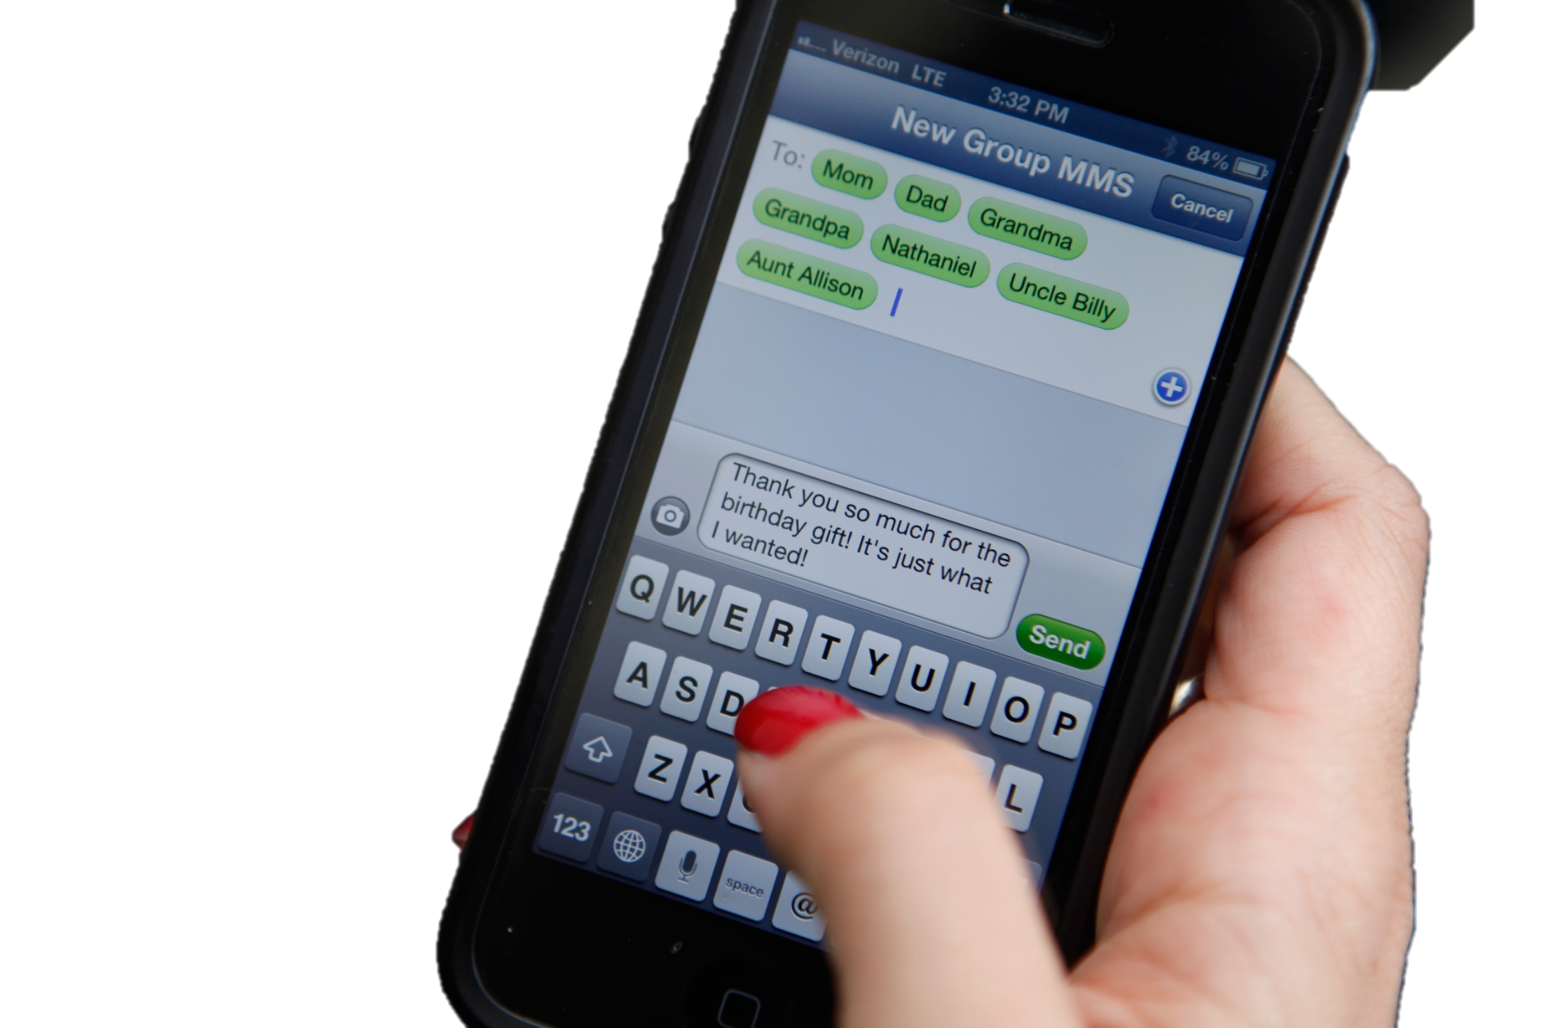
7. They Expect And “Need” Speed
One of the greatest distinguishers of digital natives is their need, or demand, for instant information & rapid communication.
Slow won’t cut it. Instantaneity!
Notes:
7. They Expect and “Need” Speed.
Perhaps one of the greatest distinguishers of digital natives is their need, or demand, for instant information and rapid communication.
Slow won’t cut it; they know by experience that instantaneity is possible and they expect nothing less.

Slide 14
8. They Actively Pursue Innovation
Kids will replace a tech toy such as a phone before it’s worn out – they want new gadgets because they have new features.
They’re in constant pursuit of innovation because it’s entertaining, helps them collaborate, and let them learn in new ways.
Notes:
8. They Actively Pursue Innovation
Kids will replace a tech toy such as a phone before it’s worn out – they want new gadgets because they have new features.
They’re in constant pursuit of innovation because it’s entertaining, helps them collaborate, and let them learn in new ways.

Slide 15
How Can We Approach These Children in Our Ministry?
Notes:
How Can We Approach These Children in Our Ministry?
Studying these characteristics can help inform how you approach the kids in your ministry to more effectively connect with them.

Slide 16
Bridge the Digital Native Divide
Today’s kids are wired to learn differently than the adults before them.
Adults who work with kids must embrace this as fact and be willing to learn from those they seek to teach.
Notes:
Bridge the Digital Native Divide
Today’s kids are wired to learn differently than the adults before them.
Adults who work with kids must embrace this as fact and be willing to learn from those they seek to teach.

Slide 17
Allow Kids To Teach You
Admitting that you’re not savvy on the latest technology will only encourage kids to show you the ropes, demo their cool tech toys, and discover ways to bring new technology and the Word of God together.
Notes:
Allow Kids To Teach You
Admitting that you’re not savvy on the latest technology will only encourage kids to show you the ropes, demo their cool tech toys, and discover ways to bring new technology and the Word of God together.

Slide 18
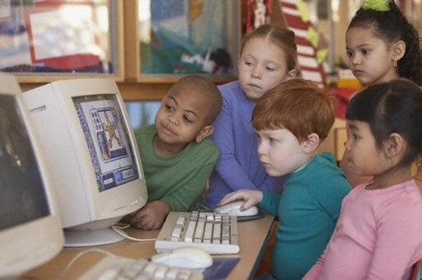
You may have rules about phone use during your time together (and you should, as long as the rules are mutually agreed upon), but it behooves you to find ways to allow kids to use their tech tools during class in a way that benefits everyone.
Notes:
A constant message from experts–those who subscribe to the notion of digital natives and those who don’t–is that:
You may have rules about phone use during your time together (and you should, as long as the rules are mutually agreed upon), but it behooves you to find ways to allow kids to use their tech tools during class in a way that benefits everyone.

Slide 19
Let Kids Learn By Doing
Ask questions, pose challenges, give case studies.
Release kids to collaborate to solve the challenges.
Become a guide, not an expert.
Notes:
Let Kids Learn by doing.
Ask questions, pose challenges, give case studies.
Release kids to collaborate to solve the challenges.
Become a guide, not an expert.
“The most technology can offer to a lecturer is pictures and video, which is no improvement at all,” laments Prensky. Instead, he advocates letting kids learn on their own.
This requires releasing control and becoming a guide, not an expert.

Slide 20
Nurture Learning 24/7
If you challenge kids to find as many phone apps related to Moses as they can in one week or to text one person with a faith-related encouragement every day for a month, you let them explore faith in a way that’s natural and interesting to them.
Notes:
Nurture learning 24/7.
If you challenge kids to find as many phone apps related to Moses as they can in one week or to text one person with a faith-related encouragement every day for a month, you let them explore faith in a way that’s natural and interesting to them.
Offer kids a challenge that lets them explore and leverage tools and time you may not have in class.

Slide 21
Change - often
Kids’ brains are hard-wired for quick change, thanks to technology.
Don’t expect them to attend to one thing for longer than a few minutes.
Notes:
Change – often.
Kids’ brains are hard-wired for quick change, thanks to technology.
Don’t expect them to attend to one thing for longer than a few minutes.

Slide 22
Dale Hudson, co-author of Turbocharged: 100 Simple Secrets to Successful Children’s Ministry, advises to “design your format in segments that last one to five minutes.”
Notes:
Turbocharged
Dale Hudson, co-author of Turbocharged: 100 Simple Secrets to Successful Children’s Ministry, advises to “design your format in segments that last one to five minutes.

Slide 23
Short Segments
By creating short segments, you’re creating multiple starting and stopping points throughout the time.
Every few minutes you’re resetting kids’ internal attention-span countdown.
Notes:
Short Segments
By creating short segments, you’re creating multiple starting and stopping points throughout the time.
Every few minutes you’re resetting kids’ internal attention-span countdown.”

Slide 24
Develop A Collaborative Environment
Your kids likely crave connection with each other. So get kids working in groups or pairs as they learn from God’s Word.
Notes:
Develop a Collaborative Environment
Your kids likely crave connection with each other. So get kids working in groups or pairs as they learn from God’s Word.

Slide 25
Find social media sources that are Adventist where kids can form a closed group to chat and interface online.
Notes:
Find social media sources that are Adventist where kids can form a closed group to chat and interface online.

Slide 26
Post messages of your church website for kids, or allow them to create content for your children’s ministry page.
Notes:
Post messages on your church website for kids, or allow them to create content for your children’s ministry page.

Slide 27
Interlope
You may not have a computer in your room. You may not own an iPhone.
You may not know how to text. That’s okay.
You don’t have to be the expert on everything–there’s no such job requirement.
Notes:
Interlope
You may not have a computer in your room. You may not own an iPhone.
You may not know how to text. That’s okay.
You don’t have to be the expert on everything–there’s no such job requirement.

Slide 28
All you need is willingness to learn–or at least a willingness to peacefully coexist with technology. If you feel so inclined, spend some time discovering available technology.
Notes:
All you need is willingness to learn–or at least a willingness to peacefully coexist with technology. If you feel so inclined, spend some time discovering available technology.

Slide 29
If you feel so inclined, spend some time discovering available technology.
Check out a Flip phone. Set up a Facebook account.
Investigate upcoming technology. Inform yourself about the world in which kids live.
Notes:
If you feel so inclined, spend some time discovering available technology.
Check out a Flip phone. Set up a Facebook account.
Investigate upcoming technology. Inform yourself about the world in which kids live.

Slide 30
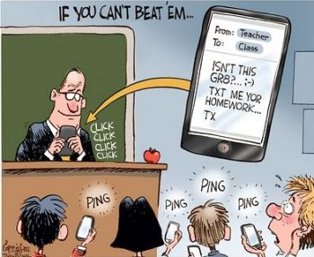
Engage All Your Kids.
Regardless of the tech-expertise and availability represented in your room, there’s one common denominator to keep in mind: All kids want and need to be engaged.
Notes:
Engage All Your Kids
Regardless of the tech-expertise and availability represented in your room, there’s one common denominator to keep in mind: All kids want and need to be engaged.

Slide 31
Hook Them!
Kids’ brains are hungry for active engagement-that’s how they learn best.
Go all out to hook kids and keep them on the line–in your curriculum choices, teaching style, experiences, and mission.
Notes:
Hook Them!
Kids’ brains are hungry for active engagement-that’s how they learn best.
Go all out to hook kids and keep them on the line–in your curriculum choices, teaching style, experiences, and mission.

Slide 32
There’s No Doubt
Kids today are mastering technology at the speed of innovation. They’re poised to learn a layer of programming literacy that was unimaginable a few decades ago.
Notes:
There’s No Doubt
Kids today are mastering technology at the speed of innovation. They’re poised to learn a layer of programming literacy that was unimaginable a few decades ago.

Slide 33
As their leader, their teacher, go with them–fearlessly venture into this wondrous, rapidly expanding landscape with your kids.
Notes:
As their leader, their teacher, go with them–fearlessly venture into this wondrous, rapidly expanding landscape with your kids.

Slide 34
Don’t be afraid to let them lead the way— celebrate when they “power up” as they walk in your door.
Notes:
Don’t be afraid to let them lead the way— celebrate when they “power up” as they walk in your door.

Slide 35
How To Reach Digital Natives With The Gospel
By
Jennifer Hooks
June 3, 2016
Children’s Ministry Magazine

