Slide 1
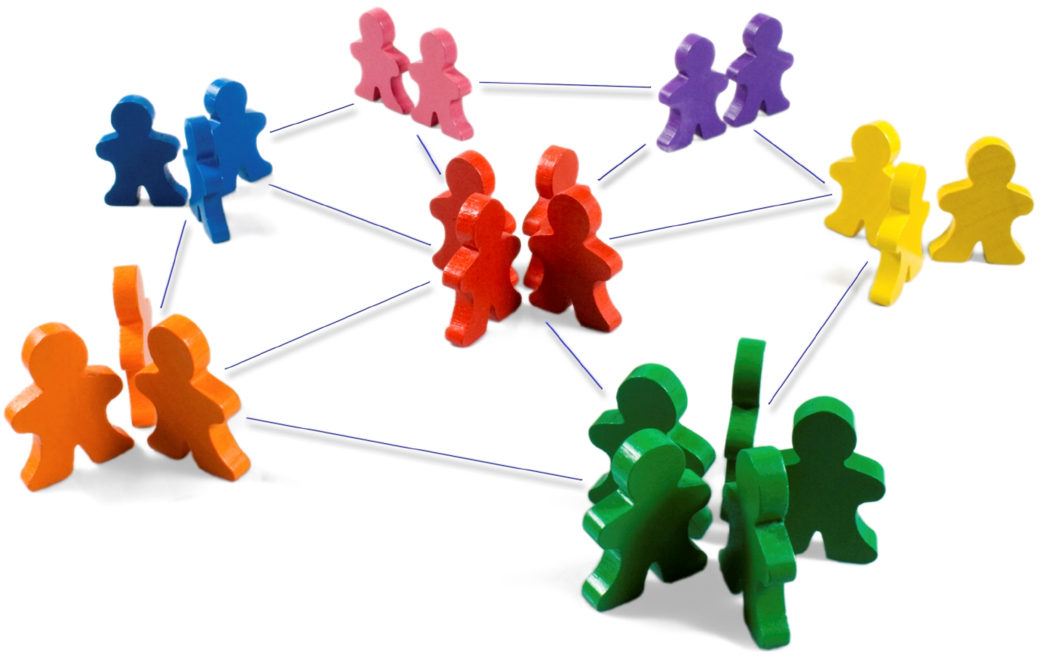
WIRED FOR CONNECTEDNESS
Linda Mei Lin Koh
GC Children’s Ministries
Notes:
WIRED FOR CONNECTEDNESS
Human beings are created for relationships. All of us need other people in order to be well and thrive. The song, “No man is an island, no man stands alone!” is so apropos in illustrating this. Moreover, to be effective in our ministry, we need to develop connectedness with the children, parents, church leaders, and other children’s leaders.

Slide 2
What is a Connection?
A connection is a point of contact. It can be:
Your voice in my ear
A simple pat on the back from a loved one just when you need it the most.
Compelling speeches, amusing emails, and irritating phone calls are all forms of connection.
Contact between you and someone who has–or wants to have–a relationship with you.
Notes:
What is a Connection?
A connection, or point of contact, in a relation-ship can take many forms:
Your voice in my ear
A simple pat on the back from a loved one just when you need it the most.
Compelling speeches, amusing emails, and irritating phone calls are all forms of connection.
Contact between you and someone who has–or wants to have–a relationship with you.

Slide 3
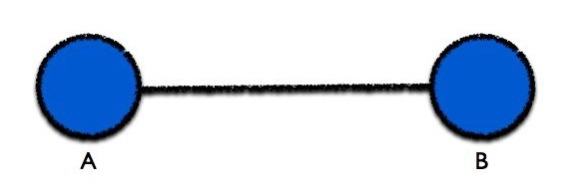
Traditional View of Relationship
The lines represent the relationships between the dots. Here you’ll see a line connecting person “A” and person “B.” That line is their relationship.
Notes:
Traditional View of Relationship
The lines represent the relationships between the dots. Here you’ll see a line connecting person “A” and person “B.” That line is their relationship.

Slide 4
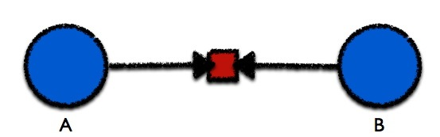
Relationship with a Connection
That red square in the middle is the point of contact, the connection between person “A” and person “B.”
Connections are actions that put people in contact with each other.
Your boss texting you to come in on the weekend; talking with your son about his class before bedtime.
Notes:
Relationship with a Connection
That red square in the middle is the point of contact, the connection between person “A” and person “B.”
Connections are actions – action that puts people in contact with each other.
Your boss texting you to come in on the weekend; talking with your son about his class before bedtime.

Slide 5
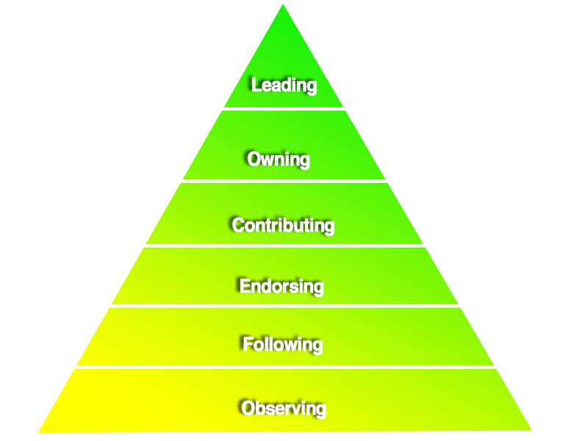
The Engagement Pyramid
Notes:
The Engagement Pyramid
Observing
Following
Endorsing
Contributing
Owning
Leading

Slide 6
Level 6: Leading
Communication initiated by the person who leads
Level 4: Contributing
Committed to discuss and contribute through phone calls, emails, face-to-face meeting
Level 1: Observing sporadic, occasional
Level 2: Following
regular, sharing information
Level 5: Owning
Regular, direct 2-way communication
Level 3: Endorsing
trust enough to seek approval
Notes:
The Engagement Pyramid
Level 1: Observing – sporadic, occasional conversation
Level 2: Following – regular, sharing information
Level 3: Endorsing – trust enough to seek approval
Level 4: Contributing – committed to discuss and contribute through phone calls, emails, face-to-face meeting
Level 5: Owning – regular, direct 2-way communication
Level 6: Leading – communication initiated by the person who leads

Slide 7

Benefits of Connectedness
Notes:
Benefits of Connectedness

Slide 8

Gives a sense of identity.
Increases ability to love and be loved.
Gives a high level of happiness.
Provides a validation of self-worth.
Provides a source of help in times of trouble.
Enriches a diversity of ideas and influences to help us grow and learn.
Notes:
Benefits of Connectedness
Gives a sense of identity.
Increases ability to love and be loved.
Gives a high level of happiness.
Provides validation of self-worth.
Provides a source of help in times of trouble.
Enriches a diversity of ideas and influences to help us grow and learn.

Slide 9
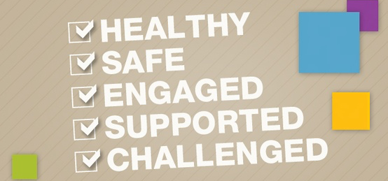

Research Findings of Connected People
Notes:
Research Findings of Connected People
HEALTHY
SAFE
ENGAGED
SUPPORTED
CHALLENGED

Slide 10

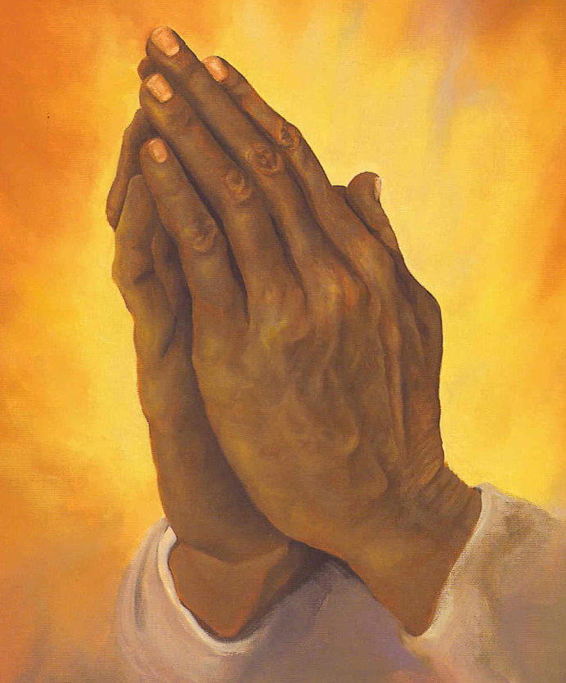
I. Connecting with God
Notes:
Connecting with God.
Connecting with God is all about a relationship -- walking and talking with the God who created you!

Slide 11
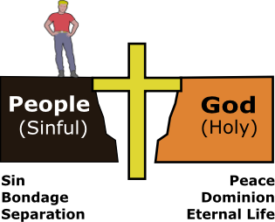
How to Stay Connected with God
Reading and studying the bible daily.
Praying daily and listening for His answers.
Be involved in church.
Notes:
How to Stay Connected with God
Reading & studying the bible daily.
Praying daily and listening for His answers.
Be involved in church.

Slide 12

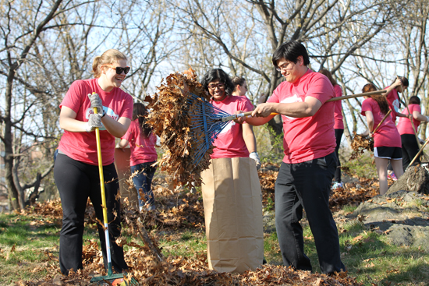
Spend time with other Christians who love Jesus.
Serve people in the church and in the community.
Notes:
Spend time with other Christians who love Jesus.
Serve people in the church and in the community.

Slide 13

Notes:
So in Christ we who are many form one body and each member belongs to all the others. Romans 12:5

Slide 14

II. Connecting with Your Children & Teens
Notes:
II. Connecting with Your Teens
Even though our teens have a strong need for independence, that doesn’t mean they can’t stay connected to us.

Slide 15
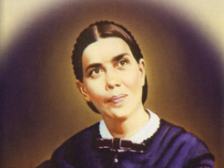
Ellen White, Adventist Home, p. 193
“Let parents become acquainted with their children seeking to understand their tastes and dispositions, entering into their feelings, and drawing out what is in their hearts.”
Notes:
Ellen White, Adventist Home, p. 193
“Let parents become acquainted with their children seeking to understand their tastes and dispositions, entering into their feelings, and drawing out what is in their hearts.”

Slide 16
Adventist Home, p. 17
“Let parents and children bear this in mind every day, relating themselves to one another as members of the family of God. .”
Notes:
Adventist Home, p. 17
“Let parents and children bear this in mind every day, relating themselves to one another as members of the family of God. .”

Slide 17
Research on Connectedness and Suicide Prevention in Adolescents
Suicide and Life-Threatening Behavior Journal, 2014
The subjective experience of belonging and feeling useful and valued in at least one proximal context will enhance positive emotions and cognitions pertaining to self and other interrelatedness and will result in fewer or less severe suicide risk behaviors.
Notes:
Research on Connectedness and Suicide Prevention in Adolescents
Suicide and Life-Threatening Behavior Journal, 2014
* The subjective experience of belonging and feeling useful and valued in at least one proximal context will enhance positive emotions and cognitions pertaining to self and other interrelatedness and will result in fewer or less severe suicide risk behaviors.

Slide 18
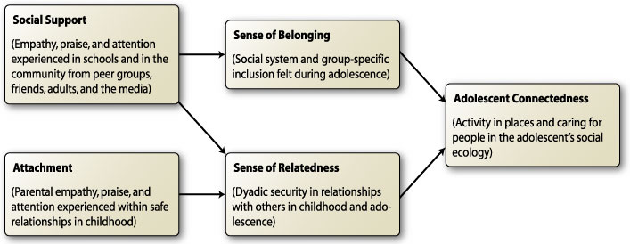
Karcher’s Research on Adolescent Connectedness
Notes:
Karcher’s Research on Adolescent Connectedness
Michael J. Karcher hypothesized connectedness to reflect an ecologically specific form of engagement with others and the environment. Exploratory and confirmatory factor analyses were conducted to develop a measure of adolescent connectedness.
Results suggest that connection to family, school, and friends make unique contributions in explaining adolescent behavior and should be examined separately in future research on connectedness. Adolescents’ level of “connectedness” to family, school, friends, and self has been found to contribute to academic performance but also predict violence and substance use.

Slide 19
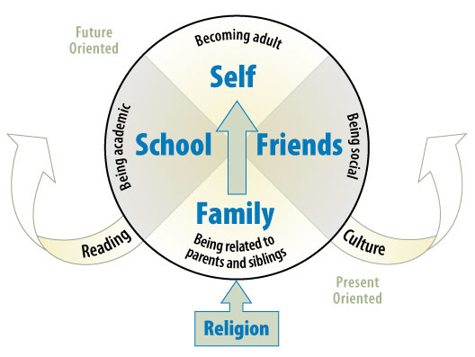
Hemingway’s Measure of Adolescent Connectedness
Notes:
Hemingway’s Measure of Adolescent Connectedness
Connectedness to Family – need to relate to parents and siblings. Home is where they learn values, religion, and how to relate to each other and with others.
Connectedness to Friends – being social; teens crave for closeness and acceptance by friends and peers. They have a strong need to feel belonged. They learn social and culture behaviors, etiquette, etc.
Connectedness to Schools – being academic – need to succeed and achieve and to plan for their future. Connect with teachers, reading.
Connectedness to Self – becoming an adult.

Slide 20
Benefits of Strong Parent-Child Connectedness
2010 Minnesota Student Survey Trends Report
Protects teens against unintended pregnancy; HIV and other sexually transmitted infections (STIs); violence; depression; eating disorders; alcohol, tobacco and drug use; and poor academic achievement.
Notes:
Benefits of Strong Parent-Child Connectedness – 2010 Minnesota Student Survey Trends Report
Protects teens against unintended pregnancy; HIV and other sexually transmitted infections (STIs); violence; depression; eating disorders; alcohol, tobacco and drug use; and poor academic achievement.

Slide 21
Centers for Disease Control and Prevention, School Connectedness, 2009
Research shows a strong relationship between school connectedness and educational outcomes, such as school attendance, staying in school longer, and higher grades and classroom scores.
Notes:
Centers for Disease Control and Prevention, School Connectedness, 2009
* Research shows a strong relationship between school connectedness and educational outcomes, such as school attendance, staying in school longer, and higher grades and classroom scores.

Slide 22
Factors That Can Increase School Connectedness
Adult Support: School staff dedicate their time, interest, attention and emotional support to students.
Belonging to a Positive Peer Group: A stable network of peers can improve student perceptions of school.
Notes:
Factors That Can Increase School Connectedness
Adult Support: School staff dedicate their time, interest, attention and emotional support to students.
Belonging to a Positive Peer Group: A stable network of peers can improve student perceptions of school.

Slide 23
Commitment to Education: Believing that school is important to their future, and perceiving that the adults in school are invested in their education, can get students engage in their own learning and involved in school activities.
Social Environment: The physical environment and psychosocial climate cam set the stage for positive student perceptions of school—safe and clean.
Notes:
Commitment to Education: Believing that school is important to their future, and perceiving that the adults in school are invested in their education, can get students engage in their own learning and involved in school activities.
Social Environment: The physical environment and psychosocial climate cam set the stage for positive student perceptions of school—safe and clean.

Slide 24
How to Stay Connected with Teens
Be supportive of what they do.
Listen, empathize. Keep advice to a minimum.
Be available when your teen wants to talk.
Welcome your teen’s friends.
Notes:
How to Stay Connected with Teens
Be supportive of what they do
Listen, empathize. Keep advice to a minimum.
Be available when your teen wants to talk.
Welcome your teen’s friends.

Slide 25

More Tips for Connecting with Teens
Fill your relationship with good interactions.
Spend some time together every single day—fun and play.
Acknowledge separations and reunions—goodbyes, hugs, welcome them home.
Notes:
More Tips for Connecting with Teens
Fill your relationship with good interactions
Spend some time together every single day—fun and play.
Acknowledge separations and reunions—goodbyes, hugs, welcome them home.

Slide 26

Know Your Teens and Social Connections
Notes:
Know Your Teens and Social Connections

Slide 27
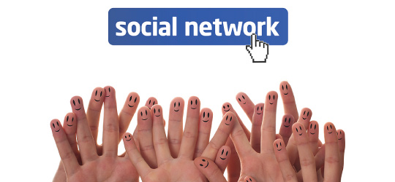
Learn your teen’s social network.
Learn their language & interests.
Establish and maintain structure.
Discuss rules and responsibility.
Notes:
Social Network
Learn your teen’s social network.
Learn their language and interests.
Establish and maintain structure.
Discuss rules and responsibility.

Slide 28
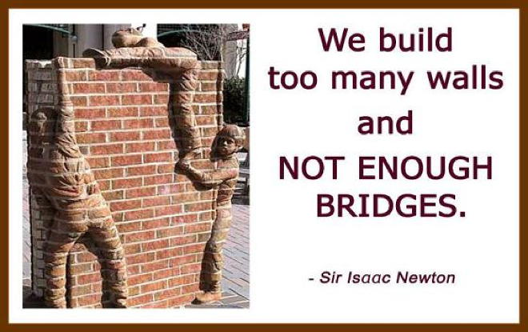
Build Bridges With Teens
Notes:
Build Bridges with Teens
“We build too many walls and NOT ENOUGH BRIDGES.” -- Sir Isaac Newton

Slide 29

III. Connecting With Others
Notes:
III. Connecting with Others

Slide 30
Seligman’s Research
"As a professor, I don't like this, but the cerebral virtues—curiosity, love of learning—are less strongly tied to happiness than to interpersonal virtues like kindness, gratitude, and capacity for love.”
– Martin Seligman
Notes:
Seligman’s Research
"As a professor, I don't like this, but the cerebral virtues—curiosity, love of learning—are less strongly tied to happiness than interpersonal virtues like kindness, gratitude, and capacity for love.” – Martin Seligman.

Slide 31

Connect with Other Leaders
Network with other experienced leaders.
Learn and share new ideas together.
Give support and encouragement to the younger and less experienced leaders.
Mentor younger leaders.
Notes:
Connect with Other Leaders
Network with other experienced leaders.
Learn and share new ideas together.
Give support and encouragement to the younger and less experienced leaders.
Mentor younger leaders.

Slide 32

Connect with church leadership
Know your board members in the church.
Share your ministry vision with the pastor and with the key people in the church.
Get them involved with your programs.
Notes:
Connect with church leadership
Know your board members in the church.
Share your ministry vision with them.
Get them involved with your programs

Slide 33

Organize community programs to invite community families to attend, eg. Messy Church.
Introduce the kids and parents to Bible class and small groups.
Notes:
Connecting Others to Jesus
Organize community programs to invite community families to attend, eg. Messy Church.
Introduce the kids and parents to Bible class and small groups
Introduce them to Jesus.

Slide 34

Connect with Parents
Get to know the parents and develop good collaborative relationships.
Involve them in your programs—transportation.
Utilize their gifts and talents to strengthen your programs—building a boat, telling story, leading a craft.
Notes:
Connect with Parents
Get to know the parents and develop good collaborative relationships.
Involve them in your programs—transportation.
Utilize their gifts and talents to strengthen your programs—building a boat, tell story, lead in a craft.

Slide 35
REFERENCES
1. Michael J. Karcher, The Hemingway: Measure of Adolescent Connectedness—Validation Studies at files.eric.ed.gov
2. Wired for Connectedness by Gideon Rosenblatt.
Notes:
References
1. Michael J. Karcher, The Hemingway: Measure of Adolescent Connectedness—Validation Studies at files.eric.ed.gov
2. Wired for Connectedness by Gideon Rosenblatt.

Slide 36
3. Albert, B. (2010). With One Voice 2010: America’s Adults and Teens Sound Off About Teen Pregnancy. Washington, DC: The National Campaign to Prevent Teen and Unplanned Pregnancy, p. 8. www.thenationalcampaign.org/national-data/2010-polling-data.aspx
4. Minnesota Student Survey Interagency Team: Minnesota Departments of Education, Health, Human Services, and Public Safety. (2010). Minnesota Student Survey. education.state.mn.us/mde/Learning_Support/Safe_and_Healthy_Learners/
Notes:
3. Albert, B. (2010). With One Voice 2010: America’s Adults and Teens Sound Off About Teen Pregnancy. Washington, DC: The National Campaign to Prevent Teen and Unplanned Pregnancy, p. 8. www.thenationalcampaign.org/national-data/2010-polling-data.aspx
4. Minnesota Student Survey Interagency Team: Minnesota Departments of Education, Health, Human Services, and Public Safety. (2010). Minnesota Student Survey. education.state.mn.us/mde/Learning_Support/Safe_and_Healthy_Learners

Slide 37
5. Janis Whitlock et.al., “Connectedness and Suicide Prevention in Adolescents: Pathways & Implications,” Suicide & Life-Threatening Behavior, June2014, vol. 44, Issue 3, pp. 233-351. Online version: 20 JAN 2014.
DO: 10.1111/sltb.12071
6.. Centers for Disease Control and Prevention. School Connectedness: Strategies for Increasing Protective Factors Among Youth. Atlanta, GC: U.S. Department of Health and Human Services, 2009.
Notes:
5. Janis Whitlock et.al., “Connectedness and Suicide Prevention in Adolescents: Pathways & Implications,” Suicide & Life-Threatening Behavior, June2014, vol. 44, Issue 3, pp. 233-351. Online version: 20 JAN 2014.
DO: 10.1111/sltb.12071
6.. Centers for Disease Control and Prevention. School Connectedness: Strategies for Increasing Protective Factors Among Youth. Atlanta, GC: U.S. Department of Health and Human Services, 2009.

