Slide 1
Children’s Mental Health
Linda Mei Lin Koh
GC Children’s inistries
Notes:
Children’s Mental Health

Slide 2
What is Children’sMental Health?
NOTE:
To change images on this slide, select a picture and delete it. Then click the Insert Picture icon
in the placeholder to insert your own image.
An essential part of children's overall health relationship with their physical health and their ability to succeed in school & life
Notes:
What is Children’s Mental Health?
An essential part of children's overall health relationship with their physical health and their ability to succeed in school, life
Mental health — an essential part of children's overall health — has a complex interactive relationship with their physical health and their ability to succeed in school, at work and in society. Both physical and mental health affect how we think, feel and act on the inside and outside.
For instance, an overweight young boy who is teased about his weight may withdraw socially and become depressed and may be reluctant to play with others or exercise, which further contributes to his poorer physical health and a a result poorer mental health.
These issues have long-term implications on the ability of children and youth to fulfill their potential as well as consequences for the health, education, labor and criminal justice systems of our society.
For instance, a boy named Bobby is being physically abused by his father and often acts out aggressively at school. His behavior is a natural reaction to the abuse, but his behavior may also mark the beginning of undiagnosed conduct disorder. His teachers simply see him as a troublemaker and continually punish his behavior. Later, Bobby drops out of school as a teenager because he finds it a harsh and unwelcoming environment and is anxious to leave his abusive home and fend for himself. However, holding down a job is difficult because Bobby often clashes with his coworkers and supervisors due to his aggression. Bobby has also begun to self-medicate by abusing alcohol and has been arrested a number of times for drunken disorderliness. By the time Bobby finally receives a proper diagnosis of his conduct disorder and substance abuse, he is in his thirties and his mental health problems have become deeply entrenched. They will require extensive therapy, which Bobby probably cannot afford without a job that provides adequate health insurance. Things could have been very different if Bobby was referred to a psychologist in his childhood who could have diagnosed him, offered effective treatment, and alerted the authorities about the abuse.

Slide 3

Promoting Children’s Mental Health
A safe and secure home.
Warmth, love and respect.
Caring and trusting relationships with family, friends, and community.
Notes:
Promoting Children’s Mental Health
All children and youth have the right to happy and healthy lives and deserve access to effective care to prevent or treat any mental health problems that they may develop. However, there is a tremendous amount of unmet need, and health disparities are particularly pronounced for children and youth living in low-income communities, ethnic minority youth or those with special needs.
How do we promote healthy children’s mental health?
A safe and secure home.
Warmth, love and respect.
Caring and trusting relationships with family, friends, and community.

Slide 4
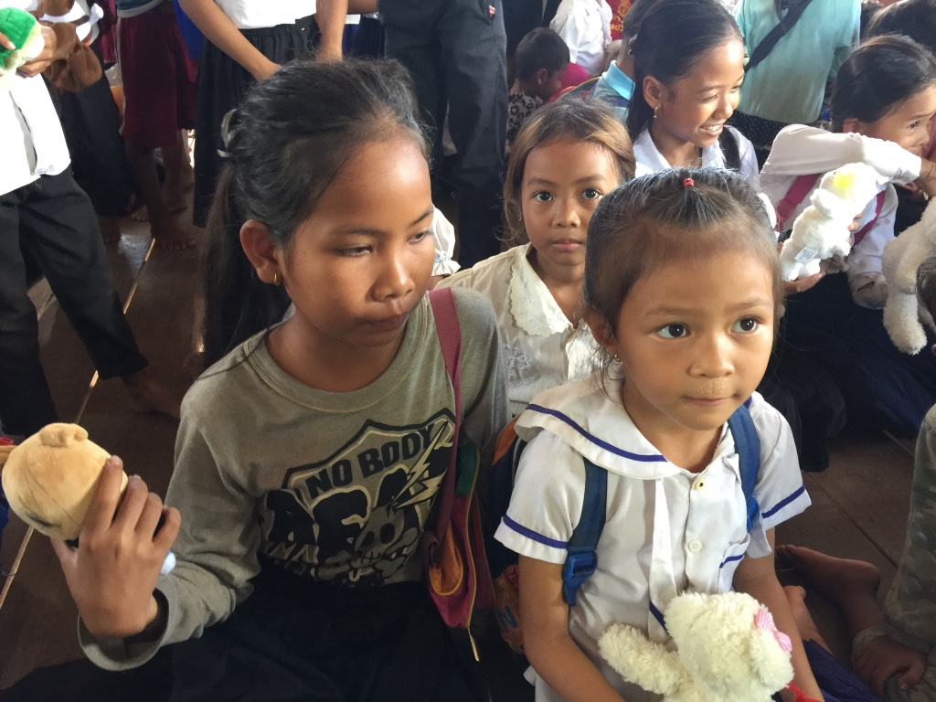
Promoting Children’s Mental Health
Opportunities to talk about experiences and feelings.
Time to play, learn, and succeed.
Encouragement and praise.
Consistent and fair expectations with clear consequences for misbehavior.
Notes:
Promoting Children’s Mental Health
Opportunities to talk about experiences and feelings.
Time to play, learn, and succeed.
Encouragement and praise.
Consistent and fair expectations with clear consequences for misbehavior.

Slide 5
What Are Childhood Mental Disorders?
NOTE:
To change images on this slide, select a picture and delete it. Then click the Insert Picture icon
in the placeholder to insert your own image.
Serious changes in the way children typically learn, behave, or handle their emotions, which may cause distress and problems getting through the day.
Notes:
What Are Childhood Mental Disorders?
Serious changes in the way children typically learn, behave, or handle their emotions, which may cause distress and problems getting through the day.

Slide 6
Types of Mental Disorders Affecting Children
Depression
Attention-deficit/hyperactivity disorder (ADHD)
Anxiety
Oppositional Defiant Disorder (ODD)
Conduct Disorder
Notes:
Types of Mental Disorders
Depression
Attention-deficit/hyperactivity disorder (ADHD)
Anxiety
Oppositional Defiant Disorder (ODD)
Conduct Disorder

Slide 7
Types of Mental Disorders Affecting Children
Obsessive-Compulsive Disorder (OCD)
Post traumatic Stress Disorder (PTSD)
Bipolar disorder
Eating disorders
Autism spectrum disorders
Tourette syndrome
Notes:
Types of Mental Disorders Affecting Children
Obsessive-Compulsive Disorder (OCD)
Post traumatic Stress Disorder (PTSD)
Bipolar disorder
Eating disorders
Autism spectrum disorders
Tourette syndrome

Slide 8
Signs of Mental Health Problems
Decline in school performance
Poor grades despite strong efforts
Constant worry or anxiety
Repeated refusal to go to school or to take part in normal activities
Hyperactivity or fidgeting
Persistent nightmares
Notes:
Signs of Mental Health Problems
Decline in school performance
Poor grades despite strong efforts
Constant worry or anxiety
Repeated refusal to go to school or to take part in normal activities
Hyperactivity or fidgeting
Persistent nightmares

Slide 9
More Signs . . .
Frequent temper tantrums
Depression, sadness or irritability
Talks about suicide or death
Persistent disobedience or aggression
Hurts other people or animals; or damages property
Has major changes in eating/sleeping habits
Substance use – drinking and using drugs.
Notes:
More Signs . . .
Frequent temper tantrums
Depression, sadness or irritability
Talks about suicide or death
Persistent disobedience or aggression
Hurts other people or animals; or damages property
Has major changes in eating or sleeping habits
Substance use – drinking and using drugs.

Slide 10
2011-2012 National Survey of Children’s Health (Parent Interviews)
Notes:
2011-2012 National Survey of Children’s Health
1 out of 7 U.S. children aged 2 to 8 years had a diagnosed mental, behavioral, or developmental disorder (MBDD)
Boys age 6-8 years, and non-Hispanic white children were more likely to have MBDD.

Slide 11
2011-2012 National Survey of Children’s Health
1 out of 7 U.S. children aged 2 to 8 years had a diagnosed mental, behavioral, or developmental disorder (MBDD)
Boys age 6-8 years, and non-Hispanic white children were more likely to have MBDD.
Children from poor families and families that spoke English in the home were more likely to have a MBDD.
Notes:
2011-2012 National Survey of Children’s Health
1 out of 7 U.S. children aged 2 to 8 years had a diagnosed mental, behavioral, or developmental disorder (MBDD)
Boys age 6-8 years, and non-Hispanic white children were more likely to have MBDD.

Slide 12
2011-2012 National Survey of Children’s Health
Notes:
2011-2012 National Survey of Children’s Health
1 out of 7 U.S. children aged 2 to 8 years had a diagnosed mental, behavioral, or developmental disorder (MBDD)
Boys age 6-8 years, and non-Hispanic white children were more likely to have MBDD.

Slide 13
2011-2012 National Survey of Children’s Health
Children with MBDDs more likely to have a parent with fair or poor mental health, trouble with keeping jobs and getting by with the family’s income.
Lives in a neighborhood that lacked support and in poor condition.
Have poor health insurance.
Notes:
2011-2012 National Survey of Children’s Health
Children with MBDDs more likely to have a parent with fair or poor mental health, trouble with keeping jobs and getting by with the family’s income.
Lives in a neighborhood that lacked support and in poor condition.
Have poor health insurance.

Slide 14

Centers for Disease Control and Prevention Children’s Mental Health Report. May 16, 2013
Children aged 3-17 years
in U.S.
ADHD (6.8%)
Behavioral or conduct problems (3.5%)
Anxiety (3.0%)
Depression (2.1%)
Autism spectrum disorders (1.1%)
Tourette syndrome (0.2%)
Notes:
Centers for Disease Control and Prevention Children’s Mental Health Report. May 16, 2013
Children aged 3-17 years in U.S.
ADHD (6.8%)
Behavioral or conduct problems (3.5%)
Anxiety (3.0%)
Depression (2.1%)
Autism spectrum disorders (1.1%)
Tourette syndrome (0.2%)

Slide 15
Centers for Disease Control and Prevention Children’s Mental Health Report. May 16, 2013
Adolescents 12-17 years in the U.S.
Illicit drug use disorder in the past year (4.7%)
Alcohol use disorder in the past year (4.2%)
Cigarette dependence in the past month (2.8%)
Notes:
Centers for Disease Control and Prevention Children’s Mental Health Report. May 16, 2013
Adolescents 12-17 years in the U.S.
Illicit drug use disorder in the past year (4.7%)
Alcohol use disorder in the past year (4.2%)
Cigarette dependence in the past month (2.8%)

Slide 16
Key Findings: Treament of Disruptive
Behavior Problems—What Works?
NOTE:
To change images on this slide, select a picture and delete it. Then click the Insert Picture icon
in the placeholder to insert your own image.
Group parent behavior therapy
Individual parent behavior therapy with child participation.
Notes:
Key Findings: Treatment of Disruptive Behavior Problems—What Works?
Researchers found that the most effective treatment for disruptive behavior problems in children aged 12 years and under are:
Group parent behavior therapy --the research studies used approaches that involved therapists who were trained in specific behavior therapy programs, and that used a training manual and specific steps to work with a group of parents on skills to help them to be more effective behavioral reinforcers in managing their child’s behavior. During this type of parent training in behavior therapy, parents work with a therapist to learn strategies to create structure, reinforce good behavior, provide consistent discipline, and strengthen the relationship with their child through positive communication.
Individual parent behavior therapy with child participation – similar to the group parent bahavior therapy procedure, except it is on a one-one basis with the child participating with the parent. This type of therapy typically has a dual focus on (a) strengthening the parent-child relationship so that the child is more motivated to behave in the way that the parent wants, and (b) providing the parents with more effective child behavior management strategies. They generally use the positive reinforcement and withholding positive reinforcement.
Key Findings: Treatment of Disruptive Behavior Problems – What Works?
Learn about current evidence on the most effective treatments for behavior problems in children
(Published: May 1, 2017)

Slide 17
What Can Parents Do?
NOTE:
To change images on this slide, select a picture and delete it. Then click the Insert Picture icon
in the placeholder to insert your own image.
Understand the treatment options available.
Talk to your child’s doctor
Talk to your child’s teacher or school counselor
Notes:
What Can Parents Do?
Talk to your child’s doctor or health care provider – Ask questions and learn everything you can about the behavior or symptoms. Share this with your child's doctor or health care provider. Keep in mind that every child is different. Ask if your child needs further evaluation by a specialist with experience in child behavioral problems. If you take your child to a specialist, ask, "Do you have experience treating the problems I see in my child?" Don't be afraid to interview more than one specialist to find the right fit. Continue to learn everything you can about the problem or diagnosis. The more you learn, the better you can work with your child's doctor and make decisions that feel right for you, your child, and your family.
Talk to your child’s teacher -- Start by speaking with your child's teacher, school counselor, school nurse, or the school's parent organization. These professionals can help you get an evaluation started. Also, each state has a Parent Training and Information Center and a Protection and Advocacy Agency that can help you request the evaluation. The evaluation must be conducted by a team of professionals who assess all areas related to the suspected disability using a variety of tools and measures.
Understand the treatment options available -- Once a diagnosis is made, your child's specialist will recommend a specific treatment. It is important to understand the various treatment choices, which often include psychotherapy or medication. Talk about the options with a health care professional who has experience treating the illness observed in your child. Some treatment choices have been studied experimentally, and other treatments are a part of health care practice. In addition, not every community has every type of service or program.

Slide 18
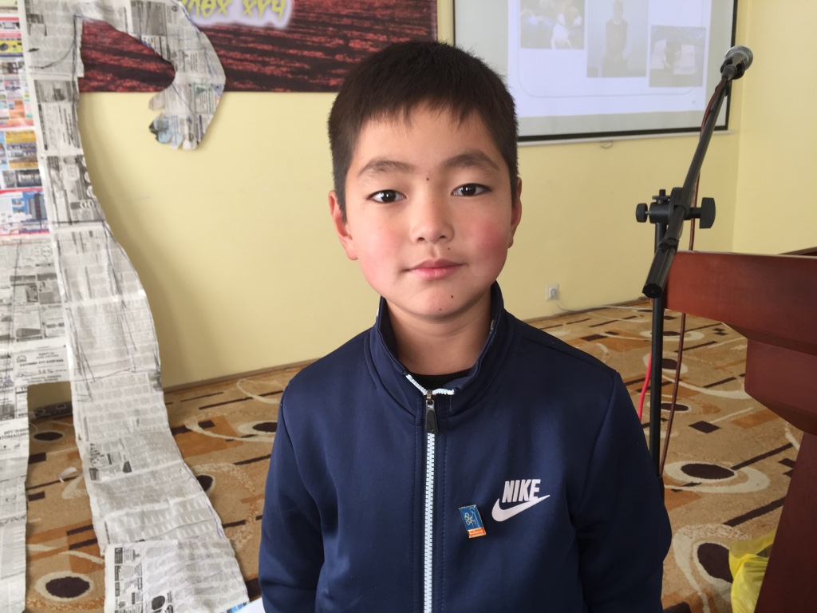

REMEMBER . . .
Early Diagnosis is the Key to Treating Children's Mental Health
Children's Mental Health can be treated if we recognize the symptoms
children
Read up all you can about treatment options
Notes:
REMEMBER
* Early Diagnosis is the Key to Treating Children's Mental Health
* Children's Mental Health can be treated if we recognize the symptoms
* Read up all you can about treatment options

Slide 19
References
Recognizing Mental Health Problems in Children. www.mentalhealthamerica.net/conditions/childrens-mental-health
Children Mental Health. www.kidsmentalhealth.org/
Children’s Mental Health. https://www.cdc.gov/childrensmentalhealth/index.html
Key Findings: Treatment of Disruptive Behavior Problems – What Works?
Learn about current evidence on the most effective treatments for behavior problems in children
(Published: May 1, 2017)
Notes:
References
Recognizing Mental Health Problems in Children. www.mentalhealthamerica.net/conditions/childrens-mental-health
Children Mental Health. www.kidsmentalhealth.org/
Children’s Mental Health. https://www.cdc.gov/childrensmentalhealth/index.html
Key Findings: Treatment of Disruptive Behavior Problems – What Works?
Learn about current evidence on the most effective treatments for behavior problems in children
(Published: May 1, 2017)

