Slide 1
10 Tips for working with Special-needs teenagers
Linda Mei Lin Koh
GC Children’s Ministries
Notes:
Nine years ago, John Pape, the author received some crushing news. His son Drew, who was almost 2, had a little-known genetic syndrome called 22q. It’s a micro-deletion of the 22nd chromosome (we don’t understand it, either). On the one hand, they were relieved to finally have a diagnosis that explained his missed developmental milestones. He has asked God many times to heal his son. He prayed and wrestled with this a lot. However, today he’s blessed and even thankful for the lessons he has learned learned on this journey. They’ve helped him become a better parent and youth worker.
As the population of children with special needs continues to grow, more and more scout leaders, soccer coaches, religious education instructors, librarians, music teachers and other adults are finding themselves working with these children for the first time. Many of these adults are volunteers who generously give their time and expertise; others are highly trained in their field, but have little or no knowledge of disabilities.
Here are some important tips you should pass on to people who will be working with your special child.

Slide 2
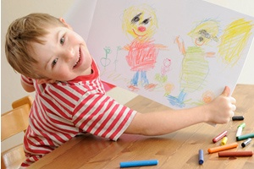
1. Treat kids with special needs as normal whenever you can
Like most boys, Drew loves monster trucks and hates school. He isn’t the same as other kids, but who is?
He can’t do everything, but he can do most things.
Encourage special-needs kids to participate whenever possible.
Notes:
Treat Kids With Special Needs As Normal Whenever You Can.
Like most boys, Drew loves monster trucks and hates school. He isn’t the same as other kids, but who is? He can’t do everything, but he can do most things. Encourage special-needs kids to participate whenever possible.

Slide 3
2. Be honest when the fit isn’t good
Games such as dodgeball are potentially dangerous when kids can’t protect themselves.
Either have an adult sit and watch the game with a student or choose another game.
For the most part, parents prefer honesty about any risks that might be involved.
Notes:
2. Be honest when the fit isn’t good
Like most youth groups, ours can get a bit crazy. Games such as dodgeball are potentially dangerous when kids can’t protect themselves. Either have an adult sit and watch the game with a student or choose another game. For the most part, parents prefer honesty about any risks that might be involved.

Slide 4
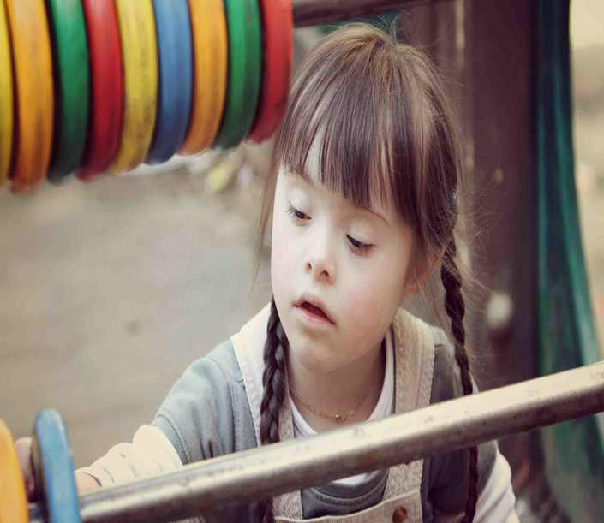
3. Focus on teenagers’ strengths, not their limits
Every kid knows a lot about something.
Find each young person’s specialty and let them use that knowledge and skill.
Notes:
3. Focus on teenagers’ strengths, not their limits.
Every kid knows a lot about something. Find each young person’s specialty and let them use that knowledge and skill.
For example, my son isn’t afraid to read out loud, so I call on him to read when I can.

Slide 5
4. View all aspects of youth group from the perspective of special-needs kids.
They already feel like an in-convenience, so don’t make matters worse.
Notes:
4. View all aspects of youth group from the perspective of special-needs kids.
They already feel like an inconvenience, so don’t make matters worse.
For example, Tina,* a high schooler who’s in a wheelchair, couldn’t reach the snack counter in our youth room, so we made some adjustments.

Slide 6
5. Encourage friendship—and be a friend
Every kid needs friends. For special-needs kids, friends are tough to find.
Leaders need to get to know the young person, too.
Work to find something you both enjoy.
Notes:
5. Encourage Friendship—and Be A Friend.
Every kid needs friends. For special-needs kids, friends are tough to find.
Leaders need to get to know the young person, too.
Work to find something you both enjoy.
One of the coolest things I’ve seen at church was when a kid took Sam*, an autistic boy, under his wing and led him to a small group. Later I pulled that kid aside and thanked him for being a friend to Sam. I struggled to befriend Sam until I found common ground with him (Pokémon Go—don’t judge!).

Slide 7
6. Enjoy the journey.
Notes:
6. Enjoy The Journey.
Sam now loves coming to youth group, which is a first for him. Another first: In a reindeer race, he was pulled around the gym on a bed sheet. His team won and had a blast. Sam came to a lock-in, spending his first night away from home. He raked leaves for his first service project. That’s a lot of firsts we’ve experienced together, and we’ve enjoyed every one.

Slide 8
7. Realize that caring for one person communicates care to everyone
When you show students that special-needs kids are welcome and valued, you let everyone know they’re welcome and valued.
Kids without special needs will realize they’ll always be accepted, no matter what they’ve done.
Notes:
7. Realize That Caring For One Person Communicates Care To Everyone.
When you show students that special-needs kids are welcome and valued, you let everyone know they’re welcome and valued.
Kids without special needs will realize they’ll always be accepted, no matter what they’ve done.

Slide 9
8. Remember that special needs mean special abilities
Recently in Sunday school, kids were asked to name a compassionate person they knew. They named, “Drew Pape.” Because Drew has been through a lot, he’s very kind and soft-hearted. He has a heart of gold.
His father probably couldn’t raise such a compassionate kid without this syndrome. He might have cared too much about his athletic abilities or academic performance.
Notes:
8. Remember That Special Needs Mean Special Abilities.
Recently in Sunday school, kids were asked to name a compassionate person they knew. They named, “Drew Pape.” Because Drew has been through a lot, he’s very kind and soft-hearted. He has a heart of gold.
His father probably couldn’t raise such a compassionate kid without this syndrome. He might have cared too much about his athletic abilities or academic performance.

Slide 10
9. Please ask
If you don’t understand a behavior or notice physical or social differences, talk to a parent.
Heartfelt inquiries let people know you care. It’s better to have an awkward conversation than for a young person to be ignored or stared at.
Don’t treat special-needs kids and families like the plague. Your kid won’t lose any chromosomes hanging out with my kid.
Notes:
9. Please Ask.
If you don’t understand a behavior or notice physical or social differences, talk to a parent. Heartfelt inquiries let people know you care. It’s better to have an awkward conversation than for a young person to be ignored or stared at. Don’t treat special-needs kids and families like the plague. Your kid won’t lose any chromosomes hanging out with my kid.

Slide 11
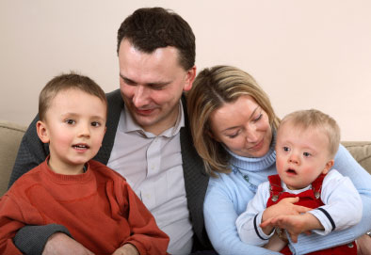
10. As a church, embrace special-needs families
Educate yourself about the condition. Search online or ask for information. Pray (for the young person, the family, schoolwork, doctor visits, and their future). Be there when you can; send a card when you can’t. If an event is being held for the condition, support or attend it.
Kids who are different shouldn’t feel unwelcome. That’s unacceptable (see Luke 14:12-14). As the body of Christ, we can do better.
Notes:
10. As A Church, Embrace Special-needs Families
Educate yourself about the condition. Search online or ask for information. Pray (for the young person, the family, schoolwork, doctor visits, and their future). Be there when you can; send a card when you can’t. If an event is being held for the condition, support or attend it.
Kids who are different shouldn’t feel unwelcome. That’s unacceptable (see Luke 14:12-14). As the body of Christ, we can do better.

Slide 12
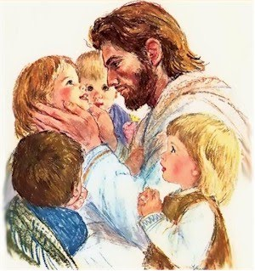
Jesus specialized in special-needs ministry; let’s follow his example
Notes:
Jesus specialized in special-needs ministry; let’s follow his example

Slide 13
10 Tips for Working With Special-Needs Teenagers
Written by John Pape
January 8, 2017

