Slide 1
7 WAYS TO REACH MORE KIDS
Linda Mei Lin Koh
GC Children’s Ministries
Notes:
7 Ways to Reach More Kids
We love ministering to children! Giving away hugs, seeing the “light” come in during lessons, witnessing heart changes. All of these things make our job worthwhile. This calling truly comes with its own rewards. There are thousands and millions of kids who need to know Jesus and His love. They need a heart change by Jesus Here are a few interesting and successful ways to reach many more kids with the gospel. Try those that suit you.

Slide 2

1. Referral Drive
This method takes some work but it is all worth it. Once a year, have a referral drive. Order printed t-shirts that say, “I Told Everyone” on the front. On the back it says, “All About Jesus.”
I
Told Everyone
All About Jesus
Notes:
1. Referral Drive
This method takes some work but it is all worth it. Once a year, have a referral drive. Order printed t-shirts that say, “I Told Everyone” on the front. On the back it says, “All About Jesus.”
Kids would like to finish you reading the message on the back of your T-shirt. Then you can talk to them about Jesus and his love for everyone.

Slide 3
5
To get their own T-shirt, each child had to provide the names, addresses and phone numbers of their five closest friends.
Notes:
To get their own T-shirt, each child had to provide the names, addresses and phone numbers of their FIVE closest friends.

Slide 4
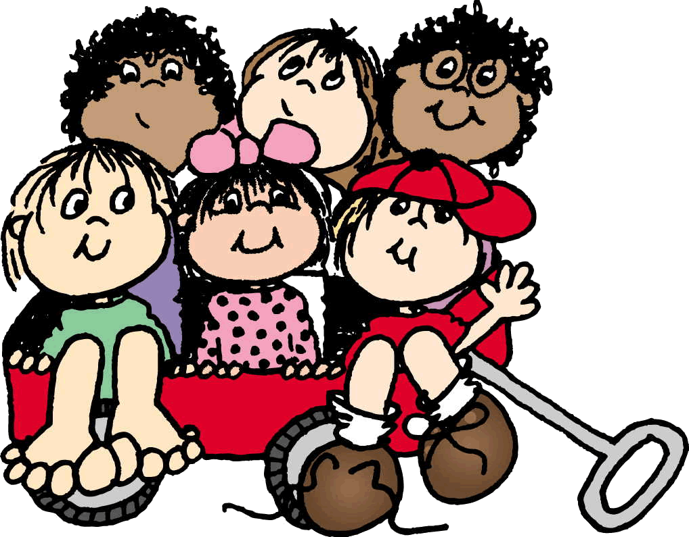
Add these names to your mailing and call list and get loads of chances to invite and meet new kids. You can reach more kids this way.
Notes:
Add these names to your mailing and call list and get loads of chances to invite and meet new kids. You can reach more kids this way.

Slide 5
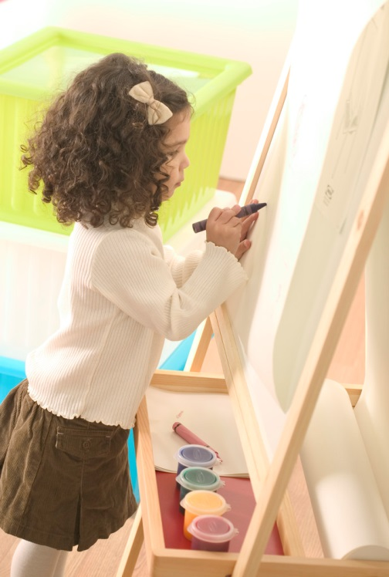

2. Art Museum
This is a fun vehicle for meeting new faces. For one afternoon in the summer or weekend, you can transform the children’s church into an art gallery.
Notes:
Art Museum. This is a fun vehicle for meeting new faces. For one afternoon in the summer or weekend, you can transform the children’s church into an art gallery.

Slide 6
Hang and display art works that the kids worked on in previous weeks. Then send invitations to relatives and friends to come attend the museum and vote for their child’s artwork.
Notes:
Hang and display art works that the kids worked on in previous weeks. Then send invitations to relatives and friends to come attend the museum and vote for their child’s artwork.

Slide 7
Organize “museum” tours and at the end of the event announce the blue ribbon winners.
Organize “museum” tours and at the end of the event
You will meet tons of kids!
Notes:
Organize “museum” tours and at the end of the event announce the blue ribbon winners. You will meet tons of kids! You will meet tons of kids!

Slide 8
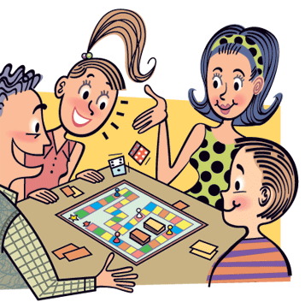
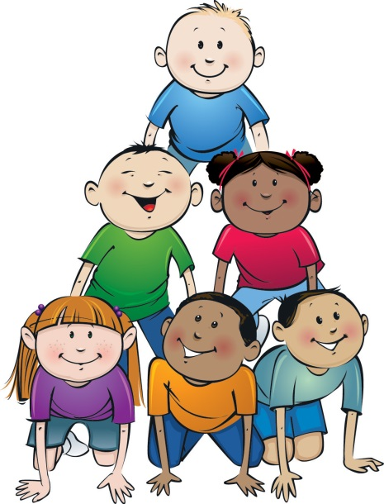
3. Games Tournaments
Have a game night and turn it into a tournament. Use of electronic gadgets can be allowed.
Notes:
3. Games Tournaments
Have a game night and turn it into a tournament. Use of electronic gadgets can be allowed.

Slide 9
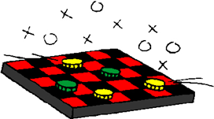

You can have an area for Checkers Champions, Super Sorry Players and Millionaire Monopoly Guys. This is a laid back way to get to know new kids.
Notes:
You can have an area for Checkers Champions, Super Sorry Players and Millionaire Monopoly Guys. This is a laid back way to get to know new kids.

Slide 10
Kids can also play games that acquaint them with other cultures, such as Passport to Cultures, Chinese chess, etc.
Notes:
Kids can also play games that acquaint them with other cultures, such as Passport to Cultures, Chinese chess, etc.

Slide 11
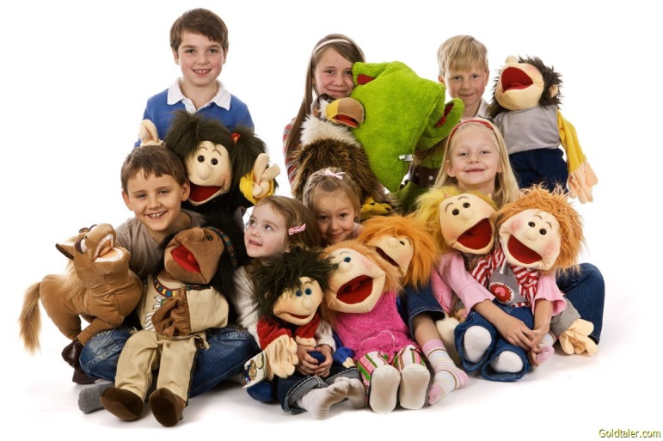
4. Puppets in the Park
Load up your puppet team and put on a show at the local park. You’ll meet tons of kids there.
Notes:
4. Puppets in the Park
Load up your puppet team and put on a show at the local park. You’ll meet tons of kids there.
Topics like health, say no to drugs, proper use of gadgets, and other values will be very relevant for the
kids of this age.

Slide 12
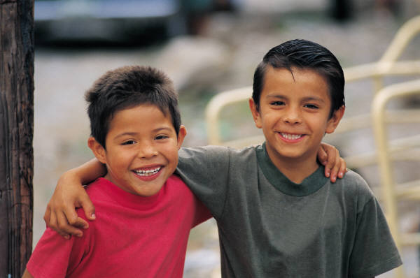
5. Best Friend Day
Having your best friend near is so much fun for children. We encourage kids to bring their best friends at least once a year on Best Friend Day.
Notes:
5. Best Friend Day
Having your best friend near is so much fun for children. We encourage kids to bring their best friends at least once a year on Best Friend Day.

Slide 13
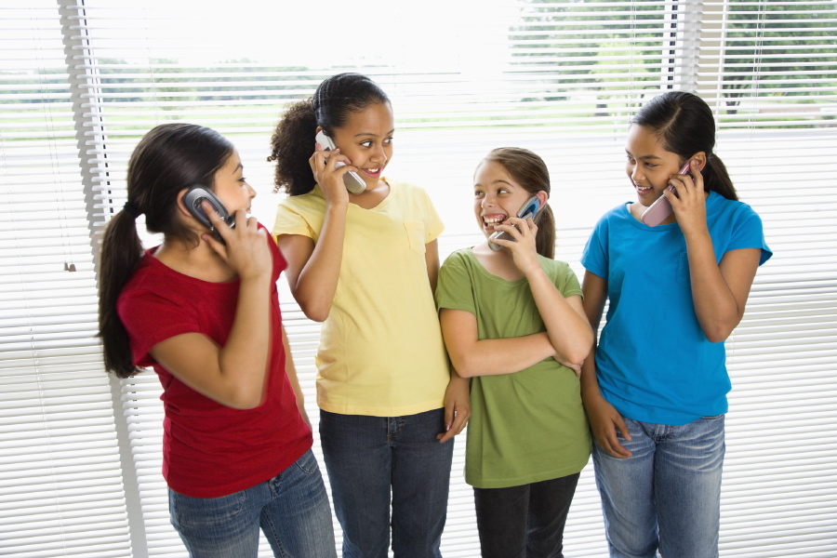
Announce Best Friend Day several weeks in advance, send invitations and make personal phone calls to friends.
Notes:
Announce Best Friend Day several weeks in advance, send invitations and make personal phone calls to friends.

Slide 14

6. Free Tutoring Help
If you’ve got professional teachers on your staff this idea may work for you. Offer tutoring classes after school once or twice a week. You’ll be helping parents and kids and you’ll build great relationships with kids.
Notes:
6. Free Tutoring Help
If you’ve got professional teachers on your staff this idea may work for you. Offer tutoring classes after school once or twice a week. You’ll be helping parents and kids and you’ll build great relationships with kids.

Slide 15
7. SPORTS DAY IN THE PARK
Organize a sports event in the park. Invite community children & parents to have fun and get acquainted. List down their names and addresses and invite them again.
Notes:
7. SPORTS IN THE PARK
Organize a sports event in the park. Invite community children & parents to have fun and get acquainted. It’s important to have food. List down their names and addresses and invite them again.

