Slide 1
EMPOWERED CHILDREN’S MINISTRIES
in the
LOCAL CHURCH
Prepared by:
Dr. Miriam L. Andres, CHM Director
Southern-Asia Pacific Division
Notes:
In his book, Natural Church Development, Christian Schwarz indicates that every healthy, growing church has eight characteristics. These characteristics can also be factored into Children’s Ministries so that it can maintain a healthy and growing department in the local church.
I have some questions to ask you… How many of you have CHM Department in your local church?

Slide 2
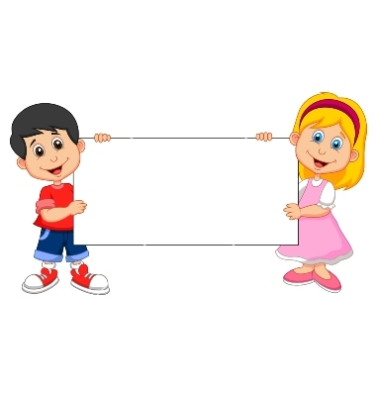
8 CHARACTERISTICS of a
HEALTHY CHILDREN’S MINISTRIES
in the LOCAL CHURCH
Notes:
8 CHARACTERISTICS of a HEALTHY CHILDREN’S MINISTRIES
in the LOCAL CHURCH

Slide 3
HEALTHY CHM IN THE LOCAL CHURCH
-- ACTIVE
-- EMPOWERED!
-- Has plans
all year- round
-- Visible, can be felt
Notes:
HEALTHY CHM IN THE LOCAL CHURCH
Active
Empowered!
Has plans all-year round
Visible, can be felt

Slide 4
Is your Children's Ministry IN Your LOCAL CHURCH
Healthy?
Notes:
Is your Children's Ministry IN Your LOCAL CHURCH
Healthy?

Slide 5
Two Targets
To give you information about the characteristics of a healthy CHM
To have idea on the rating /measure of CHM in terms of the characteristics we will discuss.
Notes:
Two Targets
1. To give you information about the characteristics of a healthy CH
2. To have idea on the rating /measure of CHM in terms of the characteristics we will discuss.

Slide 6
Rating Scale
Excellent E
Satisfactory S
Needs improvement NI
Notes:
I want you to get your hand –out and encircle the Roman Numeral for each Characteristics

Slide 7
4.
Functional Structures
Holistic
Small Groups
1.
Gift -
oriented Ministry
6.
Empowering Leadership
2.
5.
Inspiring Worship
Services
7.
Need-oriented Evangelism
3.
Passionate Spirituality
8.
Loving
Relationship
Notes:
8 CHARACTERISTICS of a HEALTHY CHILDREN’S MINISTRIES in the LOCAL CHURCH
1. Empowering Leadership
2. Gift-oriented Ministry
3. Passionate Spirituality
4. Functional Structures
5. Inspiring Worship Services
6. Holistic Small Groups
7. Need-oriented Evangelism
8. Loving Relationship

Slide 8
8 Characteristics of a healthy CHM
E---Excellent S- Satisfactory NI Needs Improvement
1 Empowering leadership
2. Gift-oriented ministry
3 Passionate Spirituality
4 Functional Structures
5 Inspiring Worship Services
6 Holistic Small group
7 Need-oriented Evangelism
8 Loving Relationships
Notes:
8 Characteristics of a Healthy CHM: E=Excellent; S=Satisfactory; N=Needs improvement
1. Empowering Leadership
2. Gift-oriented Ministry
3. Passionate Spirituality
4. Functional Structures
5. Inspiring Worship Services
6. Holistic Small Groups
7. Need-oriented Evangelism
8. Loving Relationship

Slide 9
A.
LEADERSHIP CERTIFICATION
1.
Empowering Leadership
B.
VOLUNTEER MANAGEMENT
C.
HOW PASTORS AND ELDERS CAN EMPOWER CHILDREN’S LEADERS
Notes:
1. Empowering Leadership
A. Leadership Training/Certification
B. Volunteer Management
C. How Pastors and Elders can Empower Children's Leaders

Slide 10
A.
LEADERSHIP Training/ CERTIFICATION
Some Approaches
Use the 6 levels of CHM certification
Seminars & Workshops
CHM Leaders bonding activities
Retreats, potlucks, outing
1.
Empowering Leadership
Notes:
1. A. Leadership Training/Certification
The 6 levels of CHM Certification - from the GC CHM
Seminars and Workshops- other seminars we have developed
CHM bonding activities - such as retreat, potluck. Outing, etc.

Slide 11
“EFFECTIVE LEADERS concentrate on empowering other Christians for ministry.”
Notes:
“EFFECTIVE LEADERS concentrate on empowering other Christians for ministry.”

Slide 12
B.
VOLUNTEER MANAGEMENT
Empowering Leadership
Notes:
1. B. Volunteer Management
"Volunteering is a work of heart."

Slide 13
Empowering Leadership
5 approaches
Notes:
"Volunteers are not paid--not because they are worthless, but because they are priceless."
There are 5 Models or approaches we use in managing our volunteers. Identify which model you use in your church.

Slide 14
The 5 APPROACHES /MODELS
Type | Description | Score
1 Impoverished Approach | Pastors do everything. | Volunteer 0; Church 0
2 Helper Approach | Volunteers asked to help; They’re used and abused | Volunteer 0; Church 10
3 Feel Good Approach | Volunteers tell where they want to serve. | Volunteer 10; Church 0
4 Assistant Approach | Class distinction between leaders and volunteers; no effort to mentor and train | Volunteer 5; Church 5
5 High Impact Approach | Church-wide commitment to select and disciple volunteers; team building to reach kingdom goals. | Volunteer 10; Church 10
Notes:
The High Impact approach scores 10 in volunteer and 10 in Church. How do we explain further this model of volunteer management?

Slide 15
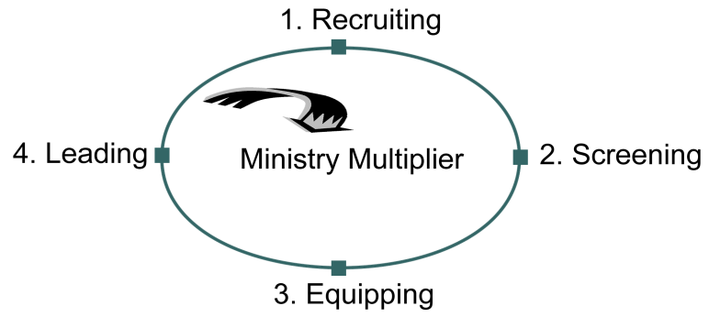
The 4 TASKS – High Impact Model
…Will multifly GREATLY!
Empowering Leadership
Notes:
The 4 Tasks--High Impact Model
1. Recruiting
2. Screening
3. Equipping
4. Leading
When all the four tasks are followed through carefully, ministry multiplies greatly. There will be more volunteers becoming leaders and are being groomed for future leadership.

Slide 16
God will
give it
TO YOU,
If He can get it THROUGH YOU!
Empowering Leadership
Notes:
"God will give it TO YOU, If He can get it THROUGH YOU!"

Slide 17
FOR PASTORS AND ELDERS:
How To Empower Children’s Leaders
C.
Provide opportunities for children’s leaders to organize children’s worships on special days.
Include children’s leaders in planning committees where they can learn leadership skills.
Support Children’s Ministries programs by helping out in areas of presentations, transportation, promotion of the event.
Encourage them to try new ideas.
Provide budgets for them to organize children’s program.
Appoint capable people to the Children’s
Ministries Committees.
Empowering Leadership
Notes:
1. C. For Pastors and Elders: How to Empower Children's Leaders
Provide opportunities for children’s leaders to organize children’s worships on special days.
Include children’s leaders in planning committees where they can learn leadership skills.
Support Children’s Ministries programs by helping out in areas of presentations, transportation, promotion of the event.
Encourage them to try new ideas.
Provide budgets for them to organize children’s program.
Appoint capable people to the Children’s Ministries Committees.
Now you can evaluate your local CHM in terms of Empowering leadership

Slide 18
8 Characteristics of a Healthy CHM
E---Excellent S- Satisfactory NI Needs Improvement
1 Empowering leadership
2. Gift-oriented ministry
3 Passionate Spirituality
4 Functional Structures
5 Inspiring Worship Services
6 Wholistic Small group
7 Need-oriented Evangelism
8 Loving Relationships
Notes:
Use E for Excellent, S for Satisfactory and NI for Needs Improvement. I give you one minute to do that. Let’s proceed to # 2 characteristics of a Healthy CHM in the local church

Slide 19
A. RECRUITING VOLUNTEERS
Gift -
oriented Ministry
2.
B. SCREENING VOLUNTEERS
C. ADVENTIST RISK MANAGEMENT
GUIDELINES
D. How PASTORS AND ELDERS CAN HELP
WITH SCREENING VOLUNTEERS
Notes:
2. Gift-oriented Ministry
A. Recruiting volunteers
B. Screening volunteers
C. Adventist Risk Management Guidelines
D. How Pastors and Elders can help with screening volunteers

Slide 20
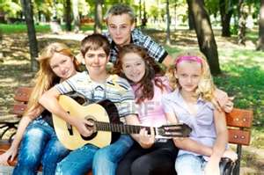
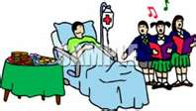
God has given to each of us different gifts and talents
Identify gifts of staff and utilize them
Those who have passion for kids, direct them to CHM
Notes:
Gift-oriented Ministry
God has given to each of us different gifts and talents
Identify gifts of staff and utilize them
Those who have passion for kids, direct them to CHM

Slide 21
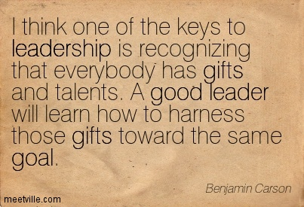
Notes:
Benjamin Carson, well-known American neurosurgeon.
"I think one of the keys to leadership is recognizing that everybody has gifts and talents. A good leader will learn how to harness those gifts toward the same goal.”

Slide 22
A. RECRUITING VOLUNTEERS
2.
Gift -
oriented Ministry
Notes:
2 A. Recruiting Volunteers
"By helping others you also help yourself. Young volunteers learn new skills and can gain confidence and social skills, which can help them in future work related roles."

Slide 23
CRITERIA FOR SELECTING VOLUNTEERS
Choose individuals who have the following character traits:
a. Demonstrate love and commitment to God and to the church.
b. Uphold high moral and ethical excellence.
c. Have leadership abilities and experience.
d. Have a passion for children.
Gift -
oriented Ministry
A. RECRUITING VOLUNTEERS
Notes:
Criteria for Selecting Volunteers
* Choose individuals who have the following character traits:
a. Demonstrate love and commitment to God and to the church.
b. Uphold high moral and ethical excellence.
c. Have leadership abilities and experience.
d. Have a passion for children.

Slide 24
RESPONSIBILITY OF RECRUITER
*Constantly looks for volunteers.
*Keeps a current file of likely volunteers.
*Has a description for each job.
*Has a supply of ministry application forms.
Gift -
oriented Ministry
A. RECRUITING VOLUNTEERS
Notes:
Responsibility of Recruiter
*Constantly looks for volunteers.
*Keeps a current file of likely volunteers.
*Has a description for each job.
*Has a supply of ministry application forms.

Slide 25
STEPS IN SELECTING VOLUNTEERS
*Pray about individuals you need.
*Share your vision with others.
*Advertise the need for volunteers.
(announcements, telephone, volunteer to volunteer, nominating committee, one-to-one)
*Identify volunteer roles that are needed.
(Teacher, Craft/Puppet Coordinator, Music Leader, Story teller, Team Coordinator)
*Determine the length of service for each position.
*Provide a job description.
*Make the search for volunteers an on-going process.
Gift -
oriented Ministry
A. RECRUITING VOLUNTEERS
Notes:
STEPS IN SELECTING VOLUNTEERS
*Pray about individuals you need.
*Share your vision with others.
*Advertise the need for volunteers.
(announcements, telephone, volunteer to volunteer, nominating committee, one-to-one)
*Identify volunteer roles that are needed.
(Teacher, Craft/Puppet Coordinator, Music Leader, Story teller, Team Coordinator)
*Determine the length of service for each position.
*Provide a job description.
*Make the search for volunteers an on-going process.

Slide 26
Like an archer who WOUNDS EVERYONE so is he who HIRES A FOOL or who hires those who any pass by.
Proverbs 26:10
Notes:
Like an archer who WOUNDS EVERYONE so is he who HIRES A FOOL or who hires those who any pass-by.
Proverbs 26:10

Slide 27
B. SCREENING VOLUNTEERS
WHY SCREEN VOLUNTEERS? Protect
children; gauge person’s interest for ministry.
WHO DOES THE SCREENING? CHM
Coordinator; church screening committee.
THE ROLES OF SCREENERS. Accepts
applications; do background checks & interviews.
PRACTICE THE SEVEN C’s
Calling to ministry, Character, Chemistry – attitude, willingness
Competency – training, experience, Consistency/congruence,
Commitment, Condition – mental, physical, spiritual)
Gift -
oriented Ministry
Notes:
B. SCREENING VOLUNTEERS
WHY SCREEN VOLUNTEERS? Protect children; gauge person’s interest for ministry.
WHO DOES THE SCREENING? CHM Coordinator; church screening committee.
THE ROLES OF SCREENERS Accepts applications; do background checks & interviews.
PRACTICE THE SEVEN C’s
Calling to ministry, Character – God’s screening,
Chemistry – attitude, willingness, Competency – training, experience,
Consistency/congruence, Commitment,
Condition – mental, physical, spiritual)

Slide 28
C. ADVENTIST RISK MANAGEMENT
GUIDELINES
Children will be supervised by adult/s at all times. Children’s programming will be conducted on an abuse free no-harassment tolerated basis at all times.
You can use the ARM guidelines when screening volunteers and in some places you may want to adapt them to suit your needs.
ARM provides these guidelines and forms to assist with the development of safety and risk control
programs.
Gift -
oriented Ministry
Notes:
C. ADVENTIST RISK MANAGEMENT GUIDELINES
Children will be supervised by adult/s at all times. Children’s programming will be conducted on an abuse free no-harassment tolerated basis at all times.
You can use the ARM guidelines when screening volunteers and in some places you may want to adapt them to suit your needs.
ARM provides these guidelines and forms to assist with the development of safety and risk control
programs.

Slide 29
D. For PASTORS AND ELDERS
How To HELP WITH SCREENING VOLUNTEERS
Appoint a screening committee.
Assist with screening volunteers.
Do the reference check of volunteers.
Support the ruling of the screening committee.
Gift -
oriented Ministry
Notes:
D. For PASTORS AND ELDERS: How To HELP WITH SCREENING VOLUNTEERS
Appoint a screening committee.
Assist with screening volunteers.
Do the reference check of volunteers.
Support the ruling of the screening committee.

Slide 30
8 Characteristics of a healthy CHM
E---Excellent S- Satisfactory NI Needs Improvement
1 Empowering leadership
2. Gift-oriented ministry
3 Passionate Spirituality
4 Functional Structures
5 Inspiring Worship Services
6 Wholistic Small group
7 Need-oriented Evangelism
8 Loving Relationships
Notes:
Use E for Excellent, S for Satisfactory and NI for Needs Improvement. I give you one minute to do that. Let’s proceed to # 3 characteristics of a Healthy CHM in the local church

Slide 31
A. The GRACELINK CURRICULUM
B. SPIRITUAL MENTORING OF
CHILDREN’S LEADERS
C. How Can PASTORS AND ELDERS NURTURE PASSIONATE
SPIRITUALITY
3.
Passionate Spirituality
Notes:
3. Passionate Spirituality--3 parts
A. The Gracelink Curriculum
B. Spiritual mentoring of children's leaders
C. How can pastors and elder nurture passionate spirituality

Slide 32
Ultimate Goal of all
Children’s Programs:
3.
Passionate Spirituality
To nurture children in their spiritual growth as they develop a loving, serving relationship with Jesus and the church.
Notes:
3. Passionate Spirituality
Ultimate Goal of all Children’s Programs: To nurture children in their spiritual growth as they develop a loving, serving relationship with Jesus and the church.

Slide 33
Passionate Spirituality
Ultimate Goal of all
Children’s Programs:
3.
RELATIONSHIP
WITH JESUS
SPIRITUALITY
CHARACTER DEVELOPMENT
Notes:
3. Passionate Spirituality
Ultimate Goal of all Children’s Programs:
* Relationship with Jesus
* Spirituality
* Character development

Slide 34
A. The GRACELINK CURRICULUM
MISSION
GOALS
PHILOSOPHY:
*Grace, Worship, Community, Service
DIVISION CYCLES
*Beginner, Kindergarten, Primary, Junior
Passionate Spirituality
Notes:
A. The GRACELINK CURRICULUM
MISSION
GOALS
PHILOSOPHY: Grace, Worship, Community, Service
DIVISION CYCLES: *Beginner, Kindergarten, Primary, Junior

Slide 35
A. The GRACELINK CURRICULUM
. . . to nurture children in their spiritual growth as they develop a loving, serving relationship with Jesus.
G
O
A
L
Bible
Bible Study Guide
Leader’s Resource
Passionate Spirituality
3.
Notes:
A. The Gracelink Currculum
. . to nurture children in their spiritual growth as they develop a loving, serving relationship with Jesus
Bible
Bible Study Guide
Leader’s Resource

Slide 36
“¹³ Therefore put on the full armor of God, so that when the day of evil comes, you may be able to stand your ground, and after you have done everything, to stand. ”
Eph 6:13
Notes:
¹³ Therefore put on the full armor of God, so that when the day of evil comes, you may be able to stand your ground, and after you have done everything, to stand." Ephesians 6:13

Slide 37
“¹⁴ Stand firm then, with the belt of truth buckled around your waist, with the breastplate of righteousness in place, ¹⁵ and with your feet fitted with the readiness that comes from the gospel of peace.
Eph 6:14-15
Notes:
"Stand firm then, with the belt of truth buckled around your waist, with the breastplate of righteousness in place, ¹⁵ and with your feet fitted with the readiness that comes from the gospel of peace." Ephesians 6:14-15

Slide 38
“¹⁶ In addition to all this, take up the shield of faith, with which you can extinguish all the flaming arrows of the evil one. ¹⁷ Take the helmet of salvation and the sword of the Spirit, which is the word of God. ”
Eph 6:16
Notes:
" In addition to all this, take up the shield of faith, with which you can extinguish all the flaming arrows of the evil one. ¹⁷ Take the helmet of salvation and the sword of the Spirit, which is the word of God.” Ephesians 6:16

Slide 39
“The great deceiver has prepared his wiles for every soul that is not braced for trial and guarded by constant prayer and living faith.”
True Revival, p. 11
Notes:
“The great deceiver has prepared his wiles for every soul that is not braced for trial and guarded by constant prayer and living faith.” True Revival, p. 11

Slide 40
Sword of Spirit
WORD OF GOD
Helmet of
SALVATION
Breastplate
RIGHTEOUSNESS
Belt -TRUTH
Shield of
FAITH
Are your children protected?
Notes:
Are your children protected?

Slide 41
Sword of Spirit
WORD OF GOD
Helmet of
SALVATION
Breastplate
RIGHTEOUSNESS
Belt -TRUTH
Shield of
FAITH
Do they have Spiritual tools that connect them to jesus?
Notes:
⁴Do they have Spiritual tools that connect them to Jesus?

Slide 42
B. SPIRITUAL MENTORING OF
CHILDREN’S LEADERS
WHY BE A MENTOR?
*Young and inexperienced leaders need mentors.
REASONS TO MENTOR
*Instills values in mentees.
*Develops their leadership skills.
*Create opportunities to share faith.
*Improves mentee’s self-confidence.
*Allows counseling on life issues.
*Provides a model for service and stewardship.
*Decreases self-centeredness for mentor.
*Opens minds to wider possibilities.
*Inspires mentee to develop a personal devotional life.
Passionate Spirituality
Notes:
B. SPIRITUAL MENTORING OF CHILDREN’S LEADERS
WHY BE A MENTOR? -- *Young and inexperienced leaders need mentors
REASONS TO MENTOR
*Instills values in mentees.
*Develops their leadership skills.
*Create opportunities to share faith.
*Improves mentee’s self-confidence.
*Allows counseling on life issues.
*Provides a model for service and stewardship.
*Decreases self-centeredness for mentor.
*Opens minds to wider possibilities.
*Inspires mentee to develop a personal devotional life.

Slide 43
MENTORING DEVELOPS SPIRITUAL GIFTS
*Observe the mentee to identify specific spiritual gifts.
*Provide opportunities for mentee to use those gifts.
*Encourage mentee to use spiritual gifts for service.
WHO CAN BE MENTOR?
*Anybody who is willing to. . .
-Be vulnerable
-Share of themselves and their time
-Be loving
-Be non-judgmental and supportive
-Be coach
*Pastors and elders can
Passionate Spirituality
B. SPIRITUAL MENTORING of Children’s Leaders
Notes:
MENTORING DEVELOPS SPIRITUAL GIFTS
*Observe the mentee to identify specific spiritual gifts.
*Provide opportunities for mentee to use those gifts.
*Encourage mentee to use spiritual gifts for service.
WHO CAN BE MENTOR?
*Anybody who is willing to. . .
-Be vulnerable
-Share of themselves and their time
-Be loving
-Be non-judgmental and supportive
-Be coach
*Pastors and elders can

Slide 44
IDEAS FOR GETTING STARTED
*Pray about it – this is ministry.
*Be a friend to teens and children.
*Affirm them – by name.
*Ask God to send you a teen to mentor.
EQUIP AND TRAIN
*Provide resources they can read to grow spiritually.
*Demonstrate the task.
*Have them try it, teaming up with you.
*Have them try it alone.
*Affirm and offer a suggestion or two.
*Take them to training events.
Passionate Spirituality
B. SPIRITUAL MENTORING of Children’s Leaders
Notes:
IDEAS FOR GETTING STARTED
*Pray about it – this is ministry.
*Be a friend to teens and children.
*Affirm them – by name.
*Ask God to send you a teen to mentor.
EQUIP AND TRAIN
*Provide resources they can read to grow spiritually.
*Demonstrate the task.
*Have them try it, teaming up with you.
*Have them try it alone.
*Affirm and offer a suggestion or two.
*Take them to training events.

Slide 45
C. TIPS FOR PASTORS AND ELDERS:
On How To nurture PASSIONATE SPIRITUALITY
Encourage families to conduct regular family worships and study the Sabbath School lessons with their children.
Promote the importance of investing money in purchasing Bible lessons for children.
Encourage parents to buy good Adventist books for their children.
Help to teach a lesson or two in the Children’s division occasionally.
Passionate Spirituality
Notes:
C. TIPS FOR PASTORS AND ELDERS:
On How To nurture PASSIONATE SPIRITUALITY
Encourage families to conduct regular family worships and study the Sabbath School lessons with their children.
Promote the importance of investing money in purchasing Bible lessons for children.
Encourage parents to buy good Adventist books for their children.
Help to teach a lesson or two in the Children’s division occasionally.

Slide 46
8 Characteristics of a healthy CHM
E---Excellent S- Satisfactory NI Needs Improvement
1 Empowering leadership
2. Gift-oriented ministry
3 Passionate Spirituality
4 Functional Structures
5 Inspiring Worship Services
6 Wholistic Small group
7 Need-oriented Evangelism
8 Loving Relationships
Notes:
Use E for Excellent, S for Satisfactory and NI for Needs Improvement. I give you one minute to do that. Lets proceed to # 4 characteristics of a Healthy CHM in the local church

Slide 47
A HEALTHY CHURCH works within the structures of the world church.
. . . CHILDREN’S MINISTRIES works within the framework of the structure!
4.
Functional Structures
Notes:
Functional Structures - A HEALTHY CHURCH works within the structures of the world church.
. . . CHILDREN’S MINISTRIES works within the framework of the structure!

Slide 48
WORKING WITH MISSIONS/CONFERENCES
B. WHAT CAN PASTORS AND ELDERS DO TO SUPPORT CHURCH STRUCTURES
4.
Functional Structures

Slide 49
WORKING WITH CONFERENCES
General Conference
Division
Union
Mission/Conference
Functional
Structures
Local Church

Slide 50
Elect/Appoint ChM Coordinators to organize nurturing program for kids.
Notify the conference of the ChM Coordinator’s name, address, and contact number.
Support conference-wide ChM programs.
B. TIPS FOR PASTORS AND ELDERS: How To support church structures

Slide 51
8 Characteristics of a healthy CHM
E---Excellent S- Satisfactory NI Needs Improvement
1 Empowering leadership
2. Gift-oriented ministry
3 Passionate Spirituality
4 Functional Structures
5 Inspiring Worship Services
6 Wholistic Small group
7 Need-oriented Evangelism
8 Loving Relationships
Notes:
Use E for Excellent, S for Satisfactory and NI for Needs Improvement. I give you one minute to do that. Lets proceed to # 5 characteristic of a Healthy CHM in the local church

Slide 52
SPECIAL CHILDREN’S WORSHIP PROGRAMS
WHAT CAN PASTORS AND ELDERS DO TO INSPIRE WORSHIP
5.
Inspiring Worship
Services

Slide 53
SPECIAL CHILDREN’S WORSHIP PROGRAMS
*Child-Friendly Church
*Children’s Sabbath
*Children Church
*Children’s Story/Homily
Intergenerational worship

Slide 54
TIPS FOR PASTORS AND ELDERS :
How to inspire worship
-See the church through a child’s eye
-Learn to know kids by their names
-Make efforts to introduce new ministries for kids.
-Incorporate 1-2 kid’s songs in the worship service
-Prepare sermons that involve kids in response and participation
-Involve children in worship

Slide 55
8 Characteristics of a healthy CHM
E---Excellent S- Satisfactory NI Needs Improvement
1 Empowering leadership
2. Gift-oriented ministry
3 Passionate Spirituality
4 Functional Structures
5 Inspiring Worship Services
6 Wholistic Small group
7 Need-oriented Evangelism
8 Loving Relationships
Notes:
Use E for Excellent, S for Satisfactory and NI for Needs Improvement. I give you one minute to do that. Lets proceed to # 6 characteristic of a Healthy CHM in the local church

Slide 56
6.
CHILDREN’S SMALL GROUP is another way of nurturing the spiritual development of children.
Wholistic
Small Groups
SMALL GROUPS - (support groups)
Those hurting and in -pain.
Provides emotional nurture as they are directed to Jesus.
Notes:
Small groups may serve as support groups for children who are hurting and in pain. It is a meeting of hearts where children are given emotional nurture as they are directed to Jesus.

Slide 57
B. TIPS FOR PASTORS AND ELDERS:
To support Small groups
Provide a budget
Send individuals
Support the children’s leaders
Participate occasionally
A. TYPES
K.I.D. (Kids In Discipleship)
Children’s Prayer Group
Rainbows

Slide 58
8 Characteristics of a healthy CHM
E---Excellent S- Satisfactory NI Needs Improvement
1 Empowering leadership
2. Gift-oriented ministry
3 Passionate Spirituality
4 Functional Structures
5 Inspiring Worship Services
6 Wholistic Small group
7 Need-oriented Evangelism
8 Loving Relationships
Notes:
Use E for Excellent, S for Satisfactory and NI for Needs Improvement. I give you one minute to do that. Lets proceed to # 7 characteristic of a Healthy CHM in the local church

Slide 59
Jesus commission for the disciples to bring the Gospel “to every kindred, tongue and people undoubtedly includes bringing the Gospel to children , as well.
7.
Need-Oriented
Eangelism
Notes:
Small groups may serve as support groups for children who are hurting and in pain. It is a meeting of hearts where children are given emotional nurture as they are directed to Jesus.

Slide 60
(EGW) Evangelism, p. 580
“When Jesus told the disciples NOT to forbid the children to come to Him, He was speaking to His followers in all ages, --- to officers of the church, to ministers, helpers, and all Christians.
Need-oriented Evangelism
7.

Slide 61
.
In teaching, He (Jesus) came down to their level. He, the majesty of Heaven, answered their questions and simplified His important lessons to meet their childish understanding. He planted in their minds the seeds of truth, which in after years would spring up and bear fruit
unto eternal life.”
Evangelism, p.579
Need-oriented Evangelism
7.

Slide 62
TYPES OF EVANGELISM
Child Preachers’ Evangelism
Friendship Evangelism
*Friendship Skills
- How to greet Someone
- How to keep Someone Company
- How to Introduce a Friend
- How to Make Friends
*Invitation Cards/Postcards
*Keep a Directory
*Follow-up
GRACELINK Daily Study Sharing Time
B. TIPS FOR PASTORS AND ELDERS:
To support CHILD EVANGELISM
Feature reports of Evangelistic Outreach activities.
Schedule the Week of Evangelism on the church calendar.
Allow children who got involved in evangelism give testimonies.
Support the children and their leaders by attending some of the meetings.
Provide a budget

Slide 63
8 Characteristics of a healthy CHM
E---Excellent S- Satisfactory NI Needs Improvement
1 Empowering leadership
2. Gift-oriented ministry
3 Passionate Spirituality
4 Functional Structures
5 Inspiring Worship Services
6 Wholistic Small group
7 Need-oriented Evangelism
8 Loving Relationships
Notes:
Use E for Excellent, S for Satisfactory and NI for Needs Improvement. I give you one minute to do that. Lets proceed to # 8 characteristic of a Healthy CHM in the local church

Slide 64
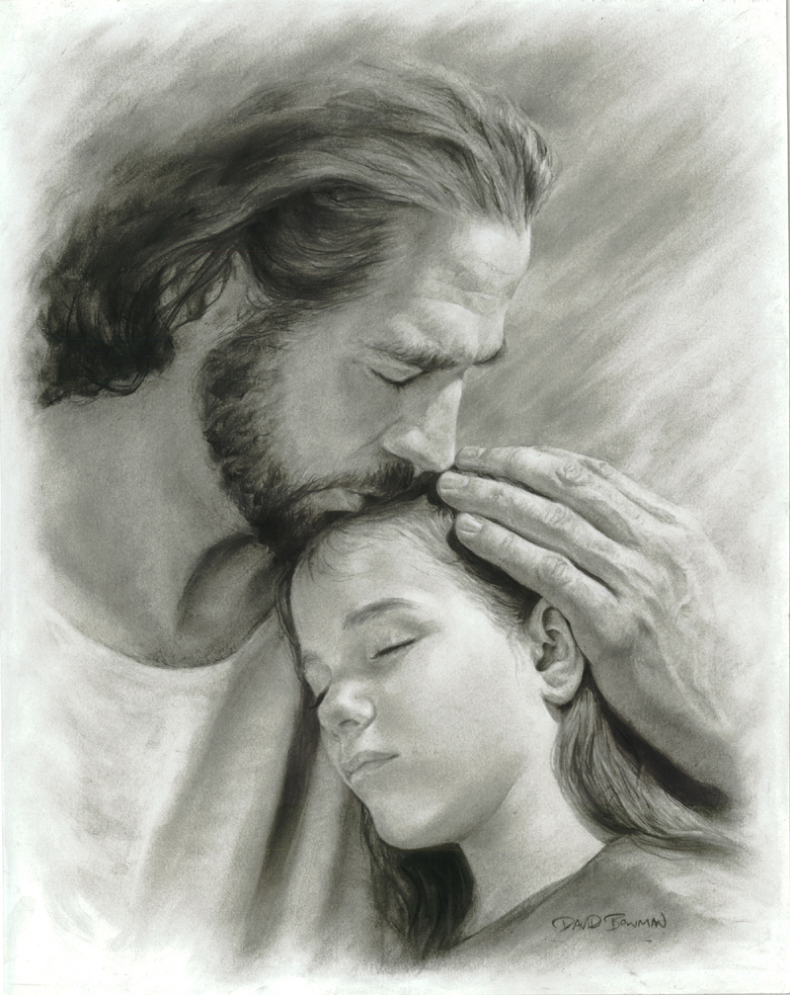
JESUS’ LOVE is the foundation of the gospel and children respond positively to such love when shown genuinely.
Loving
Relationship
8.

Slide 65
DEMONSTRATING LOVING RELATIONSHIP
A. HOW PASTORS & ELDERS NUTURE LOVING RELAINSHIPS WITH CHILDREN
Loving
Relationship
8.

Slide 66
WE must love children!
WE must be passionate for children!

Slide 67
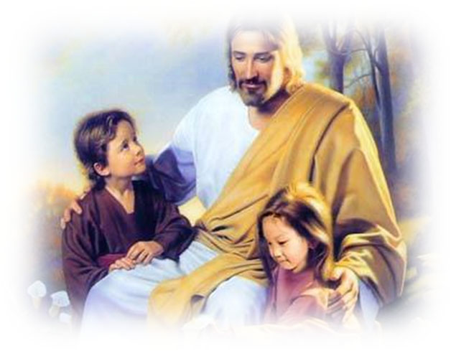
DEMONSTRATING LOVING RELATIONSHIP
Affirm children and their parents publicly.
Children’s leaders and teachers are loving and kind to one another.
Correct children patiently and be willing to give them a second chance.
Remember their birthdays.
Give special time to children for sharing their gifts and talents.
8.
Loving
Relationship

Slide 68
B. TIPS FOR PASTORS AND ELDERS:
How To demonstrate love for children
Schedule children’s story during worship service.
Collect special “lambs’ offering” for children’s projects.
Have special children’s features in church programs and sermons.
Allow children to participate in church.
Loving
Relationship

Slide 69
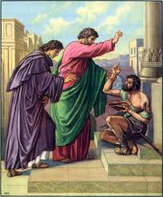
The Law or Principle of Buy-in
But Peter said, “I don’t have any
silver or gold!
But I will give
you what I do
have.
In the name of Jesus Christ from Nazareth, get up and start walking.”
Acts 3:6 CEV

Slide 70
Acts 3:6 Amplified Bible (AMP)
⁶ But Peter said, Silver and gold (money) I do not have; but what I do have, that I give to you: in [the^{[a]}use of] the name of Jesus Christ of Nazareth, walk!

Slide 71
8 Characteristics of a healthy CHM
1 Empowering leadership
2. Gift-oriented ministry
3 Passionate Spirituality
4 Functional Structures
5 Inspiring Worship Services
6 Wholistic Small group
7 Need-oriented Evangelism
8 Loving Relationships
Notes:
Use E for Excellent, S for Satisfactory and NI for Needs Improvement. I give you one minute to do that.

Slide 72
8 Characteristics of a healthy CHM
E---Excellent S- Satisfactory NI Needs Improvement
1 Empowering leadership
2. Gift-oriented ministry
3 Passionate Spirituality
4 Functional Structures
5 Inspiring Worship Services
6 Wholistic Small group
7 Need-oriented Evangelism
8 Loving Relationships
Notes:
How many of you scored Excellent in all 8 Characteristics? How many scored Satisfactory? How about NI?
Note: Evaluation sheet will be collected and given to the CHM Director of the union/ or mission/conference– as needed. In closing I want to recall the experience of King David found in 2 Samuel 24

Slide 73
2 Samuel 24
David asked his generals to number Israel
without instruction from the Lord God
-- lasted for 9 months & 20 days verse 9
RESULT:
800,000 valiant men in Israel
500,000 in Judah
Notes:
^{Result: 10} And David’s heart condemned him after he had numbered the people. So David said to the Lord, “I have sinned greatly in what I have done; but now, I pray, O Lord, take away the iniquity of Your servant, for I have done very foolishly.”

Slide 74
2 Samuel 24
God was not pleased on what King David did.
He was given 3 choices verse 13
7 years of famine
Flee 3 months from his enemies
3 Days plague
Notes:
¹¹ Now when David arose in the morning, the word of the Lord came to the prophet Gad, David’s seer, saying, ¹² “Go and tell David, ‘Thus says the Lord: “I offer you three things; choose one of them for yourself, that I may do it to you.”’” ¹³ So Gad came to David and told him; and he said to him, “Shall seven^{[a]} years of famine come to you in your land? Or shall you flee three months before your enemies, while they pursue you? Or shall there be three days’ plague in your land? Now consider and see what answer I should take back to Him who sent me.”

Slide 75
David chose the 3days of plague
2 Samuel 24:14 (NKJV)
¹⁴ And David said to Gad, “I am in great distress. Please let us fall into the hand of the Lord, for His mercies are great; but do not let me fall into the hand of man.”
Prophet Gad’ admonishes David to erect altar to the Lord at Araunah’s place
Notes:
¹⁵ So the Lord sent a plague upon Israel from the morning till the appointed time. From Dan to Beersheba seventy thousand men of the people died. ¹⁶ And when the angel^{[b]} stretched out His hand over Jerusalem to destroy it, the Lord relented from the destruction, and said to the angel who was destroying the people, “It is enough; now restrain your hand.” And the angel of the Lord was by the threshing floor of Araunah^{[c]} the Jebusite.
¹⁷ Then David spoke to the Lord when he saw the angel who was striking the people, and said, “Surely I have sinned, and I have done wickedly; but these sheep, what have they done? Let Your hand, I pray, be against me and against my father’s house.”
¹⁸ And Gad came that day to David and said to him, “Go up, erect an altar to the Lord on the threshing floor of Araunah the Jebusite.” ¹⁹ So David, according to the word of Gad, went up as theLord commanded. ²⁰ Now Araunah looked, and saw the king and his servants coming toward him. So Araunah went out and bowed before the king with his face to the ground.
²¹ Then Araunah said, “Why has my lord the king come to his servant?”
And David said, “To buy the threshing floor from you, to build an altar to the Lord, that the plague may be withdrawn from the people.”

Slide 76
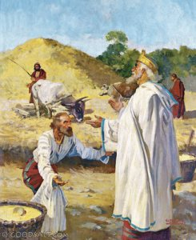
Now Araunah said to David, “Let my lord the king take and offer up whatever seems
good to him. Look, here are oxen for burnt sacrifice, and threshing implements and the yokes of the oxen for wood”.
Notes:
Araunah’s response “Let my lord the king take and offer up whatever seems
good to him. Look, here are oxen for burnt sacrifice, and threshing implements and the yokes of the oxen for wood.

Slide 77
“No, but I will surely buy it from you for a price…
David’s
response
Notes:
What was David’s response to Araunah? ²⁴ Then the king said to Araunah, “No, but I will surely buy it from you for a price; “I will not sacrifice to the Lord, my God burnt offerings that cost me nothing.”

Slide 78
“
“I will not sacrifice to the Lord, my God burnt offerings that cost me nothing.”
David’s
response
Notes:
What was David’s response to Araunah? ²⁴ Then the king said to Araunah, “No, but I will surely buy it from you for a price; “I will not sacrifice to the Lord, my God burnt offerings that cost me nothing.”
So David bought the threshing floor and the oxen for fifty shekels of silver.

Slide 79
Concluding Thoughts
“I will not sacrifice to the Lord, my God burnt offerings that cost me nothing.”
` 2 Samuel 24:24
Notes:
CHM and children’s leaders, how about us? Can we join with David and say “I will not sacrifice to the Lord,
my God burnt offerings that cost me nothing.”
Serving the Lord will always cost us something– the things we give up, the things we have to do for the cause of the children. What a commitment!--- not satisfied with an ordinary service, but will always endeavor to do our best for the Lord?

