Slide 1
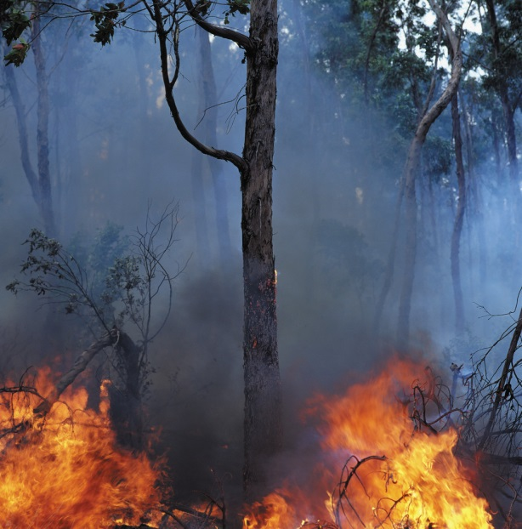
Talking to Kids about disaster
Linda Mei Lin Koh
GC Children’s Ministries
Notes:
TALKING TO KIDS ABOUT DISASTER
Today many children have to deal with disasters and catastrophes that make them fearful and anxious. How can we minister to these children and families who have been affected by a disaster? Here are some tips from Dale Hudson, Insight E-Magazine, for children’s leaders.

Slide 2
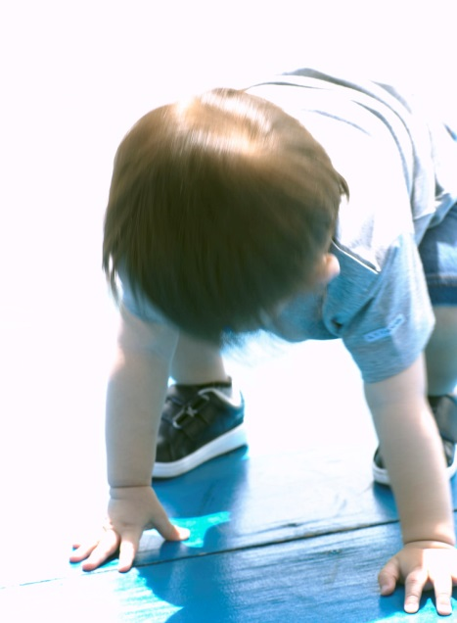
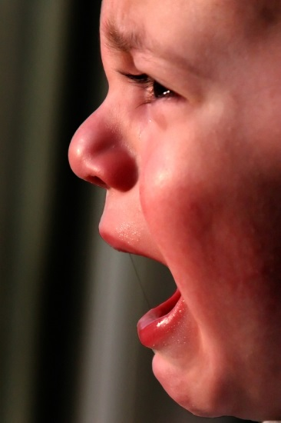
1. Observe how the child is reacting
PRESCHOOLERS
  thumb sucking, bed-wetting, clinging to parents, sleep disturbances, loss of appetite, fear of the dark, regression in behavior and withdrawal from friends and routines (National Assoc. of School Psychologists).
Notes:
1. Observe How The Child Is Reacting
PRESCHOOLERS
thumb sucking, bed-wetting, clinging to parents, sleep disturbances, loss of appetite, fear of the dark, regression in behavior and withdrawal from friends and routines. (National Association of School Psychologists)

Slide 3
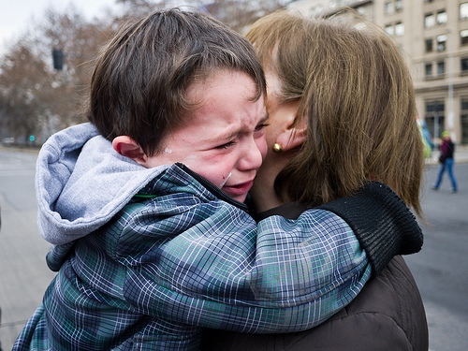
What can you do for preschoolers?
Reassure them that you are there by their side; that it’s okay to feel sad, scared and angry.
Create an open and supportive environment where they can ask questions.
It’s best not to force children to talk about things or their fears unless and until they’re ready.
Notes:
What Can You Do For Preschoolers?
Reassure them that you are by their side; that it’s okay to feel sad and scared.
Create an open and supportive environment where they can ask questions.
It’s best not to force children to talk about things or their fears unless and until they’re ready.

Slide 4
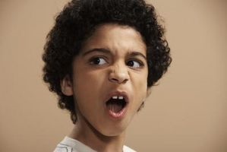

Elementary school children
Irritability, aggressiveness, clinginess, nightmares, school avoidance, poor concentration and withdrawal from activities and friends.
Notes:
ELEMENTARY SCHOOL CHILDREN
Irritability, aggressiveness, clinginess, nightmares, school avoidance, poor concentration and withdrawal from activities and friends.

Slide 5
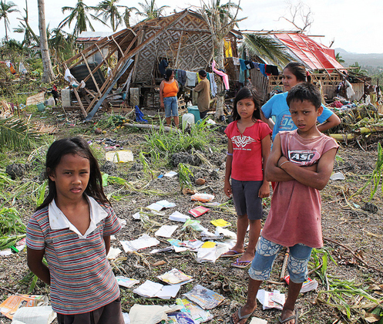
What Can you do?
Children can cope better when they understand what is happening & what they can do to help protect themselves, family, and friends.
Provide basic information to help them understand, without providing unnecessary details that may only alarm them.
Limit media coverage of the disaster—they don't benefit from graphic details or exposure to disturbing images or sounds. Instead sit down together and talk as a family.
Notes:
What Can You Do?
Children can cope more effectively with a disaster when they feel they understand what is happening and what they can do to help protect themselves, family, and friends.
Provide basic information to help them understand, without providing unnecessary details that may only alarm them.
Limit media coverage of the disaster—they don't benefit from graphic details or exposure to disturbing images or sounds. Instead sit down together and talk as a family.

Slide 6
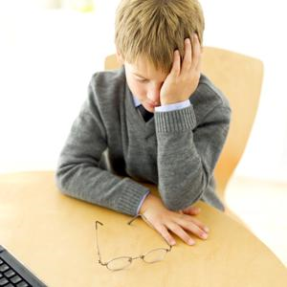

Adolescents
Sleeping and eating disturbances, agitation, increase in conflicts, physical complaints, delinquent behavior and poor concentration.
Notes:
Adolescents
Sleeping and eating disturbances, agitation, increase in conflicts, physical complaints, delinquent behavior and poor concentration.

Slide 7
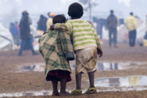
What Can You do?
Older children will likely want, and benefit from, additional information about the disaster and recovery efforts.
Start by asking children what they already know and what questions they have. Use that as a guide for conversation.
Be reassuring, but don't make unrealistic promises. It's fine to let children know that they are safe in their house or in their school. But you can't promise that there won't be another earthquake or other natural disaster.
Notes:
What Can You Do?
Older children will likely want, and benefit from, additional information about the disaster and recovery efforts.
Start by asking children what they already know and what questions they have. Use that as a guide for conversation.
Be reassuring, but don't make unrealistic promises. It's fine to let children know that they are safe in their house or in their school. But you can't promise that there won't be another earthquake or other natural disaster.

Slide 8
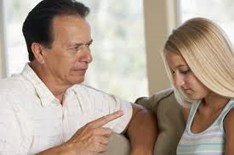
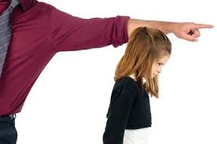
2. Respond to the child’s reaction
Acknowledge and accept their reaction.
Empathize with their reaction.
If they cry, it is okay to cry with them.
Notes:
2. Respond to the Child’s Reaction
Acknowledge and accept their reaction.
Empathize with their reaction.
If they cry, it is okay to cry with them.

Slide 9
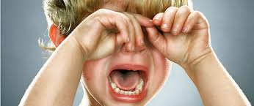
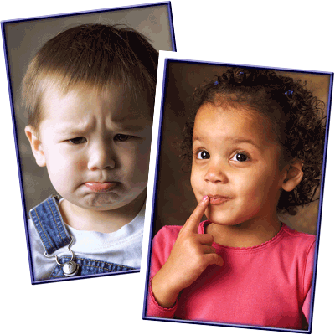
3. Listen. Ask questions. Listen. Ask questions
Allow children to express their feelings, concerns and fears.
Listening will help them to prove it.
Encourage them to write down or draw what they are feeling.
Notes:
3. Listen. Ask questions. Listen. Ask questions
Allow children to express their feelings, concerns and fears.
Listening will help them to prove it.
Encourage them to write down or draw what they are feeling.

Slide 10

4. Be prepared to answer their questions several times.
Notes:
4. Be prepared to answer their questions several times.
Be prepared to repeat information and explanations several times. Some information may be hard to accept or understand. Asking the same question over and over may also be a way for a child to ask for reassurance.

Slide 11

5. Share God’s promises with the child
Read appropriate Bible verses that deal with what the child is feeling.
Have them read to you and share what it means to them.
Notes:
5. Share God’s promises with the child
Read appropriate Bible verses that deal with what the child is feeling.
Have them read to you and share what it means to them.

Slide 12

Bible Promises
The Bible promises our loved ones who have died will live again. "Do not be amazed at this, for a time is coming when all who are in their graves will hear His voice and come out--those who have done good will rise to live, and those who have done evil will rise to be condemned”
(John 5:28-29, NIV).
Notes:
Bible Promises
The Bible promises our loved ones who have died will live again. It’s in the Bible, "Do not be amazed at this, for a time is coming when all who are in their graves will hear His voice and come out--those who have done good will rise to live, and those who have done evil will rise to be condemned” (John 5:28-29, NIV).

Slide 13
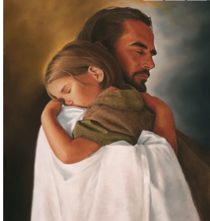

He has promised an end to death, sorrow, and pain. "He will wipe every tear from their eyes. There will be no more death or mourning or crying or pain, for the old order of things has passed away" (Revelation 21:4, NIV).
Notes:
He has promised an end to death, sorrow, and pain. "He will wipe every tear from their eyes. There will be no more death or mourning or crying or pain, for the old order of things has passed away" (Revelation 21:4, NIV).

Slide 14
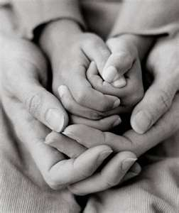
6. Pray with the child about the tragedy
Notes:
6. Pray with the child about the tragedy

Slide 15
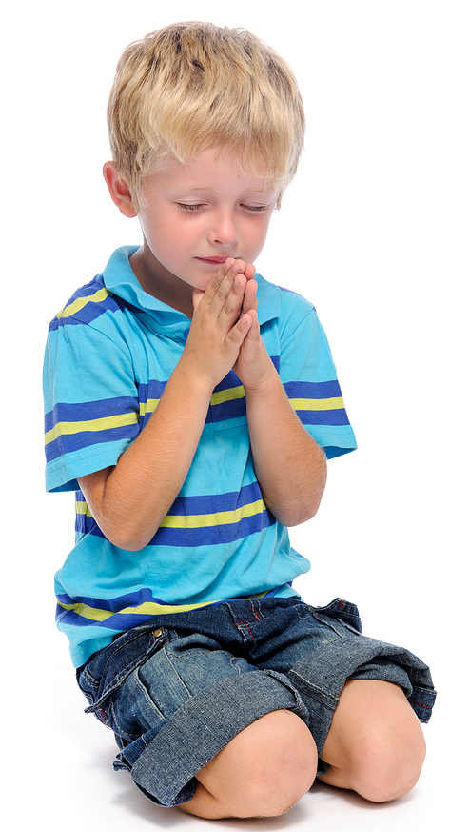
Prayer time
Set aside time to pray with children during times of disasters and crises.
Give children the opportunity to make prayer requests and express their concerns, but don’t compel them.
Children can offer to pray or parents can do the prayer.
Close your prayer that acknowledges the situation and conveys a sense of hope for the future.
Notes:
Prayer Time
Set aside time to pray with children during times of disasters and crises.
Give children the opportunity to make prayer requests and express their concerns, but don’t compel them.
Children can offer to pray or parents can do the prayer.
Close your prayer that acknowledges the situation and conveys a sense of hope for the future.

Slide 16
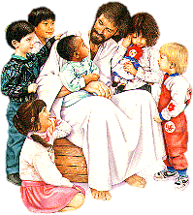
7. Let the child know that jesus is their best friend and will always be with them no matter what they go through
Notes:
7. Let the child know that Jesus is their best friend and will always be with them no matter what they go through.

Slide 17
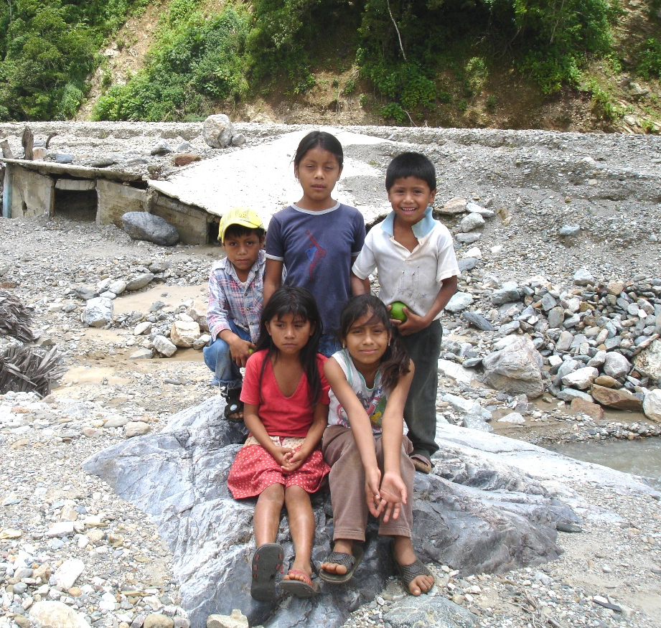
JESUS IS OUR FRIEND
We live in a world of troubles, storms, and stress.
We can still trust Jesus in times of stress.
Jesus invites us to cast our worries on Him because He cares. (1 Peter 5:7)
Jesus will be our Comforter in sorrow when our heart is faint. (Jeremiah 8:18)
He offers strength when we are weak. (Philippines 4:13)
Notes:
Jesus Is Our Friend
We live in a world of troubles, storms, and stress.
We can still trust Jesus in times of stress.
Jesus invites us to cast our worries on Him because He cares. (1 Peter 5:7)
Jesus will be our Comforter in sorrow when our heart is faint. (Jeremiah 8:18)
He offers strength when we are weak. (Philippines 4:13)

Slide 18
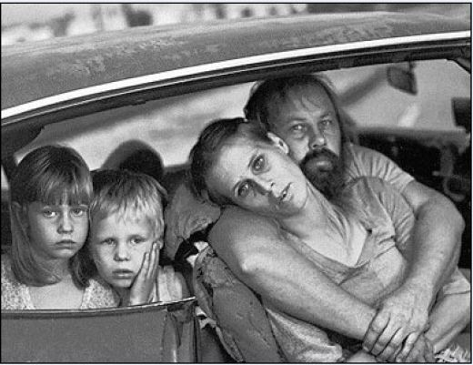
8. Help meet their needs
If the child and family need food or clothing, get members and others to help provide that.
Notes:
8. Help meet their needs
If the child and family need food or clothing, get members and others to help provide that.

Slide 19
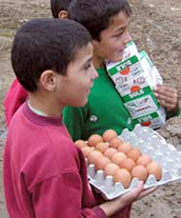
Involve your childREN
Organize outreach activities to involve children to help the victims affected by disasters.
Children can help fill boxes with toiletries, food, blankets, and other needed items.
Take the children out to distribute food boxes for disaster victims & families.
Notes:
Involve Your Children
Organize outreach activities to involve children to help the victims affected by disasters.
Children can help fill boxes with toiletries, food, blankets, and other needed items.
Take the children out to distribute food boxes for disaster victims & families.

Slide 20

8. Help the children get back into a routine as soon as possible
Routine brings security and stability back into a child’s life.
Notes:
8. Help the children get back into a routine as soon as possible
Routine brings security and stability back into a child’s life.

Slide 21

9. Be there
Even if you are at a loss for words, just being there for the child and his family will make a difference.
Notes:
9. Be there
Even if you are at a loss for words, just being there for the child and his family will make a difference.

