Slide 1

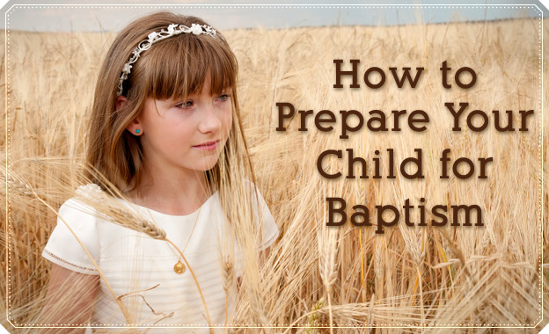
Click here to add text. Click here to add text. Click here to add text. Click here to add text. Click here to add text. Click here to add text. Click here to add text. Click here to add text. Click here to add text.
Click here to add text. Click here to add text. Click here to add text. Click here to add text. Click here to add text. Click here to add text. Click here to add text. Click here to add text.
This could be a call out area. This could be a call out area.
Linda Mei Lin Koh
GC Children’s Ministries
Notes:
HOW TO PREPARE YOUR CHILD FOR BAPTISM

Slide 2
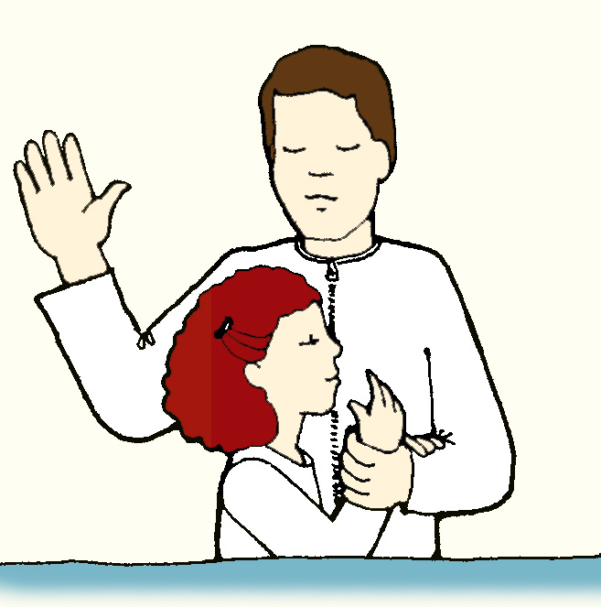
Steps in Baptismal Preparation
Delete text and place photo here.
Expresses desire to be baptized.
Understands the Gospel
Affirmation of faith.
Bible studies.
Baptism celebration.
“I want to be baptized on my birthday!”
Notes:
Steps in Baptismal Preparation
Expresses desire to be baptized.
Understands the Gospel
Affirmation of faith.
Bible studies.
Baptism celebration.

Slide 3
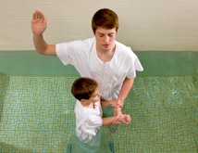
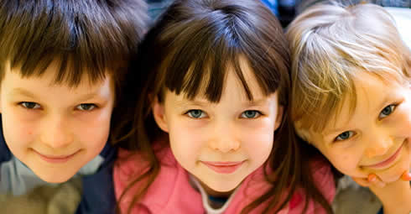
What is Baptism?
Delete text and place photo here.
The word “baptize” comes from the Greek verb baptizo which means “immersion.”
Notes:
What is Baptism?
The word “baptize” comes from the Greek verb baptizo which means “immersion.”

Slide 4

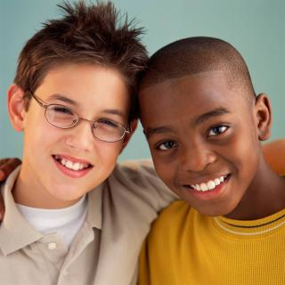
Why Is Baptism Important?
Jesus was baptized and commands the church to baptize (Matt. 3:15-16; 28:18-20).
Baptism is connected with belief and salvation—that Jesus died on the cross to save us.
Notes:
Why Is Baptism Important?
Jesus was baptized and commands the church to baptize (Matt. 3:15-16; 28:18-20).
Baptism is connected with belief and salvation—that Jesus died on the cross to save us.

Slide 5
Why Is Baptism Important?
Baptism indicates a new lifestyle and a commitment to follow Jesus (Rom. 6:3).
Baptism is a public announcement that you are willing to follow Jesus .
Notes:
Baptism indicates a new lifestyle and a commitment to follow Jesus (Rom. 6:3).
Baptism is a public announcement that you are willing to follow Jesus

Slide 6
Step 1. Express Desire to be Baptized
Notes:
Step 1. Express Desire to be Baptized

Slide 7
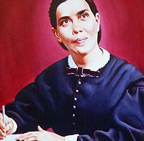
Testimonies, Vol. 6, p. 93
“Parents whose children desire to be baptized have a work to do, both in self-examination and in giving faithful instruction to their children. Baptism is a most sacred and important ordinance, and there should be a thorough understanding as to its meaning. It means repentance for sin, and the entrance upon a new life in Christ Jesus. There should be no undue haste to receive the ordinance. Let both parents and children count the cost. In consenting to the baptism of their children, parents sacredly pledge themselves to be faithful stewards over these children, to guide them in their character building. They pledge themselves to guard with special interest these lambs of the flock, that they may not dishonor the faith they profess."
Notes:
Testimonies, Vol. 6, p. 93
“Parents whose children desire to be baptized have a work to do, both in self-examination and in giving faithful instruction to their children. Baptism is a most sacred and important ordinance, and there should be a thorough understanding as to its meaning. It means repentance for sin, and the entrance upon a new life in Christ Jesus. There should be no undue haste to receive the ordinance. Let both parents and children count the cost. In consenting to the baptism of their children, parents sacredly pledge themselves to be faithful stewards over these children, to guide them in their character building. They pledge themselves to guard with special interest these lambs of the flock, that they may not dishonor the faith they profess.

Slide 8
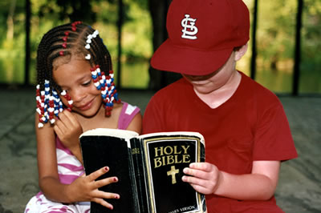
Something To Look Out For
If a child comes to a pastor & said, “I want to be baptized,” don’t disregard such a request.
Take their request seriously.
The Holy Spirit convicts children of their need of Jesus regardless of chronological age.
Notes:
Something to Look Out For
If a child comes to a pastor & said, “I want to be baptized,” don’t disregard such a request.
Take their request seriously.
The Holy Spirit convicts children of their need of Jesus regardless of chronological age.
What your child needs is Jesus Christ, not happiness, or health, or academic success.

Slide 9

Indicate your delight at their decision.
Meet with the parents and child together to discuss how to prepare.
Ask the child a few questions:
*why do you want to be baptized?
*when did you feel Jesus is
tugging at your heart?
Notes:
Indicate your delight at their decision.
Meet with the parents and child together to discuss how to prepare.
Ask the child a few questions:
*why do you want to be baptized?
*when did you feel Jesus is tugging at your heart?

Slide 10
Intellectual Readiness
Does your child still believe in Santa Claus and the tooth fairy?
Can your child articulate his/her reasons for requesting baptism?
Have you noticed your child beginning to spend time in personal devotions?
Is he able to answer “why” questions
Notes:
Intellectual Readiness
Does your child still believe in Santa Claus and the tooth fairy?
Can your child articulate his/her reasons for requesting baptism?
Have you noticed your child beginning to spend time in personal devotions?
Is he able to answer “why” questions

Slide 11
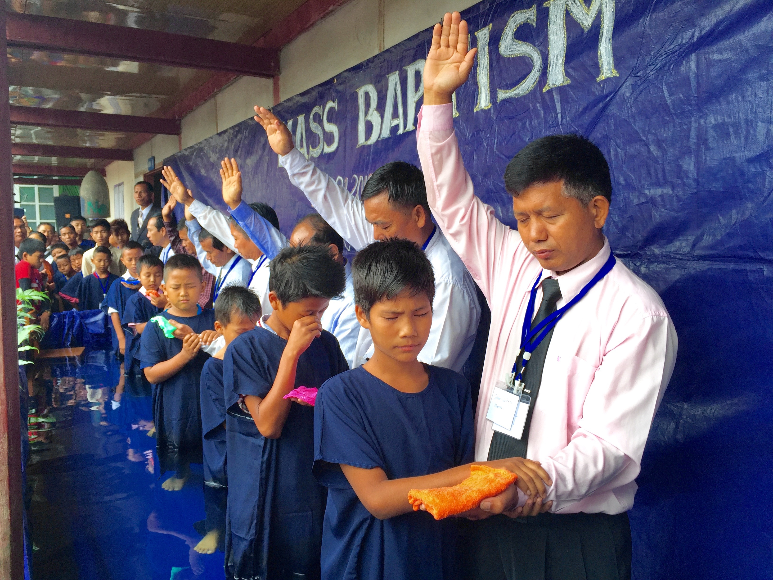
Emotional Readiness
Do you think your child has been captured by the mood of the baptism event rather than having a conscious decision to follow Jesus?
Is your child getting baptized to please an adult?
Notes:
Emotional Readiness
Do you think your child has been captured by the mood of the baptism event rather than having a conscious decision to follow Jesus?
Is your child getting baptized to please an adult?

Slide 12
Step 2. Understand the Gospel
Notes:
STEP 2: UNDERSTAND THE GOSPEL
The following concepts will help your children to understand the Gospel. It is a good practice to look for ways to bring out one or more of these points in every lesson you teach. Build a child’s understanding over time rather than trying to introduce all this information to them at once. This gives the Holy Spirit time to work deeply in their lives – convicting them of their need, revealing God’s love, giving them understanding of the Gospel and bringing them to a point of decision. Periodically bring it all together in a Gospel presentation which gives them an opportunity to make a personal commitment. The verses given are for your information.

Slide 13
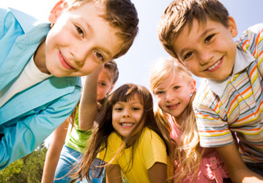
Essential Elements of the Gospel
God -- There is only one true and holy God who is the Creator and Ruler of everything. He is always good. (Gen. 1:1; Psalm 24:1)
You -- You are God’s special creation. He loves and cares for you. (Psalm 23: 1,2; 139:13,14) He shows you the right way to live in the Bible. (Ex. 20:1-17; Matthew 5-7)
Notes:
Essential Elements of the Gospel
God -- There is only one true and holy God who is the Creator and Ruler of everything. He is always good. (Genesis 1:1; Psalm 24:1)
You -- You are God’s special creation. He loves and cares for you. (Psalm 23: 1,2; 139:13,14) He shows you the right way to live in the Bible. (Ex. 20:1-17; Matthew 5-7)

Slide 14
Essential Elements of the Gospel
Sin -- You have sinned and done what is wrong; you have disobeyed God (Romans 3:23). This is a problem because sin separates us from God so we can no longer be his friends. (Isaiah 59:1-2) There is absolutely no way that you could ever do anything good enough to win back God’s favor. (Ephesians 2:8-9)
Notes:
ESSENTIALS OF THE GOSPEL
Sin -- You have sinned and done what is wrong; you have disobeyed God (Romans 3:23). This is a problem because sin separates us from God so we can no longer be his friends. (Isaiah 59:1-2) There is absolutely no way that you could ever do anything good enough to win back God’s favor. (Ephesians 2:8-9)

Slide 15
Essential Elements of the Gospel
Jesus -- BUT God loved you so much that he found a way for you to be his friend again. So he sent Jesus to earth to save you from sin. (1 John 4:9; John 3:16; Romans 5:8) Jesus was God and he never did anything wrong. (Hebrews 4:15) He took the punishment for your sin by dying on the cross. (1 Peter 3:18) God brought Jesus back to life and he is alive today. (Acts 2:32)
Notes:
ESSENTIALS OF THE GOSPEL
Jesus -- BUT God loved you so much that he found a way for you to be his friend again. So he sent Jesus to earth to save you from sin. (1 John 4:9; John 3:16; Romans 5:8) Jesus was God and he never did anything wrong. (Hebrews 4:15) He took the punishment for your sin by dying on the cross. (1 Peter 3:18) God brought Jesus back to life and he is alive today. (Acts 2:32)

Slide 16
Essential Elements of the Gospel
Salvation--There is no other way to be saved from your sin and to become friends with God. (John 14:6, Romans 5:8) You need to admit that you have sinned and ask God to forgive you. (1 John 1:9) If you believe that Jesus Christ is God, that he died to take the punishment for your sins and that he came back to life again, then God will cleanse you from your sins and make you his child. (Acts 16:31; John 1:12; Romans 10:9)
Notes:
ESSENTIALS OF THE GOSPEL
Salvation--There is no other way to be saved from your sin and to become friends with God. (John 14:6, Romans 5:8) You need to admit that you have sinned and ask God to forgive you. (1 John 1:9) If you believe that Jesus Christ is God, that he died to take the punishment for your sins and that he came back to life again, then God will cleanse you from your sins and make you his child. (Acts 16:31; John 1:12; Romans 10:9)

Slide 17
Essential Elements of the Gospel
New Life -- He will give you the Holy Spirit to come into your life and help you to do what is right. (I Corinthians 3:16; 10:13; Philippians 4:13) He calls you to be his disciple (follower), living life to the full, making a difference in your world and being changed to be like him. (Matthew 28:19,20; Romans 8:29; John 10:10). When Jesus comes again, you will go to heaven to live with him forever. (John 14:2,3)
Notes:
ESSENTIALS OF THE GOSPEL
New Life -- He will give you the Holy Spirit to come into your life and help you to do what is right. (I Corinthians 3:16; 10:13; Philippians 4:13) He calls you to be his disciple (follower), living life to the full, making a difference in your world and being changed to be like him. (Matthew 28:19,20; Romans 8:29; John 10:10). When Jesus comes again, you will go to heaven to live with him forever. (John 14:2,3)

Slide 18
Step 3. Commitment of Faith Ceremony
Notes:
STEP 3: COMMITMENT OF FAITH CEREMONY

Slide 19

Celebrate the Child’s Decision with the Church
Have a short ceremony before worship service to affirm the child’s decision.
Introduce the child to the church family and invite parents to stand. Let them know of his/her decision to follow Jesus and the preparation that is made for baptism.
Notes:
Celebrate the Child’s Decision with the Church
Have a short ceremony before worship service to affirm the child’s decision.
Introduce the child to the church family and invite parents to stand. Let them know of his/her decision to follow Jesus and the preparation that is made for baptism.

Slide 20
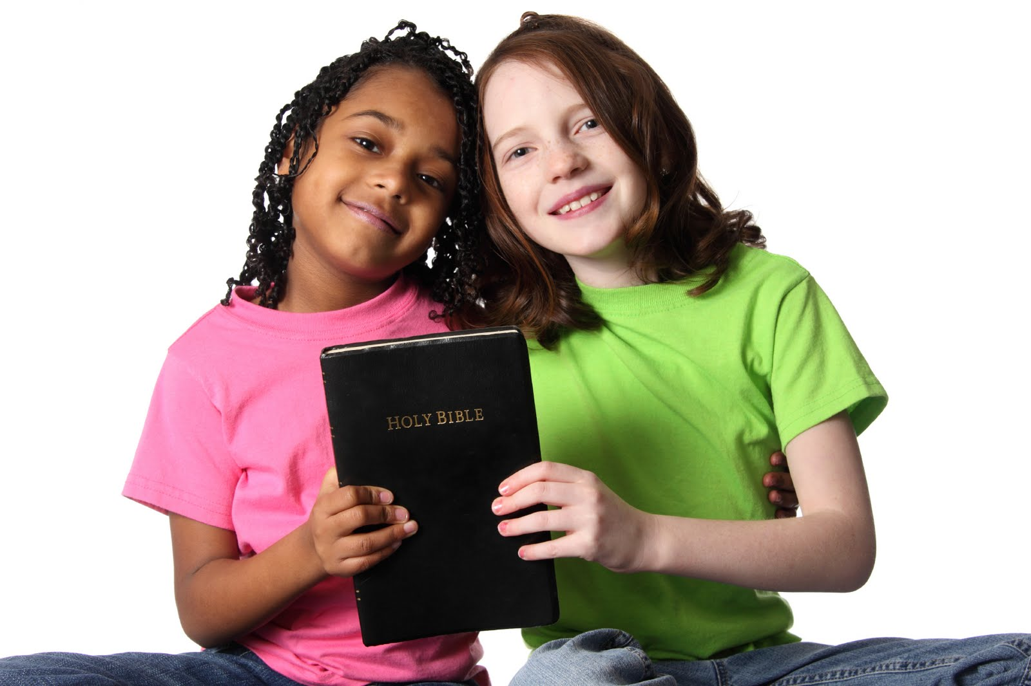
Ahead of time ask the child to select a faith friend who will be the guardian for him/her in her journey with Jesus.
Introduce the faith friend to the church and then let him/her speak a few words.
Notes:
Ahead of time ask the child to select a faith friend who will be the guardian for him/her in her journey with Jesus.
Introduce the faith friend to the church and then let him/her speak a few words.

Slide 21
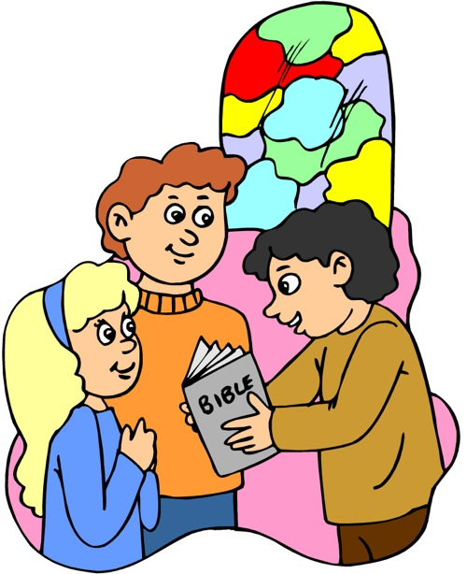
Invite the church members to come forward to shake hands with the child as gesture of welcome and blessing.
Have a special prayer for the child and ask God to bless the child as she/he prepares to be baptized.
Give the child a Bible to study and mark in it. Give him/her the certificate.
Notes:
Invite the church members to come forward to shake hands with the child as gesture of welcome and blessing.
Have a special prayer for the child and ask God to bless the child as she/he prepares to be baptized.
Give the child a Bible to study and mark in it. Give him the certificate.

Slide 22
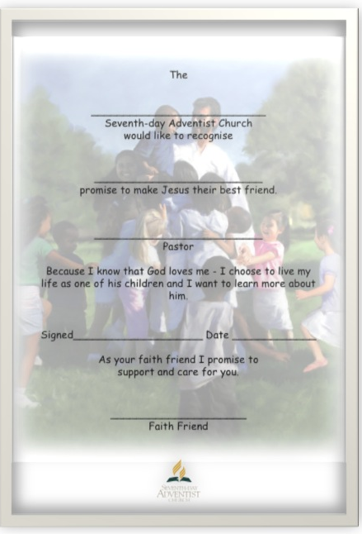

Notes:
A Child’ Commitment Ceremony

Slide 23
Step 4. Bible Studies
Notes:
Step 4. Bible Studies

Slide 24
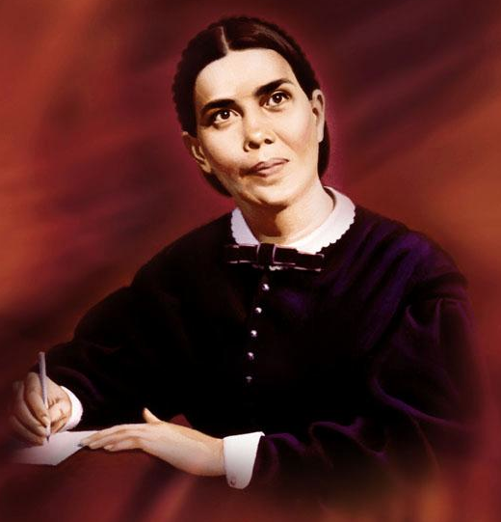
Testimonies, Vol. 1, p. 400
“Children of eight, ten or twelve years, are old enough to be addressed on the subject of personal religion. Do not teach your children with reference to some future period when they shall be old enough to repent and believe the truth. If properly instructed, very young children may have correct views of their state as sinners, and of the way of salvation through Christ.”
Notes:
Testimonies, Vol. 1, p. 400
“Children of eight, ten or twelve years, are old enough to be addressed on the subject of personal religion. Do not teach your children with reference to some future period when they shall be old enough to repent and believe the truth. If properly instructed, very young children may have correct views of their state as sinners, and of the way of salvation through Christ.”

Slide 25
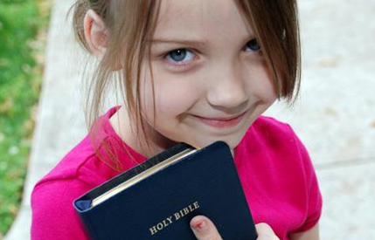
Testimonies, Vol. 5, p. 303
"He who will study the Bible with a humble and teachable spirit will find a sure guide, pointing out the way of life with unfailing accuracy. But what does your study of the Bible avail, ... unless you practice the truths it teaches? That Holy Book contains nothing that is revealed that has not a bearing upon our actual lives. The deeper our love for Jesus, the more highly we shall regard that word as the voice of God directly to us."
Notes:
Testimonies, Vol. 5, p. 303
"He who will study the Bible with a humble and teachable spirit will find a sure guide, pointing out the way of life with unfailing accuracy. But what does your study of the Bible avail, ... unless you practice the truths it teaches? That Holy Book contains nothing that is revealed that has not a bearing upon our actual lives. The deeper our love for Jesus, the more highly we shall regard that word as the voice of God directly to us."

Slide 26


Guidelines for Bible Studies
The pastor can run a Bible study baptismal class for children.
Do not put children in the adult baptismal class. Children have different needs and questions that are relevant to their age.
In the presence of adults, they are often shy or afraid to ask questions.
Notes:
GUIDELINES
The pastor can run a Bible study baptismal class for children.
Do not put children in the adult baptismal class. Children have different needs and questions that are relevant to their age.
In the presence of adults, they are often shy or afraid to ask questions.

Slide 27
More Guidelines
Pray for the Holy Spirit to help you explain the truth to the child
Be careful of the symbolism and religious terminology you use.
Take time to study each lesson with the child. Don't try to rush.
Correct misunderstandings.
Notes:
MORE GUIDELINES
Pray for the Holy Spirit to help you explain the truth to the child
Be careful of the symbolism and religious terminology you use.
Take time to study each lesson with the child. Don't try to rush.
Correct misunderstandings.

Slide 28

Affirmation of Faith
Use a more contemporary version or a children’s version that would be more understandable by children. Do not use the old King James version.
Notes:
Use a more contemporary version or a children’s version that would be more understandable by children. Do not use the old King James version for it is difficult to understand old English.

Slide 29

More Guidelines
Take time to answer the children’s questions.
Have children fill in answers to the lessons.
Use Bible studies that are age appropriate.
Notes:
More Guidelines
Take time to answer the children’s questions.
Have children fill in answers to the lessons.
Use Bible studies that are age appropriate.

Slide 30

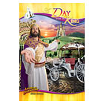
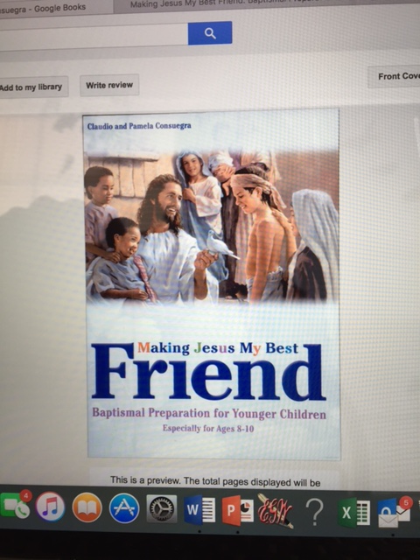

Resources
Making Jesus My Best Friend Baptismal Guide
for Younger
Children
The Amazing
Adventures
by Amazing Facts
Bible Adventures for
Young Readers
Notes:
Resources:
Bible Adventures for Young Readers
The Amazing Adventures by Amazing Facts
Making Jesus My Best Friend Baptismal Guide for Younger Children

Slide 31

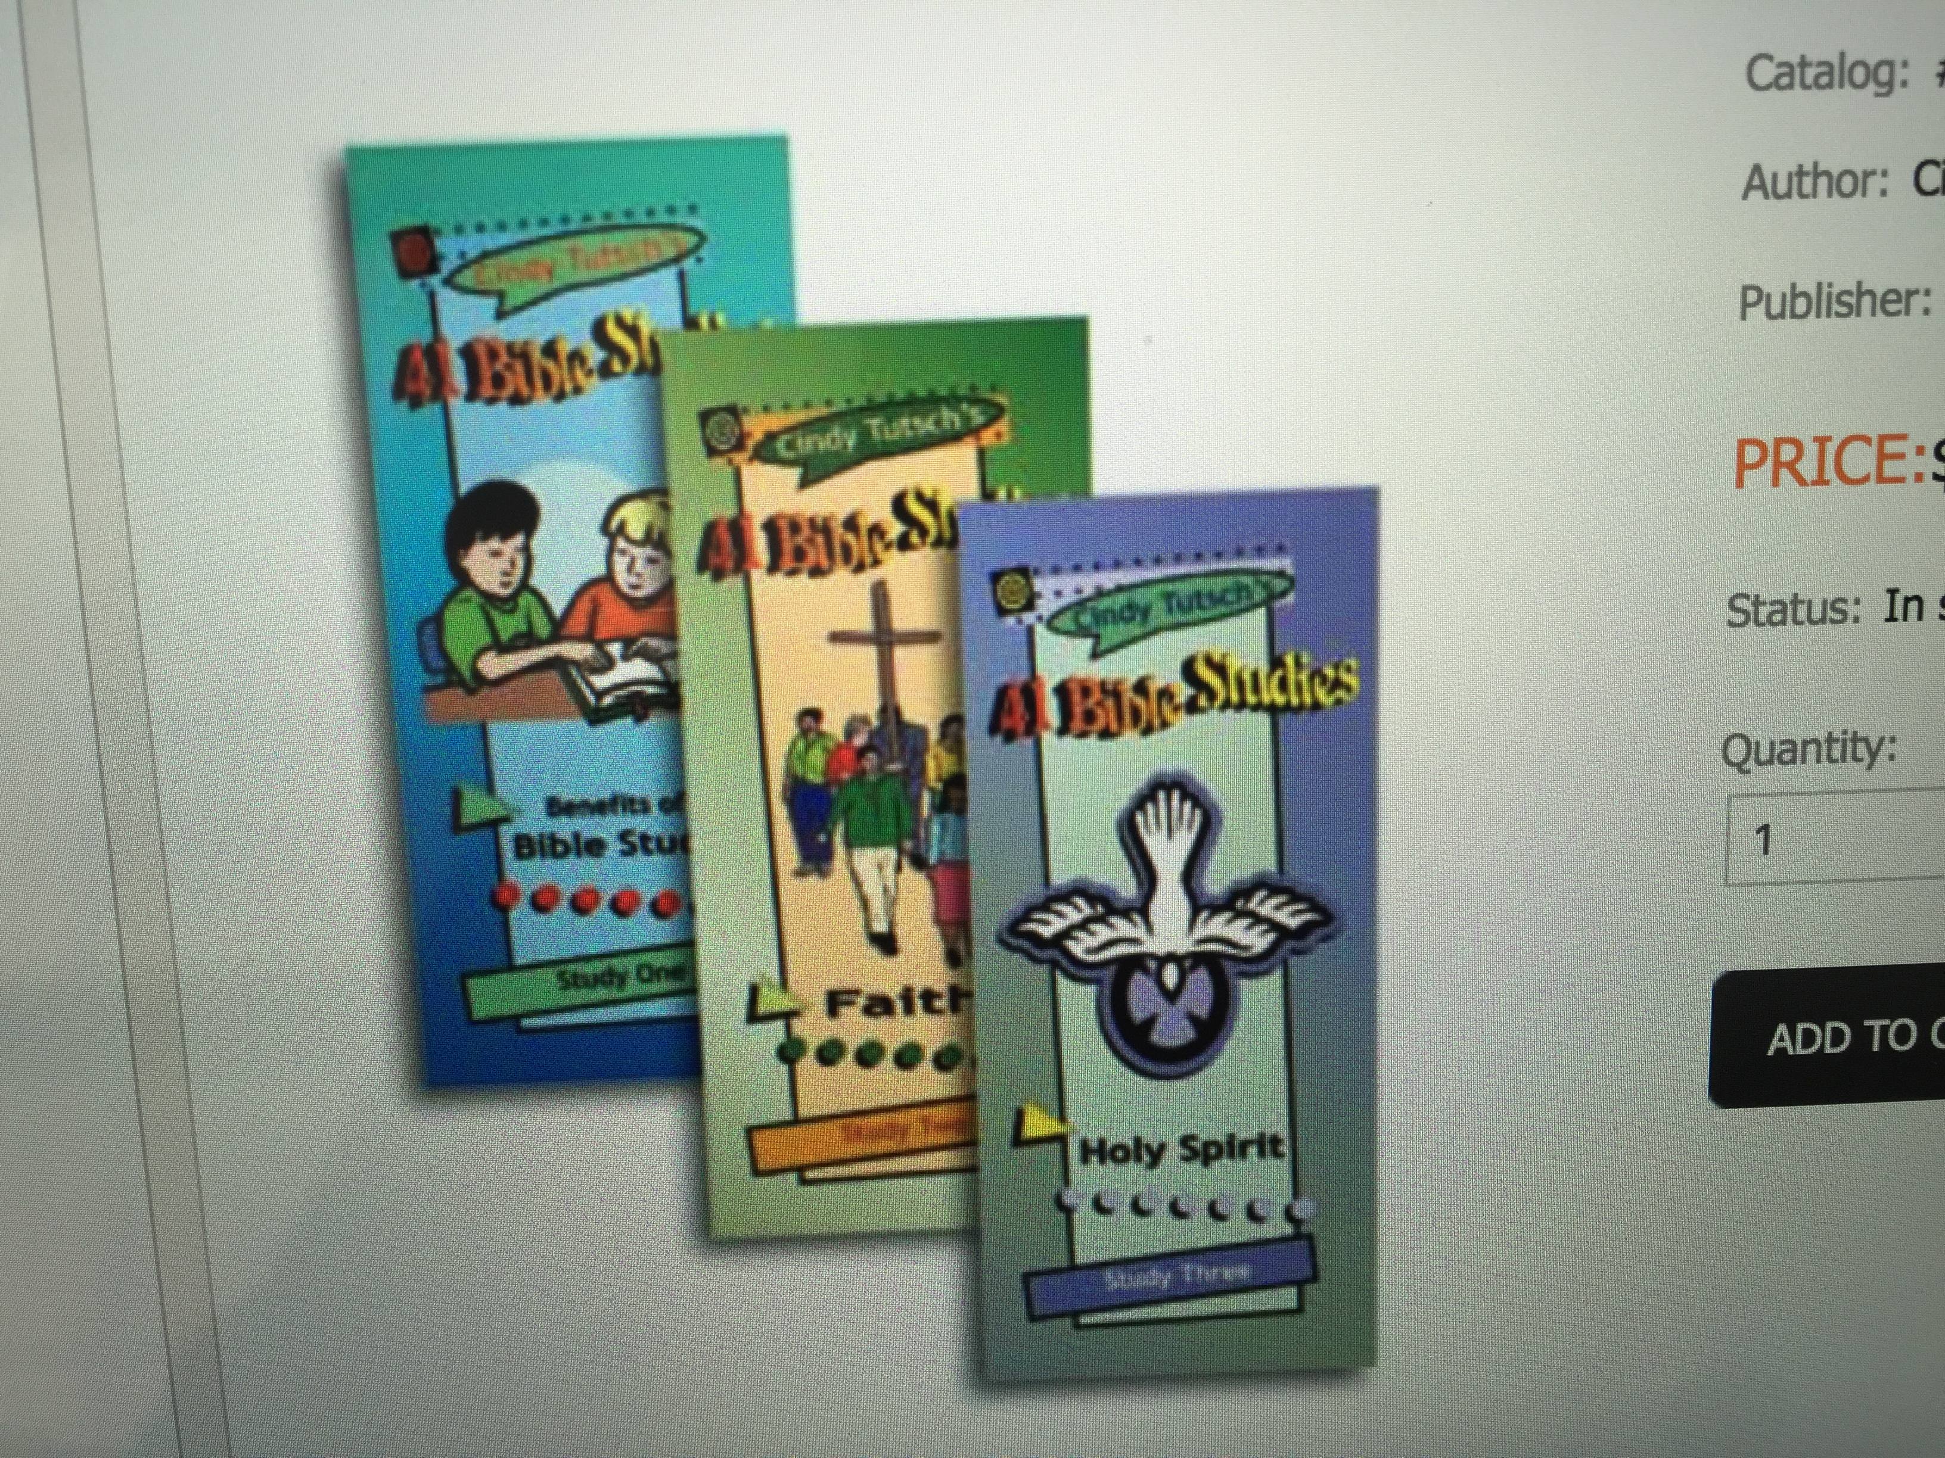

More Resources
It’s My Choice Baptismal Guide for Juniors
41 Bible studies by Cindy Tutsch
Children’s Great Controversy (abr. ed.)
Notes:
More Resources:
It’s My Choice Baptismal Guide for Juniors
Children’s Great Controversy (abridged ed.)
41 Bible Studies by Cindy Tutsch

Slide 32
The Pastor’s Role
Facilitator
Supporter
Encourager
Christian role model
Initiator
If children learn to trust their pastor and feel safe in his/her presence then are they more likely to relate to him/her as their Spiritual Mentor.
Notes:
The Pastor’s Role
Facilitator
Supporter
Encourager
Christian role model
Initiator
If children learn to trust their pastor and feel safe in his/her presence then are they more likely to relate to him/her as their Spiritual Mentor.

Slide 33
Step 5. Baptism Celebration
Notes:
Step 5: Baptism Celebration

Slide 34
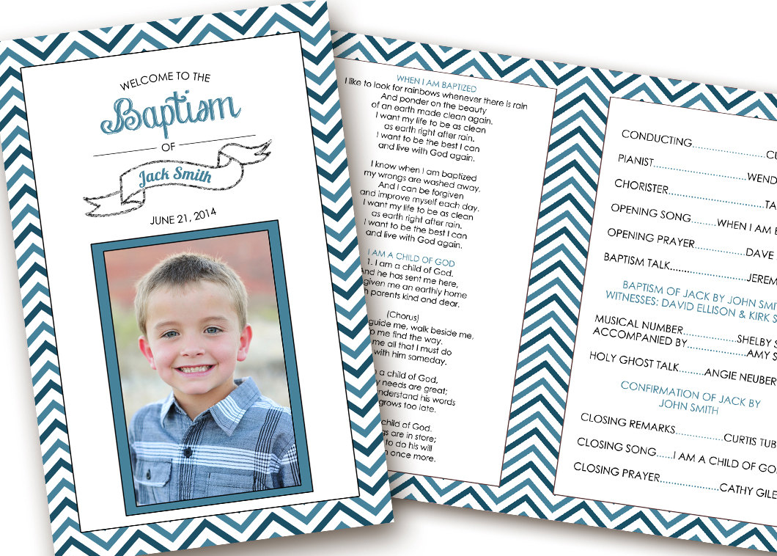
Suggestions for Planning A Child’s Baptism Celebration
Involve children in planning their own baptism program.
Encourage them to choose their favorite Christian song to be sung.
Plan to have the child answer pre-arranged questions about their personal Christian experience or prepare a pre-arranged video instead.
Notes:
Suggestions for Planning A Child’s Baptism Celebration
Involve children in planning their own baptism program.
Encourage them to choose their favorite Christian song to be sung.
Plan to have the child answer pre-arranged questions about their personal Christian experience or prepare a pre-arranged video instead.

Slide 35

Suggestions for Planning A Child’s Baptism Celebration
Celebrate their decision. This is another child being welcomed into God’s Kingdom!
Make it a memorable experience.
Include their mentor and friends in the program and experience.
Make it a special feature not just squeeze it in between offering & prayer
Notes:
Suggestions for Planning A Child’s Baptism Celebration
Celebrate their decision. This is another child being welcomed into God’s Kingdom!
Make it a memorable experience.
Include their mentor and friends in the program and experience.
Make it a special feature not just squeeze it in between offering & prayer

Slide 36

Simplified SDA Baptism Vows (Steve Case)
1. I believe in God the Father; in His Son, Jesus Christ; and in the Holy Spirit.
2. I accept the death of Jesus to pay for my sins.
3. I accept the new heart Jesus gives me in place of my sinful heart.
4. I believe that Jesus is in heaven as my best friend and that He gives me the Holy Spirit so I can obey Him.
5. I believe God gave me the Bible as my most important guidebook.
6. By God living in me, I want to obey the Ten Commandments, which include the observance of the seventh day of the week as the Sabbath.
7. I want to help as many people as possible to be ready for the soon coming of Jesus.
8. I believe God gives special abilities to His people, and that the Spirit of Prophecy is given to His chosen people.
9. I want to help God’s church with my influence, effort, and money.
10. I want to take good care of my body because the Holy Spirit lives there now.
11. With God’s power, I want to obey the basic principles of the Seventh-day Adventist Church.
12. I want to be baptized to show people I am a Christian.
13. I want to be a member of the Seventh-day Adventist Church, and I believe this church has a special message to give to the world.
Notes:
Simplified SDA Baptism Vows (Steve Case)
1. I believe in God the Father; in His Son, Jesus Christ; and in the Holy Spirit.
2. I accept the death of Jesus to pay for my sins.
3. I accept the new heart Jesus gives me in place of my sinful heart.
4. I believe that Jesus is in heaven as my best friend and that He gives me the Holy Spirit so I can obey Him.
5. I believe God gave me the Bible as my most important guidebook.
6. By God living in me, I want to obey the Ten Commandments, which include the observance of the seventh day of the week as the Sabbath.
7. I want to help as many people as possible to be ready for the soon coming of Jesus.
8. I believe God gives special abilities to His people, and that the Spirit of Prophecy is given to His chosen people.
9. I want to help God’s church with my influence, effort, and money.
10. I want to take good care of my body because the Holy Spirit lives there now.
11. With God’s power, I want to obey the basic principles of the Seventh-day Adventist Church.
12. I want to be baptized to show people I am a Christian.
13. I want to be a member of the Seventh-day Adventist Church, and I believe this church has a special message to give to the world.

