Slide 1
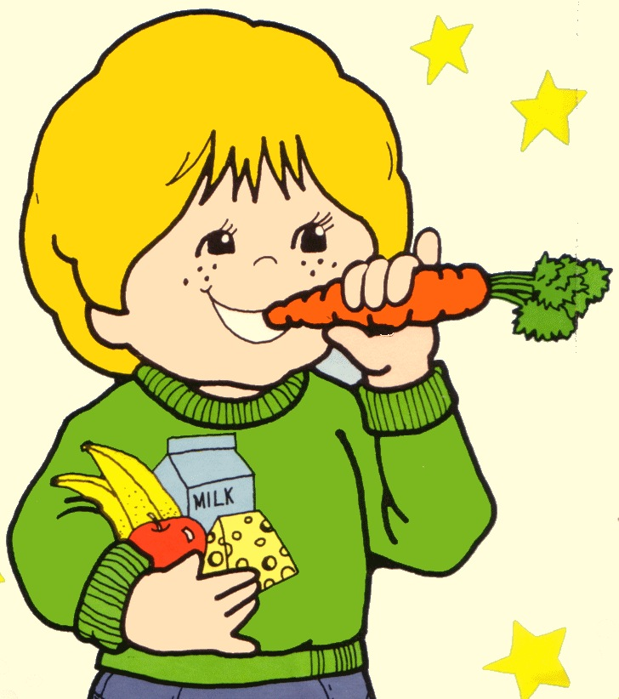
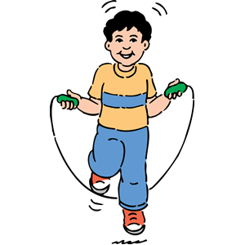
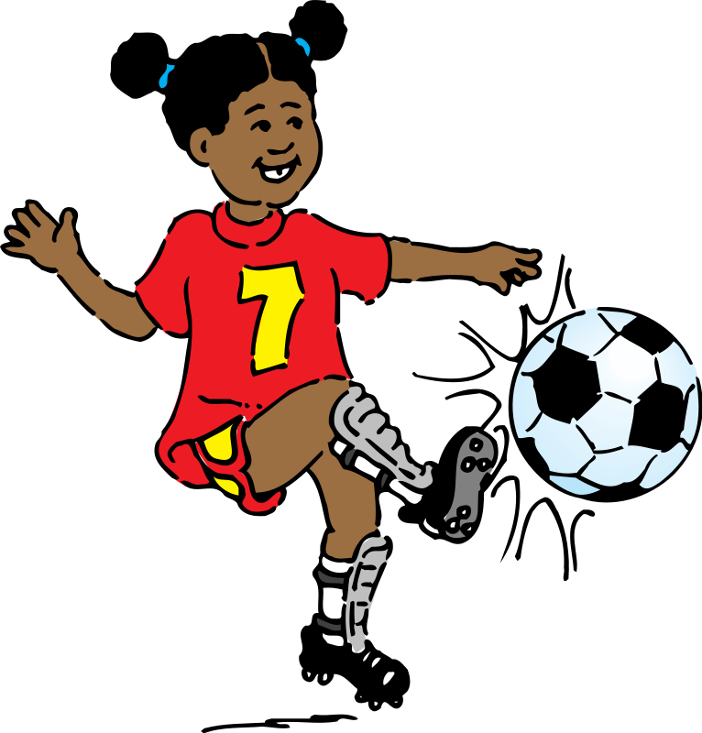
God’s Design for Highly Healthy Children
Linda Mei Lin Koh, Ed. D, CFLE
GC Director of Children’s Ministries
Adapted from God’s Design for the Highly Healthy Child
by Walt Larimore
Notes:
God’s Design for the Highly Healthy Child (Adapted from God’s Design for a Highly Healthy Child by Walt Larimore).

Slide 2
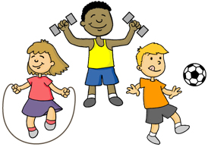
What’s a Highly Healthy Child?
True health involves our entire beings, with all the following elements:
Physical
Emotional
Relational
Spiritual
Notes:
What’s a Highly Healthy Child?
True health involves our entire beings, with all the following elements:
Physical
Emotional
Relational
Spiritual
It is not just eating good food or regular exercise alone that will make children healthy. It also involves how they feel and adjust to their daily life.

Slide 3
Nick Zervanos, M. D., family physician
“When the physical, mental, and spiritual dimensions of well-being are singing in harmony, you’re healthy. That doesn’t mean there is no room for a dissonant chord, but that the music of life is pleasant to the ear.”
Notes:
Nick Zervanos, M. D., family physician says:
“When the physical, mental, and spiritual dimensions of well-being are singing in harmony, you’re healthy. That doesn’t mean there is no room for a dissonant chord, but that the music of life is pleasant to the ear.”

Slide 4
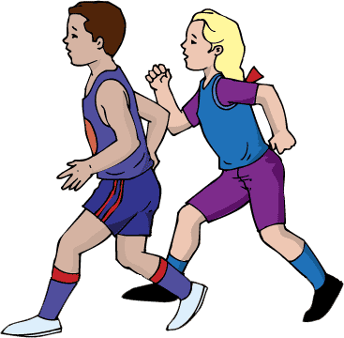
Ellen G. White, Child Guidance, p. 103.
“The future happiness of your families and the welfare of society depend largely upon the physical and moral education which your children receive in the first years of their life.”
Notes:
Ellen G. White, Child Guidance, p. 103.
“The future happiness of your families and the welfare of society depend largely upon the physical and moral education which your children receive in the first years of their life.”

Slide 5
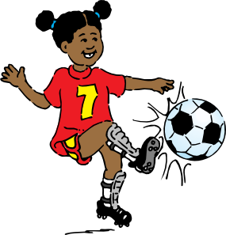
The Four Wheels of Health
Physical
Emotional
Relational
Spiritual
Notes:
The Four Wheels of Health
Physical –the well-being of a child’s body
Emotional – the well-being of a child’s mental faculties and connection with his or her emotions
Relational – the well-being of a child’s associations with parents, family members, friends, and community; and
Spiritual – the well-being of a child’s relationship with God

Slide 6
The Physical Wheel
Preventing diseases and treating it as early as possible is essential.
When illness or disorder occurs, physical health involves learning to cope and adapt at needed.
With good emotional, relational, and spiritual health, a child lacking physical “wholeness” can still be highly healthy.
Notes:
The Physical Wheel
Preventing diseases and treating it as early as possible is essential.
When illness or disorder occurs, physical health involves learning to cope and adapt as needed.
Illustration: Kate was born with cerebral palsy. Most of her right brain and about one-half of her left brain died and dissolved while she was in the womb. The brain damage greatly affected her physical development. She had had several operations to straighten her limbs and eyes. She wore braces and splints, casts and eye patched, and for a time she was in a wheelchair.
Though she is not normal, but Kate has learned to cope and adapt. She learns to care for herself physically. She takes her medications, makes her doctor appointments, and does her own self-care. Her physical wheel is fairly healthy—not because he health is perfect but because it is reasonably balanced.
Kate could become unhealthy if her parents had not helped and supported her and taught her to adapt. Other children with similar disabilities became obese and unhappy.

Slide 7
The Physical Wheel
Activity – exercise, play outside, participate in sports and physical education.
Rest – adequate sleep and rest.
Nutrition – drink water, nutritious foods, abstain from alcohol, smoking, etc.
Immunizations – get the necessary immunizations and recommended vaccines.
Notes:
The Physical Wheel
Activity – exercise, play outside, participate in sports and physical education.
Rest – adequate sleep and rest.
Nutrition – drink water, nutritious foods, abstain from alcohol, smoking, etc.
Immunizations – get the necessary immunizations and recommended vaccines.

Slide 8
The Emotional Wheel
Great emotional healthy is not the absence of emotional stress.
Emotional health is learning to cope with and then embrace the full spectrum of human emotions—positive and negative.
Parents must teach our children how to appropriately recognize and express the full range of human emotions.
Notes:
The Emotional Wheel
Great emotional healthy is not the absence of emotional stress.
Emotional health is learning to cope with and then embrace the full spectrum of human emotions—positive and negative.
Parents must teach our children how to appropriately recognize and express the full range of human emotions.
Illustration:

Slide 9
The Emotional Wheel
Love/Respect – communicate love & respect to your child.
Affirmation/Appreciation -- Praise your child’s unique qualities, gifts, and talents.
Media/Learning – influence your child’s learning. Encourage reading, playing besides TV/ computer games.
Boundaries -- Set appropriate & limits for media use and learning.
Notes:
The Emotional Wheel
Love/Respect – communicate love & respect to your child.
Affirmation/Appreciation -- Praise your child’s unique qualities, gifts, and talents.
Media/Learning – influence your child’s learning. Encourage reading, playing besides TV/ computer games.
Boundaries -- Set appropriate & limits for media use and learning.

Slide 10
The Relational Wheel
A child’s relationships with his parents, siblings, friends, schoolmates, teachers, neighbors and the community affects his relational health.
Parents must involve their children in healthy relationships and protect them from toxic relationships.
Teach children how to exercise discernment in their relationships.
Notes:
The Relational Wheel
A child’s relationships with his parents, siblings, friends, schoolmates, teachers, neighbors and the community affects his relational health.
Parents must involve their children in healthy relationships and protect them from toxic relationships.
Teach children how to exercise discernment in their relationships.

Slide 11
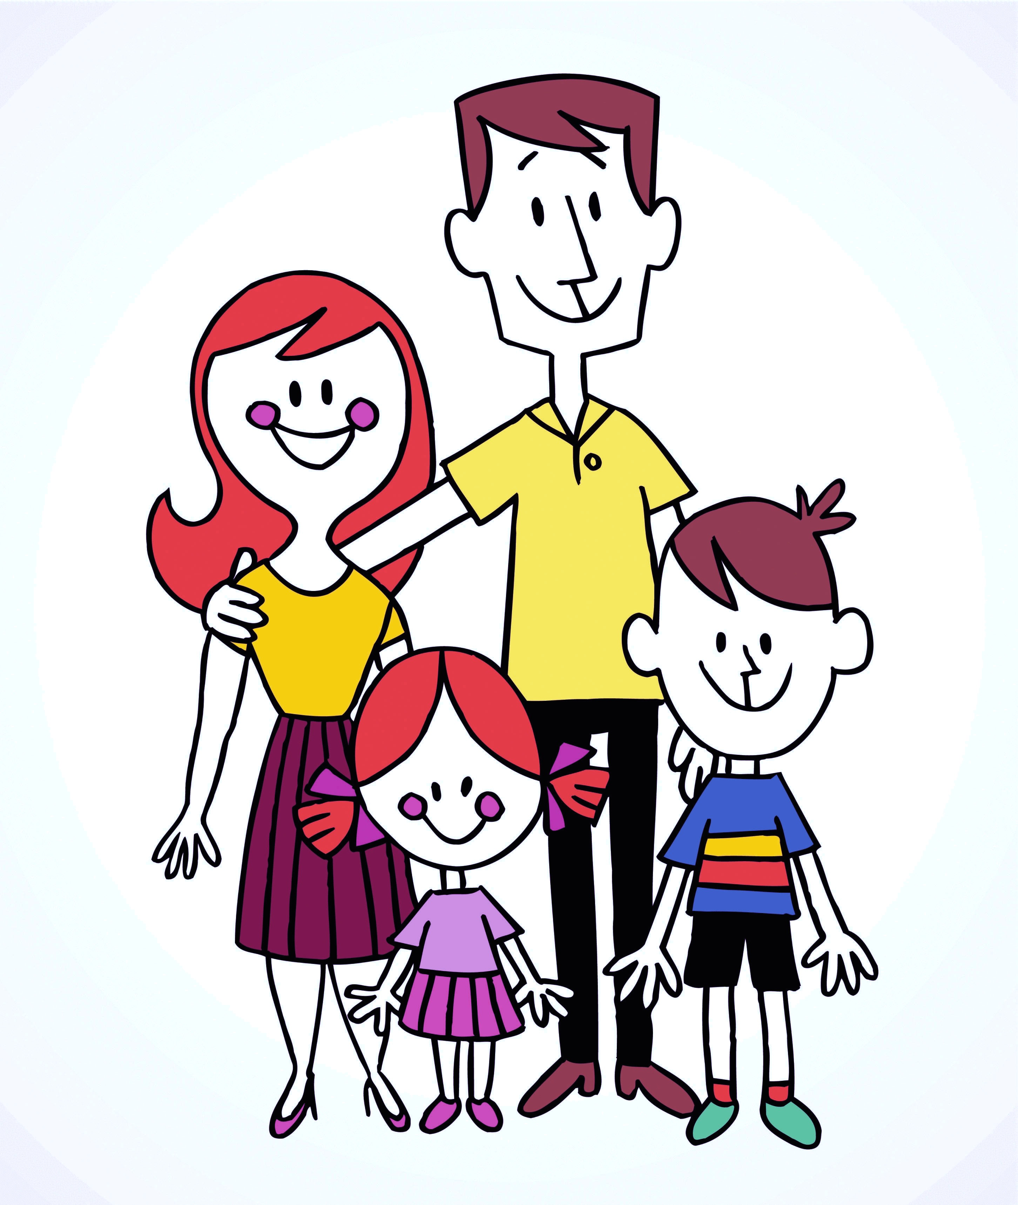
The Relational Wheel
Relationship with Parents – need to spend time with your child – critical to his/her self-concept and ability to develop and maintain healthy relationships.
Connectedness – is foundational to a child’s relational & emotional healthy. Helps develop constructive interactions with others, good attitude, optimistic, and can tackle life’s problems.
Notes:
The Relational Wheel
Relationship with Parents – need to spend time with your child – critical to his/her self-concept and ability to develop and maintain healthy relationships.
Connectedness – is foundational to a child’s relational & emotional healthy. Helps develop constructive interactions with others, good attitude, optimistic, and can tackle life’s problems.

Slide 12
The Spiritual Wheel
Personal relationship with God – personal devotions, Bible reading & prayer.
Prayer – involvement in prayer groups, prayer conference.
Spiritual instruction – training in church doctrines, Sabbath Schools. and Bible study guides, small groups
Spiritual activity – involvement in church worship and activity, involvement in community services.
Notes:
The Spiritual Wheel
Personal relationship with God – personal devotions, Bible reading & prayer.
Prayer – involvement in prayer groups, prayer conference.
Spiritual instruction – training in church doctrines, Sabbath Schools. and Bible study guides, small groups
Spiritual activity – involvement in church worship and activity, involvement in community services.

Slide 13
VALUABLE TEACHING PRINCIPLES
Notes:
VALUABLE TEACHING PRINCIPLES

Slide 14
1. Be Proactive in Preventing Physical Disease
Notes:
1. Be Proactive in Preventing Physical Disease

Slide 15
Make sure your children receive regular checkups.
See to it that your children receive appropriate immunizations.
See to it that your children receive preventive dental care.
Notes:
Make sure your children receive regular checkups.
See to it that your children receive appropriate immunizations.
See to it that your children receive preventive dental care.

Slide 16
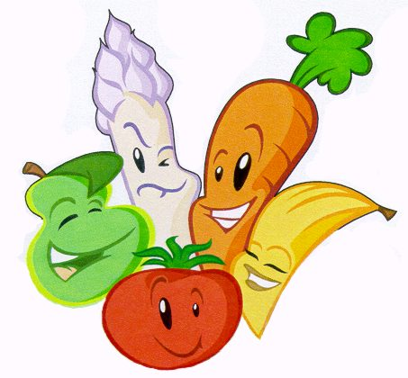
2. Ensure Proper Nutrition
Teach them to select a balanced diet.
Eat more vegetables and fruits and less meat.
A healthy eating plate should have:
vegetables
proteins
whole grains
fruits
Limit or eliminate fast food.
Avoid snacks, sweets, and fast foods.
Notes:
Ensure Proper Nutrition
Teach them to select a balanced diet.
Eat more vegetables and fruits and less meat.
A healthy eating plate should have:
vegetables
proteins
whole grains
fruits
Limit or eliminate fast food.
Avoid snacks, sweets, and fast foods.

Slide 17
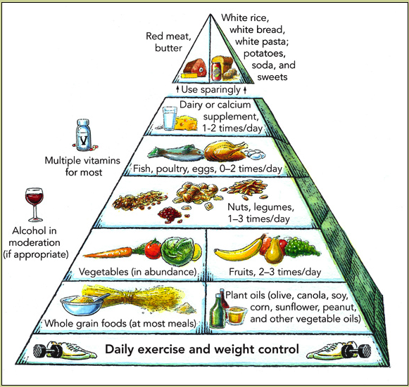
Harvard School of Public Health
Healthy Eating
Pyramid
3-5 servings
6-11 servings
88
Notes:
The Healthy Eating Pyramid – Harvard School of Public Health
Eat a plant-based diet rich in fruits, vegetables, and whole grains. Eat a variety of fruits and vegetables with various colors.
Whole Grain Bread, Cereal, Pasta, and Rice Group—Eat Liberally—6-11 servings at most meals.
Vegetables—Eat in abundance – 3-5 servings.
Fruit -- 2-4 servings
Legume, Nut, Seed,—Eat Moderately— 1-3 times a day.
Vegetable Fats and Oils (olive, canola, soy, corn, sunflower, peanut, and other vegetable oils).
Vegetables—Eat Generously—3-5 servings
Fish, poultry, eggs – 0-2 times a day.
Dairy or calcium supplement— 1-2 times a day.
Red meat, butter, white rice, white bread, white pasta, potatoes, soda, and sweets.– use sparingly.

Slide 18
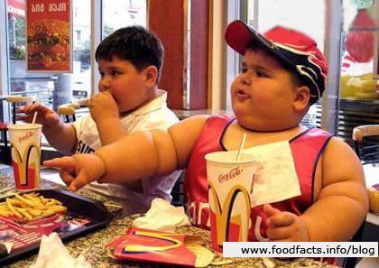
Dangers of Childhood Obesity
(Mayo Clinic report)
Childhood obesity is on the rise in children.
Childhood obesity is now an epidemic in the United States.
Childhood obesity increases the risk of childhood diseases, such as type 2 diabetes, high blood pressure, cardio-vascular risks.
Notes:
Dangers of Childhood Obesity (Mayo Clinic Report)
Childhood obesity is on the rise in children.
Childhood obesity is now an epidemic in the United States.
Childhood obesity increases the risk of childhood diseases, such as type 2 diabetes, high blood pressure, cardiovascular risks.

Slide 19
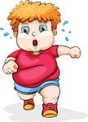
U. S. Childhood Obesity Facts
Centers for Disease Control & Prevention
www.cdc.gov/healthyyouth/obesity/facts.htm
Ages | 1980 | 2012
Children Adolescents | in 30 years | Doubled Quadrupled
6-11 | 7% | 18%
12-19 | 5% | 21%
Children & Adolescents |  | >1/3 overweight
Notes:
U. S. Childhood Obesity Facts
(Centers for Disease Control & Prevention; www.cdc.gov/healthyyouth/obesity/facts.htm)

Slide 20
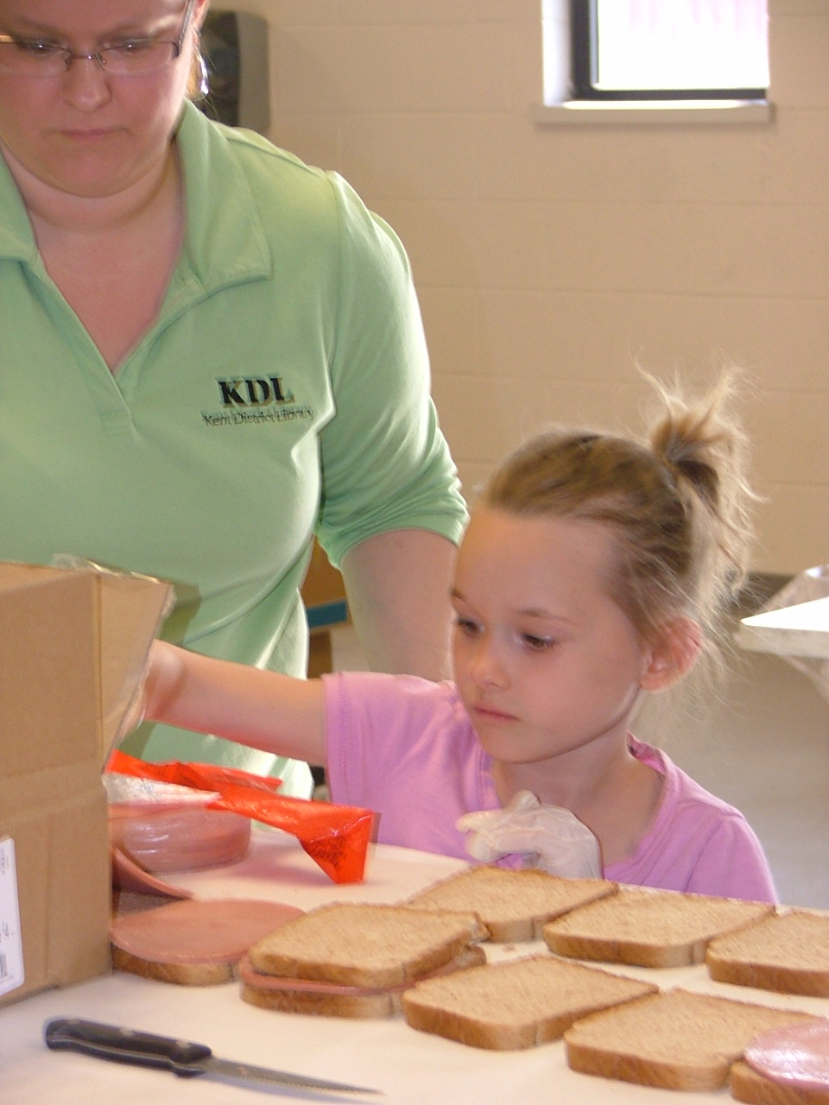
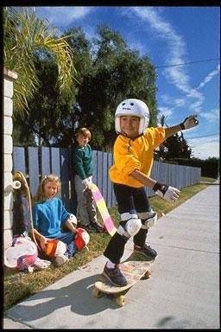
What Can You Do?
Turn off the TV and get some exercise—5 or more hours of TV have 5 times more likely to be overweight .
Limit or eliminate fast food—a Big Mac with fries and large soda, he gets 1,500 ca.
Eat Together as a family—study by American Psychological Association found that teens who are with families 5 or more times a week were less likely to do drugs or depressed, were motivated at school & had better peer relationships.
Notes:
What Can You Do?
Turn off the TV and get some exercise—5 or more hours of TV have 5 times more likely to be overweight .
Limit or eliminate fast food—a Big Mac with fries and large soda, he gets 1,500 ca.
Eat Together as a family—study by American Psychological Association found that teens who are with families 5 or more times a week were less likely to do drugs or depressed, were motivated at school & had better peer relationships.

Slide 21
3. Provide Adequate Protection
Protect our children by building strong relationships with them.
-- love them unconditionally
-- listen to them as they share concerns
-- hug them, write notes, little gifts, etc.
-- build their self esteem & confidence
-- spend time to do things together
Protect our children through discipline
-- define boundaries before enforcing them
-- avoid making impossible demands
Notes:
Provide Adequate Protection
Protect our children by building strong relationships with them.
-- love them unconditionally
-- listen to them as they share concerns
-- hug them, write notes, little gifts, etc.
-- build their self esteem & confidence
-- spend time to do things together
Protect our children through discipline
-- define boundaries before enforcing them
-- avoid making impossible demands

Slide 22
-- distinguish between willful defiance & childish irresponsibility
-- when defiantly challenged, respond with confident decisiveness
-- reassure & teach after the confrontation is over
-- let love be our guide
Protect our children from a hostile world
-- guard against abuse & abduction.
-- Know where your children are
-- know their friends
-- teach them how get help
Notes:
-- distinguish between willful defiance & childish irresponsibility
-- when defiantly challenged, respond with confident decisiveness
-- reassure & teach after the confrontation is over
-- let love be our guide
Protect our children from a hostile world
-- guard against abuse & abduction.
-- Know where your children are
-- know their friends
-- teach them how get help

Slide 23
-- teach children to face bullying head on
-- investigate the school’s anti-bullying policy
-- guard against strangers on the internet and television
-- too much TV viewing can decrease family interaction, lower creativity, shape our children’s minds and hearts
Protect your children from substance abuse
-- set an example as parents
-- talk to your children about the dangers of drugs, alcohol, cigarettes
Notes:
-- teach children to face bullying head on
-- investigate the school’s anti-bullying policy
-- guard against strangers on the internet and television
-- too much TV viewing can decrease family interaction, lower creativity, shape our children’s minds and hearts
Protect your children from substance abuse
-- set an example as parents
-- talk to your children about the dangers of drugs, alcohol, cigarettes

Slide 24
4. Nurture Family Relationships
Strong families impact a child’s physical, psychological, educational, social health.
Studies show that father love is important in predicting social, emotional, & cognitive development & functioning of children & young adults.
Developmental psychologist Brenda Hunter’s studies leads her to conclude that mothers play a powerful role in a child’s formation of conscience & empathy.
Notes:
Nurture Family Relationships
Strong families impact a child’s physical, psychological, educational, social health.
Studies show that father love is important in predicting social, emotional, & cognitive development & functioning of children & young adults.
Developmental psychologist Brenda Hunter’s studies leads her to conclude that mothers play a powerful role in a child’s formation of conscience & empathy.

Slide 25
5. Establish A Spiritual Foundation
God intends that the home to be the primary religious training facility, not the church (Deuteronomy 6).
It is important to live and teach our children spiritual beliefs that permeate our conversation & interactions with our children.
According to Barna’s survey, children ages 5-13 have a 32% likelihood of beginning a relationship with God.
Notes:
Establish A Spiritual Foundation
God intends that the home to be the primary religious training facility, not the church (Deuteronomy 6).
It is important to live and teach our children spiritual beliefs that permeate our conversation & interactions with our children.
According to Barna’s survey, children ages 5-13 have a 32% likelihood of beginning a relationship with God.

Slide 26
Research about Spirituality
Three variables emerge strongly from James Garbarino’s studies of kids committing senseless, violent crimes:
* spiritual emptiness (vacuum)
* toxic social environment
* family instability
Andrew Weaver’s research concludes that a spiritual foundation helps to buffer children from the cultural and social poisons of modern life—gives a sense of hope.
Notes:
Research about Spirituality
Three variables emerge strongly from James Garbarino’s studies of kids committing senseless, violent crimes:
* spiritual emptiness (vacuum) – spiritual emptiness—a lack of spiritual meaning in life
* toxic social environment
* family instability
Illustrations: Eric Harris and Dylan Klebold shot and killed twelve classmates and one teacher at Columbine High School before taking their own lives. They were healthy physically, however, their emotional and social health wheels were severely damaged, and their spiritual wheel was totally deflated. According to the videotapes the killers made weeks before American’s most deadly high school shooting, they shared an intense hostility toward Christianity and Christians.
Garbarino writes, “With neither hope nor a sense of purpose, troubled [children] are psychologically adrift and … are drawn to nihilism, Satanism, and all the other ‘isms’ of the dark side.”
Andrew Weaver’s research concludes that a spiritual foundation helps to buffer children from the cultural and social poisons of modern life.

Slide 27
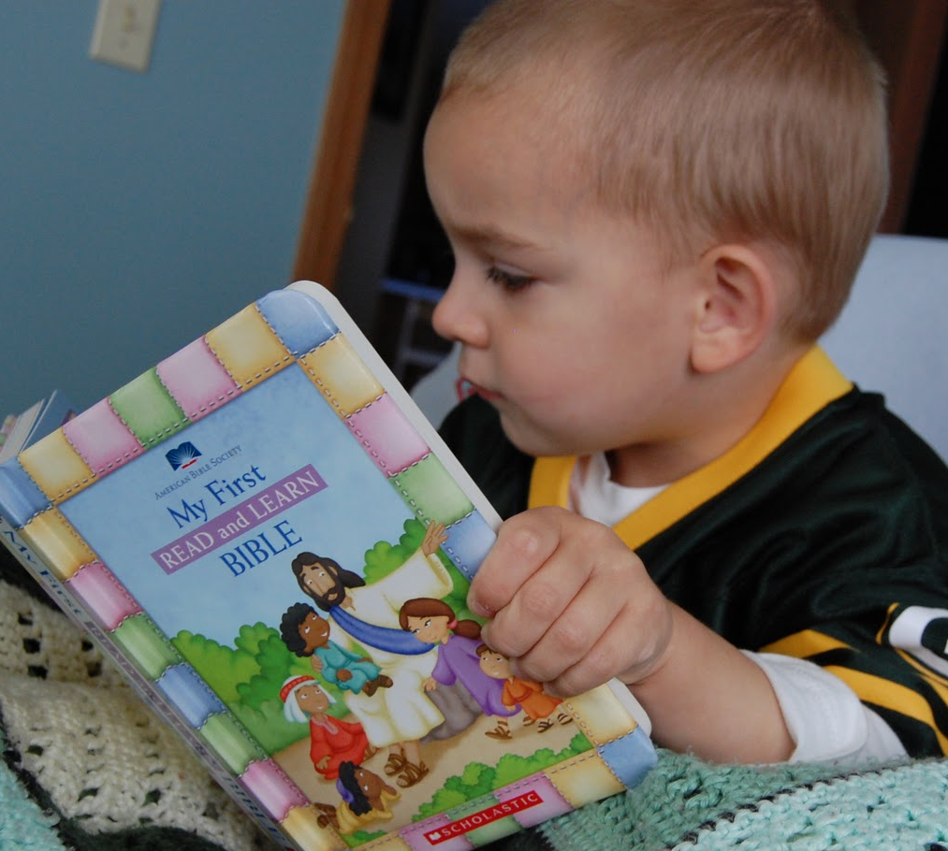
Parents need to develop true spirituality that results in the most important and enduring form of health and vitality.
Medical studies clearly show that spiritual distress can negatively affect physical, emotional, and relational health.
Spiritual distress or crisis occurs when people cannot find meaning, hope, joy, satisfaction, love, peace, comfort, strength, and connection in life.
Notes:
Parents need to develop true spirituality that results in the most important and enduring form of health and vitality.
Medical studies clearly show that spiritual distress can negatively affect physical, emotional, and relational health.
Spiritual distress or crisis occurs when people cannot find meaning, hope, joy, satisfaction, love, peace, comfort, strength, and connection in life.

Slide 28
Establishing Your Child’s Spiritual Foundation
Balance your own spiritual wheel.
Teach your children spiritual truth daily.
Pray with and for your children and family.
Involve your family in a faith community.
Prepare your children to make a difference in their world.
Notes:
Establishing Your Child’s Spiritual Foundation
Balance your own spiritual wheel.
Teach your children spiritual truth daily.
Pray with and for your children and family.
Involve your family in a faith community.
Prepare your children to make a difference in their world.

Slide 29
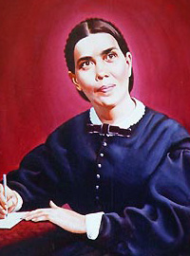
Child Guidance, 163
“No higher work was ever committed to mortals than the shaping of character. Children are not only to be educated, but trained as well; and who can tell the future of a growing child, or youth? Let the greatest care be bestowed upon the culture of your children. One child, properly disciplined in the principles of truth, who has the love and fear of God woven through the character, will possess a power for good in the world that cannot be estimated.”
E. G
White
Notes:
Ellen G. White, Child Guidance, 163
“No higher work was ever committed to mortals than the shaping of character. Children are not only to be educated, but trained as well; and who can tell the future of a growing child, or youth? Let the greatest care be bestowed upon the culture of your children. One child, properly disciplined in the principles of truth, who has the love and fear of God woven through the character, will possess a power for good in the world that cannot be estimated.”

Slide 30
6. Connect With the Larger Community
Allow your children to grow beyond the family.
Teach them to obey and respect authority.
Teach them to respect differences that make people unique.
Teach them to contribute to the world around them.
Notes:
Connect With the Larger Community
Allow your children to grow beyond the family.
Teach them to obey and respect authority.
Teach them to respect differences that make people unique.
Teach them to contribute to the world around them.

Slide 31
“And do not forget to do good and to share with others, for with such sacrifices God is pleased.”
Hebrews 13:16, The Bible
Notes:
“And do not forget to do good and to share with others, for with such sacrifices God is pleased.”
Hebrews 13:16, The Bible

Slide 32
Teach them to build great friendships.
Teach them to seek out mentors:
* mentors provide unconditional support
* mentors model positive values attitudes, and behaviors
* mentors help kids discover solutions to their problems
* mentors help kids look beyond today and to see tomorrow’s possibilities
Notes:
Teach them to build great friendships.
Teach them to seek out mentors:
* mentors provide unconditional support
* mentors model positive values attitudes, and behaviors
* mentors help kids discover solutions to their problems
* mentors help kids look beyond today and to see tomorrow’s possibilities

Slide 33
7. Instill A Balanced Self-Concept
Notes:
7. Instill A Balanced Self-Concept

Slide 34
Child development experts tell us that when a child believes he or she is a certain kind of person, that belief guides his or her behavior.
An unhealthy self-concept originates in childhood.
Parents, teachers, and peers are very important influences on a child’s developing self-concept.
According to John Eldredge, boys & girls seek answers primarily from their dads regarding how strong they are, or how beautiful they are.
Notes:
Child development experts tell us that when a child believes he or she is a certain kind of person, that belief guides his or her behavior.
An unhealthy self-concept originates in childhood.
Parents, teachers, and peers are very important influences on a child’s developing self-concept.
According to John Eldredge, boys & girls seek answers primarily from their dads regarding how strong they are, or how beautiful they are.

Slide 35
Nurturing Your Child’s Self-Concept
Love each child unconditionally.
Understand the child’s temperament.
Provide plenty of focused attention.
Give plenty of appropriate physical contact.
Appreciate uniqueness of each child.
Encourage child to believe in himself Allow your child to make his or her own healthy choices.
Notes:
Nurturing Your Child’s Self-Concept
Love each child unconditionally.
Understand each child’s temperament.
Provide plenty of focused attention.
Give plenty of appropriate physical contact.
Appreciate uniqueness of each child.
Encourage child to believe in himself or herself.
Allow your child to make his or her own healthy choices.

Slide 36
8. Engage in Healthy Activities
There needs to be a balanced diet for the mind:
* reading aloud to your children
stimulates their brains
* reading together as a family and
discuss about stories or articles
read
Choose active as well as passive activities for the family.
Choose activities with physical health benefits.
Notes:
8. Engage in Healthy Activities
There needs to be a balanced diet for the mind:
* reading aloud to your children
stimulates their brains
* reading together as a family and
discuss about stories or articles
read
Choose active as well as passive activities for the family.
Choose activities with physical health benefits.

Slide 37
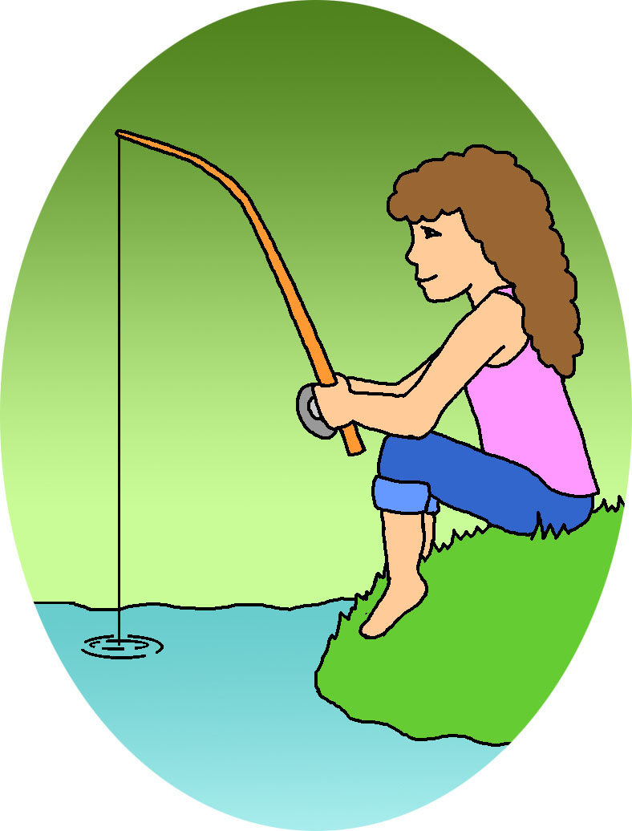
Choose activities that promote spiritual health.
Help your children choose the right balance of appropriate activities.
Do not over plan too many activities.
Plan a healthy dose of family traditions.
* have kids write down their feelings
* start a gratitude journal
Make family vacations
a healthy memory.
Notes:
Choose activities that promote spiritual health.
Help your children choose the right balance of appropriate activities.
Do not over plan too many activities.
Plan a healthy dose of family traditions.
* have kids write down their feelings
* start a gratitude journal
Make family vacations a healthy memory.

Slide 38
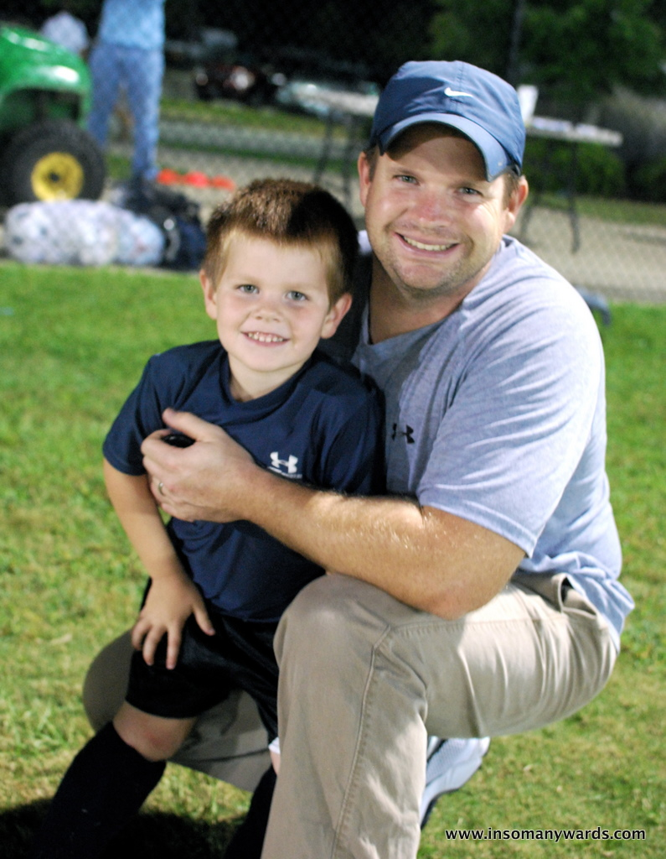
9. Cultivate Growth & Maturity
“Train a child in the way he should go, and when he is old he will not turn from it.”
Proverbs 22:6
Each child is to be trained according to his or her bent – according to his or her temperament and giftedness, according to the way he or she is created.
Notes:
9. Cultivate Growth & Maturity
Each child is to be trained according to his or her bent – according to his or her temperament and giftedness, according to the way he or she is created.

Slide 39
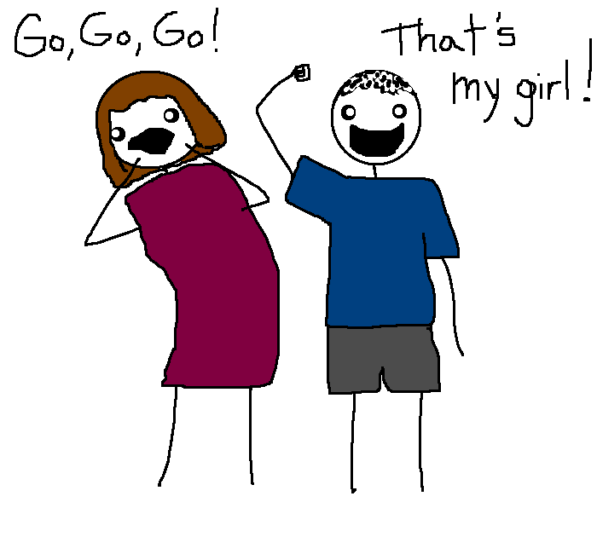
Children need cheerleaders, not critics.
Avoid comparing them with others.
Don’t demand perfection.
Avoid making rash comments in anger.
Cheer them through their ups and downs.
Give them wings and
let go.
Be sure to allow mistakes.
Notes:
Children need cheerleaders, not critics.
Avoid comparing them with others.
Don’t demand perfection.
Avoid making rash comments in anger.
Cheer them through their ups and downs.
Give them wings and let go.
Be sure to allow mistakes.

Slide 40
May the essentials presented by Dr. Larimore will assist you in raising highly healthy children, who will become highly healthy adults, who will contribute mightily to the health of the world around them.
Notes:
May the essentials presented by Dr. Larimore will assist you in raising highly healthy children, who will become highly healthy adults, who will contribute mightily to the health of the world around them.

Slide 41
References
Barna, George. “Teens & Adults Have Little Change of Accepting Christ as Their Savior.” Barna’s Updates, November 15, 1999.
Garbarino, James. Lost Boys: Why Our Sons Turn Violent and How We Can Save Them (New York: Free Press, 1999).
Larimore, Walt with Stephen & Amanda Sorenson. God’s Design for Highly Healthy Children Grand Rapids, MI: Zondervan, 2004).
Notes:
References
Barna, George. “Teens & Adults Have Little Change of Accepting Christ as Their Savior.” Barna’s Updates, November 15, 1999.
Garbarino, James. Lost Boys: Why Our Sons Turn Violent and How We Can Save Them (New York: Free Press, 1999).
Larimore, Walt with Stephen & Amanda Sorenson. God’s Design for Highly Healthy Children Grand Rapids, MI: Zondervan, 2004).

Slide 42
References
Mayo Clinic Report. In www.mayoclinic.org/diseases-conditions/childhood-obesity/basics.
National Center for Health Statistics. Health, United States, 2011: With Special Features on Socioeconomic Status and Health. Hyattsville, MD; U.S. Department of Health and Human Services; 2012.
Notes:
Mayo Clinic Report. In www.mayoclinic.org/diseases-conditions/childhood-obesity/basics.
National Center for Health Statistics. Health, United States, 2011: With Special Features on Socioeconomic Status and Health. Hyattsville, MD; U.S. Department of Health and Human Services; 2012.

Slide 43
References
Ogden CL, Carroll MD, Kit BK, Flegal KM. “Prevalence of childhood and adult obesity in the United States, 2011-2012.” Journal of the American Medical Association 2014;311(8):806-814
Weaver, Andrew, et. Al. “An Analysis of Research on Religious and Spiritual Variables in Three Major Mental Health Nursing Journals, 1991-1995,” Issues in Mental Healthy Nursing 1998 (April 1998): 3:263-76.
.
Notes:
Ogden CL, Carroll MD, Kit BK, Flegal KM. “Prevalence of childhood and adult obesity in the United States, 2011-2012.” Journal of the American Medical Association 2014;311(8):806-814
Weaver, Andrew, et. Al. “An Analysis of Research on Religious and Spiritual Variables in Three Major Mental Health Nursing Journals, 1991-1995,” Issues in Mental Healthy Nursing 1998 (April 1998): 3:263-76.

