Slide 1
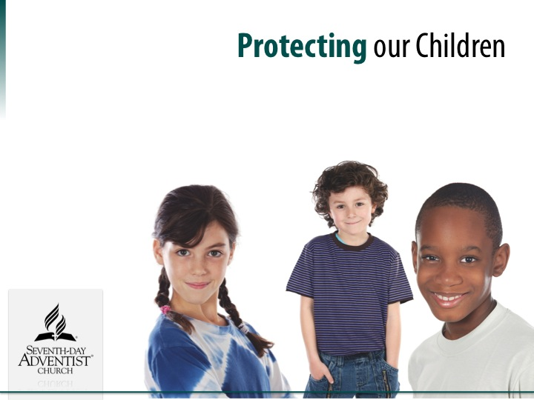
Your Church Name
Notes:
This presentation is designed to introduce Seventh-day Adventist Church Board members concerning the challenge of being PREPARED in the prevention of child abuse within our families, congregations, during church sponsored activities and the rising trend of children and youth abusing one another. This presentation will outline the proactive steps the _____________________ Conference is taking to address the tragic issue of child abuse and the actions that will help to protection children and adults from being vulnerable to harm or false accusations. We invite you to join our church leadership in the implementation of these policies and practices that will help us achieve our mission to provide safe Christ-centered ministries at all times.

Slide 2
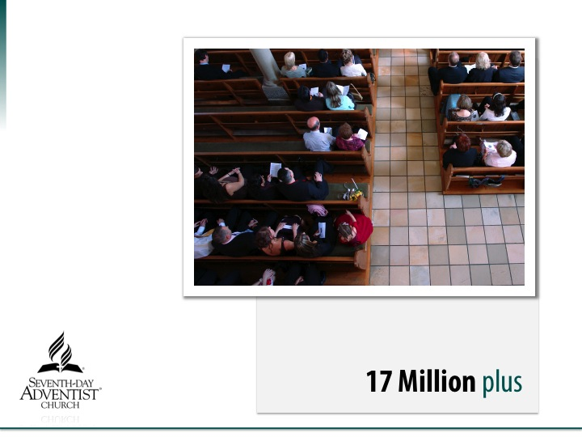
Notes:
The Seventh-day Adventist Church is one of the fastest growing Christian denominations in North America and around the world with over 17 Million members which includes over 1.2 Million members here in North America. The church has the privilege of ministering to 100,000’s of children each day!

Slide 3
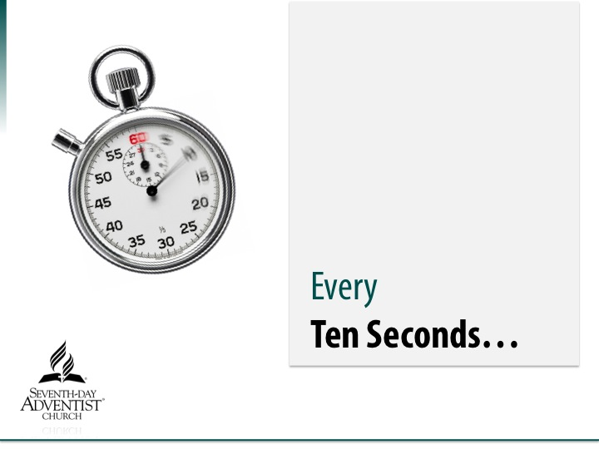
Notes:
Child Abuse statistics tell the tragic story that every Ten Seconds a child is abused in North America.

Slide 4
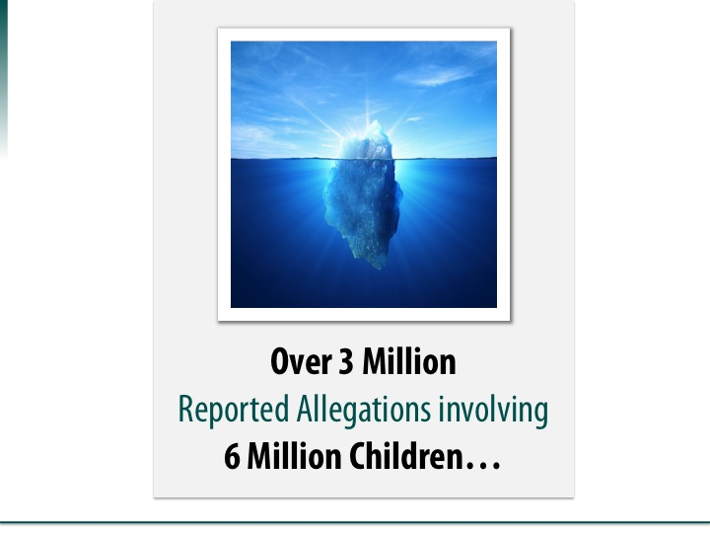
Notes:
In the United States each year over 3 Million reported allegations our made to law enforcement authorities involving over 6 Million children. Unfortunately, all too often the Church has an iceberg mentality, that although we know it happens in our community, it couldn’t happen in my church or school. Sadly, society and news reports only show a glimpse of the tip of the growing tragedy of child abuse and the devastating impact it can have on our families, congregation and the community at large to whom the Church is called to serve.

Slide 5

Notes:
The children in our Adventist churches and schools are a priceless gift entrusted to us. Is our church prepared to protect our children from Harm?

Slide 6
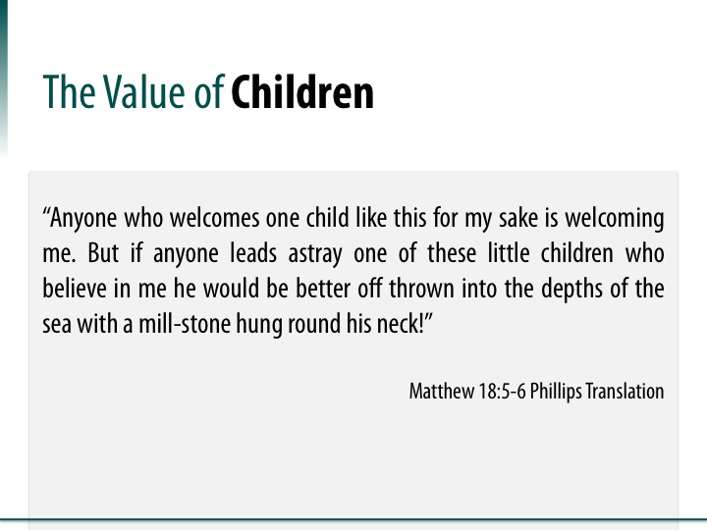

Notes:
The Value of Children
During His ministry, Jesus place a very high value on Children and the responsibility adults have in protecting children from harm. These words still instruct us today on how serious is our duty to appropriately interact with children and to be prepared in shielding them from harm.
“Anyone who welcomes one child like this for my sake is welcoming me. But if anyone leads astray one of these little children who believe in me he would be better off thrown into the depths of the sea with a mill-stone hung round his neck!” Matthew 18:5-6 (Phillips Translation)
SHOW THE VIDEO CLIP – Predator At the Door -- This is a 4 minute dramatization which illustrates how vulnerable Seventh-day Adventist churches and schools can be in providing easy/unsupervised access to Adventist children. Is our congregation Prepared?

Slide 7

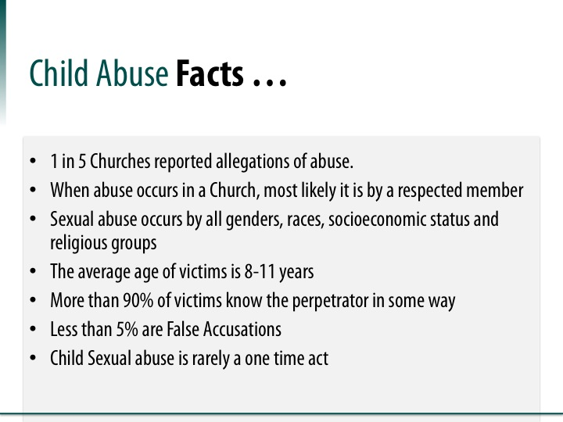
Notes:
Child Abuse Facts . . .
The Seventh-day Adventist Church is not immune from the tragic results of child abuse.
Consider these lessons learned from Child Abuse statistics within the faith-based Christian community:
1 in 5 Churches (20%) have reported allegations of child abuse to authorities
When child abuse occurs within the Church setting, the abuser will most likely be a respected adult member of the congregation.
Child sexual abuse occurs by individuals of both genders, all races, socioeconomic status and within all religious faiths.
The average age of the victim is between 8 to 11 years old -- This is the critical age when children are often making their life-long decision for Jesus Christ and to be baptized. Is it any wonder, the scripture says: “Satan is a roaring lion, seeking whomever he may devour” – 1 Peter 5:8, especially at these young ages when they are especially vulnerable.
When abuse occurs, 90% of victims know the perpetrator in some type of relationship…. Most often within their own family.
Children seldom lie when they disclose they are being abused. It is a cry for help and less than 5% are false accusations.
When child sexual abuse occurs, it is rarely a one time act and most perpetrators have more than one victim.

Slide 8
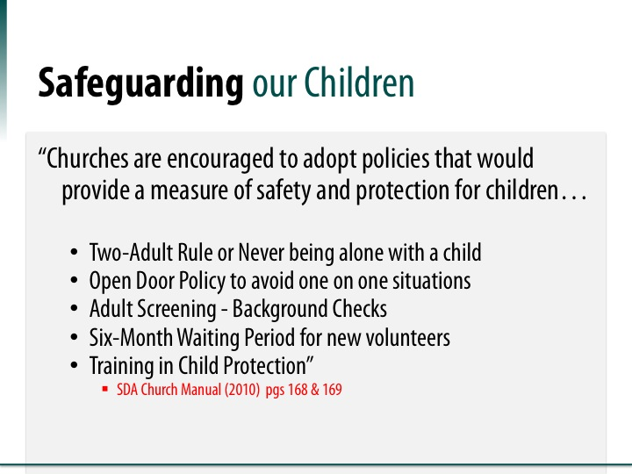

Notes:
Safeguarding Our Children
The Seventh-day Adventist Church Manual outlines the key guiding principles for establishing safeguards that will protect children from harm and reduce the vulnerability of false accusations towards adults (church employees and volunteers) concerning abuse. Recognizing the importance of having a pro-active child abuse prevention program, the North American Division has implemented into working policy these practices as a safeguard for children, adults in order to help provide Christ-centered ministries for children and youth.
Two-Adult Rule or Never being alone with a child
Open Door Policy to avoid one on one situations
Adult Screening – Background Checks
Six-Month Waiting Period for new volunteers
Training in Child Protection
SDA Church Manual (2010), pp. 168 & 169

Slide 9
“Shielding the Vulnerable”
Our Responsibility
Youth Protection Program
Train Adults
Background Screening
Stop predators at the door
Train Youth
Stop predators before they abuse
Stop predators on
the front lines
Notes:
Shielding the Vulnerable—Our Responsibility
To properly protect vulnerable children and adults for the tragic results of abuse is everyone’s Moral & Ethical Responsibility
In some cases adult employees and volunteers may be legally mandated to report all suspected incidents of child abuse or neglect.
In order to have a pro-active child protection program in place within the church requires our time, resources and training of all adults and where possible children on how to recognize the signs of abuse, how to seek help when needed and to conduct background screening and reference checking.
Youth Protection Program:
Background Screening – stop predators at the door
Train Adults – stop predators before they abuse
Train Youth – Stop predators on the front lines

Slide 10
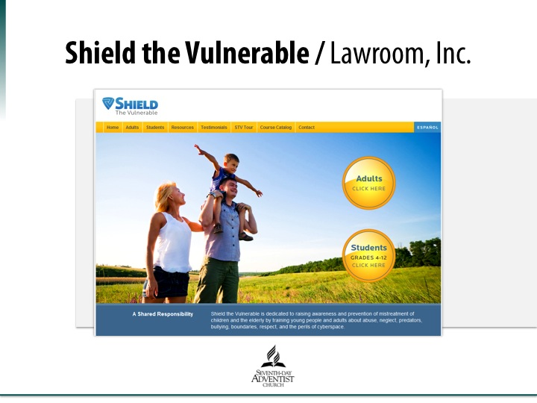

Notes:
Shield the Vulnerable/Lawroom, Inc.
To assist the Seventh-day Adventist Church in the conduct the necessary background screening and training of all adults who interact with children in ministry, the North American Division has entered into a service agreement with “Shield the Vulnerable” who will provide the Church with a web-based secure 24/7 online platform to conduct criminal background screening of adult employees and volunteers. In addition to the background screening, Shield the Vulnerable will provide an online classroom to train both adults and children in the area of child abuse prevention and child safety issues.

Slide 11
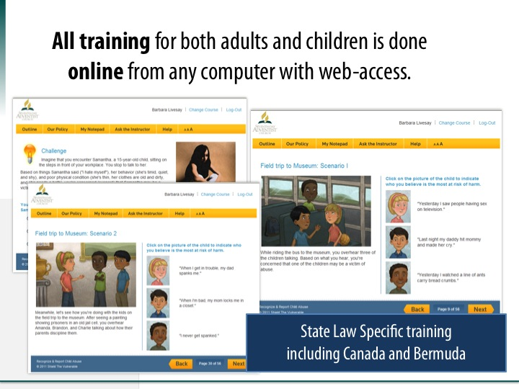
Notes:
Online Training
Online training will be provided for both adults and children in the area of child abuse prevention and child safety. These courses are being customized specifically for the Seventh-day Adventist Church in North America. Child abuse reporting training will be specifically based on the local law where each church and school is located including all 50 states, all Canadian provinces, Bermuda and the Guam-Micronesia Mission. The adult training course can be completed in approximately ninety (90) minutes and each individual will receive a certificate of completion that will be recorded in a North American Division wide data base.

Slide 12
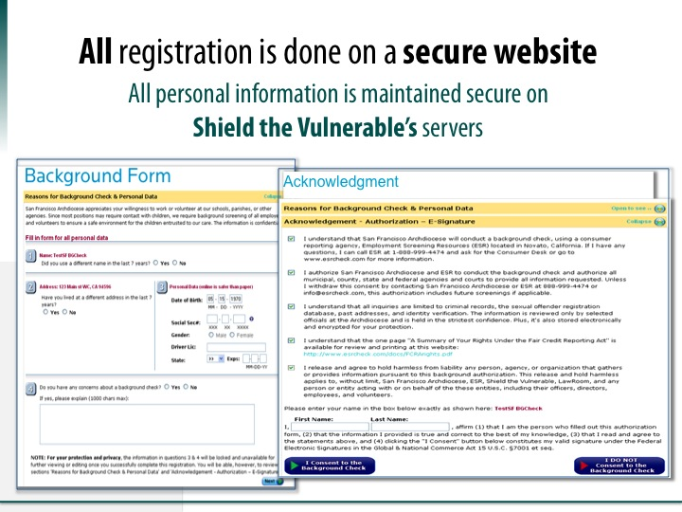
Notes:
Shield the Vulnerable Secure Website
All adults register for their background screening online at the Shield the Vulnerable secure website. Personal privacy and information is maintained by Shield the Vulnerable in accordance with all Federal and local reporting laws. Each Applicant personally authorizes their own criminal background check on a voluntary basis. Neither the local church or conference ever have access to an individual’s personal information.
Only the local conference will receive specific information concerning an applicant’s criminal background history. This information will be used to determine eligibility for service in working with children at that conference. The local church or school will only have access to an individual’s status as either eligible or in-eligible for service with children and record of the successful completion of the required adult child protection training class.
Background screening and child protection training will be required on a three (3) year re-occuring basis.

Slide 13

What Do You Have In Your Country?
Check out the laws of your country that protect children.
Identify organizations that can offer help for abused victims and their families.
Check out Hotlines, counseling services, Helplines, etc. that are available.
Notes:
What Do You Have in Your Country?
Check out the laws of your country that protect children.
Identify organizations that can offer help for abused victims and their families.
Check out Hotlines, counseling services, Helplines, etc. that are available.

Slide 14
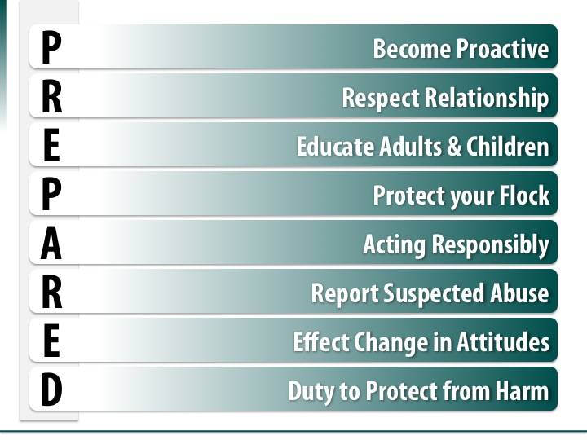
Notes:
PREPARED
Is your Church Prepared? As a congregation we all have a responsibility to protect our children from harm and abuse. Let’s make a commitment today to take our responsibility seriously by following the action steps of the “PREPARED” model here in our church.
Become Proactive
Respect Relationship
Educate Adults and Children
Protect your Flock
Acting Responsibly
Report Suspected Abuse
Effect Change in Attitudes
Duty to Protect from harm

