Slide 1

Helping parents of teens cope with bullies
Leadership Certification
Level IV, Course #5
Linda Koh, GC Children’s Ministries
Notes:
Illustration
Dave and Kay Conner receive a message from their daughter’s school: “Come to the office immediately.” Every thought imaginable races through their minds. Is she sick? Is she hurt? Is she in trouble?
As they enter the school parking lot, an ambulance pulls away. Rushing into the principal’s office, they see another student’s mother bent over in a chair … sobbing. Mrs Harper’s daughter, Dana, is the “flyer” atop the human pyramid on the school’s cheerleading squad.
The principal solemnly greets the Conners. “It appears that some of the other cheerleaders are jealous of Dana. So they ‘accidentally’ failed to catch her during a stunt this morning. Dana’s collarbone was shattered. She’ll be sidelined for the season. This is a malicious, premeditated act, intended to ‘eliminate the competition.’ And it was spearheaded by … your daughter.”
Dave and Kay are horrified – reeling with disbelief that their fun, popular Polly could be involved in such a dark plot, and deeply saddened by for Dana and her family. Tears of anger, shame, and frustration stream down their faces. Still in shock, the Conners drive home and immediately call …. You, asking, “How do we handle this horrible situation?”

Slide 2
What can parents do?
When counseling parents about bullying–whether their child is the victim or the perpetrator–first provide education about the problem and then help create a strategy to address specific instances of bullying.
Explain that bullying is a deliberate hostile physical or verbal activity intended to harm, induce fear, and create terror.” Those who are bullied live with continual fear and expectation of future harassment … or they themselves become bullies to stop the pain.
Notes:
What Can Parents Do?
When counseling parents about bullying – whether their child is the victim or the perpetrator – first provide education about the problem, in general, and then help create a strategy to address specific instances of bullying.
Explain that bullying is a deliberate hostile physical or verbal activity intended to harm, induce fear, and create terror.” Those who are bullied live with continual fear and expectation of future harassment … or they themselves become bullies to stop the pain.

Slide 3

Recommend that Parents:
Educate themselves about girl bullies, who are typically:
  Perceived as fickle “bully-princesses” seeking power
  Physically aggressive and mean-spirited
  Emotionally manipulative and deceptive
  Socially willing to seek and destroy anyone considered weaker, superior, threatening, or disliked
  Eager to pressure & coerce in order to control others
Notes:
Recommend that Parents:
Educate themselves about girl bullies, who are typically:
*Perceived as fickle “bully-princesses” seeking power
*Physically aggressive and mean-spirited
*Emotionally manipulative and deceptive
*Socially willing to seek and destroy anyone considered weaker, superior, threatening, or disliked
*Eager to pressure and coerce in order to control others

Slide 4
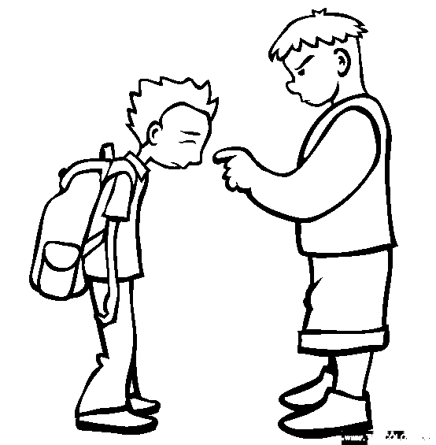
Educate themselves about boy bullies, who are typically:
  Perceived as “bully-gangsters” seeking power
  Physically violent
  Lacking emotional empathy, yet possessing a sense of entitlement
  Socially ready to hurt anyone
Notes:
Educate themselves about boy bullies, who are typically:
*Perceived as “bully-gangsters” seeking power
*Physically violent
*Lacking emotional empathy, yet possessing a sense of entitlement *Socially ready to hurt anyone

Slide 5

Initiate immediate intervention
Speak with the school counselor about bullying policies and procedures
Speak with police regarding intervention programs available for teens
Notes:
Initiate immediate intervention
Speak with the school counselor about bullying policies and procedures
Speak with police regarding intervention programs available for teens

Slide 6
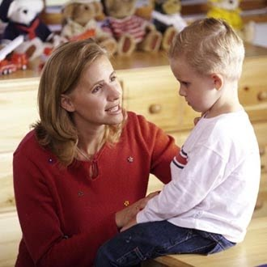
Set a zero-tolerance level for bullying by holding teen(s) accountable for offensive behaviors
Establish boundaries that are unquestionably fair and clearly communicated.
Administer repercussions when bullying occurs – discipline that relates to the offense, and that helps reprogram behavior… consequences that are restorative in nature, and are relative to the degree of repentance.
Notes:
Set a zero-tolerance level for bullying by holding teen(s) accountable for offensive behaviors
Establish boundaries that are unquestionably fair and clearly communicated.
Administer repercussions when bullying occurs – discipline that relates to the offense, and that helps reprogram behavior… consequences that are restorative in nature, and are relative to the degree of repentance.

Slide 7

Provide opportunities for teen perpetrators to make restitution
Establish requirements for what to do and how to do it.
Reinforce responsible behavior by rewarding it with verbal acknowledge-ments, praise, and increased responsibilities and privileges.
Notes:
Provide opportunities for teen perpetrators to make restitution
Establish requirements for what to do and how to do it.
Reinforce responsible behavior by rewarding it with verbal acknowledgements, praise, and increased responsibilities and privileges.

Slide 8
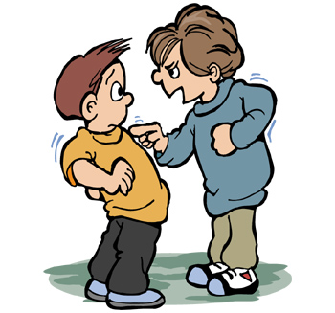
Establish a safe, bully-free environment in the home by cultivating a family spirit that communicates, “I love you, hear you, value you, respect you, believe in you, and am here for you.”
Monitor and restrict inappropriate, aggressive video games, movies and television programs, social relationships, music and music videos.
Model kindness, consideration, active listening and unconditional love.
Notes:
Establish a safe, bully-free environment in the home by cultivating a family spirit that communicates, “I love you, hear you, value you, respect you, believe in you, and am here for you.”
Monitor and restrict inappropriate, aggressive video games, movies and television programs, social relationships, music and music videos.
Model kindness, consideration, active listening and unconditional love.

Slide 9

“The tongue that brings healing is a tree of life, but a deceitful tongue crushes the spirit” (Proverbs 15:4).
Bullying can escalate quickly. A parent’s goal is to train their children to handle conflict constructively, ask for help in addressing serious situations, and develop compassion and empathy.
Notes:
Bullying can escalate quickly. A parent’s goal is to train their children to handle conflict constructively, ask for help in addressing serious situations, and develop compassion and empathy.
“The tongue that brings healing is a tree of life, but a deceitful tongue crushes the spirit” (Proverbs 15:4).

Slide 10

Be mindful of cyber-bullying (intimidating others through e-mail, instant messaging, texting, and social networking)
Use parental controls and filtering, software, and/or online tracking programs.
Offer to look at the teens’ communications with them, make copies of threatening correspondence, and delete harmful content together so the teen feels supported.
Before “deleting,” communicate all cyber-bullying to the school.
Talk and pray together about bullying.
Notes:
Be mindful of cyber-bullying (intimidating others through e-mail, instant messaging, texting, and social networking)
Use parental controls and filtering, software, and/or online tracking programs.
Offer to look at the teens’ communications with them, make copies of threatening correspondence, and delete harmful content together so the teen feels supported.
Before “deleting,” communicate all cyber-bullying to the school.
Talk and pray together about bullying.

Slide 11
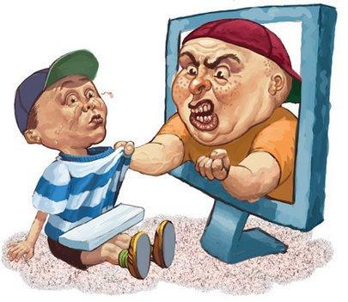

Since bullies have typically been victims of bullying, watch for signs that their teen is currently being bullied
Wanting to miss school
Withdrawing from social activities
Changes in eating patterns
Experiencing general anxiety, fear, and/or depression
Engaging in extreme self-destructive behaviors
Receiving threatening e-mails or visiting suspicious websites
Notes:
Since bullies have typically been victims of bullying, watch for signs that their teen is currently being bullied
Wanting to miss school
Withdrawing from social activities
Changes in eating patterns
Experiencing general anxiety, fear, and/or depression
Engaging in extreme self-destructive behaviors
Receiving threatening e-mails or visiting suspicious websites

Slide 12

Look for signs that their teen is bullying others
Pay close attention to conversations the teen has with friends
Be aware of changes in the teen’s demeanor
Notice the kind of clothing being worn. (All one color is often a sign of involvement with a clique, posse, or gang-all black may represent the occult and/or Satanism.)
Notes:
Look for signs that their teen is bullying others
Pay close attention to conversations the teen has with friends
Be aware of changes in the teen’s demeanor
Notice the kind of clothing being worn. (All one color is often a sign of involvement with a clique, posse, or gang-all black may represent the occult and/or Satanism.)

Slide 13
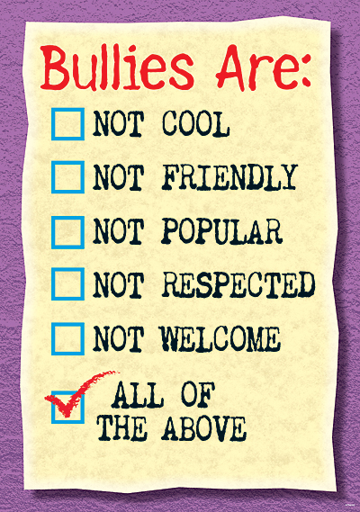
More Signs to look out for …
Pay attention to the way the teen wears a hat. Some hat positions may be associated with gang activity or intimidation
Watch for symbolic marks on the teen’s body
Note any unusual, recurring doodling or drawings (e.g., occult signs, “666,” upside-down cross)
Check out e-mails, text messages, and website participation.
Notes:
More Signs to Look Out For …
Pay attention to the way the teen wears a hat. Some hat positions may be associated with gang activity or intimidation
Watch for symbolic marks on the teen’s body
Note any unusual, recurring doodling or drawings (e.g., occult signs, “666,” upside-down cross)
Check out e-mails, text messages, and website participation.

Slide 14
Enforce repercussions if their teen is a bully
Find a time and place to talk with their teen in private
Pray, ponder, and plan what to say
State the concerns in a calm manner
Make repercussions specific, swift, and relevant to the offense.
Prioritize the condition of the teen’s heart. If there is sincere remorse with a repentant heart, a plan of restoration can include restitution with those being bullied.
Notes:
Enforce repercussions if their teen is a bully
Find a time and place to talk with their teen in private
Pray, ponder, and plan what to say
State the concerns in a calm manner
Make repercussions specific, swift, and relevant to the offense.
Prioritize the condition of the teen’s heart. If there is sincere remorse with a repentant heart, a plan of restoration can include
restitution with those being bullied.

Slide 15

More Repercussions
Arrange a meeting with the perpetrator, the injured teen, their parents, and you. Meeting with the injured person face-to-face – rather than communicating by phone or e-mail – gives the bullying teen an opportunity to see the victim’s pain, and begin to develop sensitivity and empathy.
Help the teen make a list of specific acts of kindness that can be done for those who have been offended
Notes:
More Repercussions
Arrange a meeting with the perpetrator, the injured teen, their parents, and you. Meeting with the injured person face-to-face – rather than communicating by phone or e-mail – gives the bullying teen an opportunity to see the victim’s pain, and begin to develop sensitivity and empathy.
Help the teen make a list of specific acts of kindness that can be done for those who have been offended

Slide 16
More repercussions
Reward godly attitudes and actions with words of praise, appreciation and encouragement, and with increased trust.
Help teenage boys learn how to use words to resolve conflict rather than to create more conflict with physical aggression.
Long-term mentoring can help both girls and boys break patterns of gossip, meanness, cliques, and aggression.
Notes:
More Repercussions
Reward godly attitudes and actions with words of praise, appreciation and encouragement, and with increased trust.
Help teenage boys learn how to use words to resolve conflict rather than to create more conflict with physical aggression.
Long-term mentoring can help both girls and boys break patterns of gossip, meanness, cliques, and aggression.

Slide 17
Proverbs 20:5 says, “The purposes of a man’s heart are a deep waters, but a man of understanding draws them out.”
Notes:
Proverbs 20:5 says, “The purposes of a man’s heart are a deep waters, but a man of understanding draws them out.”

Slide 18

Dealing with the teen perpetrator
Parents should confront teen perpetrators with the truth and the need to change. Since bullies almost always were, themselves, bullied at some point in their own lives, parents might start a conversation by saying:
Notes:
Dealing with the teen perpetrator
Parents should confront teen perpetrators with the truth and the need to change. Since bullies almost always were, themselves, bullied at some point in their own lives, parents might start a conversation by saying:

Slide 19
Parent conversation with teen
  “Years ago, my heart went out to you because I knew you were being bullied. It was completely unjust. Later, I saw you learn to resist pressure and develop endurance. But now you’ve reached a point in your life when you are doing to others what was done to you. You don’t want to be hurt, so you’ve chosen ways to hurt others. If you continue to hurt others, you’ll never have peace within your heart, or experience God’s purpose for your life.”
Notes:
Parent conversation with teen
“Years ago, my heart went out to you because I knew you were being bullied. It was completely unjust. Later, I saw you learn to resist pressure and develop endurance. But now you’ve reached a point in your life when you are doing to others what was done to you. You don’t want to be hurt, so you’ve chosen ways to hurt others. If you continue to hurt others, you’ll never have peace within your heart, or experience God’s purpose for your life.”

Slide 20
What can parents say?
Notes:
What can parents say?

Slide 21

“I love you too much to stand back and do nothing. I’ve arranged for us to talk with someone who understands the kind of pain you’re in … and how to bring true hope to your heart.”
Notes:
“I love you too much to stand back and do nothing. I’ve arranged for us to talk with someone who understands the kind of pain you’re in … and how to bring true hope to your heart.”

Slide 22

“This situation is very serious
because you have literally brought
harm to others. The meeting I’ve arranged is essential. If you should think about not attending, you’ll be choosing to give up all of your privileges: no car, no allowance, no phone, no after-school activities–no nothing. Our first meeting is Saturday morning at 10. Although this will take real work, I’m genuinely grateful for the healing that is available to you, and the future God has for you. I love you.”
Notes:
“This situation is very serious because you have literally brought harm to others. The meeting I’ve arranged is essential. If you should think about not attending, you’ll be choosing to give up all of your privileges: no car, no allowance, no phone, no after-school activities–no nothing. Our first meeting is Saturday morning at 10. Although this will take real work, I’m genuinely grateful for the healing that is available to you, and the future God has for you. I love you.”

Slide 23
Share Wisdom from God’s Word
Notes:
Share Wisdom from God’s Word
Teens can be either bullies or bullied in various ways. Regardless, their role always begins in their hearts. Parents can help their children understand their words and actions come from the overflow of their hearts. When their hearts are right with the Lord, everything else will follow.

Slide 24

Psalms 139:23-24
Wisdom from God’s Word will remain with young people long after human words are forgotten. Here’s a suggested prayer: “Search me, O God, and know my heart! Try me and know my thoughts! And see if there be any grievous way in me, and lead me in the way everlasting!”
Notes:
Wisdom from God’s Word will remain with young people long after human words are forgotten. Here’s a suggested prayer: “Search me, O God, and know my heart! Try me and know my thoughts! And see if there be any grievous way in me, and lead me in the way everlasting!” (Ps. 139:23-24 ESV).

Slide 25

With effective guidance and decisive intervention, an insightful counselor can be a powerful force to stop bullying, and ultimately change the entire course of a young person’s life.
Notes:
With effective guidance and decisive intervention, an insightful counselor can be a powerful force to stop bullying, and ultimately change the entire course of a young person’s life.

Slide 26
Helping Parents of Teens Cope with Bullies by June Hunt
Adapted from: Bonding with Your Teen through Boundaries by June Hunt with Jody Capehart ©2010.
Notes:
Helping Parents of Teens Cope with Bullies by June Hunt
Adapted from: Bonding with Your Teen through Boundaries by June Hunt with Jody Capehart ©2010.

