Slide 1

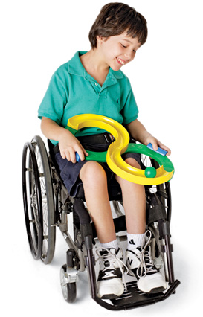
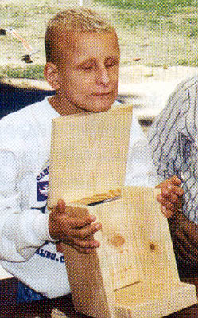
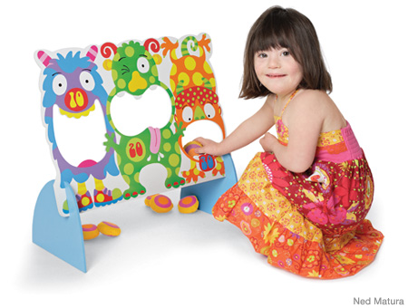
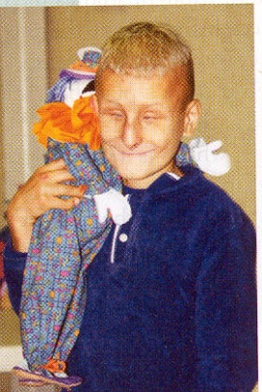

Ministry to Children with
Special Needs
CHM Leadership Certification
Level III, Course #6
Linda Mei Lin Koh
GC Children’s Ministries
Notes:
Ministry to Children with Special Needs
Children are like a box of colored pencils:
Some are sharp
Some are pretty
Some are dull
Some have short
Some are broken
And all are different colors
In the same way, children with special needs come with different types of disabilities. Some are less severe while others need more care. Some respond well to us while others could just smile. Some have unusual gifts while others are mentally challenged. But they all need our love.

Slide 2
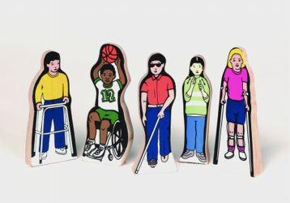
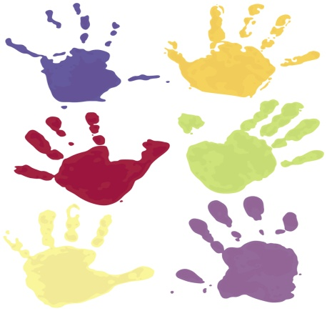
What is a Special Need?
Special = peculiar to a specific person
Need = Lack of something required
A child with special needs requires individualized attention.
Notes:
What is a Special Need?
Special = peculiar to a specific person
Need = Lack of something required
A child with special needs requires individualized attention.

Slide 3

Children with Special Needs are Valuable to God
They remind us that God is good.
They remind us that God is faithful.
They show us that the image of God is within us—not outside us.
Romans 8:28
Notes:
Children with Special Needs Are Valuable to God
“We know that in all things God works for the good of those who love him, who have been called according to his purpose.” Romans 8:28.
In the beginning when God separated the light from the darkness and created day, how bright that first light must have been. The contrast of an early sunrise against a black backdrop can still take one’s breath away. We will witness this same sort of contrast in the lives of children with disabilities. The depths of their struggles can make their smallest success glow with heavenly light. Those of you who are fortunate enough to know these amazing children will experience the warm rays of God’s love shining through their smiles.
Children with special needs remind us that God is good – According to Romans 8:28, He promised to share that goodness with us. Yet when Katie was born with a neurobiological disorder, the doctors said she would be mentally retarded. One day, however, the toddler looked out of the car window and read a street sign. Then her parents gave her a book, which she also read. Katie was hyperlexic, meaning she had an exceptional, untaught reading ability at a very young age. As a fourth grader, Katie, who was diagnosed with Asperger’s syndrome, taught herself Japanese. She continued too amaze her family and friends with God’s perfect plan for her life.
Children with special needs remind us that God is faithful – From his wheelchair, Cole feared the rough neighborhood where he and his mom lived. He often cried himself to sleep because bullies made fun of him. But through his faith in Jesus, Cole learned to pray for bad people and to trust God for protection. He even requested prayer at church for his neighborhood, leading members to faithfully reach out to the bullies and share Christ with them.
Children with special needs remind us that the image of God is within us, not outside us. Christy discovered this concept when she care for Elliot at camp. Locked in a twisted body racked by multiple physical and mental disabilities, Elliot sat almost motionless in his wheelchair. He never spoke, made eye contact or responded to her touch. Early in the week, Christy watched with Elliot as the other campers swam, made crafts and giggled. By midweek, she felt content to push Elliot’s chair down the paths under the trees, where she would stop and read poems to him or sing simple songs. When it was time to say goodbye, Christy patted Elliot’s right hand. To her surprise, he slowly lifted her hand with his, drew it to his mouth, and gave it a soft kiss. Christy’s eyes filled with tears. Later, she described it as a kiss from God’s own heart.
The Bible speaks of the need for childlike faith—a faith that surrenders our grown-up efforts to fix things. As you minister to these extraordinary children, you’ll slam head on into Romans 8:28. You may even question God’s goodness and power to make all things work for good for children like Katie, Cole or Elliot. And that’s when children with special needs will become your teachers!

Slide 4
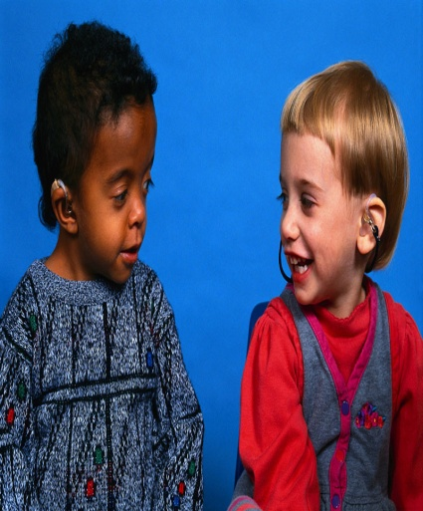
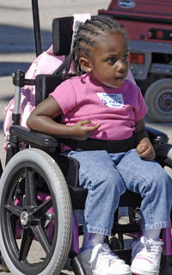
The Problem with Labels
Man-made labels create negative effects on the child.
Derogative labels can obscure the vision of God’s words for the child.
Labels limit, degrade, and hurt, and is offensive to God.
Every child, whether handicapped or not, is God’s workmanship, created in His image (Eph 2:10).
Notes:
The Problem with Labels
Walking into a school, a person might be strongly tempted to sort or “label” the students as “athletic,” “brainy,” “loser,” “stupid,” or “weird.” Such categorizing of students emphasizes only one aspect of complex individuals. Some labels create a negative effect on the children. Here are some problems with labels:
Man-made labels create negative effects on the child.
Derogative labels can obscure the vision of God’s words for the child.
Labels limit, degrade, and hurt, and is offensive to God.
Every child, whether handicapped or not, is God’s workmanship, created in His image (Eph 2:10).
Ephesians 2:10 affirms that “we are God’s workmanship, created in Christ Jesus to do good works, which God prepared in advance for us to do.” The Bible is clear that each child who attends your church is hand-knit with an individualized pattern by God. That pattern beautifully displays God’s image in some form. Each child is created specifically to be able to fill a prepared spot in God’s kingdom and an honored place in the Body of Christ.

Slide 5
Peel Away the Negative Labels Associated with Disabilities
Focus on children’s
gifts
Give all children an honored place in your church community
Notes:
Peel Away the Negative Labels Associated with Disabilities
Make it clear to peers, parents, and volunteers that your church rejects all hurtful labels. While disability labels are needed for communicating useful information, always remember that God’s perspective is much truer. Instead we should:
Focus on children’s gifts
Give all children an honored place in your church community
While some children may require specialized equipment or techniques in order to meet their needs, you have the joy of seeing the participation of those children enrich the lives of others. “And this is his command:…to love one another” (1 John 3:23).

Slide 6
People may see | God sees
Cerebral Palsy Cindy | Cindy, handcrafted by Himself before she was even born. Part of her unique knitting pattern is her love for animals and gifted singing voice. She also happens to have cerebral palsy.
Down Syndrome Adam | Adam, image-bearer of Himself, who displays passion for prayer and care for the people in his life. He also happens to have Down syndrome.
Autistic Sam | Sam, honored and significant member of the Body of Christ, who is a gifted servant as he joyfully organizes the toy shelves at church. He also happens to have autism.
Notes:
People may see God sees
Cerebral Palsy Cindy Cindy, handcrafted by Himself before she
was even born. Part of her unique
knitting pattern is her love for animals
and gifted singing voice. She also happens to have cerebral palsy.
Down Syndrome Adam Adam, image-bearer of Himself, who displays passion for prayer and care for the people in his life. He also happens to have Down syndrome.
Autistic Sam Sam, honored and significant member of the Body of Christ, who is a gifted servant as he joyfully organizes the toy shelves at church. He also happens to have autism.

Slide 7
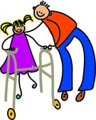
Myths About Special Needs
We don’t need a special ministry, there’s one in the church downtown
I can’t serve children with disabilities—I’ve no training
Aren’t children with mental retardation spiritually innocent before God?
Notes:
Myths About Special Needs
I can’t serve children with disabilities—I’ve no training.
Do you know that children with disabilities are born into families with no training. Parents, grandparents, aunts and
uncles do what comes naturally. First they love these children; then they get to know them. God simply asks their
church family to do the same. As a new volunteer, you’’ be trained and maybe partnered with an experienced person,
and you’ll be surprised how quickly your confidence grows.
Aren’t children with mental retardation spiritually innocent before God?
While some children with special needs may not understand God’s grace, they can all experience His love in amazing
ways. Many churches are worried about whether these children can be baptized, or whether they can be saved. What
we need to be concerned is how we minister to them. We don’t need to figure out their age of accountability or their
mental capacity to introduce them to Jesus.
We don’t need a special ministry—there’s one in the church downtown
If you do your research of your community, you will notice churches will list many programs from Bible studies to youth
ministries, recovery programs, sports events and others, but may find not one add lists a disability ministry. Yet school
districts in United States estimate that children with special needs make up 15-25 percent of their student body. Your
church may need to think about how to serve your community.

Slide 8
Myths About Special Needs
Aren’t parents the best caregivers? Can’t they take turns?
Afraid of legal responsibility of caring for a child with disability
Guess I should volunteer –God sent these children to teach me
Notes:
Myths About Special Needs
Guess I should volunteer –God sent these children to teach me
“God does not send the disabled child to test one’s faith or teach one to love. Each person has equal value. Each person can be a blessing to others, whether handicapped or not,” says Rev. Dennis D. Schurter, retired chaplain at the Denton State School in Denton, Texas.*
Aren’t parents the best caregivers? Can’t they take turns?
Sure, parents could take turns, but you would miss God’s blessings. You would miss building wonderful relationships with some of the most terrific children you’ll ever meet. And the fruit of the Spirit in your life will be less ripe on the vine.
Afraid of legal responsibility of caring for a child with disability
There are legal responsibilities involved in serving in the nursery, in youth activities, in VBS, in the church kitchen and the parking lot. But we don’t neglect those ministries. The church carries insurance for accidents. On occasion, a child with a disability may experience a medical condition that requires the intervention of a parent or a call to emergency. But you can rest assured that you will always have a supervisor for support.
*Dennis D. Schurter, D. Min., A Ministry Manual (Denton, TX, 2003), p. 16.

Slide 9
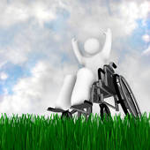
Unique Family Challenges of Disabilities
Impact on Parents
*need to feel welcome
*look for a break
*seek religious education for disabled child
*need friendship
Impact on Siblings
*some accept handicapped
* some are frustrated and embarrassed
Impact on Grandparents
*most do not have training & strength to care for child
Notes:
Unique Family Challenges
Impact on Parents
*need to feel welcome
*look for a break
*seek religious education for disabled child
*need friendship
Impact on Siblings
*some accept handicapped
* some are frustrated and embarrassed
Impact on Grandparents
*most do not have training & strength to care for child

Slide 10
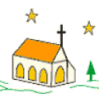
Church-Family Supports
1
Provide Financial Aid
Show Unconditional Love
Share Grief
Promise Hope
Supplement Needed Care
5
2
4
3
Notes:
Church-Family Support
In addition to simply understanding a family’s stress and their child’s unique difficulties, churches can provide support in a number of ways.
1. Provide Financial Aid – Having a child with special needs can drain a family’s resources. Medical treatments and various therapies can be costly. Often at least one parent quits his or her job or cuts back on work hours to become the child’s primary caregiver. Church members can help relieve this stress by becoming a safety net when an occasional financial emergency occurs.
2. Supplement Needed Care – Parents work to provide exceptional care but feat that no one else would be willing to take care of their child as they do. Parents also realize their child with a disability may never become an independent, self-sufficient adult. This can cause enormous concerns about what the future may hold. As these families build strong relationships within the church, their fears are alleviated because they see that people outside their family can love and enjoy their children.
3. Show Unconditional Love – Taking a child with special needs out into the community can be challenging. People may stare, make cruel comments or fail to understand obvious physical differences or strange behaviors. This stress can prevent a family from accepting an invitation for dinner at a friend’s home after church or staying for a church social. By showing unconditional love, church members can help families overcome fears of embarrassment or rejection. A loving hand from a friend to help can keep a family from feeling isolated in their church community.
4. Share Grief – Although raising children with special needs brings many joyful experiences, parents must accept grief and sorrow as their companions along the way. They grieve over developmental milestones that their children miss, failed treatment plans, and dreams that will never come true. The success they hoped for is mixed with the powerful emotions of denial, anger, fear and shame. Church members can take time to listen to them or be there when they need a shoulder to cry on.
5. Promise Hope – While the world might focus on cost, inconvenience and lay blame at the feet of parents, the church must speak out with an alternative message:
“But [God] knows the way that I take; when he has tested me, I will come forth as gold” (Job 23:10).
“[God] was despised and rejected by men, a man of sorrows, and familiar with suffering” (Isaiah 53:3).
“All your sons [and daughters] will be taught by the Lord, and great will be your children’s peace” (Isaiah 54:13).
God calls His people to proclaim hope to families affected by disability. As Christians, we must commit too accept and help families dealing with special needs. Each child’s differences must be understood and his or her strengths and gifts celebrated. As insight is gained into each unique situation, we will discover how remarkable these children are and how easy they are to love.

Slide 11

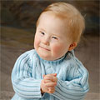
Some Special Needs
Visually Impaired Children
Deaf Children
A child who uses a Wheelchair
A child with Chronic Illnesses
Bright Children
Gifted Children
High Energy Level Children
Notes:
Some Special Needs
Visually Impaired Children
Deaf Children
A child who uses a Wheelchair
A child with Chronic Illnesses
Bright Children
Gifted Children
High Energy Level Children

Slide 12
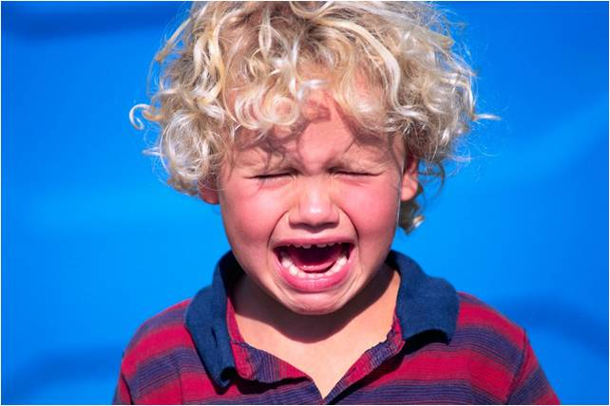
Types of Disabilities
Autism
Learning Disabilities
Physical Disabilities
Developmental Disabilities
Visual and Hearing Impairments
Speech and Language Impairments
Emotional and Behavioral Disorders
Notes:
Types of Disabilities
Autism
Learning disabilities
Physical disabilities
Developmental disabilities
Visual and hearing impairments
Speech and language impairments
Emotional and behavioral disorders

Slide 13
U. S. Children (Ages 3-17) Need a Hand Because . . .
4.7 million
children
have learning
disabilities
1 in 800
born with Down
syndrome
2 or 3 children per
1,000 have
cerebral palsy
21% children have
emotional and
behavioral difficulties
3.4 children out
of 1,000 have
autism
55,200 children
are legally
blind
5.4 million
children
receive
special
education
4.7 million
children have
AD/HD
Notes:
U. S. Children (Ages 3-17) Need a Hand Because . . .
1 in 800 children born with Down syndrome
2 or 3 children per 1,000 have cerebral palsy
3.4 children out of 1,000 have autism
55,200 children are legally blind
4.7 million children have learning disabilities
21% children have emotional and behavioral difficulties
5.4 million children receive special education
4.7 million children have AD/HD
Resources:
Autism: http://www.nimh.nih.gov
Down syndrome: National Institute of Child Health and Human Development, http;://www.nichd.nih.gov/publications/pubs/downsyndrome.cfm
ADHD: http://www.cdc.gov/nchs/fastats
Emotional and behavioral difficulties: http://www.childstats.gov/americaschildren/glance.asp
Learning disabilities: Summary Health Statistics for U. S. Children
Cerebral palsy: http:www.cerebral palsy.org/what-is-cerebral-palsy/statistics
Blindness: http://www.afb.org/Section.asp?SectionID=15+DocumentID=4398
Special education: National Institute on Disability and Rehabilitation Research

Slide 14
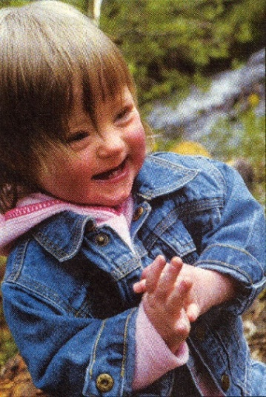
What Are Our Responsibilities?
To Remember Each Person
is Special
To Share God’s Love
To Be Prepared
To Create A Nurturing
Environment
Notes:
What Are Our Responsibilities?
To Remember Each Person is Special
To Share God’s Love
To Be Prepared
To Create A Nurturing Environment

Slide 15
Many have learned that…
A Person who hears less may see more.
One who sees less may perceive more.
One who speaks slowly may have more to say.
A Person who moves with difficulty may have a clearer sense of direction.
Notes:
Many have learned that . . .
A Person who hears less may see more.
One who sees less may perceive more.
One who speaks slowly may have more to say.
A Person who moves with difficulty may have a clearer sense of direction.

Slide 16
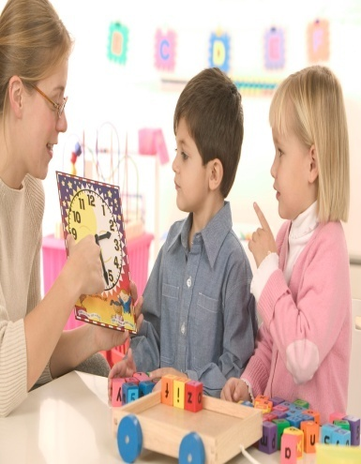
A Prepared Teacher will
Know all of his/her students
Plan with each student in mind
Ask for assistance
Pray for the out-pouring of the holy spirit
Know his/her own weaknesses
Notes:
A Prepared Teacher will
Know all of his/her students
Plan with each student in mind
Ask for assistance
Pray for the out-pouring of the holy spirit
Know his/her own weaknesses

Slide 17
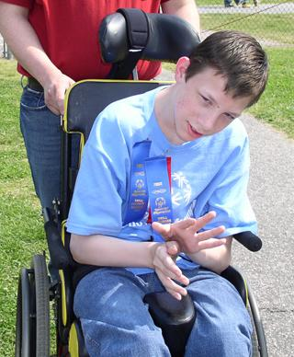
It’s You I Like
(Poem)
It’s You I Like,
It’s not the things you wear,
It’s not the way you do your
hair – But it’s you I like
The way you are right now,
The way down deep inside of you –
Not the things that hide you,
Not your toys –
They’re just beside you.
Notes:
It’s You I Like
(Poem)
It’s You I Like,
It’s not the things you wear,
It’s not the way you do your
hair – But it’s you I like
The way you are right now,
The way down deep inside of you –
Not the things that hide you,
Not your toys –
They’re just beside you.

Slide 18
It’s You I Like
But it’s You I like,
Every part of you,
Your skin, your eyes, your feelings
Whether old or new
I hope that you remember
Even when you’re feeling blue
That it’s you I like,
It’s You yourself
It’s You, it’s You I like.
Notes:
It’s You I Like
But its You I like,
Every part of you,
Your skin, your eyes, your feelings
Whether old or new
I hope that you remember
Even when you’re feeling blue
That it’s you I like,
It’s You yourself
It’s You, it’s You I like.
Resource: Joni and Friends. Special Needs Smart Pages. Gospel Light, 2009.

