Slide 1
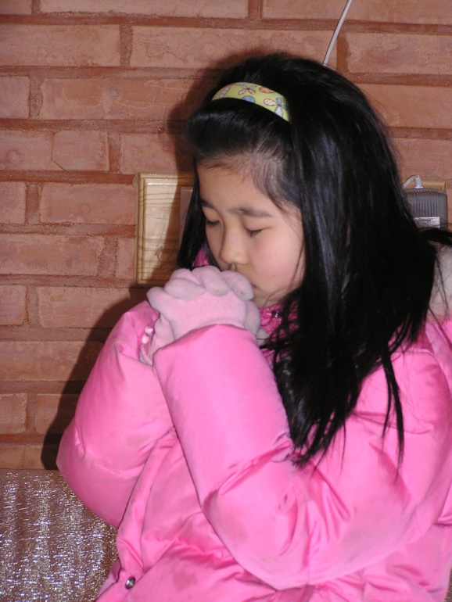
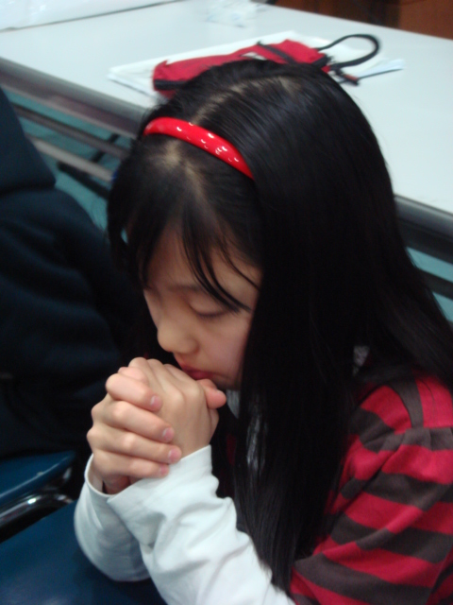
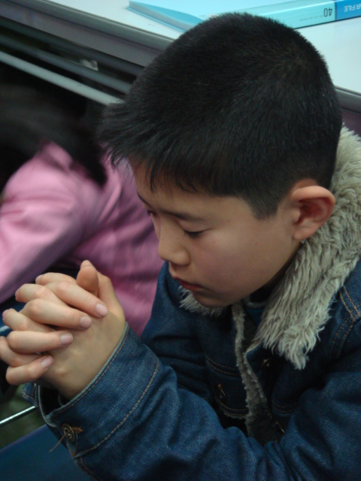
CHM Leadership Certification
Level III, Course #5
FOSTERING KIDS’
Time
Alone with
God
Sally Phoon
Children’s Ministries Director
Northern Asia-Pacific Division
Notes:
Fostering Kid’s Time Alone with God

Slide 2
What is this Mother thinking?
Notes:
What is this Mother thinking?
Usually parents set secular goals as opposed to spiritual goals.

Slide 3
Research Statistics
Josh McDowell says that only 15% have a biblical worldview
Barna thinks it’s less than 10%.
(Larry Fowler, Raising a Modern-Day Joseph,
( pp. 27, 28)
More than half of our teens leave the church after high school.
Christian young people today don’t know the Bible as they used to.
Are not transferring their Biblical knowledge into a biblical worldview.

Slide 4
Research Implications
Crisis situation.
Something is wrong
Across all denominations we see our young people and teens leaving the church in groups, and we often wonder why.

Slide 5
Research Implications
Attended church faithfully for years ,
Know the Bible facts and information
But they do not know the Lord
of the Bible.
Do a lot of memory work every week in church
But information stays as data
in their minds.

Slide 6
Research Implications
Not integrated into real living Christianity;
Lacks the power of influencing the life because they have not connected them to Jesus.
Worse yet, we see a declining interest in reading the Bible among adults themselves,
Today’s children don’t know their Bibles as well as they used to a generation ago.

Slide 7
When parents don’t read their Bibles or connect with God in prayer and worship, can we expect children to pick up this habit?
No surprise as we look at Adventists today.
Only about half of them do read their Bibles on a regular basis.
Family worship is a thing of the past as we struggle to maintain our balance in a life where time is a scarce commodity.

Slide 8
SDA Research- 10 year Study by Roger Dudley Why Our Teenagers Leave the Church (2000, pp 27-37),
55% leave the church in each generation (conservative estimate.)
Barry Gane in his book, Loving Them Back, Leading Them Home (2010, p. 15)
35-65% of youth leave the church.
Notes:
55% leave the church in each generation (conservative estimate.) based on his own personal pastoral experience,

Slide 9
Home
Church
School
Community
Notes:
Interaction between these 4 entities but the Home plays the role of primary discipler

Slide 10
Home, School, Church, Community
The training of children begins in the home
And so is discipleship.
Parents are the main disciple-makers
Home is where children develop a genuine faith.

Slide 11
Survey Results
How often did your parents talk to you about God?
43% Never
32% Occasionally
13% Once a week
13% On a daily basis
Notes:
Survey Results
How often did your parents talk to you about God?
43% Never
32% Occasionally
13% Once a week
13% On a daily basis

Slide 12
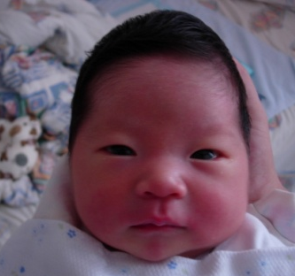
Home Influences
Mother
Father
Grand-parents
Uncles Aunts
Relatives
Notes:
Home Influences

Slide 13
Ellen White reminds us..
“Parents, remember that your home is a training school, in which your children are to be prepared for the home above. (Child Guidance, p. 17)

Slide 14
Questions to Ponder
Am I saved by grace through faith in Jesus Christ?
Do I experience the joy of a new life in Jesus?
Am I growing every day in my relationship with Jesus?
Do I have time alone with God myself?
Do my children know that I read the Bible and pray daily?
Notes:
Modeling—the most powerful teaching tool
Don’t do as I say but do as I do
Saved by Grace—all of us are sinners
humility of being a learner instead of I’m a parent, therefore I know it all
the ability to admit I am wrong
Joy of a new life—operate from joy
when things go wrong, what is my reaction—anger? Worry? Trust? Peace? Children watch how we handle life
Growing relationship with Jesus
can children see that you are changing and growing, getting better
yesterday you lost your temper; today you exercise more self-control
share what you are learning from God’s word with your children
talk about your prayer life—who, what, why you are praying for or about
share answered prayers

Slide 15
Questions to Ponder
Do I believe that God has dreams for my children?
Am I intentional about my children’s spiritual growth and development as much as their physical, academic and social development?
Do I teach my kids to love God’s Word?
Do I lead my kids to worship God?
Do I recognize the importance of helping our children become God’s children?
Notes:
Most parents don’t set spiritual goals for their kids
Intentionality—clear about your direction
Focus not only on their future success in this world but a world to come
God has no grandchildren—the kite illustration

Slide 16
Questions to Ponder
Do I have the skills to be a spiritual mentor for my children?
Is my family comfortable discussing spiritual things?
Is family worship an important part of our family life?
Notes:
Spiritual mentor—parents often push responsibility to the church and the school
Is there a focus on the spiritual aspect in your family?
tearing the pastor/spiritual leaders apart @ Sabbath lunch?
respect for leadership
showing compassion instead of criticism
Family worship

Slide 17
Questions to Ponder
Do I walk the talk?
Are you positive in your outlook?
Do you worry and lose your temper when something goes wrong?
Does God’s love shine through your behaviour everyday, not only on Sabbath?

Slide 18
Questions to Ponder
In my relationships
Am I involved with my spouse?
Do the children feel secure with the connection and love between both parents?
Are you involved intimately with your children (fathers especially)?
Are you involved with your close relatives & church family?

Slide 19
Questions to Ponder
Am I active in sharing my faith in God with others?
Am I active in leading my children in serving others?

Slide 20
Home
Church
School
Community

Slide 21
Fathers and mothers, we entreat you to take up your long-neglected duties. Search the Scriptures yourselves; assist your children in the study of the Sacred Word. Make diligent work because of past neglect. Do not send the children away by themselves to study the Bible, but read it with them, teach them in a simple manner what you know, and keep in the school of Christ as diligent students yourselves. CSW 20
Notes:
Admonition from EGW; because of the NEGLECT
To change a habit—21 days
Study first with the children and then transition to TAG if they are old enough

Slide 22
TAG—Time Alone with God
Preparing the heart with prayer
ACTS
Adoration
Confession
Thanksgiving
Supplication

Slide 23
TAG—Time Alone with God
Connecting with the Word
What does this mean to me today?
Praying the Word
Application in real life

Slide 24
How do we foster TAG
at the different ages?
0 – 5 years
6-10 years
11-15 years

Slide 25
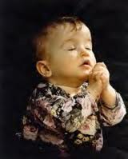
0-5 years Old
Need to learn the basic lessons of
.. obedience
.. love
..joy and
.. answered prayers
shorter as compared to other age group
may do TAG with their parents
or have their parents nearby
Notes:
For the young children, time alone with God will be shorter as compared with the teenager who has a much longer attention span. Very small children may do TAG with their parents or have their parents nearby as they do their TAG.
Young children from 0-5 need to learn the basic lessons of obedience, love, joy and answered prayers, Yes, even as early as two years of age, as soon as the child can talk, they can begin to spend their own short private time alone with God.

Slide 26
0-5 years Old
“Dear God, help Mommy to sell many, many fruit so she can have time to have her Bible study this afternoon with Aunty Lyn. Please help the people to buy lots and lots of fruit this morning, in Jesus’ name, Amen.”

Slide 27
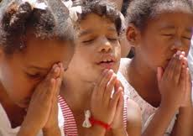
6-10 years Old
read the Bible on their own
--supplementary materials
easy-to-read version Bible (The Clear Word)
--other aids ..maps or the Bible in digital (www.childmin.com) …podcasts and
-- other interesting materials and activities
Notes:
Those in the primary years will be able to read the Bible on their own and supplementary materials, an easy-to-read version of the Bible (The Clear Word) and other aids such as maps or the Bible in digital form will be helpful in sustaining the interest. Digitally, much is available and the Children’s Ministries website (www.childmin.com) with its podcasts and other interesting materials and activities will be helpful in this area. Other websites you could visit include: www.dltk-bible.com; www.msscrafts.com; www.akidsheart.com/bible/bible.htm; www.kidssundayschool.com.

Slide 28
11-15 years Old
encouraged to read widely,
ask curious questions about the Bible,
play Bible trivia,
connect with other kids on line to discuss a lesson for the week. can be
challenged to teach the younger children
Notes:
Those who are 11-15 can be encouraged to read widely, ask curious questions about the Bible, play Bible trivia, connect with other kids on line to discuss a lesson for the week. They can be challenged to teach the younger children a particular bible study and in order to do that, they themselves will have to be prepared. Their time alone with God will take on more meaning as they see their prayers answered and feel the presence and leading of God. Parents need to engage them often in conversations regarding their answered prayers and their spiritual walk. They may pose questions that will stump their parents, but parents can always help to connect them to some authority to find the answers if they don’t know.

Slide 29
11-15 years Old
TAG more meaningful as they see their prayers answered / feel God’s presence
Parents need to engage them often in conversations about answered prayers / spiritual walk.
May pose questions that will stump their parents, but parents can always help to connect them to some authority to find the answers if they don’t know.
Notes:
Those who are 11-15 can be encouraged to read widely, ask curious questions about the Bible, play Bible trivia, connect with other kids on line to discuss a lesson for the week. They can be challenged to teach the younger children a particular bible study and in order to do that, they themselves will have to be prepared. Their time alone with God will take on more meaning as they see their prayers answered and feel the presence and leading of God. Parents need to engage them often in conversations regarding their answered prayers and their spiritual walk. They may pose questions that will stump their parents, but parents can always help to connect them to some authority to find the answers if they don’t know.

Slide 30
Flexibility
Allow primary/teen to approach their TAG in creative ways
Have challenges with emotional highs and lows.
Cannot sit and read 3 chapters Bible daily
Can connect with God in different ways.
Can memorize a text /meditating on it through the day may be just as powerful as reading 1-3 chapters.
Can listen/view DVD music and meditate on the message
Notes:
Allow your primary and teens to approach their TAG in creative ways is necessary. Teens have their challenges with their emotional highs and lows. Instead of telling them to sit and read 3 chapters of their Bible as a daily mandate, allow them to connect with God in different ways. Just memorizing a text, meditating on it through the day may be just as powerful as reading a chapter or 3 chapters.

Slide 31
WHY Do TAG?
To Make
Disciples
www.kidsindiscipleship.org

Slide 32
THE K.I.D. MOVEMENT
Hear, O Israel: The LORD our God, the LORD is one. Love the LORD your God with all your heart and with all your soul and with all your strength. These commandments that I give you today are to be upon your hearts. Impress them on your children. Talk about them when you sit at home and when you walk along the road, when you lie down and when you get up. Deut 6:4-7

Slide 33
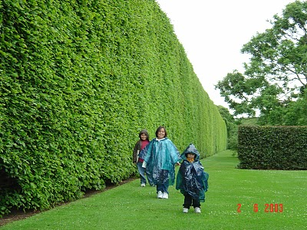
PRAYER
Christian parents, morning and evening, by earnest prayer and persevering faith, to make a hedge about their children. {1T 397}

Slide 34
Prayer
“Could our children learn these lessons of finding at dawn and twilight a quiet season for communion with their Father in heaven] in the morning of their years, what freshness and power, what joy and sweetness, would be brought into their lives!” – CG 525

