Slide 1
Making Family Worship fun for all ages
By the grace of god & Litiana Rakarakatia turner
South pacific division
August 2020

Slide 2
what do you see?
Notes:
In many of your homes right now, whether you are zooming in from home or at your local church, you probably have sitting on your kitchen bench some fruit, they may be in a bowl or a basket, hanging off the side of the door. As you can see on my slide here, I have a bowl of mandarins Your fruit bowls may have… pineapples, pears, bananas, pawpaw, apples. If you are home right now, you might be able to run to your kitchen and bring back your fruit bowl. As you look at the fruit bowl on my slide… I want to invite you to turn to each other and just share with another what you see?
I’ll give you a few moments to talk with each other…or if you are alone reflectively jot down on your writing pad what you see? As words come into your mind about what you see please add them to the chat so we can engage with each other…

Slide 3
Words that might have popped into your conversation…
Mandarins
Fresh Juice
Sweet
Clementines
Bright orange colours
Fruit
Summer days
Notes:
Words that might have popped into your conversation… or been written down on our chat include…

Slide 4
Anyone say Fruit segments?
Notes:
Did anyone say fruit/mandarine segments?

Slide 5
Anybody say seeds?
Notes:
Did anybody say seeds? In the chat??? I am wondering…

Slide 6
Anybody say orchard?
Notes:
Did anybody say orchard or a mandarine farm… did anyone type in our chat that they saw ….a , plantation of citrus trees??? From that fruit bowl picture?

Slide 7
Start with the end in mind
Notes:
Mums & Dads we need to remember that phrase that Dr Covey popularized “Start with the End in Mind”…

Slide 8
Notes:
Right now I just want to ask you to consider … Why are you sitting in this specific workshop? What is your end goal? What do you hope to achieve? What life lessons do you want for your child to have from these seasons of his/her life with you?
What is YOUR reason or your purpose to pursue ‘Making family worship fun for all ages?... you might want to Make Family Worship fun for all ages, because;
you loved your family worship experience as a child and you want to emulate that with your children, or it could be that
you are new to this walk with Jesus and you’d like to introduce your family to Him through family worships, it might even be that
your experience of family worship was not positive and you hope to be different in the way you approach worship time with your kids…
Or maybe you’re not sure why you should but you know that as a parent it sounds like the right thing to do…
No matter what your reason, I think two words that should always go together are fun & family, now when you throw worship into that equation it get’s me thinking… ummm…

Slide 9
Where did worship first happen on this earth?
In the beginning God created the heavens and the earth. The earth was formless and void, and darkness was over the surface of the deep, and the spirit of God was moving over the surface of the waters. Then God said, “Let there be light”, and there was light. God saw that the light was good, and God separated the light from the darkness. God called the light day, and the darkness He called night. And there was evening and there was morning, one day. Genesis 1: 1-5
Notes:
When I started thinking about worship and where or when did worship first happen ON THIS EARTH and why did worship take place then… something that became really clear to me as I reflected on these IDEAS was that Worship first took place in THE garden OF Eden or in the bush, it happened out in nature…I don’t say that to be disdainful, I say it because when I read again the creation story and as I read it with an intentionality to understand why worship happened when it happened I realized anew that… WORSHIP…any worship is a response to an action or a deed. Here in my reading of the creation story, something absolutely spectacular has happened… where there was a formless void and darkness… THE SPIRIT OF GOD moved over the surface of the waters and the God said…”Let there be light!” WOW!!!! And just like that…. There was light…. Now wouldn’t you want to just worship…be still and humble yourself in awe before this creator God?

Slide 10
children.adventistchurch.com/resources/category/discipleship/
Notes:
I’m not sure if you’ve seen this book by Karen Holford as she has a wonderful brief introduction on the history of worship…and how it has changed over the years…you may want to download i from the website children.adventistchurch.com/resources
This book explores both the ‘why’ and the ‘how’ of intergenerational worship and provides simple history of worship through the Bible….
https://children.adventistchurch.com/wp-content/uploads/sites/14/2019/09/altogether-wonderful-exploring-intergenerational-worship.pdf

Slide 11
Notes:
As I was preparing and reflecting on this time we have together, I would look up from desk in my study at home and see these flowers from my window and one morning when the sun was shining warm and bright I took this photograph and these purple daisy like flowers (African Daisy- osteospermum) just make me smile… why???... because they are bright and cheerful the cornflower blue center is just gorgeous in the sunlight. And when I stop and think that God just spoke and flowers like these just came into existence…I am in awe of this creator God of ours. I see God in the beauty of these daisies, I see Gods grace towards me when I spend time with my 70 year old mother, when I’ve had the flu and my tastebuds don’t work so well and my sense of smell is diminished that first return of a beautiful scent or that surprise realization I get when suddenly my taste buds have returned…these small instances point me towards an attitude of gratitude…and as an adult speaking with you as mums and dads… Our adult selves experience the world in a vastly different way to our children.

Slide 12
Making family worship fun for all ages
Notes:
As we commence our time of worship and conversation together right now I would like to invite you mums and dads to keep in mind that the child you have living in your home today, will grow up, they will leave your home and will become their own person. Therefore the activities which you prioritise or focus on now, the accomplishments you celebrate and take pride in, these are the things which will inadvertently be communicated to your child as important. So if Jesus is important to you, and if you and I spend time with Him daily, our children will get that message loud and clear. You want to have children who love the Lord and yearn to serve Him and his church? Then mums and dads, you and I need to love the Lord ourselves and we need to BE willing to serve and support our local churches and pastors. You’ve heard the saying that “an apple does not fall far from its tree”… well today as we consider Making family worship fun for all ages we need to remember that the ultimate goal…the end goal is that our child grows and develops their own walk with Jesus. So that when they are no longer with us, they are confident in who they are, and what their purpose is in life… Research tells us that children are more likely to adopt the faith of their parents. And that “Worship habits formed early on in the child’s life are often lifelong and highly formative.” (Worship in a Box, Finding Jesus by Daron Pratt)

Slide 13
Deuteronomy 6:4-7
“Listen, O Israel! The Lord is our God, the Lord alone. ⁵ And you must love the Lord your God with all your heart, all your soul, and all your strength. ⁶ And you must commit yourselves wholeheartedly to these commands that I am giving you today. ⁷ Repeat them again and again to your children. Talk about them when you are at home and when you are on the road, when you are going to bed and when you are getting up.
Notes:
In Deuteronomy 6 we read this directive which Moses gives to the children of Israel from God. They are living in the wilderness and God says to them for their lives to be fulfilled and prosperous, happy and healthy Moses reminds the mums and dads that they must teach their children …they must pass on their faith to the next generation.
⁴ “Listen, O Israel! The Lord is our God, the Lord alone.^{[a]} ⁵ And you must love the Lord your God with all your heart, all your soul, and all your strength. ⁶ And you must commit yourselves wholeheartedly to these commands that I am giving you today. ⁷ Repeat them again and again to your children. Talk about them when you are at home and when you are on the road, when you are going to bed and when you are getting up.

Slide 14
Karen Holford suggests this worship style… in DeutERTONOMY 6…
Familiar-using everyday events and moments to teach children about God, His love, His law, and their responsibilities
Natural multisensory and interactive as it is closely connected with everyday activities and events
About loving God with all their heart, mind, physical strength and spiritual strength – every part of their being
Naturally intergenerational as extended families lived together or in close proximity
Notes:
In her Book Altogether Wonderful Karen Holford discusses what we can learn from Deuteronomy 6 family worship that will inspire us in the way we worship today….she points out that the Deuteronomy 6 worship style is…
Familiar-using everyday events and moments to teach children about God, His love, His law, and their responsibilities
Natural multisensory and interactive as it is closely connected with everyday activities and events
About loving God with all their heart, mind, physical strength and spiritual strength – every part of their being
Naturally intergenerational as extended families lived together or in close proximity
So worship and being in Gods presence and acknowledging God needs to be a natural part of the living …it’s an everyday common occurrence. So how does one make family worships fun and inclusive for all ages???

Slide 15
You can’t say no to CC’s
Notes:
Growing up in Sydney in the early 80’s I remember a popular advertising slogan for Corn Chips… or as they called it in it’s abbreviated form, CC’s
The slogan was basically this, You can’t say No to… CC’s
So what are the things which need to happen if we are to make Worship fun for all ages?... I’d like to suggest 4- C’s
There are four C’s you cannot say No too.

Slide 16
Making Family Worship Fun for all ages REQUIRES…?
Consistent
Choice
Clarity
Closeness/closure
Notes:
Making Family Worship fun for all ages…
I’d like to suggest four C’s
Consistency or a consistent effort/application
Choice
Clarity
Closeness/Closure

Slide 17
Consistent
When parents are consistent with an activity or practice then it will more likely become habit forming…
Notes:
Consistent may be defined as done in the same way over time or not contradictory
Consistent | Definition of Consistent at Dictionary.com
www.dictionary.com › browse › consistent
I’d like you to consider for a moment what a typical day is like for you and your family… Would you say that your family just pop out of bed in the morning ready to face the day or are they more likely to be the leave me alone in the morning type of family… just by considering this honestly you can already begin to determine which times would best work for your family for worship…. Times??

Slide 18
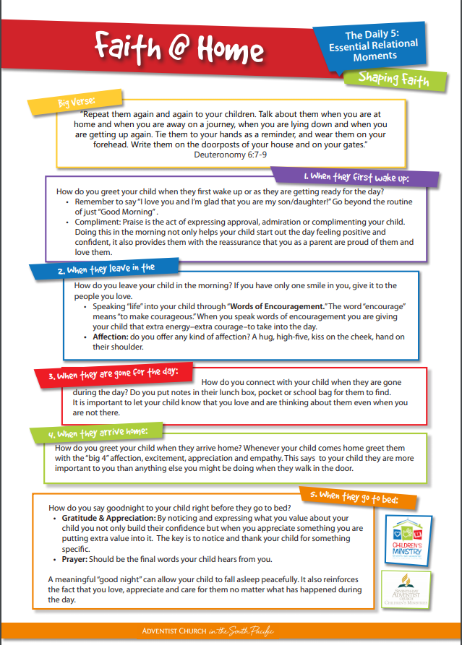
The Daily 5 Essential Relational Moments
When they first wake up
When they leave in the morning
When they are gone for the day
When they arrive home
When they go to bed
Notes:
AS you look at making family worship fun for all ages…I’d like you to also consider your 5 Daily Essential Moments as a parent…
Building Authentic relationships with your kids takes intentionality. We have listed our daily five essential relational moments to help you connect with your kids daily, in a consistent and intentional manner. We have also included some ideas, so you have a place to start from.
https://children.adventistchurch.com/wp-content/uploads/sites/14/2017/03/The-Daily-5-Essential-Relational-Moments.pdf

Slide 19
Basic worship format
Welcome & Opening Prayer (5mins)
A couple of songs of praise (10mins)
Meditational thoughts/Reflection (10mins)
Closing Prayer & Challenge (Worship Book) (5mins)

Slide 20
Consistent
Synonyms of consistent include; steady, stable, constant, regular, even, uniform, orderly, unchanging, unvarying, unswerving, undeviating, unwavering, unfluctuating, homogeneous, true to type. dependable, reliable, unfailing, predictable.
Notes:
Synonyms of consistent include; steady, stable, constant, regular, even, uniform, orderly, unchanging, unvarying, unswerving, undeviating, unwavering, unfluctuating, homogeneous, true to type. dependable, reliable, unfailing, predictable.
Consistent | Synonyms of Consistent by Lexico

Slide 21
Can consistent become boring?
Notes:
Ask yourself can doing something consistently become boring? YES of course it can…and that is why we need to constantly be open and aware of what is happening with our families, what is happening at school for our children, what’s happening in the world around them and the community within which we live.
Being consistent or having a routine, is NOT necessarily a bad thing in fact sometimes children and families benefit from knowing that every evening after dinner we will have a time for family worship, however it is in our worship… our responses to God…that we should not be just routine. We need to teach our children and ourselves to celebrate and see God and HIS LOVE FOR US IN OUR EVERYDAY LIVES. For those things which He chooses to provide for us and those things that are withheld from us. To be at peace or content with what God has blessed us with. This is a choice which we need to consistently make in our worship lives.

Slide 22
Choice
There always needs to be a choice or a variety of ways that worship is experienced.
The choices we make on what to include and how we worship need to be strategic not just convenient.
Notes:
The second C which I wish to talk with you about is the C of Choice!
There always needs to be a choice or a variety of ways that worship is experienced… the reason I say this is because a five year old child’s sense of inclusion or fun in worship will differ somewhat to a 12 or thirteen year old’s sense of participation and connection. I am not saying that they won’t enjoy worshipping together however when we do make the worship time schedule, there definitely needs to be some strategic choices made… that takes into consideration, the child’s areas of joy (passion) and skills (what are they good at/what makes them shine)- gifted at reading or prayer, singing or intercession are they artistic or great at writing…
The choices we make on what to include and how we worship need to be strategic not just convenient.

Slide 23
Basic worship format
Welcome & Opening Prayer (5mins)
A couple of songs of praise (10mins)
Meditational thoughts/Reflection (10mins)
Closing Prayer & Challenge (Worship Book) (5mins)
Notes:
For instance in the Basic Worship Format… keeping in mind that you have a 5 year old and a tween aged person in your home…
You may have;
Mum welcoming the family to worship & helping 5 year old as they open with prayer (Dear Jesus please be with us as we worship tonight)
Dad might lead out in songs and have a child choose their favourite chorus to sing…
The Tween aged person might read the meditational thought .or passage of scripture (Ask the DBR questions here??)
Worship/Prayer Journal where prayers are recorded…
Popcorn prayers of thanks and prayer requests…

Slide 24
Choice
Think of your five senses and imagine experiencing worship with one of the senses highlighted based on a Bible story…
Think back through your day, and share with the family one interaction or experience which you are grateful for? Was there one which you wish you could change? What was it and Why?
Giving yourselves and your children an opportunity to share authentically in worship time opens the family to having Jesus as a part of the conversation when reflecting on your day, so when you say…”Let’s pray about it…” It has come from a conversation/sharing in worship…
Notes:
Think of your five senses and imagine experiencing worship with one of the senses highlighted based on a Bible story…
Another way you could give your family choices in their worship format is where you get them to…
Think back through your day, and share with the family one interaction or experience which you are grateful for? Was there one which you wish you could change? What was it and Why?
Giving yourselves and your children an opportunity to share authentically in worship time opens the family to having Jesus as a part of the conversation when reflecting on your day, so when you say…”Let’s pray about it…” It has come from a conversation/sharing in worship…

Slide 25
“The use of object lessons, blackboards, maps, and pictures, will be an aid in explaining these lessons, and in fixing them in the memory. Parents and teachers should constantly seek for improved methods. The teaching of the Bible should have our freshest thought, our best methods, and our most earnest effort” (Education, p 186).
Notes:
“The use of object lessons, blackboards, maps, and pictures, will be an aid in explaining these lessons, and in fixing them in the memory. Parents and teachers should constantly seek for improved methods. The teaching of the Bible should have our freshest thought, our best methods, and our most earnest effort” (Education, p 186).

Slide 26
YOU Choose
15mins or 30 mins
Active/Reflective
Parent led/Child focused
Share an experience/Read a Sabbath school Lesson/Short Story/#DBR-Passage of Scripture/ Worship in a Box/The Tuis/
Prayer
Repeat the process…

Slide 27
Notes:
https://children.adventistchurch.com/resources/category/discipleship/

Slide 28
Discovery Bible Reading
Notes:
https://children.adventistchurch.com/resources/category/discipleship/

Slide 29
Clarity
Worship messages need to be very clear, and simple to understand.
Children must experience the wonder and joy of Jesus’ love whenever possible.

Slide 30
Clarity
“Select a portion of Scripture that is interesting and easily understood; a few verses will be sufficient to furnish a lesson which may be studied and practiced through the day… At least a few verses of spirited song may be sung, and the prayer offered should be short and pointed. The one who leads in prayer should not pray about everything but should express the needs in simple words and praise God with thanksgiving.”
Notes:
Signs of the Times, August 7, 1884

Slide 31
https://children.adventistchurch.com/resources/category/discipleship/
Notes:
I suggest that journaling your prayers may be a sure simple way to consider scripture and to think on them throughout the day…We have this downloadable prayer Journal on our website which focuses on a different Bible verse every day and encouragers one to reflect on the passage of scripture. It’s a 30 day Prayer/Worship journal and perhaps if it is done consistently a new habit for spending time in the word may begin
Children.adventistchurch.com
https://children.adventistchurch.com/resources/category/discipleship/
https://children.adventistchurch.com/wp-content/uploads/sites/14/2017/03/Litiana-Prayer-Journal-SPD.pdf

Slide 32
closeness
Worship messages need to draw those worshipping closer to each other and closer to Jesus
Notes:
It should be the special object of the heads of the family to make the hour of worship intensely interesting. By a little thought and careful preparation for this season, when we come into the presence of God, family worship can be made pleasant and will be fraught with results that eternity alone will reveal.

Slide 33
Deuteronomy 6:4-7
“Listen, O Israel! The Lord is our God, the Lord alone. ⁵ And you must love the Lord your God with all your heart, all your soul, and all your strength. ⁶ And you must commit yourselves wholeheartedly to these commands that I am giving you today. ⁷ Repeat them again and again to your children. Talk about them when you are at home and when you are on the road, when you are going to bed and when you are getting up.
Notes:
⁴ “Listen, O Israel! The Lord is our God, the Lord alone.^{[a]} ⁵ And you must love the Lord your God with all your heart, all your soul, and all your strength. ⁶ And you must commit yourselves wholeheartedly to these commands that I am giving you today. ⁷ Repeat them again and again to your children. Talk about them when you are at home and when you are on the road, when you are going to bed and when you are getting up.

Slide 34
Worship Started in the Garden
Worship began as an opportunity to be still a while and enter into conversation with our Creator God.
Worship was and is about a personal connection to Jesus
I’d love to suggest that worship should not just be an activity that is slotted in at the beginning of the day or somewhere after dinner in the evening before people retire to their bedrooms/ rather that worship is what we do throughout the day…
Notes:
Worship began as an opportunity to be still a while and enter into conversation with our Creator God.
Worship was and is about a personal connection to Jesus
I’d love to suggest that worship should not just be an activity that is slotted in at the beginning of the day or somewhere after dinner in the evening before people retire to their bedrooms/ rather that worship is what we do throughout the day…
That our everyday living breathing life is about practicing being in the presence of Jesus… oh how wonderful that would be….

Slide 35
“…worship provides an insight into who Christians are and why they are here. It unleashes for them the power, through God’s grace, to become more than they are. Worship for the Christian is not relegated to certain times or special occasions. However, Christian history has shown that to maintain and assist this daily, vital connection of experiencing God, Christians need to adopt various forms of worship.”
Alan Reynolds: Reading the Bible for the Love of God, 2003
Notes:
Alan Reynolds in the book Reading the Bible for the Love of God, points out that;
worship provides an insight into who Christians are and why they are here. It unleashes for them the power, through God’s grace, to become more than they are. Worship for the Christian is not relegated to certain times or special occasions. However, Christian history has shown that to maintain and assist this daily, vital connection of experiencing God, Christians need to adopt various forms of worship.”
So how can one make family worship fun for all ages … I’d like to conclude with the instructions given in Romans 12 the Message Version…

Slide 36
Romans 12 (MSG)
Place Your Life Before God
12 ¹⁻² So here’s what I want you to do, God helping you: Take your everyday, ordinary life—your sleeping, eating, going-to-work, and walking-around life—and place it before God as an offering. Embracing what God does for you is the best thing you can do for him. Don’t become so well-adjusted to your culture that you fit into it without even thinking. Instead, fix your attention on God. You’ll be changed from the inside out. Readily recognize what he wants from you, and quickly respond to it. Unlike the culture around you, always dragging you down to its level of immaturity, God brings the best out of you, develops well-formed maturity in you.

Slide 37
Additional resources to consider
The Adventist Home (has a chapter on ‘Religion in the Family’) by EG White
Households of Faith by George Barna
Altogether Wonderful exploring intergenerational Worship By Karen Holford
Worship in a Box, Finding Jesus By Daron Pratt

Slide 38
Discovery Bible Reading
Notes:
https://children.adventistchurch.com/resources/category/discipleship/

Slide 39
Notes:
https://children.adventistchurch.com/resources/category/discipleship/

Slide 40
Worship in a Box
Use the objects in the box to tell the story of Jesus. When the child is very young it’ll be more you telling the story, when they are older it’ll be the child telling you the story.
I wonder what this…. Teaches us about Jesus?
I wonder where we find a …story in the Bible
Notes:
Worship in a Box
Use the objects in the box to tell the story of Jesus. When the child is very young it’ll be more you telling the story, when they are older it’ll be the child telling you the story.
I wonder what this…. Light, Boat, fish, sheep, compass, piece of blue material (water), rockS teaches us about Jesus?
I wonder where we find a …story in the Bible

Slide 41
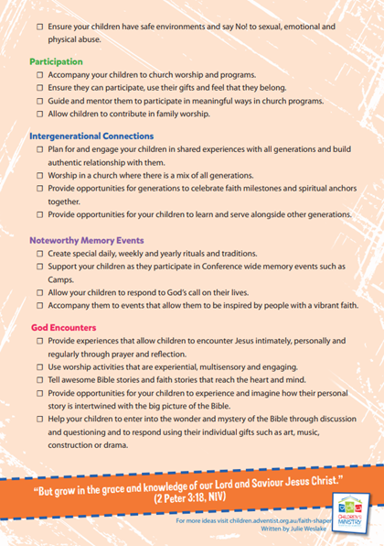
Notes:
Faith Shaper - Shaping Faith @ Home
Making lifelong disciples of children and youth is a key priority of our church. We believe that it is time to have the important discussions on what formational experiences they need. In partnership with the Interdenominational National conversation here2stay South Pacific Division and Australian Conferences Children’s Ministries have put together 7 Essential Experiences that will shape this faith that stays. We want this faith to be deep, and it needs to be strong and active.
As you plan to give your children the 7 essential experiences they need for life-long faith, have a look at the following checklist as a starting point. Tick off how many practices you do. Put a start beside those that you are going to try. Don’t be afraid to adapt this list to fit your family and situation.
https://children.adventistchurch.com/resources/category/discipleship/

