Slide 1
Building Your Child’s
SELF-ESTEEM
Linda Mei Lin Koh, Ed. D
GC Children’s Ministries
Notes:
Building Your Child’s Self-Esteem
A healthy self-esteem is vitally important to a child’s future happiness, health, and success. Children with high self-esteem are better equipped to deal with peer pressure, responsibility, frustrations, challenges, and both positive and negative emotions.

Slide 2
WHAT IS
SELF-ESTEEM?
It’s your self-worth, or
how you value yourself
Your self-esteem is made up of thoughts and
feelings you have about yourself. These may be:
POSITIVE
NEGATIVE
I’m ugly
I’m stupid
I’m pretty
I’m smart
I’m fun
I’m boring
You’re a unique person – there’s no one else in the world like you. God made you special!
Notes:
What is Self-Esteem?
It’s your self-worth or how you value yourself.
Your self-esteem is made up of thoughts and feelings you have about yourself. These may be:
Positive feelings -- I’m pretty; I’m smart; “I’m fun
Negative feelings – I’m ugly; I’m stupid; I’m boring.
You’re a unique person – there’s no one else in the world like you. God made you special!

Slide 3
Notes:
American psychologist Abraham Maslow included self-esteem in his hierarchy of human needs. Two different forms of "esteem":
the need for respect from others in the form of recognition, success, and admiration
the need for self-respect in the form of self-love, self-confidence, skill, or aptitude.
Respect from others was believed to be more fragile and easily lost than inner self-esteem. According to Maslow, without the fulfillment of the self-esteem need, individuals will be driven to seek it and unable to grow and obtain self-actualization. Maslow also states that the healthiest expression of self-esteem "is the one which manifests in the respect we deserve for others, more than renown, fame, and flattery".

Slide 4
Self-esteem affects:
how a child thinks, acts & feel about himself & others
how successful will he/she be in life
WHY
SHOULD A CHILD
HAVE GOOD
SELF-ESTEEM?
HIGH SELF-ESTEEM
makes a child feel:
effective
productive
capable
loved
willing to try new things
LOW SELF-ESTEEM
Makes a child feel:
*ineffective
*worthless
*incompetent
*unloved
*lack confidence
Notes:
Why Should a Child Have Good Self-Esteem?
Self-esteem affects how a child thinks, acts and feel about himself and others; and how successful will he/she be in life
High self-esteem makes a child feel effective, productive, capable, loved, willing to try new things.
Low self-esteem makes a child feel ineffective, worthless, incompetent, unloved, lack confidence.

Slide 5
“I will praise you, for I am fearfully and wonderfully made; Marvelous are Your works, and that my soul knows very well.”
Psalms 139:14
Notes:
The Bible tells us in Psalms 139:14 that we are special.
“I will praise you, for I am fearfully and wonderfully made; Marvelous are Your works, and that my soul knows very well.”
Every child should be taught that he is created special and unique. God has a special plan for him and as a child of God, he should have great self-esteem.

Slide 6
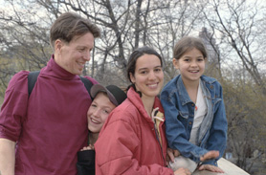
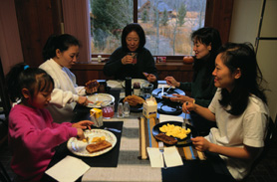
AT HOME
Relationships with his parents,
grandparents, brothers, sisters, etc.
FACTORS
THAT
INFLUENCE
SELF-ESTEEM
IN SOCIAL LIFE
Relationships with childhood & adult friends, neighbors, sports teams
A child’s self-esteem
is based on unique
experiences and
personal relationships that make up his/her life.
Notes:
Factors that Influence Self-Esteem: A Child’s self-esteem is based on unique experiences and personal relationships that make up his life.
At Home – relationships with parents, grandparents, brothers and sisters.
In Social Life – relationships with childhood and adult friends, neighbors, sports teams, etc.

Slide 7
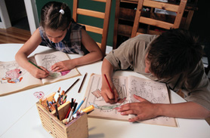
IN SCHOOL
Relationships with classmates, teachers, principals & counselors.
IN SOCIETY
Relationships with members of
different cultures, races and
religions & those in the community
In general, positive experiences,
fulfilling relationships help raise self- esteem. Negative experiences lower self-esteem.
Notes:
In School – relationships with classmates, teachers, principals and counselors.
In Society – relationships with members of different cultures, races and relations and those in the community.
In general, positive experiences, fulfilling relationships help raise self- esteem. Negative experiences lower self-esteem.

Slide 8
HOW PARENTS CAN BUILD SELF-ESTEEM
Notes:
HOW PARENTS CAN BUILD SELF-ESTEEM

Slide 9
1. Love Unconditionally
Children need unconditional love and support.
Love does not depend on grades, performance, or looks.
Reassure your child that you love him, even when he misbehaves. Take time to explain what he did wrong. Never withhold love because of misbehavior.
Notes:
1. Love Unconditionally
Children need unconditional love and support – God loves us unconditionally.
Love does NOT depend on grades, performance, or looks – love your child even if he gets low grades and is not an “A” performer.
Reassure your child that you love him, even when he misbehaves. Take time to explain what he did wrong. Never withhold love because of misbehavior.

Slide 10
2. Help Your Child To Learn To Do Things
Let your child learn new things.
Show him how and help him at the beginning till he masters it .
Mastery helps your child feel good about himself.
Notes:
2. Help Your Child To Learn To Do Things
Let your child learn new things
Show him how and help him at the beginning till he masters it.
Mastery helps your child feel good about himself.

Slide 11
3. Praise Your Child Genuinely
Praise your child when he does good work.
Praise his effort, progress, and attitude, not just results and performance.
Do not overpraise a child.
Do not flatter for he knows it is not true.
Notes:
3. Praise Your Child Genuinely
Praise your child when he does good work.
Praise his effort, progress, and attitude, not just results and performance.
Do not overpraise a child.
Do not flatter for he knows it is not true,

Slide 12
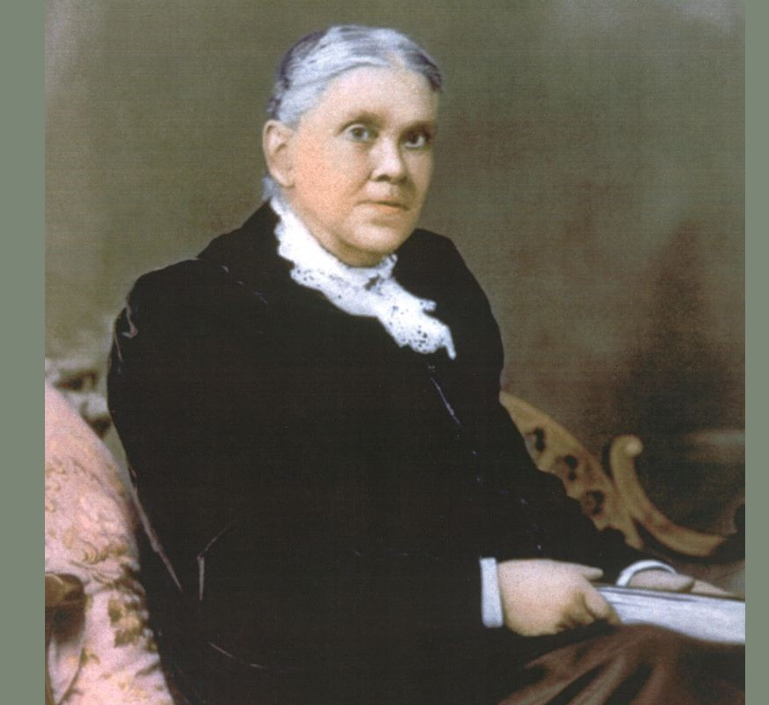
“By speaking kindly to their children and praising them when they try to do right, parents may encourage their efforts, make them very happy . . . and bring cheerful
sunlight in.”
Adventist Home, 421
Notes:
Adventist Home, p. 421
“By speaking kindly to their children and praising them when they try to do right, parents may encourage their efforts, make them very happy . . . and bring cheerful sunlight in.”

Slide 13
4. Let Kids Make Choices
Let kids make age-appropriate choices—they feel more confident.
Help them to learn about the consequences of their decisions.
Notes:
4. Let Kids Make Choices
Let kids make age-appropriate choices -- they feel more confident. Any time kids try things, do things, and learn things can be a chance for self-esteem to grow.
Help them also learn about the consequences of their decisions -- both positive and negative.
Parents need to set expectations and not threats. Work to connect specific consequences to specific behavior. For example, if a child makes a mess, the natural consequence is that they need to clean it up. An unrelated consequence for making a mess — such as having no dessert — isn’t a specific connection or natural consequence and may be difficult for children to understand.
Be consistent and positive. Discuss the good things that come out of certain types of behavior. (“She was so happy that you shared your toys.”) and the possible positive outcomes of doing certain things. Knowing that he or she can have a positive impact on the world through his or her actions is a powerful lesson that your child can use throughout life.

Slide 14
5. Be A Good Role Model
When parents put effort in doing their work well and doing it cheerfully, we are modeling a good attitude.
Parents also model their Christian values.
Notes:
5. Be a Good Role Model
When parents put effort in doing their work well and doing it cheerfully, we are modeling a good attitude.
Parents also model their Christian values
It is often said that “values are caught more than taught.” It is amazing how children imitate their parents in everything they do. They imitate our attitudes and actions such as how we treat others with love and respect regardless of race, language, or cultures.; whether we have self-control or we fly into a temper. They catch on to our prejudices toward people, food, and things. They even model our communication tone and how we speak with others.
The good values such as reaching out to the less fortunate, donating food and money to help the homeless or refugees will be imbibed by our children who will grow into caring adults. So watch out for the kind of role model you are providing for your children.

Slide 15
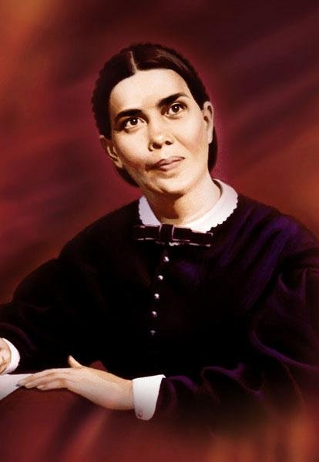
Child Guidance p. 215
“Children imitate their parents; hence great care should be taken to give them correct models. Parents who are kind and polite at home, while at the same time they are firm and decided, will see the same traits manifested in their children.”
Notes:
Child Guidance p. 215
“Children imitate their parents; hence great care should be taken to give them correct models. Parents who are kind and polite at home, while at the same time they are firm and decided, will see the same traits manifested in their children.”

Slide 16
6. Focus On Strengths
Pay attention to what your child does well and enjoys.
Provide opportunities for him to develop those strengths.
Notes:
6. Focus on Strengths
Pay attention to what your child does well and enjoys.
Provide opportunities for him to develop those strengths.
Parents will notice each child has different gifts and talents. Observe your child and provide lots of opportunities to develop those gifts he has. Capitalize on his strengths and encourage him to use them to serve others.
Illustration:
Jerry was a 14-year-old Down Syndrome child. But he was pleasant and smiled a lot. He loved to help with giving directions. So his mom encouraged him to serve as the parking attendant for their big church parking lot. The church was happy to give him something to do. Jerry was faithful every Sabbath morning, arriving early with a whistle hanging around his neck. He directed the cars as they arrived in the parking lot to the various parking spots.
Jerry couldn’t teach a Sabbath School class nor lead out in any way, but he was excellent at directing the cars to their parking spots. When asked why was he doing that, he would smile his biggest, “That’s what I am good at!” beamed Jerry with satisfaction. What a great self-esteem he has!

Slide 17
1 Peter 4:10 (ESV)
“As each has received a gift, use it to serve one another, as good stewards of God's varied grace.”
Notes:
1 Peter 4:10
“As each has received a gift, use it to serve one another, as good stewards of God's varied grace.”
Every child is endowed with different gifts and talents. Help them to develop those gifts and strengths to serve the church and others in the community.

Slide 18
7. Let Them Help With Chores
Children need opportunities to demonstrate their competence.
They need to feel their contribution is valuable.
Ask them to help with cooking, setting the table, etc.
Notes:
7. Let Them Help Around the House
Children need opportunities to demonstrate their competence.
They need to feel their contribution is valuable.
Ask them to help with cooking, setting the table, etc.

Slide 19
8. Don’t Call Your Child Names or Use Sarcasm
Never belittle your child’s feelings.
When you get angry, take a break so you don’t say anything you’ll regret.
You can dislike his action without disliking the child.
Notes:
8. Don’t Call Your Child Names or Use Sarcasm
Never belittle your child’s feelings.
When you get angry, take a break so you don’t say anything you’ll regret.
You can dislike his action without disliking the child.

Slide 20
ASSESS YOUR OWN LEVEL OF
SELF-ESTEEM
PARENTS, HOW DO
YOU FEEL ABOUT
YOURSELF?
1. Are you easily hurt by criticism?……
2. Are you very shy or overly aggressive?
Do you try to hide your feelings?……
Do you fear close relationships?………
Do you try to blame your mistakes
on others?………………………….
Do you find excuses for refusing
to change?……………………………
7. Do you avoid new experiences?……
Do you continually wish you could
change your physical appearance?…
9. Are you too modest about personal
successes?……………………………
10. Are you glad when others fail?………
If MOST of your answers
are “yes,” your self-esteem could probably use some improvement.
Notes:
PARENTS, HOW DO YOU FEEL ABOUT YOURSELF?
ASSESS YOUR OWN LEVEL OF SELF-ESTEEM
1. Are you easily hurt by criticism?
Are you very shy or overly aggressive?
Do you try to hide your feelings?
Do you fear close relationships?
Do you try to blame your mistakes on others?
Do you find excuses for refusing to change?
Do you avoid new experiences?
Do you continually wish you could change your physical appearance?
Are you too modest about personal successes?
Are you glad when others fail?
If most of your answers are “yes,” your self-esteem could probably use some improvement.

Slide 21
MORE ASSESSMENT OF
YOUR SELF-ESTEEM
1. Do you accept constructive criticism?
2. Are you at ease meeting new people?
3. Are you honest & open about your
feelings?
4. Do you value your closest friends?
5. Are you able to laugh at your
mistakes?
6. Do you notice & accept changes in
yourself?
7. Do you look for and tackle new
challenges?
8. Do you believe you are created special
by God?
9. Do you give yourself credit when credit
is due?
Are you happy when others succeed?
Do you use your gifts & talents when asked to do so?
If MOST of your answers are“yes,” you probably have a healthy self-esteem.
When you have a healthy self-esteem, you will also impact your child’s self-esteem.
Notes:
More Assessment of Self-Esteem
1. Do you accept constructive criticism?
2. Are you at ease meeting new people?
3. Are you honest & open about your feelings?
4. Do you value your closest friends?
5. Are you able to laugh at your mistakes?
6. Do you notice & accept changes in yourself?
7. Do you look for and tackle new challenges?
8. Do you believe you are created special by God?
9. Do you give yourself credit when credit is due?
Are you happy when others succeed?
Do you use your gifts & talents when asked to do so?
If MOST of your answers are“yes,” you probably have a healthy self-esteem.
When you have a healthy self-esteem, you will also impact your child’s self-esteem.

Slide 22
IN CONCLUSION
Is building self-
esteem just the responsibility of parents?
Is high self-
esteem a good thing?
NO! It is the relationships in the home, school, & church that impact the child.
Yes! your confidence and self-esteem help kids move out to reach their goals & to help others.
Can you help
your children feel better about
themselves?
Does high self-esteem
mean self-centeredness?
YES! offer them encouragement,
love, patience and spending time with them. Never compare them with others but help them develop their gifts and talents.
NO. It’s not egotism or snobbishness. High self-esteem helps you appreciate your uniqueness created by God.
Notes:
In Conclusion
Is high self-esteem a good thing? -- Yes! Your confidence and self-esteem help kids move out to reach their goals and to help others.
Is building self-esteem just the responsibility of parents? -- No! it is the relationships in the home, school, and church that impact the child.
Does high self-esteem mean self-centeredness? -- No! it’s not egotism or snobbishness, High self-esteem helps you appreciate your uniqueness created by God.
Can you help your children feel better about themselves? -- Yes! Offer them encouragement, love, patience, and spending time with them. Never compare them with others but help them develop their gifts and talents.

Slide 23
References
Reviewed by: D’Arcy Lyness, “Your Child’s Self-esteem.” https://kidshealth.org/en/parents/self-esteem.html
https://en.wikipedia.org/wiki/Maslow%27s_hierarchy_of_needs
https://www.todaysparent.com/family/parenting/how-to-build-your-childs-self-esteem/
Notes:
References
Reviewed by: D’Arcy Lyness, “Your Child’s Self-esteem.” https://kidshealth.org/en/parents/self-esteem.html
https://en.wikipedia.org/wiki/Maslow%27s_hierarchy_of_needs
https://www.todaysparent.com/family/parenting/how-to-build-your-childs-self-esteem/

