Slide 1

The 7 Biggest Mistakes That Destroy Kids’ Mental Strength
Tanya Muganda
GC Children’s Ministries
Notes:
A Therapist Shares The 7 Biggest Mistakes That Destroy A Kids’ Mental Strength

Slide 2

1. Minimizing Your Kid’s Feelings
Kids need to know that it’s healthy to express and talk about their emotions.
When parents tell their kids things such as
-- “don’t be so sad about it” or
-- “it’s not a big deal,” they’re sending the message that feelings don’t matter and that it’s better to suppress them.
Notes:
Minimizing Your Kid’s Feelings
Kids need to know that it’s healthy to express and talk about their emotions.
When parents tell their kids things such as
“don’t be so sad about it” or “it’s not a big deal,” they’re sending the message that feelings don’t matter and that it’s better to
suppress them.

Slide 3

If your kid is displaying expressions of fear during a loud storm, for example, consider saying, “I know you’re scared right now.”
Then ask them what they think would make them feel better.
This teaches them how to manage and cope with emotions on their own.
Notes:
If your kid is displaying expressions of fear during a loud storm, for example, consider saying, “I know you’re scared right now.”
Then ask them what they think would make them feel better.
This teaches them how to manage and cope with emotions on their own.

Slide 4
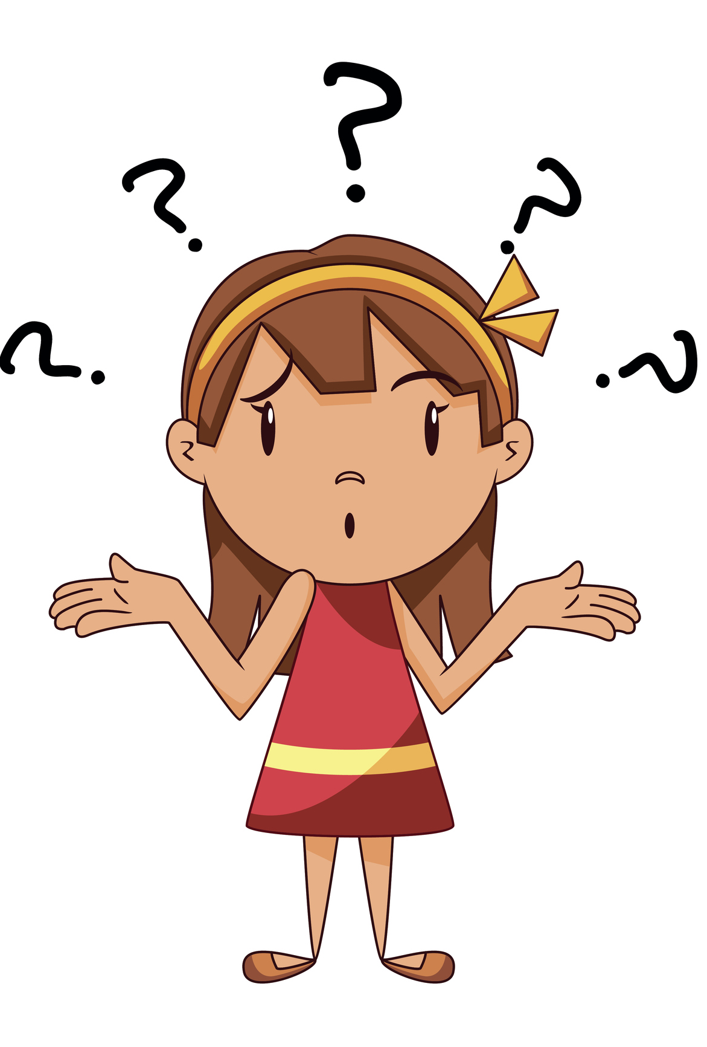
Assurance from the Bible
John 14:27
“Peace I leave with you; my peace I give you. I do not give to you as the world gives. Do not let your hearts be troubled and do not be afraid.”
Notes:
Assurance from the Bible John 14:27
“Peace I leave with you; my peace I give you. I do not give to you as the world gives. Do not let your hearts be troubled and do not be afraid.”

Slide 5
Ellen White, Mind, Character, and Personality, p. 466 (adapted)
“It is not work that kills; it is worry. The only way to avoid worry is to take every trouble to Christ. Let us not look on the dark side. Let us develop cheerfulness of spirit.”
Notes:
Ellen White, Child Guidance, p. 27
“Your children are God’s property, bought with a price. Be very particular, O father and mothers, to treat them in a Christlike manner. The youth should be carefully and judiciously trained, for the wrong habits formed in childhood and youth often cling to the entire life-experience. May God help us to see the necessity of beginning right.”

Slide 6

2. Always Saving Them From Failure
As parents, it’s hard to watch our children struggle through challenges that we know we can easily fix for them.
Notes:
Always Saving Them From Failure
As parents, it’s hard to watch our children struggle through challenges that we know we can easily fix for them.

Slide 7

But think of it this way:
  If your kid is doing poorly in school, you know that telling them the homework answers will only backfire, because you can’t be in the classroom when they have to complete those tests on their own.
Notes:
But think of it this way:
If your kid is doing poorly in school, you know that telling them the homework answers will only backfire, because you can’t be in the classroom when they have to complete those tests on their own.

Slide 8

Failure is a big part of success.
If kids are never given the chance to learn the lessons that come with failure.
They’ll never develop the perseverance they need to rise back up after a setback.
Notes:
Failure is a big part of success.
If kids are never given the chance to learn the lessons that come with failure.
They’ll never develop the perseverance they need to rise back up after a setback.

Slide 9
Proverbs 24:16
“For the righteous falls seven times and rises again, but the wicked stumble in times of calamity.”
Notes:
Proverbs 24:16
“For the righteous falls seven times and rises again, but the wicked stumble in times of calamity.”

Slide 10


3. Overindulging
Your Kids
Kids love stuff
Parents love giving it to them.
But research shows that when you give your kids whatever they desire, they miss out on skills related to mental strength, such as self-discipline.
Notes:
Overindulging Your Kids
Kids love stuff
Parents love giving it to them.
But research shows that when you give your kids whatever they desire, they miss out on skills related to mental strength, such as self-discipline.

Slide 11

You want your kids to grow up knowing that it’s possible to achieve what they want — if they work for it.
Parents can teach their kids to learn self-control by
-- Setting clear rules for things like finishing homework before screen time
-- Doing chores to boost allowance (so they can buy things on their own, while knowing they earned it).
Notes:
You want your kids to grow up knowing that it’s possible to achieve what they want — if they work for it.
Parents can teach their kids to learn self-control by
Setting clear rules for things like finishing homework before screen time
Or doing chores to boost allowance (so they can buy things on their own, while knowing they earned it).

Slide 12
Amy Morin, LCSW
Psychotherapist
“When you start saying no, and stop overindulging your child, you’re likely to see increased behavior problems. Your child will likely retaliate and do everything in his power to undermine your efforts. But if you become more authoritative, you’ll teach your child the valuable life skills he needs to become a responsible adult.”
https://www.verywellfamily.com/why-you-shouldnt-overindulge-your-child-1094827
Notes:
Amy Morin, LCSW
Psychotherapist
“When you start saying no, and stop overindulging your child, you’re likely to see increased behavior problems. Your child will likely retaliate and do everything in his power to undermine your efforts. But if you become more authoritative, you’ll teach your child the valuable life skills he needs to become a responsible adult.”

Slide 13
Child Guidance, p. 234
“Blind affection for those who are connected with us by the ties of nature too often exists. This affection is carried to great lengths; it is not balanced by the wisdom or the fear of God. Blind parental affection is the greatest obstacle in the way of the proper training of children. It prevents the discipline and training which are required by the Lord.”
Notes:
Child Guidance, p. 234
“Blind affection for those who are connected with us by the ties of nature too often exists. This affection is carried to great lengths; it is not balanced by the wisdom or the fear of God. Blind parental affection is the greatest obstacle in the way of the proper training of children. It prevents the discipline and training which are required by the Lord."

Slide 14

4. Expecting Perfection
It’s natural to want your child to aim for big goals and be the best at everything.
But that’s not how things work.
Setting the bar too high can lead to self-esteem and confidence issues later in life.
Notes:
Expecting Perfection
It’s natural to want your child to aim for big goals and be the best at everything.
But that’s not how things work.
Setting the bar too high leads can lead to self-esteem and confidence issues later in life.

Slide 15

Build mental strength in your kids by making sure expectations are realistic.
Even if your kids don’t meet them, the setbacks they face will still teach them valuable life lessons
How to succeed the next time around.
Notes:
Build mental strength in your kids by making sure expectations are realistic.
And even if your kids don’t meet them, the setbacks they face will still teach them valuable life lessons
And how to succeed the next time around.

Slide 16

5. Making Sure They Always Feel Comfortable
There are many things that might make your kid feel uncomfortable, especially when it involves doing something new:
  Trying new foods, making new friends,
  Playing a new sport
  Moving homes and having to go to a new school.
Notes:
5. Making Sure They Always Feel Comfortable
There are many things that might make your kid feel uncomfortable, especially when it involves doing something new:
-- Trying new foods, making new friends,
-- Playing a new sport
-- Moving homes and having to go to a new school.

Slide 17

Just like failure, embracing uncomfortable moments can boost mental strength.
Encourage your kids to try new things. Help them get started, because that’s the hardest part.
Once they take that first step, they might realize that it isn’t as difficult as they thought it’d be — and that they might even be good at it!
Notes:
But just like failure, embracing uncomfortable moments can boost mental strength.
Encourage your kids to try new things. Help them get started, because that’s the hardest part.
But once they take that first step, they might realize that it isn’t as difficult as they thought it’d be — and that they might even be good at it!

Slide 18

6. Not Setting Parent-Child Boundaries
You want your kids to make their own decisions, but they also need to know you’re the boss.
For example, if you set a curfew for your 12-year-old, make sure they stick to it every night (or as much as possible).
Notes:
Not Setting Parent-Child Boundaries
You want your kids to make their own decisions, but they also need to know you’re the boss.
For example, if you set a curfew for your 12-year-old, make sure they stick to it every night (or as much as possible).

Slide 19

Kids who are mentally strong have parents who understand the importance of boundaries and consistency.
Caving in and allowing rules to be negotiated too often can lead to power struggles between you and your child.
Notes:
Kids who are mentally strong have parents who understand the importance of boundaries and consistency.
Caving in and allowing rules to be negotiated too often can lead to power struggles between you and your child.

Slide 20

7. Not Taking Care of Yourself
The older we get, the harder it becomes to maintain healthy habits (e.g., eating healthy, exercising daily, taking time to restore).
That’s why it’s important to model self-care habits for your kids.
Notes:
Not Taking Care of Yourself
The older we get, the harder it becomes to maintain healthy habits (e.g., eating healthy, exercising daily, taking time to restore).
That’s why it’s important to model self-care habits for your kids.

Slide 21

It’s also critical to practice healthy coping skills in front of your children.
For example, if you’re stressed about work, consider telling your child, “I had a very tiring day at work, and I’m going to relax with tea and a book.”
Notes:
It’s also critical to practice healthy coping skills in front of your children.
For example, if you’re stressed about work, consider telling your child, “I had a very tiring day at work, and I’m going to relax with tea and a book.”

Slide 22

What Does the Bible Say About Mental
Strength?
Philippines 4:6-7
“Do not be anxious about anything, but in everything by prayer and supplication with thanksgiving, let your requests be made known to God. And the peace of God, which surpasses all understanding, will guard your hearts and your minds in Christ Jesus.”
Notes:
What does the Bible say about Mental Strength?
Philippines 4:6-7
“Do not be anxious about anything, but in everything by prayer and supplication with thanksgiving, let your requests be made known to God. And the peace of God, which surpasses all understanding, will guard your hearts and your minds in Christ Jesus.”

Slide 23
7 Biggest Parenting Mistakes That Destroy Kids Mental Strength
by
Tracey Hutchinson PHD, LMHC
Powerpoint developed by Tanya Muganda

