Slide 1
Racism and Violence
How To Help Kids Handle The News
Linda Mei Lin Koh & Tanya Muganda
GC Children’s Ministries
Notes:
Racism and Violence; How To Help Kids Handle The News
With protests over the violent deaths of black Americans dominating the news in the US, it’s understandable that many kids are feeling scared, confused or angry about the situation. How can parents, many of whom are struggling themselves, help children process what they’re seeing and manage their feelings?
There’s no one right answer. That said, there are a few guidelines parents can keep in mind to help kids deal with troubling news about race and violence.

Slide 2
What Does the Bible Teach About Racism?
Galatians 3:28 -- “There is neither Jew nor Gentile, neither slave nor free, nor is there male and female, for you are all one in Christ Jesus.”
John 13:34 – “A new command I give you: Love one another As I have loved you, so you must love one another.”
Romans 10:12 – “For there is no difference between Jew and Gentile – the same Lord is Lord of all and richly blesses all who call on him.” (NIV)
Notes:
What Does the Bible Teach About Racism? (NIV)
Galatians 3:28 -- “There is neither Jew nor Gentile, neither slave nor free, nor is there male and female, for you are all one in Christ Jesus.”
John 23:34 – “A new command I give you: Love one another As I have loved you, so you must love one another.”
Romans 10:12 – “For there is no difference between Jew and Gentile – the same Lord is Lord of all and richly blesses all who call on him.”

Slide 3
What Does Ellen White Say About Racism?
“Christ died just as much for the Black people as for the White people, and the God of the White man is the same God of the Black man.”
"The Black man's name is written next to the White man's name in the Book of Life.”
“God makes no distinction between the North and the South; therefore, we must learn to live together here on earth before we can get to heaven.”
The Southern Work (Review and Herald Publishing Association, 1966), pp. 9-18)
Notes:
What Does Ellen White Say About Racism?
“Christ died just as much for the Black people as for the White people, and the God of the White man is the same God of the Black man.”
"The Black man's name is written next to the White man's name in the Book of Life.”
“God makes no distinction between the North and the South; therefore, we must learn to live together here on earth before we can get to heaven.”
The Southern Work (Review Publishing Association, 1966), pp. 9-18

Slide 4
Tips for Helping Your Child Deal with Racism
Notes:
Tips for Helping Your Child Deal with Racism

Slide 5
Start by checking in with your child. Even young ones are extremely perceptive and may have worries or concerns they don’t know how to express.
Ask broad questions that give kids space to talk over what they’re feeling: “How did you feel about what we saw on the news?”
For young children, drawing, painting or acting out stories with toys can be helpful tools for expressing thoughts and feelings that aren’t easy to put into words.
1. Validate Their Feelings
Notes:
1. Validate Their Feelings
Start by checking in with your child. Even young ones are extremely perceptive and may have worries or concerns they don’t know how to express.
Ask broad questions that give kids space to talk over what they’re feeling: “How did you feel about what we saw on the news?”
For young children, drawing, painting or acting out stories with toys can be helpful tools for expressing thoughts and feelings that aren’t easy to put into words.

Slide 6
2. Don’t Avoid Talking About it
Racism is not new.
These are ongoing problems and it takes all of us changing the mentality and the mindset to work towards a better future and fix them.
That change can happen only with frank, open conversation — “It’s really not a choice.”
Notes:
2. Don’t Avoid Talking About it
Racism is not new.
These are ongoing problems and it takes all of us changing the mentality and the mindset to work towards a better future and fix them.
That change can happen only with frank, open conversation — “It’s really not a choice.”

Slide 7
For families of color, racism is a daily reality. Black parents can’t wait, even if they wanted to.
White parents can help by addressing race and racism with kids early and often.
Research shows that even very young children are aware of racial differences, and children can learn harmful lessons about race when it’s not discussed openly.
Notes:
For families of color, racism is a daily reality. “Black parents can’t wait, even if they wanted to.”
White parents, she says, can help by addressing race and racism with kids early and often.
Research shows that even very young children are aware of racial differences, and children can learn harmful lessons about race when it’s not discussed openly

Slide 8
It’s helpful for white families to see that minimizing the legacy of racism in our society by avoiding ugly truths does children a disservice.
Instead, white parents can commit to educating themselves and building conversations about race into kids’ lives early on.
Notes:
It’s helpful for white families to see that minimizing the legacy of racism in our society by avoiding ugly truths does children a disservice.
Instead, white parents can commit to educating themselves and building conversations about race into kids’ lives early on.

Slide 9
3. Diversity in Kids Products
White families can make a concerted effort to represent racial diversity in the products they buy for their children.
For example, parents of white children can look for black dolls and books with predominantly black characters, which can help normalize diversity for kids and spark spontaneous, everyday conversations about race.
Notes:
3. Diversity in Kids Products
White families can make a concerted effort to represent racial diversity in the products they buy for their children.
For example, parents of white children can look for black dolls and books with predominantly black characters, which can help normalize diversity for kids and spark spontaneous, everyday conversations about race.

Slide 10
4. Be Clear, Direct And Factual
Even
Even with young children, use clear language.
Don’t say
Don’t say, “People are upset because some groups treat other groups unfairly.”
Say
Instead, say: “This is about the way that white people treat black people unfairly.”
“If you expect children to read between the lines, they can miss the message,” says Dr. Hameed.
Notes:
4. Be Clear, Direct and Factual
Even with young children, use clear language.
Don’t say, “People are upset because some groups treat other groups unfairly.”
Instead, say: ”This is about the way that white people treat black people unfairly.” If you expect children to read between the lines, they can miss the message,” says Dr. Hameed.

Slide 11
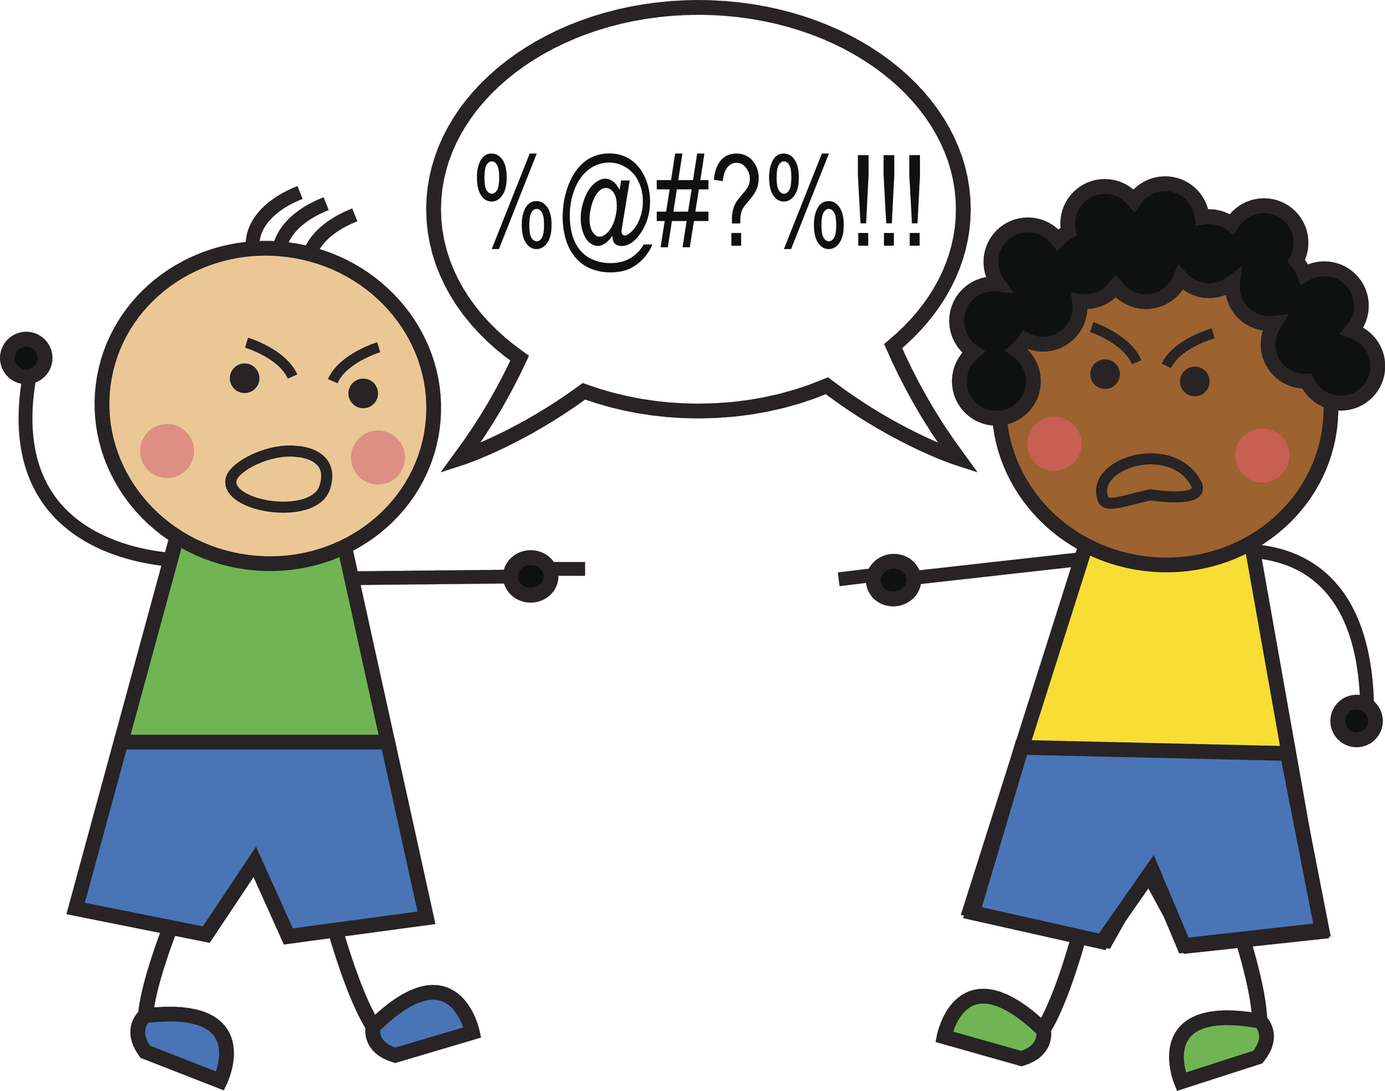
Emphasize that racial violence is wrong.
It’s easy for kids (especially little ones) to think that bad things happen to black people because black people are themselves bad.
“Even if a child doesn’t explicitly tell you this,” says Dr. Hameed, “it is an easy assumption they can make based on how black people have been portrayed and treated in this country.”
Notes:
Emphasize that racial violence is wrong.
It’s easy for kids (especially little ones) to think that bad things happen to black people because black people are themselves bad.
“Even if a child doesn’t explicitly tell you this,” says Dr. Hameed, “it is an easy assumption they can make based on how black people have been portrayed and treated in this country.”

Slide 12
Help children understand by speaking to them in a developmentally appropriate way.
Emphasize to your child that black people are good and that being black doesn’t make you bad.
Treating people unfairly is the thing that’s bad, and black people have been treated unfairly for a long time.
Notes:
Help children understand by speaking to them in a developmentally appropriate way.
Emphasize to your child that black people are good and that being black doesn’t make you bad.
Treating people unfairly is the thing that’s bad, and black people have been treated unfairly for a long time.

Slide 13
Talk about history
Kids need to know that racism is part of a history that dates back hundreds of years.
At the same time, you can also emphasize your hope for a better future and plan ways your family can help make that a reality.
Notes:
Talk about history
Kids need to know that racism is part of a history that dates back hundreds of years, Dr. Hameed notes.
At the same time, you can also emphasize your hope for a better future and plan ways your family can help make that a reality.

Slide 14
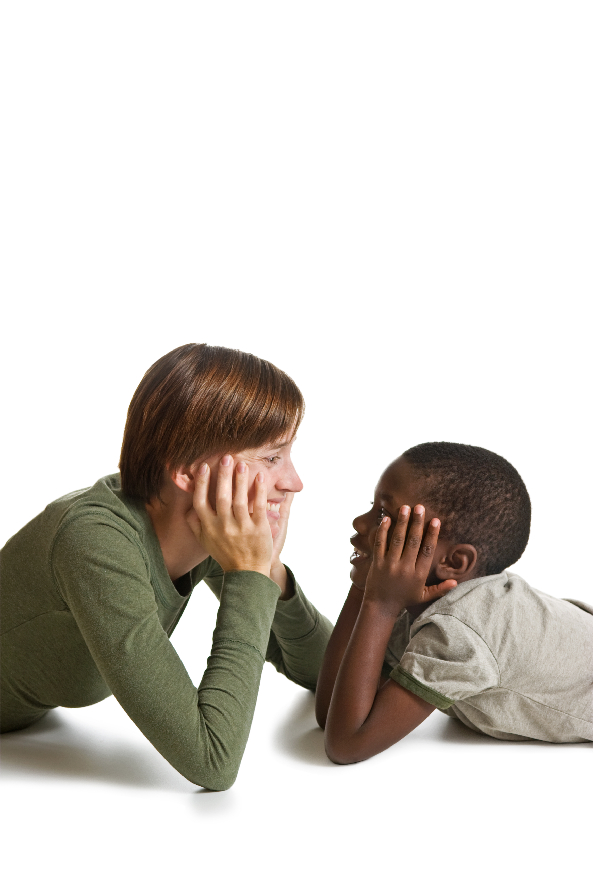
5. Encourage Questions – And Don’t Worry If You Can’t Answer Them
Kids are likely to have lots of questions about racism and violence, and chances are they won’t be easy ones.
They might want to know how racism affects them or why white people treat black people unfairly.
These aren’t easy subjects and feeling uncomfortable during the conversation is normal — but it’s not a reason to stop talking.
Notes:
5. Encourage Questions – And Don’t Worry If You Can’t Answer Them
Kids are likely to have lots of questions about racism and violence, and chances are they won’t be easy ones.
They might want to know how racism affects them or why white people treat black people unfairly.
These aren’t easy subjects and feeling uncomfortable during the conversation is normal — but it’s not a reason to stop talking.

Slide 15
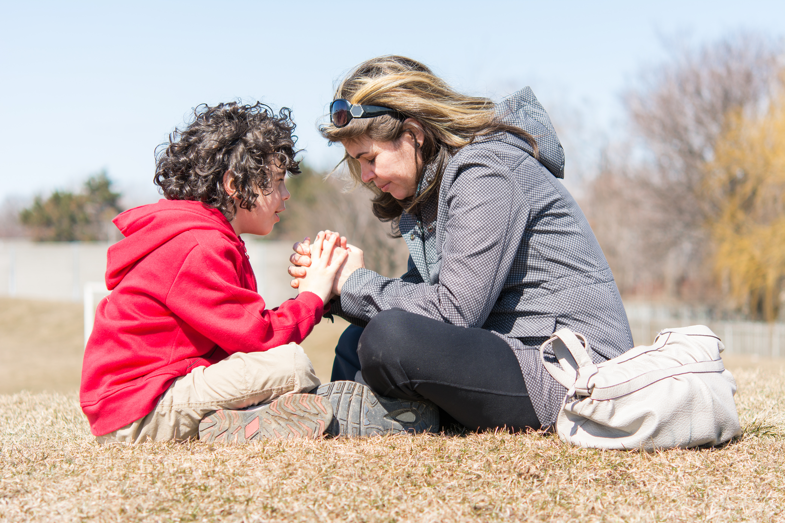
By tolerating discomfort you’re modeling an important skill for your child.
Be honest. You might say, “I find it really hard to talk about this. It feels scary.
But it also makes me more hopeful about making change.”
Notes:
By tolerating discomfort you’re modeling an important skill for your child.
Be honest. You might say, “I find it really hard to talk about this. It feels scary.
But it also makes me more hopeful about making change.”

Slide 16
6. Try To Be Calm But Don’t Hide Your Emotions
Children take their cues from parents, so talking to them calmly and staying factual helps them process information.
It’s helpful to pick a time when you’re feeling centered and have had a chance to work through your own feelings.
At the same time, it’s important that we don’t hide our emotions from children, especially when the subject is so important.
Notes:
6. Try To Be Calm But Don’t Hide Your Emotions
Children take their cues from parents, so talking to them calmly and staying factual helps them process information.
It’s helpful to pick a time when you’re feeling centered and have had a chance to work through your own feelings.
At the same time, it’s important that we don’t hide our emotions from children, especially when the subject is so important.

Slide 17
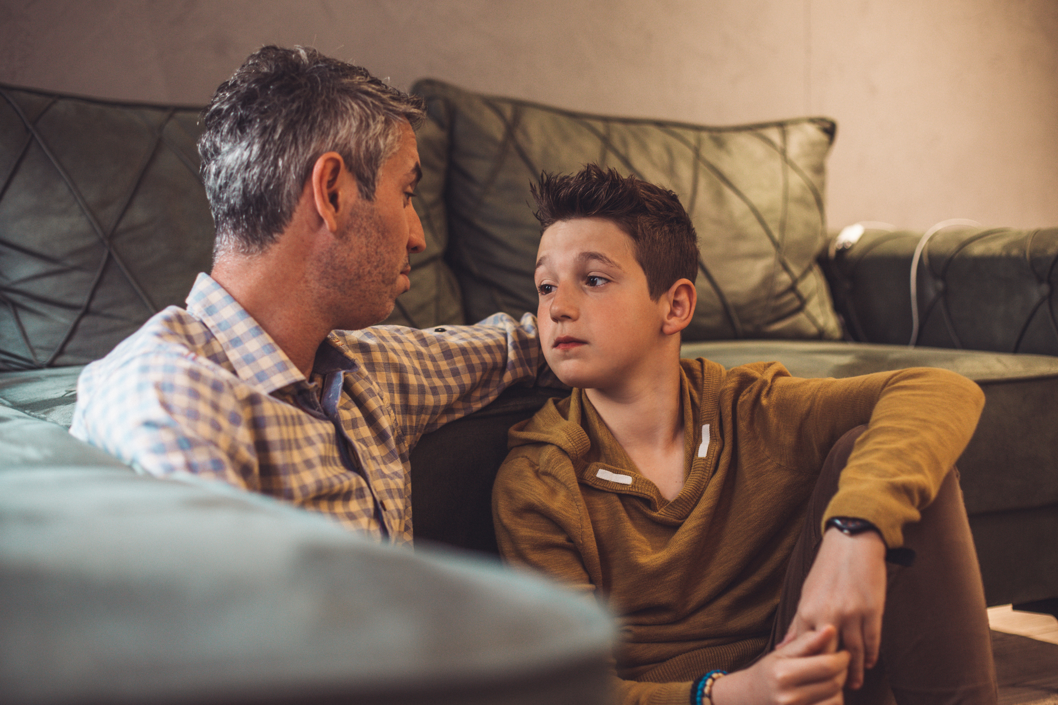
Let them know that you’re sad or angry and acknowledge that it’s good to be upset by injustice.
As long as it doesn’t stop you from working to make it better.
That way, you’ll leave kids with a clear lesson about the family values you want to pass on to them.
Notes:
Let them know that you’re sad or angry, says Dr. Hameed, and acknowledge that it’s good to be upset by injustice
As long as it doesn’t stop you from working to make it better.
That way, you’ll leave kids with a clear lesson about the family values you want to pass on to them.

Slide 18
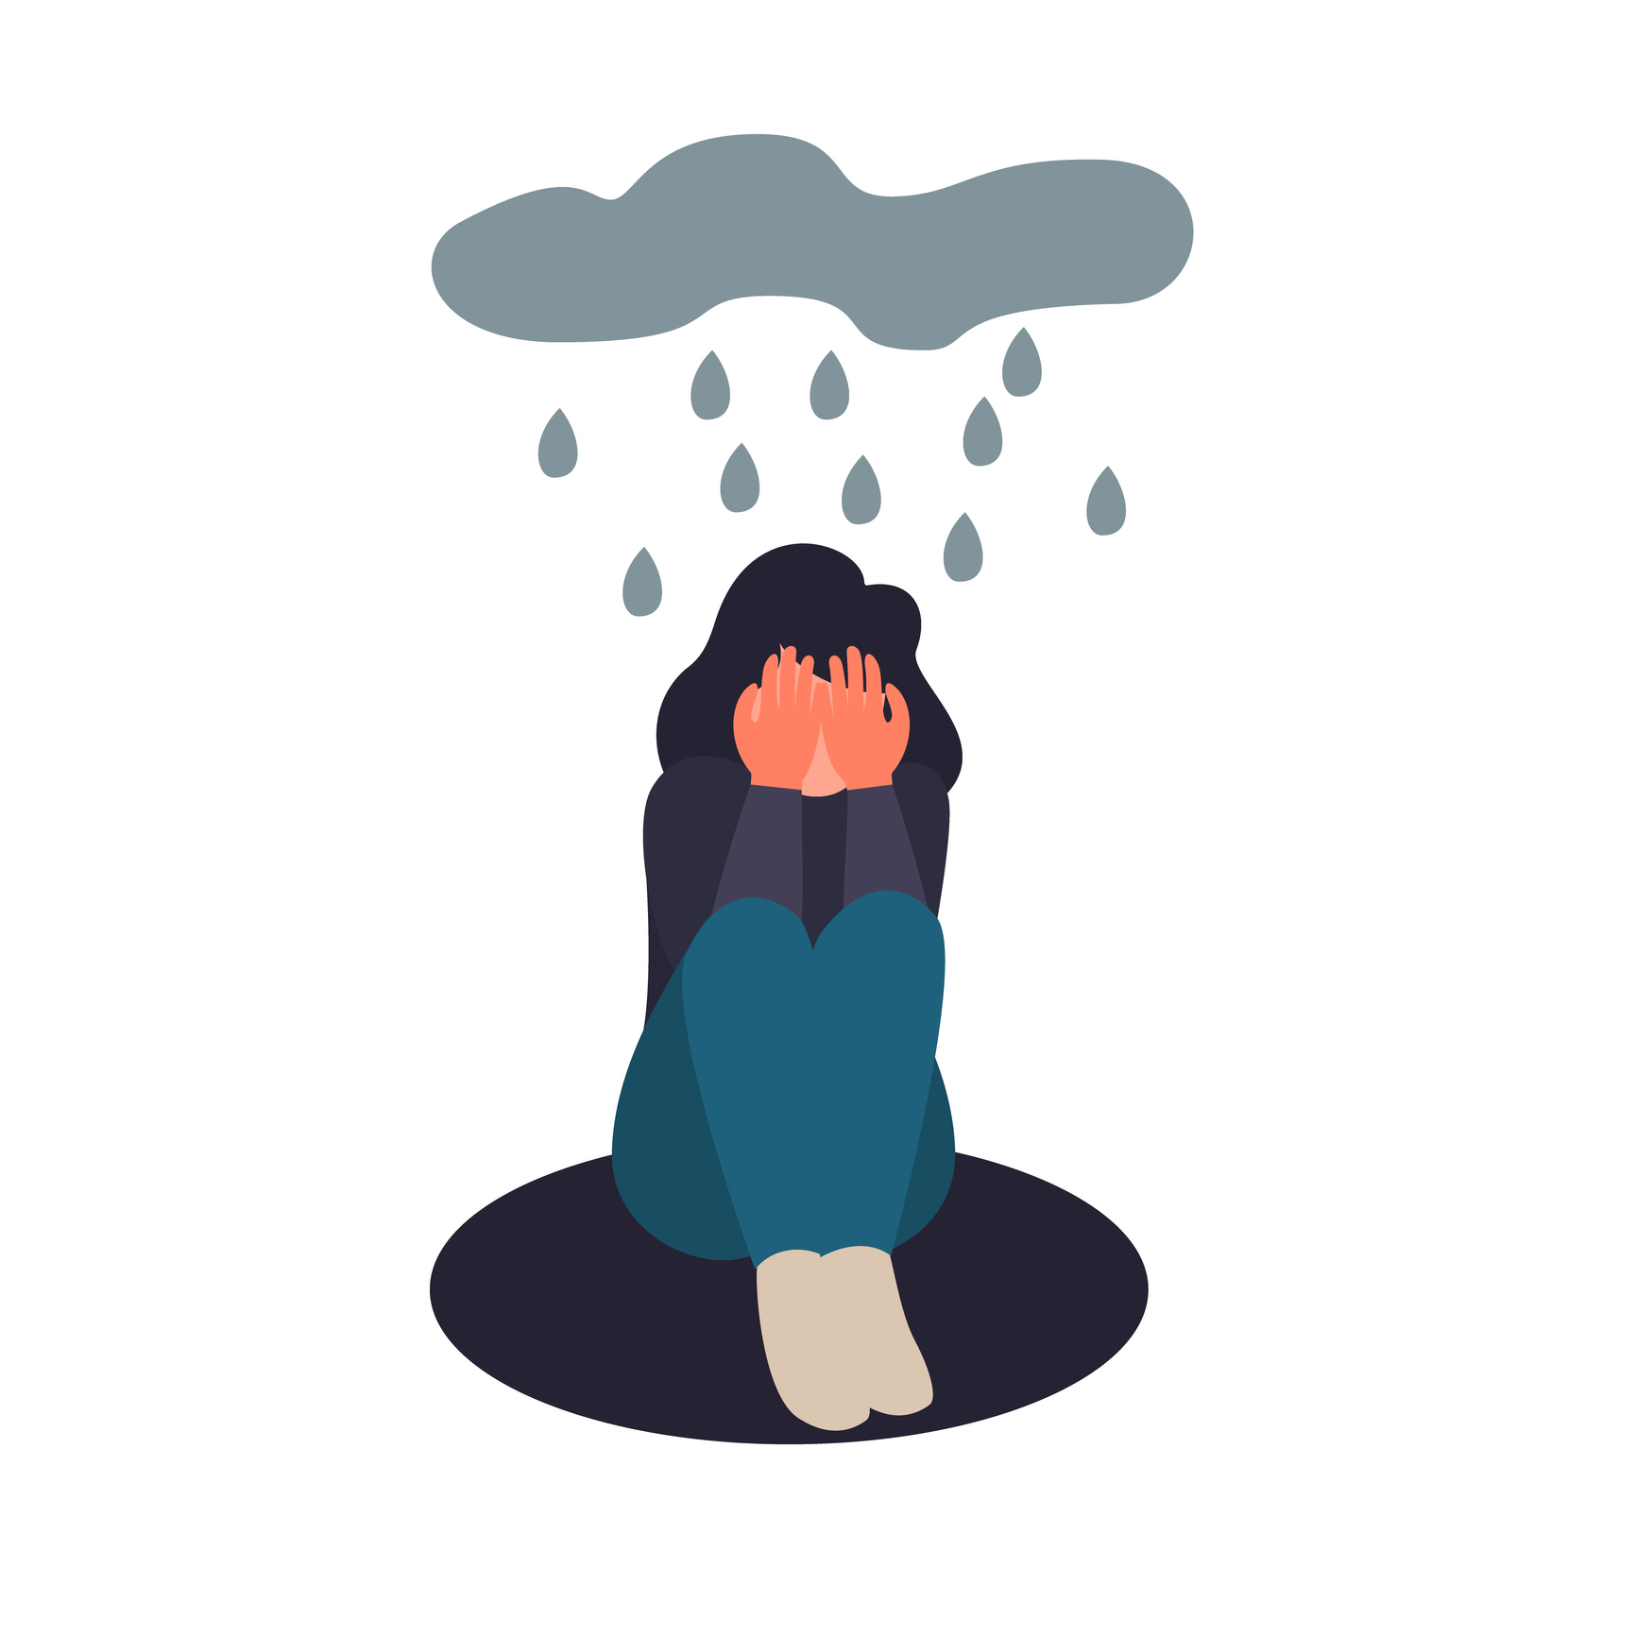
7. Rely On Your Support System
Witnessing scenes of racist violence is deeply upsetting for many parents, but for parents of children of color, it can also be traumatic.
Take time to check in with your own mental health during this time, especially given the additional stress of the coronavirus crisis.
If you’re feeling exhausted or overwhelmed, reach out to your networks for support.
Notes:
7. Rely On Your Support System
Witnessing scenes of racist violence is deeply upsetting for many parents, but for parents of children of color, it can also be traumatic.
Take time to check in with your own mental health during this time, especially given the additional stress of the coronavirus crisis.
If you’re feeling exhausted or overwhelmed, reach out to your networks for support.

Slide 19
Friends, family members, religious leaders and mental health professionals can all help you process your own emotions and plan conversations with children.
It can also help to bring in trusted allies to talk to your children themselves .
Having an adult perspective that doesn’t come from a parent can give them more space to sort through what they’re feeling and ask questions.
Notes:
Friends, family members, religious leaders and mental health professionals can all help you process your own emotions and plan conversations with children.
It can also help to bring in trusted allies to talk to your children themselves —
Having an adult perspective that doesn’t come from a parent can give them more space to sort through what they’re feeling and ask questions.

Slide 20
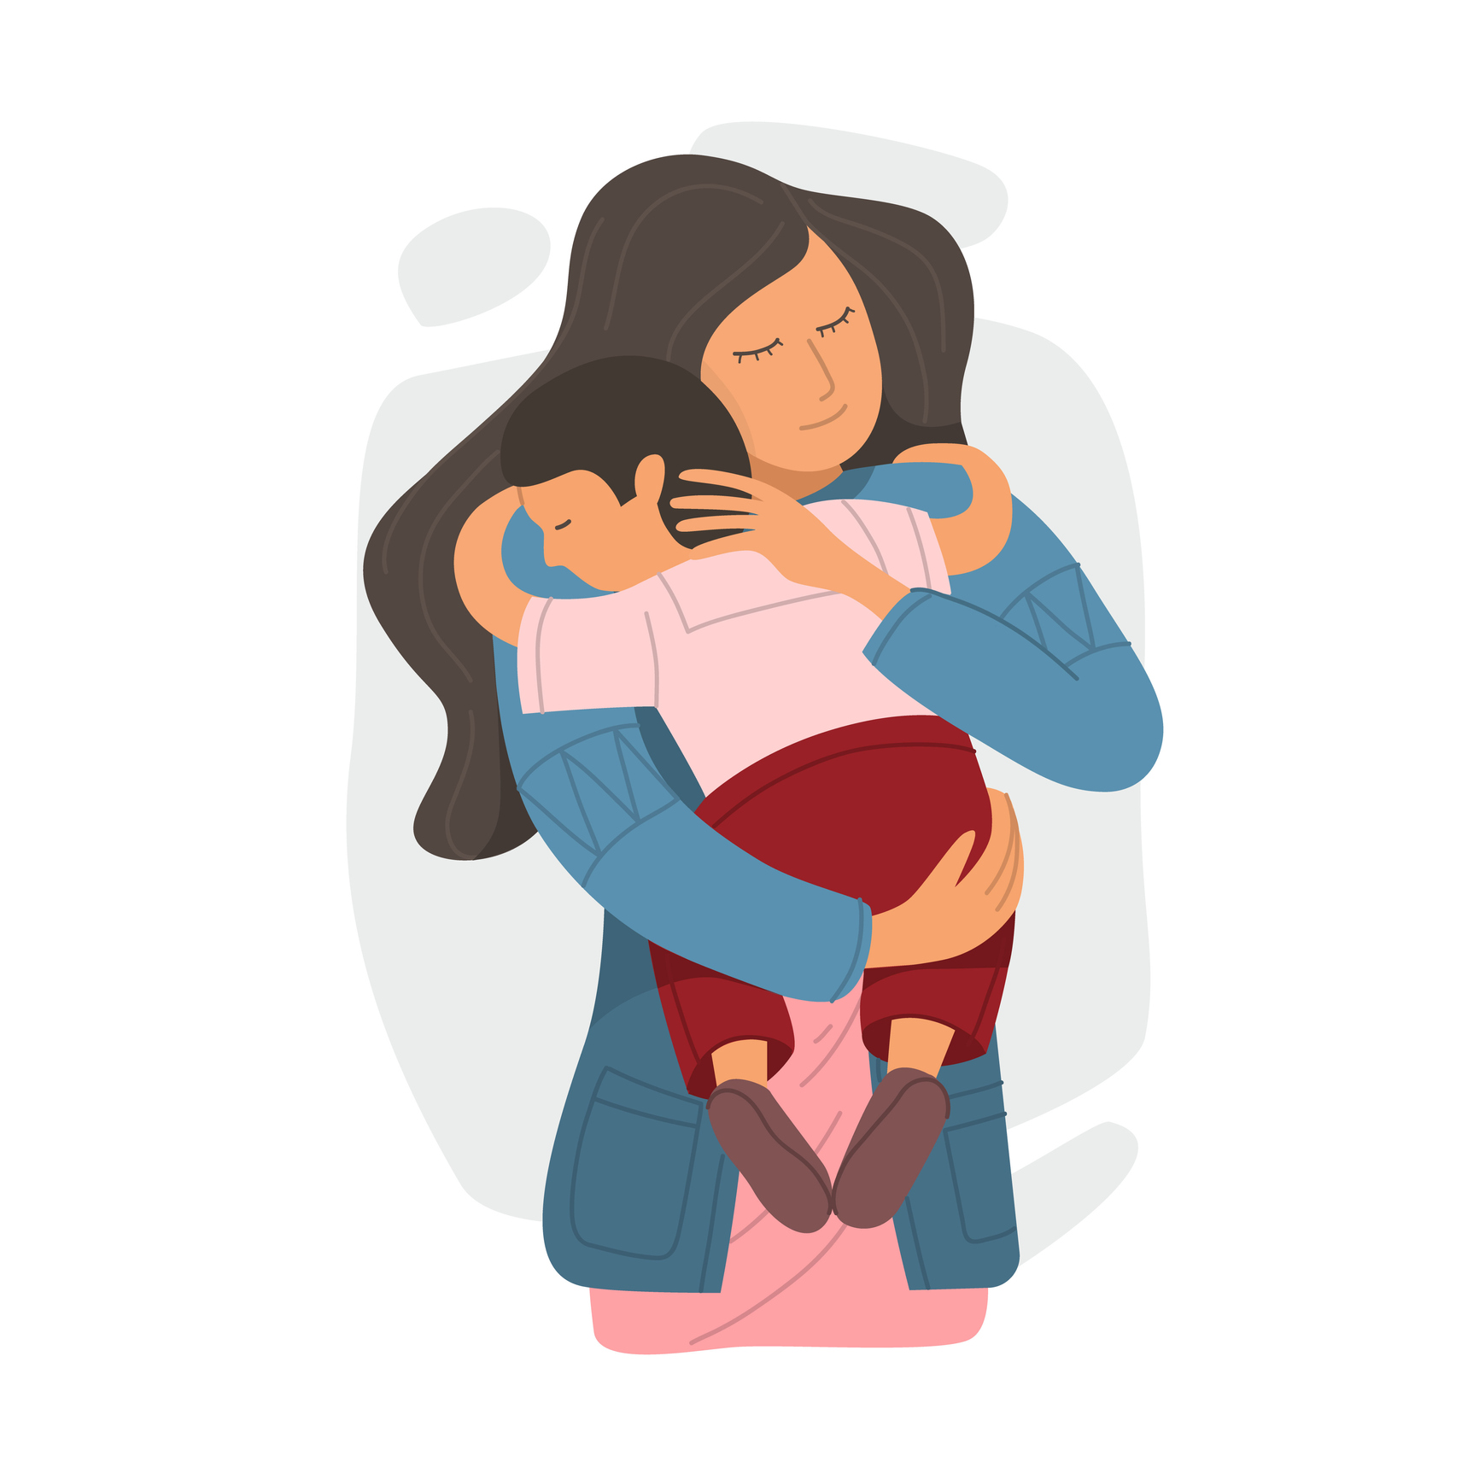
8. Keep the Conversations Open
Like any important topic, racism and violence aren’t something you can have “the talk” about just once.
For kids of any age and race, this is something that’s going to keep coming up, so be sure to let your kids know that you’re there for them whenever they need to talk.
Keep checking in proactively, too.
Notes:
8. Keep the Conversations Open
Like any important topic, racism and violence aren’t something you can have “the talk” about just once.
For kids of any age and race, this is something that’s going to keep coming up, so be sure to let your kids know that you’re there for them whenever they need to talk —
and keep checking in proactively, too.

Slide 21
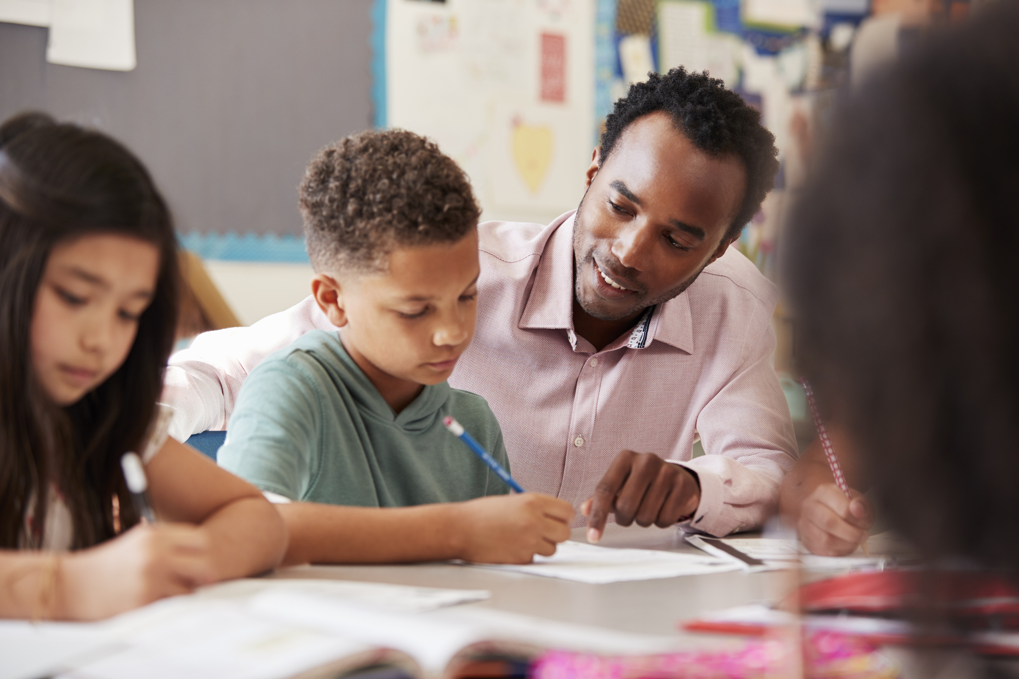
9. Explore Resources
No matter what challenges come up as you talk with your kids, there are lots of great resources out there to help you continue these crucial conversations.
Notes:
9. Explore Resources
No matter what challenges come up as you talk with your kids, there are lots of great resources out there to help you continue these crucial conversations.

Slide 22
Check out the following resources:
Colorlines: The Dos and Don’ts of Talking to Kids of Color About White Supremacy.
Safe Space Radio: Talking to White Kids About Race and Racism
Center for Racial Justice in Education: Resources for Talking About Race, Racism and Racialized Violence With Kids.
Notes:
Check out the following resources for further help and support along the way:
Colorlines: The Dos and Don’ts of Talking to Kids of Color About White Supremacy.
Safe Space Radio: Talking to White Kids About Race and Racism
Center for Racial Justice in Education: Resources for Talking About Race, Racism and Racialized Violence With Kids.

Slide 23
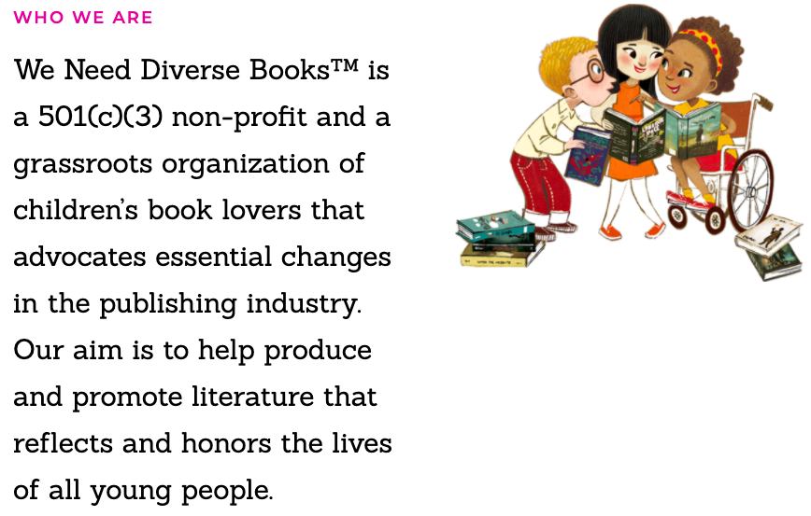
We Need Diverse Books: Resources for Race, Equity, Anti-Racism and Inclusion
The Anti-Defamation League: Children’s Books Addressing Race and Racism and Activities to Promote Social Justice
The Oakland Public Library: Resources for Talking to Kids About Racism and Justice
Notes:
We Need Diverse Books: Resources for Race, Equity, Anti-Racism and Inclusion
The Anti-Defamation League: Children’s Books Addressing Race and Racism and Activities to Promote Social Justice
The Oakland Public Library: Resources for Talking to Kids About Racism and Justice

Slide 24
References
“Racism and Violence: How to Help Your Child Handle the News,” by Dr. Kenya Hameed, Child Mind Institute, 2020.

