Slide 1
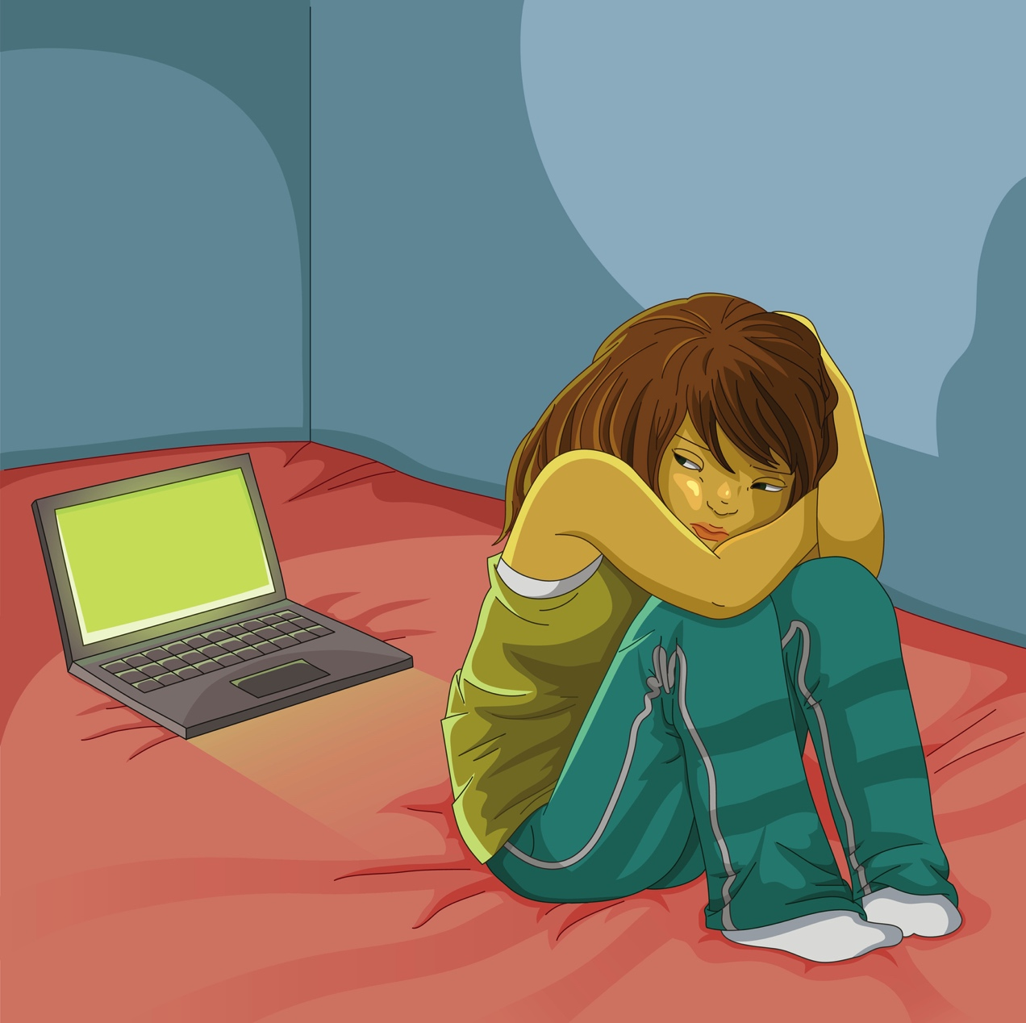
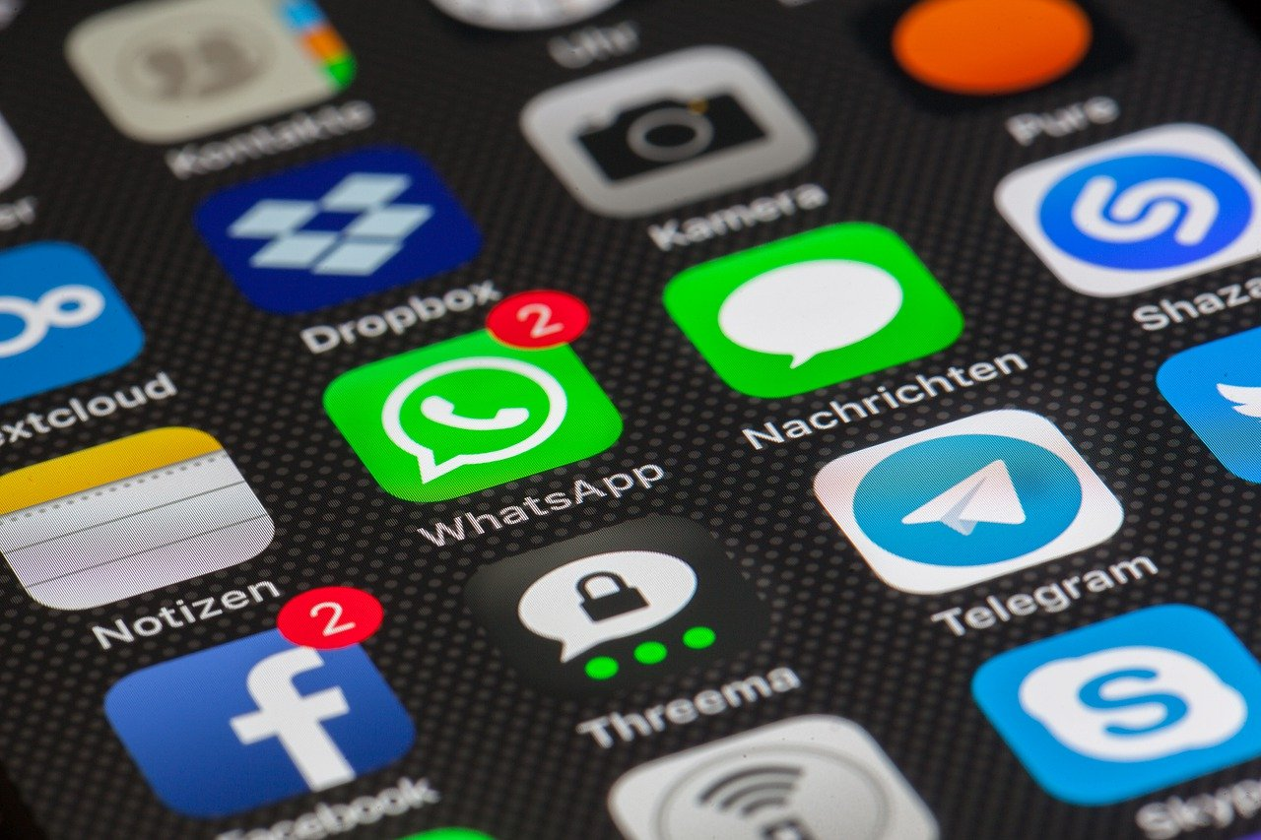
DOES SOCIAL MEDIA CAUSE DEPRESSION?
Linda Mei Lin Koh &
Tanya Muganda
GC Children’s Ministries
Notes:
Does Social Media Cause Depression?
Is using social media making our kids unhappy? Evidence is mounting that there is a link between social media and depression.

Slide 2
Correlation Between Smartphone Use & Depression
2017 San Diego Study
By Jean Twenge
2010
8th-12th graders
13% reported depression
2015
8th-12th graders
66% reported depression
2010-2015 Suicide rates for girls
increased by 65%
2010-2015
Visits to counseling centers jumped 30%
2007—Smartphones introduced.
2015—
92% teen have phones
Notes:
Correlation Between Smartphone and Depression: 2017 San Diego Study by Jean Twenge
2010 – 13%l of 8th-12th graders reported depression
2015 – 66% of 8th-12th graders reported depression
Suicide rates for girls increased by 65%
2010-2015 – visits to counseling centers jumped by 30%
2007 Smartphones was introduced – 2015: 92% of teens have phones
In several recent studies, teenage and young adult users who spend the most time on Instagram, Facebook and other platforms were shown to have a substantially (from 13 percent to 66 percent) higher rate of reported depression than those who spent the least time.
Does that mean that Instagram and Facebook are actually causing depression? These studies show a correlation, not causation. But it’s worth a serious look at how social media could be affecting teenagers and young adults negatively.
One reason the correlation seems more than coincidental is that an increase in depression occurred in tandem with the rise in smartphone use.
A 2017 study of over half a million eighth through 12th graders found that the number exhibiting high levels of depressive symptoms increased by 33 percent between 2010 and 2015. In the same period, the suicide rate for girls in that age group increased by 65 percent.
Smartphones were introduced in 2007, and by 2015 fully 92 percent of teens and young adults owned a smartphone. The rise in depressive symptoms correlates with smartphone adoption during that period, even when matched year by year, observes the study’s lead author, San Diego State University psychologist Jean Twenge.
Over that same time period there was a sharp spike in reports of students seeking help at college and university counseling centers, principally for depression and anxiety. Visits jumped 30 percent between 2010 and 2015

Slide 3
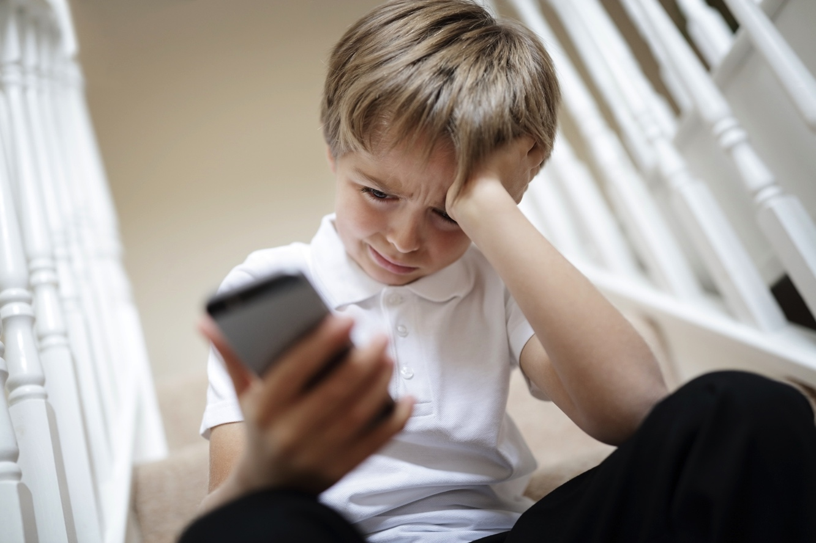
Social Media and Depression
“The less you are connected with human beings in a deep, empathic way, the less you’re really getting the benefits of a social interaction. The more superficial it is, the less likely it’s going to cause you to feel connected, which is something we all need.”
Alexandra Hamlet, PsyD, Clinical psychologist Child Mind Institute.
Notes:
Social Media and Depression
“The less you are connected with human beings in a deep, empathic way, the less you’re really getting the benefits of a social interaction,” points out Alexandra Hamlet, PsyD, a clinical psychologist at the Child Mind Institute. “The more superficial it is, the less likely it’s going to cause you to feel connected, which is something we all need.”
Background/Illustration
One of the biggest differences in the lives of current teenagers and young adults, compared to earlier generations, is that they spend much less time connecting with their peers in person and more time connecting electronically, principally through social media.
Some experts see the rise in depression as evidence that the connections social media users form electronically are less emotionally satisfying, leaving them feeling socially isolated.
“The less you are connected with human beings in a deep, empathic way, the less you’re really getting the benefits of a social interaction,” points out Alexandra Hamlet, PsyD, a clinical psychologist at the Child Mind Institute. “The more superficial it is, the less likely it’s going to cause you to feel connected, which is something we all need.”
Indeed, one exception to the depression correlation is girls who are high users of social media but also keep up a high level of face-to-face social interaction. Jean Twenge’s study showed that those girls who interact intensely online as well as through social media don’t show the increase in depressive symptoms that those who interact less in person do.
And there are some teenagers who aren’t successful in connecting with peers online, because they are isolated geographically or don’t feel accepted in their schools and local communities. For those kids, electronic connection can be lifesaving.

Slide 4
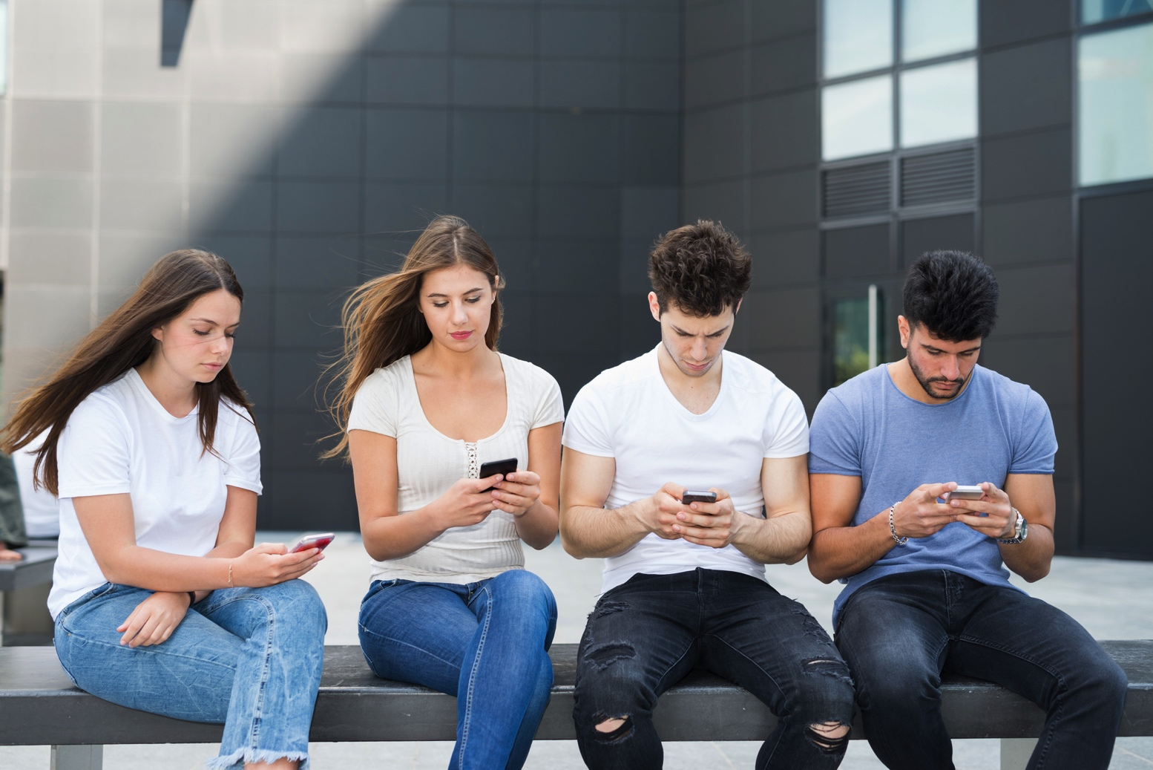
Social Media and Perceived Isolation
Jerry Bubrick, PhD, a clinical psychologist at the Child Mind Institute, observes that “FOMO (Fear of Missing Out) is really the fear of not being connected to our social world, and that need to feel connected sometimes trumps whatever’s going on in the actual situation we’re in. The more we use social media, the less we think about being present in the moment.”
Notes:
Social Media and Perceived Isolation
Jerry Bubrick, PhD, a clinical psychologist at the Child Mind Institute, observes that “FOMO is really the fear of not being connected to our social world, and that need to feel connected sometimes trumps whatever’s going on in the actual situation we’re in. The more we use social media, the less we think about being present in the moment.”
Background/Illustration
Another study last year of a national sample of young adults (age 19-32) showed correlation between the time spent on social media and perceived social isolation (PSI). The authors noted that directionality can’t be determined. That is, “Do people feeling socially isolated spend more time on social media, or do more intense users develop PSI?”
If it’s the latter, they noted, “Is it because the individual is spending less time on more authentic social experiences that would decrease PSI? Or is it the nature of observing highly curated social feeds that they make you feel more excluded?”
Which brings us what we now call FOMO, or fear of missing out.
Jerry Bubrick, PhD, a clinical psychologist at the Child Mind Institute, observes that “FOMO is really the fear of not being connected to our social world, and that need to feel connected sometimes trumps whatever’s going on in the actual situation we’re in. The more we use social media, the less we think about being present in the moment.”
Instead we might be occupied with worrying why we weren’t invited to a party we’re seeing on Instagram, or making sure we don’t miss a single post from a friend. But if we’re always playing catch-up to endless online updates, we’re prioritizing social interactions that aren’t as emotionally rewarding and can actually make us feel more isolated.

Slide 5
What is FOMO?
“Fear of Missing Out”
Worrying why we weren’t invited to a party we’re seeing on Instagram.
Making sure we don’t miss a single post from a friend.
Catching up to endless online updates.

Slide 6
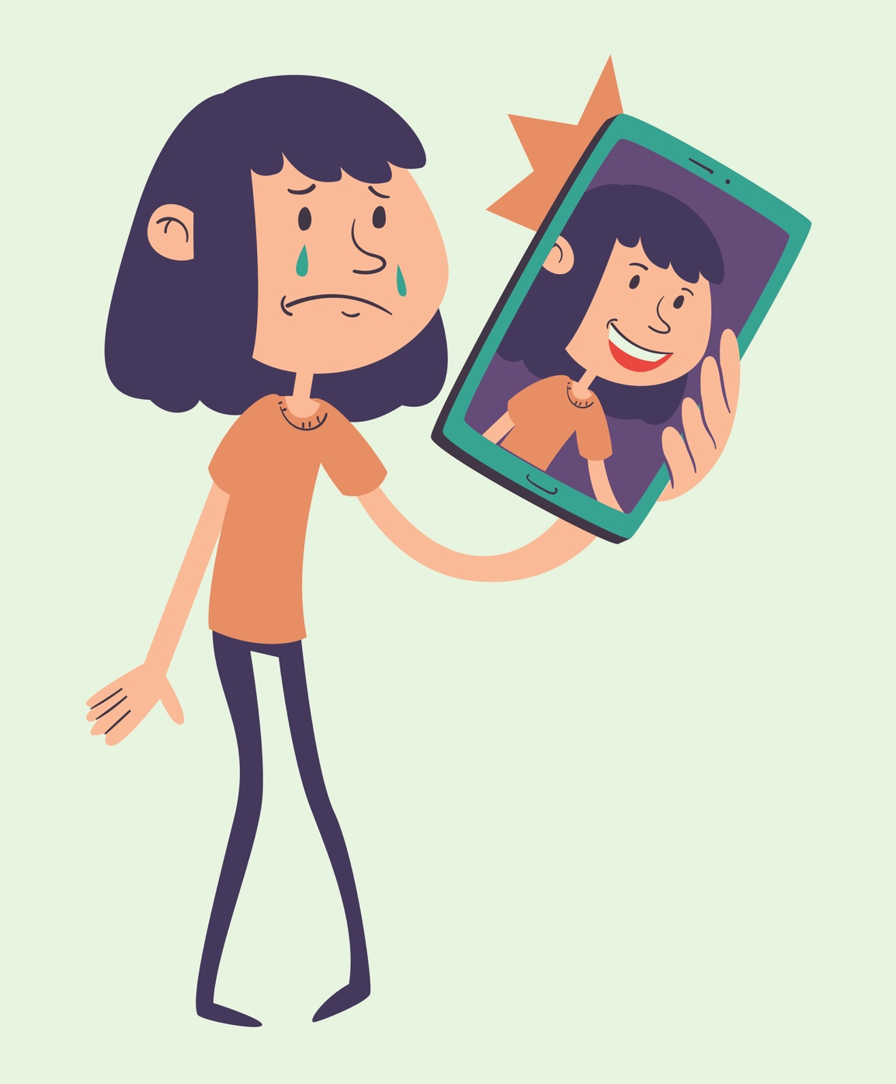
Social Media and Self-esteem
Another theory about the increase in depression is the loss of self-esteem, especially in teenage girls, when they compare themselves negatively with artfully curated images of those who appear to be prettier, thinner, more popular and richer.
Notes:
Social Media and Self-esteem
Another theory about the increase in depression is the loss of self-esteem, especially in teenage girls, when they compare themselves negatively with artfully curated images of those who appear to be prettier, thinner, more popular and richer.
Background/Illustration
“Many girls are bombarded with their friends posting the most perfect pictures of themselves, or they’re following celebrities and influencers who do a lot of Photo shopping and have makeup and hair teams,” explains Dr. Hamlet. “If that’s their model for what is normal, it can be very hard on their self- confidence.”
Curation of a perfect image may not only make others feel inadequate, it’s unhealthy even for those who appear to be successful at it, notes Dr. Bubrick.

Slide 7
Kids spent so much time on social media trying to post what they think the world will think is a perfect life.
Look at how happy I am! Look how beautiful I am! Without that they’re worried that their friends won’t accept them. They’re afraid of being rejected.”
Notes:
“Kids spend so much time on social media trying to post what they think the world will think is a perfect life.
Look at how happy I am! Look how beautiful I am! Without that they’re worried that their friends won’t accept them. They’re afraid of being rejected.”
And if they are getting positive feedback from their social media accounts, they might worry that what their friends like isn’t the “real” them.

Slide 8
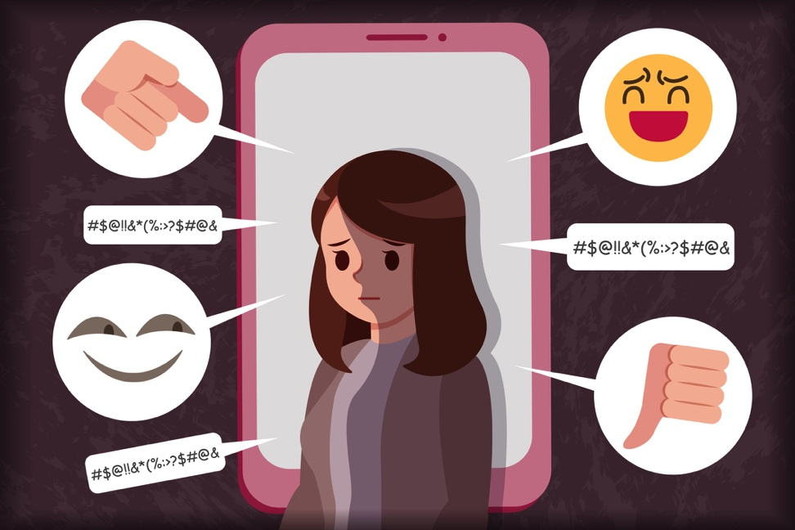
And if they are getting positive feedback from their social media accounts, they might worry that what their friends like isn’t the “real” them.
Curation of a perfect image may not only make others feel inadequate, it’s unhealthy even for those who appear to be successful at it.
Notes:
And if they are getting positive feedback from their social media accounts, they might worry that what their friends like isn’t the “real” them.
Curation of a perfect image may not only make others feel inadequate, it’s unhealthy even for those who appear to be successful at it.

Slide 9
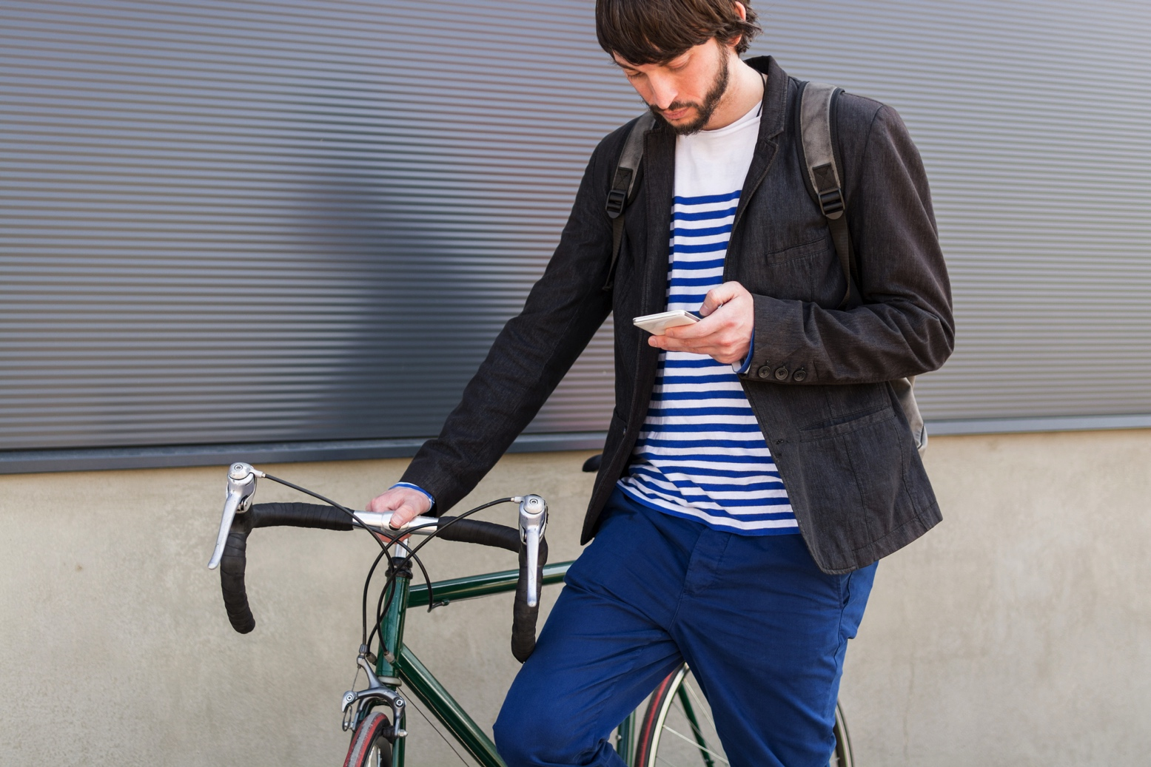
Less Healthy Activity
Another possible source of depression may be what teenagers are not doing during while they’re spending time on social media, including physical activity and things that generate a sense of accomplishment, like learning new skills and developing talents.
Notes:
Less Healthy Activity
Another possible source of depression may be what teenagers are not doing during while they’re spending time on social media, including physical activity and things that generate a sense of accomplishment, like learning new skills and developing talents.
Illustration/Background
“If you’re spending a lot of time on your phone, you have less time for activities that can build confidence, a sense of achievement and connectedness,” explains Dr. Hamlet.
Kids who are spending a lot of time on devices are not getting much in return to make them feel good about themselves, she adds. “Yes, you get a little dopamine burst whenever you get a notification, or a like on a picture, or a follow request. But those things are addicting without being satisfying.”

Slide 10

Disrupted Concentration
Another thing disrupted by social media is the process of doing homework and other tasks that require concentration.
It’s become common for teenagers to engage with friends on social media at the same time they are studying.
They take pride in being able to multi-task, but evidence shows that it cuts down on learning and performance.
Notes:
Disrupted Concentration
Another thing disrupted by social media is the process of doing homework and other tasks that require concentration.
It’s become common for teenagers to engage with friends on social media at the same time they are studying.
They take pride in being able to multi-task, but evidence shows that it cuts down on learning and performance.
“Basically, multitasking isn’t possible,” Dr. Hamlet notes. “What you end up doing is really just switching back and forth between two tasks rather quickly. There is a cost to the brain.” And with poorer concentration and constant interruption, homework takes substantially longer than it should, cutting into free time and adding to stress.

Slide 11
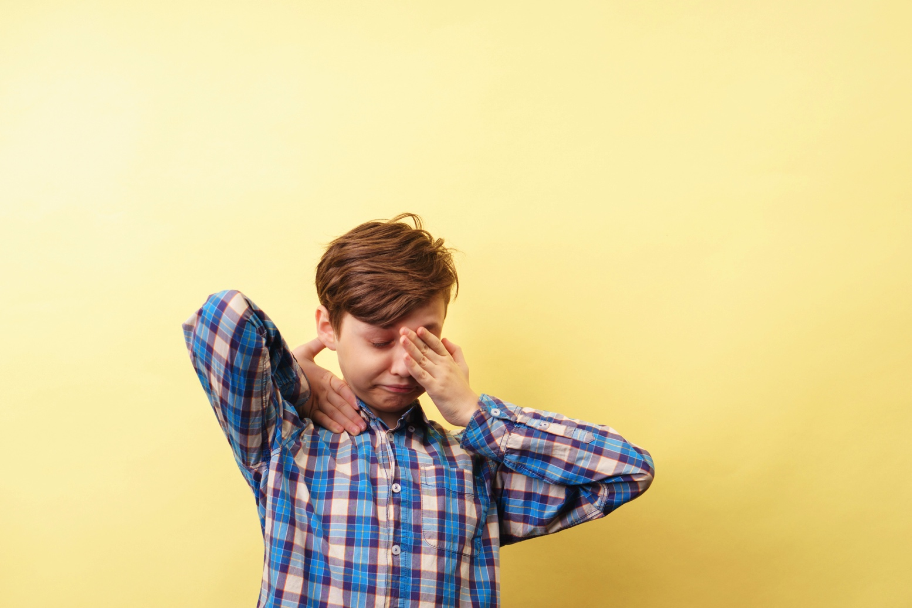
Sleep Deprivation And Depression
Research shows that 60 percent of adolescents are looking at their phones in the last hour before sleep, and that they get on average an hour less sleep than their peers who don’t use their phones before bed.
Blue light from electronic screens interferes with falling asleep; on top of that, checking social media is not necessarily a relaxing or sleep-inducing activity.
Scrolling on social media, can easily end up causing stress.
Notes:
Sleep Deprivation And Depression
Research shows that 60 percent of adolescents are looking at their phones in the last hour before sleep, and that they get on average an hour less sleep than their peers who don’t use their phones before bed.
Blue light from electronic screens interferes with falling asleep; on top of that, checking social media is not necessarily a relaxing or sleep-inducing activity.
Scrolling on social media, notes Dr. Hamlet, can easily end up causing stress.
Some of the ways in which social media use impacts mood may be indirect. For instance, one of the most common contributors to depression in teenagers is sleep deprivation, which can be caused, or exacerbated, by social media.
Research shows that 60 percent of adolescents are looking at their phones in the last hour before sleep, and that they get on average an hour less sleep than their peers who don’t use their phones before bed. Blue light from electronic screens interferes with falling asleep; on top of that, checking social media is not necessarily a relaxing or sleep-inducing activity. Scrolling on social media, notes Dr. Hamlet, can easily end up causing stress.
“Social media can have a profound eTect on sleep,” adds Dr. Bubrick. “You have
the intention to check Facebook or Instagram for 5 minutes, and the next thing you know 50 minutes are gone. You’re an hour behind in sleep, and more tired the next day. You Vnd it harder to focus. You’re oT your game, and it spirals from there.”

Slide 12
University of Pennsylvania
Research
143 participants completed a survey to determine mood and well-being at the study's start.
They shared shots of their iPhone battery screens to offer a week's worth of baseline social-media data.
Hunt then looked at seven outcome measures including fear of missing out, anxiety, depression, and loneliness.
Psychologist Melissa G. Hunt published her findings in the December 2018 Journal of Social and Clinical Psychology.
Notes:
University of Pennsylvania Research: Psychologist Melissa G. Hunt published her findings in the December 2018 Journal of Social and Clinical Psychology
143 participants completed a survey to determine mood and well-being at the study's start.
They shared shots of their iPhone battery screens to offer a week's worth of baseline social-media data.
Hunt then looked at seven outcome measures including fear of missing out, anxiety, depression, and loneliness.

Slide 13
Research Results
Using less social media leads to significant decreases in both depression and loneliness.
When you're not busy getting sucked into social media, you're actually spending more time on things that are more likely to make you feel better about your life.
"In general, put your phone down and be with the people in your life."
Notes:
Research Results
Using less social media leads to significant decreases in both depression and loneliness.
When you're not busy getting sucked into social media, you're actually spending more time on things that are more likely to make you feel better about your life.
"In general, put your phone down and be with the people in your life."

Slide 14

How To Minimize Negative Effects Of Social Media Use
1. Focus on balance:
  Make sure your kids are also engaging in social interaction online and have time for activities that help build identity and self-confidence.
Notes:
How To Minimize Negative Effects Of Social Media Use
1. Focus On Balance:
Make sure your kids are also engaging in social interaction online and have time for activities that help build identity and self-confidence.
While we don’t yet have conclusive evidence that social media use actually causes depression, we do have plenty of warning signs that it may be aTecting our kids negatively. So it’s smart for parents to check in regularly with kids about their social media use, to make sure it’s positive and healthy, and guide them towards ways to change it, if you think it’s not.
Also, be alert for symptoms of depression. If you notice signs that your child might be depressed, take them seriously. Ask your child how he is doing, and don’t hesitate to set up an appointment with a mental health provider.

Slide 15
2. Turn off Notifications:
App developers are getting more and more aggressive with notifications to lure users to interrupt whatever they’re doing to engage constantly with their phones. Don’t let them.
Notes:
2. Turn Off Notifications:
App developers are getting more and more aggressive with notifications to lure users to interrupt whatever they’re doing to engage constantly with their phones. Don’t let them.

Slide 16

3. Look out for girls at higher risk of depression:
  Monitor girls who are going through a particularly tough time or are under unusual stress.
  Negative effects of social media can have more impact when confidence is down.
Notes:
Look Out For Girls At Higher Risk Of Depression:
Monitor girls who are going through a particularly tough time or are under unusual stress.
Negative effects of social media can have more impact when confidence is down.

Slide 17
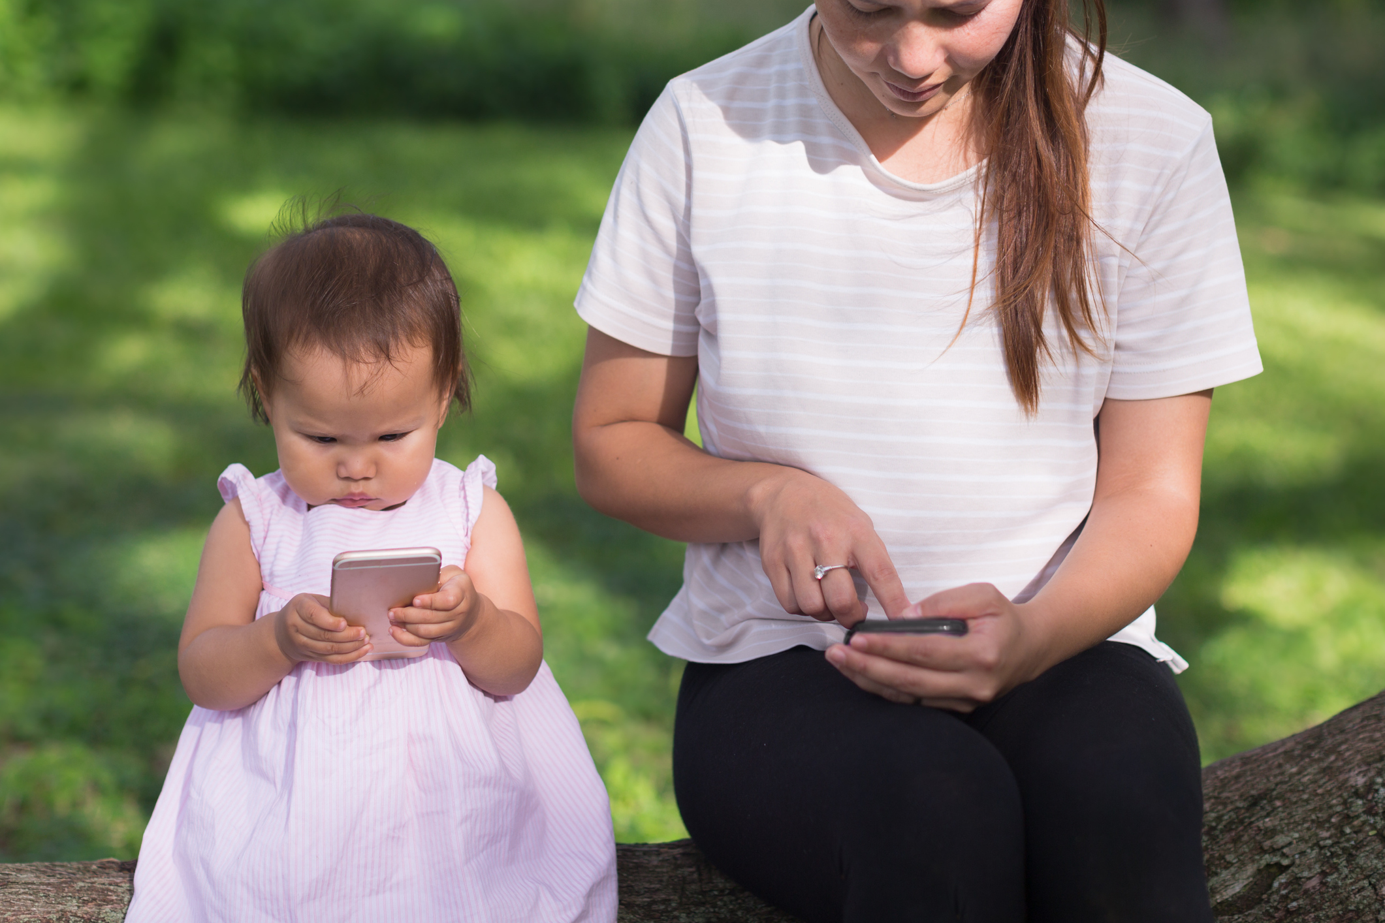
4. Teach mindful use of social media:
  Encourage teenagers to be honest with themselves about how time spent on social media makes them feel and disengage from interactions that increase stress or unhappiness.
Notes:
Teach Mindful Use Of Social Media:
Encourage teenagers to be honest with themselves about how time spent on social media makes them feel and disengage from interactions that increase stress or unhappiness.

Slide 18

5. Model Restraint And Balance In Your Own Media Diet:
  Set an example by disengaging from media to spend quality family time together, including phone-free dinners and other activities.
  Kids may resist, but they’ll feel the benefits.
Notes:
5. Model Restraint And Balance In Your Own Media Diet:
Set an example by disengaging from media to spend quality family time together, including phone-free dinners and other activities.
Kids may resist, but they’ll feel the benefits.

Slide 19

6. Phone-free Time Before Sleep:
  Enforce a policy of no smartphones in the bedroom after a specific time and overnight.
  Use an old-fashioned alarm clock to wake up.
Notes:
6. Phone-free Time Before Sleep:
Enforce a policy of no smartphones in the bedroom after a specific time and overnight. Use an old-fashioned alarm clock to wake up.

Slide 20
References
https://www.sciencedaily.com/releases/2018/11/181108164316.htm
https://childmind.org/article/is-social-media-use-causing-depression/
Notes:
https://www.sciencedaily.com/releases/2018/11/181108164316.htm
https://childmind.org/article/is-social-media-use-causing-depression/

