Slide 1
Principles of writing a Drama
Saustin Sampson Mfune
GC Associate CHM Director
Notes:
Principles of writing a Drama

Slide 2
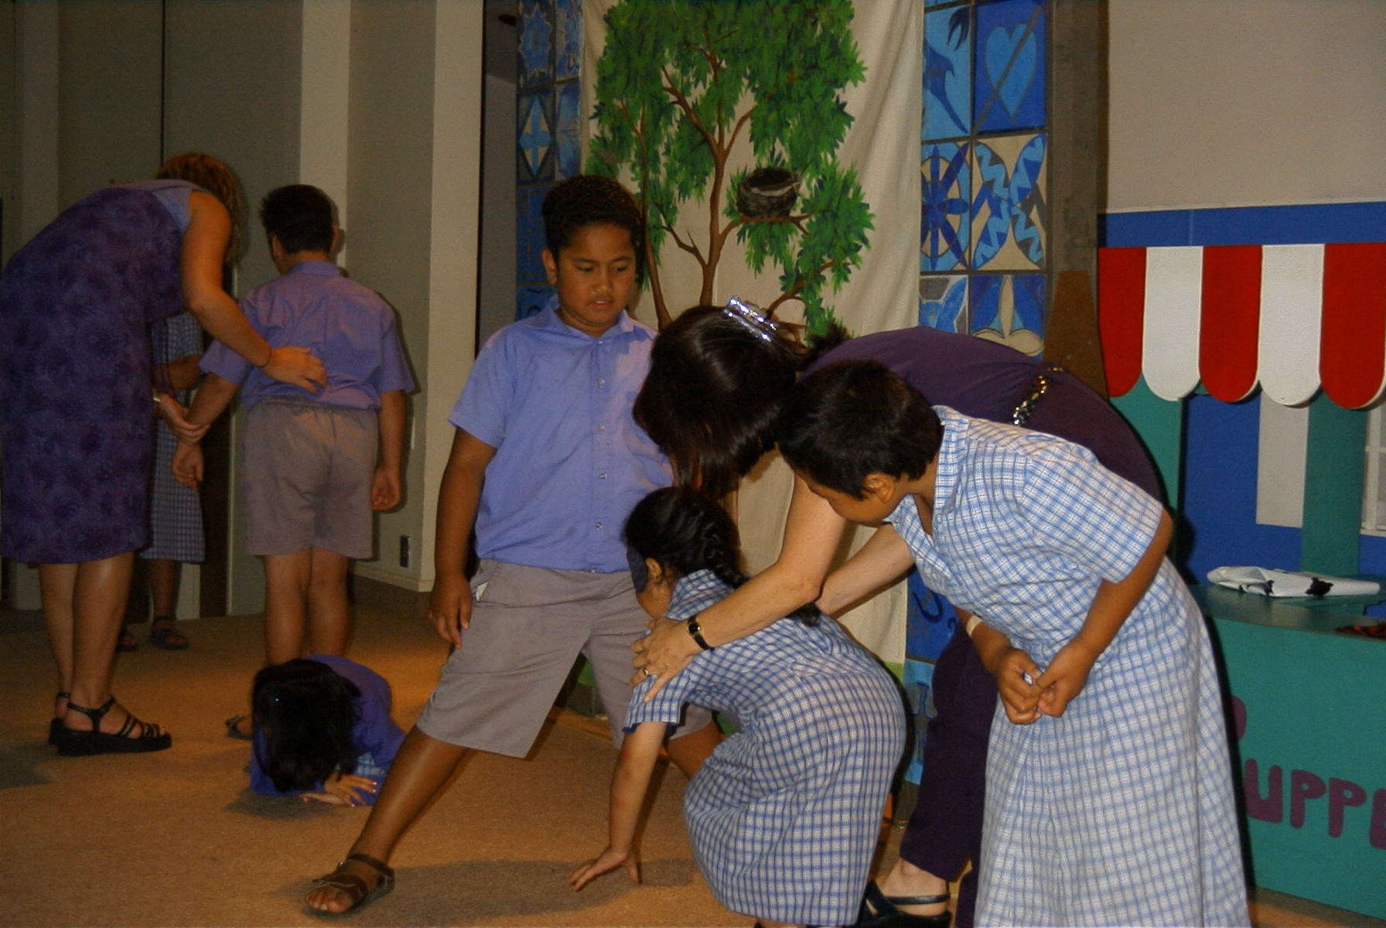
What is drama?
Notes:
What is drama?

Slide 3
A drama is a means of communication through acting.
Notes:
A drama is a means of communication through acting.

Slide 4
Why is drama effective?
Notes:
Why is drama effective?

Slide 5
How we learn.
1% of learning is from the sense of taste
1.5% from the sense of touch
3.5% from the sense of smell
11% from the sense of hearing
83% from the sense of sight
Notes:
How we learn.
1% of learning is from the sense of taste
1.5% from the sense of touch
3.5% from the sense of smell
11% from the sense of hearing
83% from the sense of sight

Slide 6
Drama is people’s way of life because life in itself is a drama.
Notes:
Drama is people’s way of life because life in itself is a drama.

Slide 7
It has been shown that drama appeals to both hemispheres of the brain and thus it makes the message pleasurable and intelligible.
It presents the message vividly through the five senses :- sight, touch, taste, smell and hearing.
Drama brings natural ‘delight’ to the viewer because it does not appeal to the “understanding only, but to the feelings … it accentuates imagination, in short, it appeals to the whole person. And all things thus learned with delight are those which are longest remembered [and likely to be applied].
Notes:
It has been shown that drama appeals to both hemispheres of the brain and thus it makes the message pleasurable and intelligible.
It presents the message vividly through the five senses :- sight, touch, taste, smell and hearing.
Drama brings natural ‘delight’ to the viewer because it does not appeal to the “understanding only, but to the feelings … it accentuates imagination, in short, it appeals to the whole person. And all things thus learned with delight are those which are longest remembered [and likely to be applied].

Slide 8
There’s no other ministry like drama ministry. Dramas are effective in reaching, teaching, and entertaining audiences of all ages and are a great way to teach children about the Bible and other themes!!
Notes:
There’s no other ministry like drama ministry. Dramas are effective in reaching, teaching, and entertaining audiences of all ages and are a great way to teach children about the Bible and other themes!!

Slide 9
The quickest and shortest avenue to a human heart is by way of a drama. Dramas excite, motivate and move human beings.
Notes:
The quickest and shortest avenue to a human heart is by way of a drama. Dramas excite, motivate and move human beings.

Slide 10

In drama writing:-
The beginning sets the stage.
The middle creates tension.
The ending brings about resolution of the tension or reveals a message or moral of the drama without you explaining it.
Notes:
In drama writing:-
The beginning sets the stage.
The middle creates tension.
The ending brings about resolution of the tension or reveals a message or moral of the drama without you explaining it.

Slide 11
Anyone can learn to write a drama. It is an art which comes naturally for some, and through effort for others.
Notes:
Anyone can learn to write a drama. It is an art which comes naturally for some, and through effort for others.

Slide 12
STEPS TO DEVELOPING A CHRIST-CENTERED DRAMA
Notes:
STEPS TO DEVELOPING A CHRIST-CENTERED DRAMA

Slide 13
1
Prayerfully ask the Lord to guide you as you consider using drama in your Ministry.
Notes:
1
Prayerfully ask the Lord to guide you as you consider using drama in your Ministry.

Slide 14
And usually a drama is divided in different scenes.
(Scene 1, 2, 3 etc.)
Notes:
1
And usually a drama is divided in different scenes.

Slide 15
2
Decide whether you are going to use Dialogue (a conversation between two or more characters) or
Monologue (a drama done by one person).
Notes:
2
Decide whether you are going to use Dialogue (a conversation between two or more characters) or
Monologue (a drama done by one person).

Slide 16
3
Ask God to help you sharpen your skills of creativeness.
Notes:
3
Ask God to help you sharpen your skills of creativeness.

Slide 17
4
Develop your Characters.
Protagonist (good guy & team) & antagonist (bad guy & team).
Notes:
4
Develop your Characters.
Protagonist (good guy & team) & antagonist (bad guy & team).

Slide 18
5. Have a goal
Before you write your drama, have a lesson, point, principle or goal you want articulated.
Ask yourself some questions:-What is the point of the drama? Are you writing it to inspire… to persuade.. to empower…to inform… to appeal… to teach a lesson or to make people laugh? The bottom line is that the goal of your drama should be clearly articulated in your mind.
Notes:
5
Have a goal
Before you write your drama, have a lesson, point, principle or goal you want articulated.
Ask yourself some questions:-What is the point of the drama? Are you writing it to inspire… to persuade.. to empower…to inform… to appeal… to teach a lesson or to make people laugh? The bottom line is that the goal of your drama should be clearly articulated in your mind.

Slide 19
6
A well developed plot
A plot is a series of events in a drama leading to a conflict.
A well written plot is the one which will move the audience from relaxation to tension /suspense.
Notes:
6
A well developed plot
A plot is a series of events in a drama leading to a conflict.
A well written plot is the one which will move the audience from relaxation to tension /suspense.

Slide 20
7
Involve the five senses +1
A good plot should draw the audience into the drama through the five senses:- sight, touch, smell, hearing and tasting plus the 6th sense of human imagination.
Notes:
7
Involve the five senses +1
A good plot should draw the audience into the drama through the five senses:- sight, touch, smell, hearing and tasting plus the 6th sense of human imagination.

Slide 21
8
Keep your destination and turning points in mind
As you write your drama, have a map in your mind. Remember to always have your destination in mind.
Once you have your starting point and the destination in mind, ask yourself about the turning points:- that is key moments in your drama.
Notes:
8
Keep your destination and turning points in mind
As you write your drama, have a map in your mind. Remember to always have your destination in mind.
Once you have your starting point and the destination in mind, ask yourself about the turning points:- that is key moments in your drama.

Slide 22
9
Let the drama explain itself
As you develop your drama, do not explain its meaning. Do not even interpret it. Just write it. Stick to what is happening.
If you have written your drama well, it will drive the point home.
Notes:
9
Let the drama explain itself
As you develop your drama, do not explain its meaning. Do not even interpret it. Just write it. Stick to what is happening.
If you have written your drama well, it will drive the point home.

Slide 23
10
KNOW THAT ONE STORY CAN GIVE BIRTH TO SEVERAL DRAMAS
Notes:
10
KNOW THAT ONE STORY CAN GIVE BIRTH TO SEVERAL DRAMAS

Slide 24
FOR EXAMPLE
The arresting of Jesus in the Garden of Gethsemane can be written from several perspectives:-
Jesus
Judas
Peter
The High Priest, etc.
Notes:
FOR EXAMPLE
The arresting of Jesus in the Garden of Gethsemane can be written from several perspectives:-
Jesus
Judas
Peter
The High Priest, etc.

Slide 25
The same story can have various variations. Look at the superscription on the cross of Jesus.
Matthew 27:37 – This is Jesus the King of the Jews.
Mark 15:26 – The King of the Jews.
Luke 23:38 – This is the King of the Jesus.
John 19:19 - Jesus of Nazareth the King of the Jews.
Notes:
The same story can have various variations. Look at the superscription on the cross of Jesus.
Matthew 27:37 – This is Jesus the King of the Jews.
Mark 15:26 – The King of the Jews.
Luke 23:38 – This is the King of the Jesus.
John 19:19 - Jesus of Nazareth the King of the Jews.

Slide 26
Remember, as a Christian, the purpose of writing your drama is to help your audience know the difference between good and evil.
Notes:
Remember, as a Christian, the purpose of writing your drama is to help your audience know the difference between good and evil.

Slide 27

THE END
GOD BLESS YOU

