Slide 1
Ministering to Boys
Linda Mei Lin Koh
Children’s Ministries Director
General Conference of Seventh-day Adventists
Notes:
Boys and girls are created differently. Have you ever wondered, “What are the boys thinking?” I am convinced that if we could make that question a personal practice in our churches, we would quickly see the need to make major changes in the way boys are being ministered to. It is our mission to evangelize, equip and empower boys to become the next generation of Christlike men who will serve God, their families, and their communities.
Ministering to Boys
Ken Hindman
https://www.preaching.com/leadership/ministering-to-boys/

Slide 2
Why a Ministry to Boys?
Many boys decide around the age of nine to leave church, but it takes a few years before they do.
Lack of sufficient male role models to encourage long-term relationships with boys that is conducive to their growth and discipleship.
Boys are very different from girls; we need to tailor our teaching to reach them.
Notes:
Why a Ministry to Boys?
Many boys decide around the age of nine to leave church, but it takes a few years before they do.
Lack of sufficient male role models to encourage long-term relationships with boys that is conducive to their discipleship.
Boys are very different from girls and we need to tailor our teaching to reach them.

Slide 3
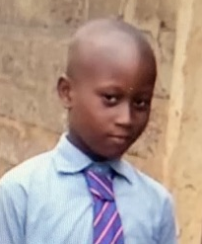
Scripture Union Survey
Sept 2009 – February 2010
SU survey was led by Ro Willoughby.
A total of 630 responses received.
90% of respondents worked with children or young people in church-related activities.
Under half worked with a mix group of boys and girls; 25% worked with mix group with girls in majority; 23% with a mix but with boys in majority; 7% work just with boys.
Notes:
Scripture Union Survey
Sept 2009 – February 2010
SU survey was an online survey.
A total of 630 responses received.
90% of respondents worked with children or young people in church-related activities.
Under half worked with a mix group of boys and girls; 25% worked with mix group with girls in majority; 23% with a mix but with boys in majority; 7% work just with boys.

Slide 4

SU Survey Overall Results
Boys need more active approach to activities
Boys need positive role models
Boys need male leaders to mentor and foster spiritual growth
Notes:
SU Survey Results
Boys need more active approach to activities
Boys need positive role models
Boys need male leaders to foster spiritual growth

Slide 5

8 out of 10 Agree with the Following
Leaders should try to understand the world in which boys live today.
A supportive team spirit and training opportunities help build a strong leadership team.
Leaders of all ages, including older leaders, are valuable in boys’ ministries.
Notes:
8 out of 10 Agree with the Following
Leaders should try to understand the world in which boys live day by day.
A supportive team spirit and training opportunities help build a strong leadership team.
Leaders of all ages, including older leaders, are valuable in boys’ ministries.

Slide 6

Leaders working with boys need to do so on a regular basis and be highly committed to building relationships.
Boys are looking for positive male role models.
Younger boys benefit in seeing the spiritual development of older boys who are serving as their role models.
Notes:
Leaders working with boys need to do so on a regular basis and be highly committed to building relationships.
Boys are looking for positive male role models.
Younger boys benefit in seeing the spiritual development of boys older than themselves, using them as role models.

Slide 7
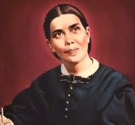
Christian Leadership, p. 23
“The ministers of Christ are to be examples to the flock. He who fails to direct his own household is not qualified to guide the church of God.”
Notes:
Boys need a positive role model at home and in the church. Fathers who model true Christian virtues to their sons will have a strong impact on their lives. Sabbath School teachers, youth leaders and pastors all play a role in inspiring the boys to emulate them in their faith.
Notice Ellen White recognizes such important role models in our church: ”The ministers of Christ are to be examples to the flock. He who fails to direct his own household is not qualified to guide the church of God.” Christian Leadership, p. 23.

Slide 8

Boys value having a specific role that uses their individual gifts.
Small groups encourage trust and openness so vital for the spiritual growth of boys.
Boys prefer variety in activities with information given in small chunks.
Boys like sport activities.
An integrated program where group activity provides leaders with the opportunity to speak about God is more effective than one single ‘God slot’.
Notes:
Boys value having a specific role that uses their individual gifts.
Small groups encourage trust and openness so vital for the spiritual growth of boys.
Boys prefer variety in activities with information given in small chunks.
Boys like sport activities.
An integrated program where group activity provides leaders with the opportunity to speak about God is more effective than one single ‘God slot’.

Slide 9
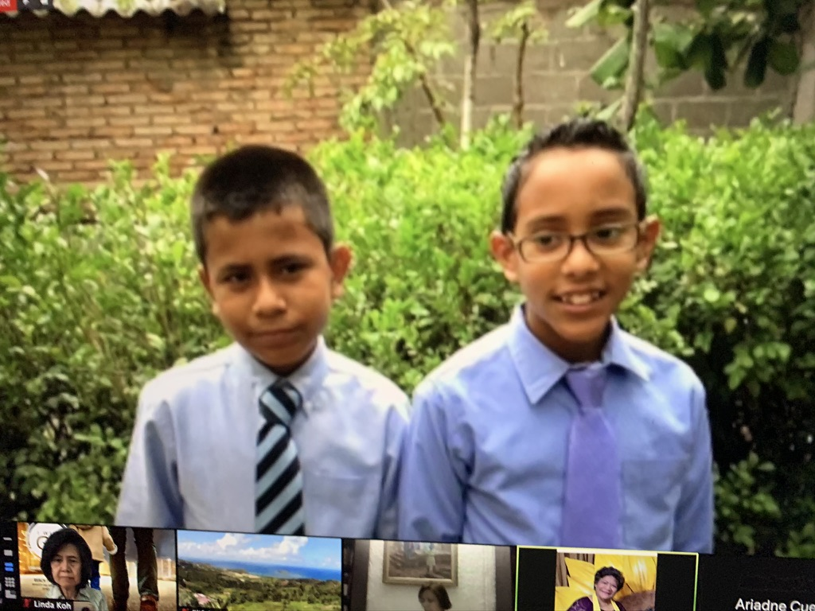
Needs of Guys
(Teenage Guys by Steve Gerali)
They need to be known and understood – how they develop, think and feel, their fears and joys.
They need a close connection to God – have a deep internal spiritual sensitivity, but must experience themselves & see that God is good.
They need validation and empowerment as unique individuals – don’t stereotype them. Empower them to be all that God wants them to be.
Notes:
Needs of Teenage Guys
(Teenage Guys by Steve Gerali)
They need to be known and understood – how they develop, think and feel, their fears and joys. We must know about adolescence and masculinity if we really want to meet this need in guys.
They need a close connection to God – have a deep internal spiritual sensitivity, but must taste for themselves & see that God is good.
They need validation and empowerment as unique individuals – don’t stereotype them. Empower them to be all that God wants them to be.

Slide 10
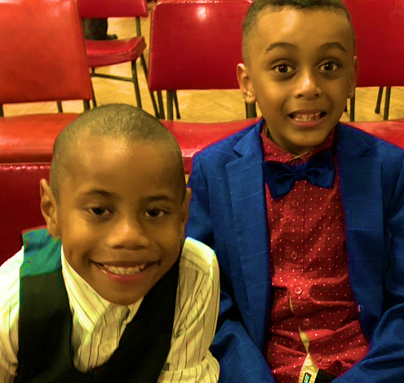
More needs . . .
They need community -- clan-oriented. They need the closeness of other men who act as a compass for their manhood. If they cannot be intimate with the masculine on a tangible level, then they cannot become intimate with an invisible God whom they perceive as predominantly masculine in nature.
They need mentors – mentors proclaim they're valuable and worthy of investment.
Notes:
More Needs . . .
They need community -- clan-oriented. They need the closeness of other men who act as a compass for their manhood. If they cannot be intimate with the masculine on a tangible level, then they cannot become intimate with an invisible God whom they perceive as predominantly masculine in nature.
They need mentors – mentors proclaim to them they ‘re valuable and worthy of investment. All throughout Scripture we see older men who come alongside younger men as mentors. David comes alongside Samuel and Jonathan. Paul comes alongside Timothy. Jesus comes alongside his 12 disciples.

Slide 11
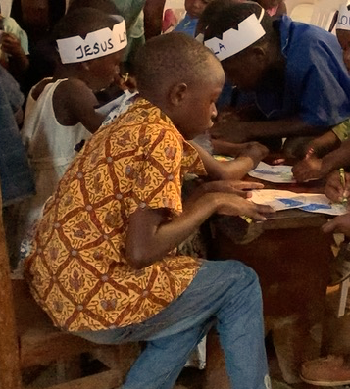
More needs . . .
6. They need to know how to work – culture defines their value by their contribution. Hard work helps them develop responsibility and sense of purpose that ultimately plugs into the Kingdom purpose of bringing glory to God.
They need to lead and to follow –
They need to play – innate need for the hunt, for competition , or for adventure.
Notes:
More needs . . .
6. They need to know how to work – culture defines their value by their contribution. Hard work helps them develop responsibility and sense of purpose that ultimately plugs into the Kingdom purpose of bringing glory to God.
They need to lead and to follow –
They need to play – innate need for the hunt, for competition , or for adventure.

Slide 12

9. They need the freedom to BE
-- they often question their identify because they are squeezed into the cultural mold of masculinity.
10. They need to be loved – often they confuse love with sex. Men who demonstrate Christ’s love to teenage boys break that sexual connection they tend to form between being and needing love.
Notes:
They need the freedom to BE -- they often question their identify because they are squeezed into the cultural mold of masculinity.
They need to be loved – often they confuse love with sex. Men who demonstrate Christ’s love to teenage boys break that sexual connection they tend to form between being and needing love. They need to be loved as a means of fulfilling their deepest emotions and understanding that they’re valuable.

Slide 13
“Don’t let anyone look down on you because you are young, but set an example for the believers in speech, in conduct, in love, in faith and in purity.”
1 Timothy 4:12

Slide 14
According to Tim Beilharz, CHM Advisor for Anglican Youthworks
Boys Need 4 Types of Relationships
The father figures – older fathers of the church who lead and guide them.
The mentors – lead & disciple them.
The peers – friends who inspire, encourage them to grow in Jesus.
The younger guys – boys are leading the younger ones who look up to them.
Notes:
According to Tim Beilharz, CHM Advisor for Anglican Youthworks
Boys Need 4 Types of Relationships
The father figures – older fathers of the church who lead and guide them.
The mentors – lead & disciple them.
The peers – friends who inspire, encourage them to grow in Jesus.
The younger guys – boys are leading the younger ones who look up to them.

Slide 15
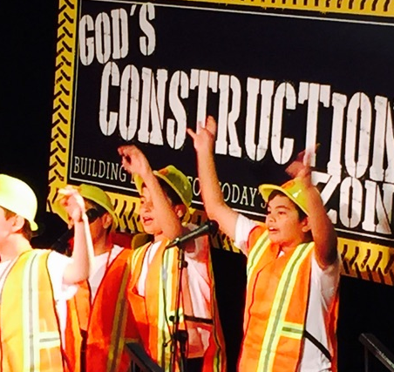
To Minister to Boys, Ask Yourself These Questions
*Can they move? – in order for boys to learn, they have to move. Attention span is 1 min per age of the child.
*Is it fun? – Make Bible stories can be fun.
*Is there adventure? -- adventure is a basic need for the male learner. The Bible is filled with stories of amazing adventure.
Notes:
To Minister to Boys, Ask Yourself These Questions
Can They Move? --in order for boys to learn, they have to move. Attention span is 1 min per age of the child.
Is it fun? – Bible stories can be fun.
Is there adventure? -- adventure is a basic need for the male learner. The Bible is filled with stories of amazing adventure.

Slide 16
*Is nature involved? --Boys love outdoors, so find ways to bring it inside to them.
*Are you training male teachers and leaders? – boys need men teachers to provide a positive role model. Train them and challenge them to lead in the ministry.
Notes:
Is nature involved? --use natural items from outside to teach. Boys love outdoors.
Are you training male teachers and leaders? – boys need men teachers to provide a positive role model. Train them and challenge them to lead in the ministry.

Slide 17

*Are you being a positive role model for boys? – in 1 Cor. 4:16 Paul says, “Therefore I urge you, imitate me.” Are you living your life as a leader that would make a boy think about imitating you or being like you? This is the true test of leadership.
Notes:
Are you being a positive role model for boys? – 1 Cor. 4:16 Paul says, “Therefore I urge you, imitate me.” Are you living your life as a leader that would make a boy think about imitating you or being like you? This is the true test of leadership.

Slide 18
Royal Rangers Ministry’s 7 Experiences for Boys
Connect with a community of Christlike men
Do fun things together
Grow in Christlike manhood
Learn in interactive ways
Belong to something big
Lead yourself and others
Serve God, your family, church, and community
Notes:
Roy Rangers is a special ministry to boys. Royal Rangers Ministry’s 7 Experiences for Boys
Connect with a community of Christlike men
Do fun things together
Grow in Christlike manhood
Learn in interactive ways
Belong to something big
Lead yourself and others
Serve God, your family, church, and community

Slide 19

In Conclusion
Focus attention on the needs in your church.
Make sure the needs of boys are being considered.
Make sure that men are given a chance to minister to boys in church activities as to equip them to lead & mentor younger ones.
Notes:
In Conclusion
Focus attention on the need in your church.
Make sure the needs of boys are being considered.
Make sure that men are given ad chance to minister to boys in church activities as to equip them to lead and mentor younger ones.

Slide 20
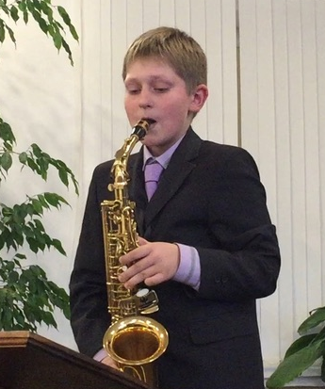


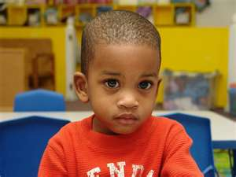
“There is no such thing as a bad boy – just a bored one!”
Notes:
“There is no such thing as a bad boy – just a bored one!”

Slide 21
References
Ken Hindman, Ministering to Boys.
https://www.preaching.com/leadership/ministering-to-boys/
Mike Andrews, Boys Ministry: Being There.
https://www.youthworker.com/articles/boys-ministry-being-there/

Slide 22
Tim Beilharz, Helping Our Boys Become Godly Men.
https://gotherefor.com/offer.php?intid=29073&changestore=true
Royal Rangers Ministry for Boys.
https://royalrangers.com

