Slide 1
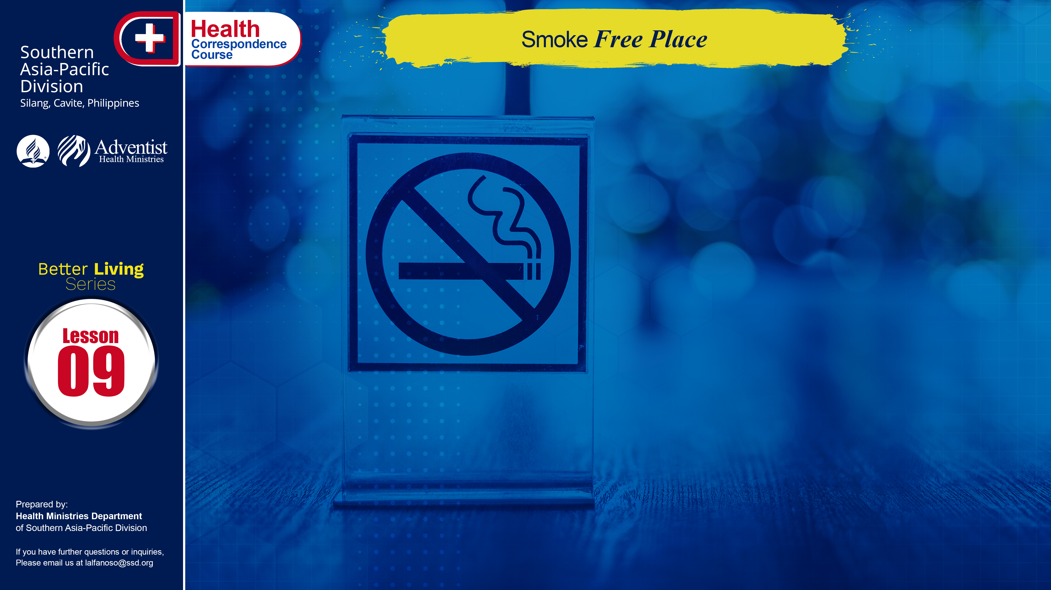

Slide 2
Tobacco addiction. It is by far America’s leading addiction when assessed in terms of damaging our nation’s health. Other countries are not far behind America when it comes to smoking. Aside from the air pollution we get from different factories and smoke belching automobiles, human smoking is a plus that many people got sick of different kinds. However, tobacco does not need to have this unenviable distinction. Millions of Americans attest that this habit can be kicked, because they have done it.

Slide 3
More than 434,000 Americans die each year from diseases caused by tobacco. Smoking causes 87% of lung cancers and in most countries it is the number one form of cancer that tops the rate of dying men. More people die from tobacco–related illness than from AIDS, car accidents, illegal drugs, murders and suicides combined.

Slide 4
Tobacco companies spend $16 million everyday to advertise cigarettes. Tobacco companies try to make smoking look cool by using good-looking models. A pack a day habit costs about 50,000 pesos a year. Smokers not only hurt themselves they hurt people around them. Secondhand smoke kills about 53,000 people every year.

Slide 5
Mortality of smokers.
At least 25% of all smokers die prematurely from a smoking-induced illness. Those individuals lose an average of 21 years of life. Smoking shortens the life span. Many are not aware of how much the average smoker’s life is shortened. Studies show that smokers lose seven minutes off their life every time they smoke a cigarette.

Slide 6
Smoking causes more than lung cancer.
It may also cause these cancers: lip, mouth (oral cavity), throat (pharynx), voice box (larynx), trachea (wind pipe), esophagus, stomach, liver, pancreas, bladder, kidney, cervix, leukemia, colon, skin, penis.

Slide 7
TOBACCO
All tobacco products – cigarettes, cigars, smokeless tobacco – have nicotine. Nicotine is a drug that is as addictive as cocaine and heroin. Nicotine is also a poison. One drop of pure nicotine will kill the average-sized person. The nicotine in cigarettes won’t kill you (right away). But it will make your heart beat faster and your blood pressure rise. Cigarette smoke has more than 4,000 chemicals in it. Forty of the chemicals in cigarettes can cause cancer. Tobacco impairs the mucus – clearing mechanisms of the lungs. Cigarette butts are the number one source of pollution on beaches.

Slide 8
SMOKING
Smokers as young as 18 have shown signs of heart disease. Smoking causes cancer, heart disease, lung disease, and strokes. Though it causes such diseases it is the number one preventable cause of death in the U.S., preventable in the sense that it’s up to the person whether he engage in or not. Smoking during pregnancy increases the risk of miscarriage. . . .

Slide 9
SMOKING
. . . Babies whose parents smoke are seven times more likely to die from sudden infant death syndrome (SIDS). Children of parents who smoke have more colds, flu, ear infections and asthma. Teens who smoke cough and wheeze three times more than non-smoking teens. It’s hard to do well at sports and other physical activities if you are short of breath from smoking. Parental smoking is one factor that influences children to smoke. Parents are role models whether they recognize it or not.

Slide 10
SMOKING
Detriments of smoking:
decreased athletic endurance, cost, strained fingers, premature graying and baldness, bad breath, cough, phlegm production, shortness of breath, body odors, cigarette burns, and risk of starting a fire.

Slide 11
SMOKING
Reasons not to engage in smoking:
smoking makes breath, hair and clothes smell bad; smoking ruins athletic performance; tobacco is addictive; tobacco causes long term health problems like cancer and lung disease; smoking causes short term health problems like more colds, flues, and asthma; most people don’t want to be around cigarettes, so smoking makes it harder to hang out with friends; it is a waste of money; it’s no fun to kiss someone who is smoking; young people are too smart to fall for tobacco advertising. DON’T BE FOOLED.

Slide 12
GOD’S WAY TO ULTIMATE HEALTH
Write T if the statement is True
and F if the statement is False.
___ Smoking shortens the life span.
___ Tobacco addiction is America’s leading addiction when it comes to nation’s health.
___ Due to smoking, lung cancer is the leading form of cancer in men in the Philippines.
___ Teens are likely to smoke if friends and family do.
___ Most smokers begin smoking when they are old.

Slide 13
Select the correct figure.
1. More than ________ Americans die each year due to tobacco. 50,000 434,000 1 million
________ are killed by second hand smoke every year. 10,000 468,900 53,000
Cigarette smoke has _______ chemicals in it.
4,000 50 700
Tobacco companies spend ________ every day to advertise their product.
$16 million 16 million pesos $5million
An individual loss ______ years of his life due to smoking. 50 30 21

Slide 14
NAME: ______________________________________
ADDRESS: ______________________________________
AGE: ______________________________________

