Slide 1
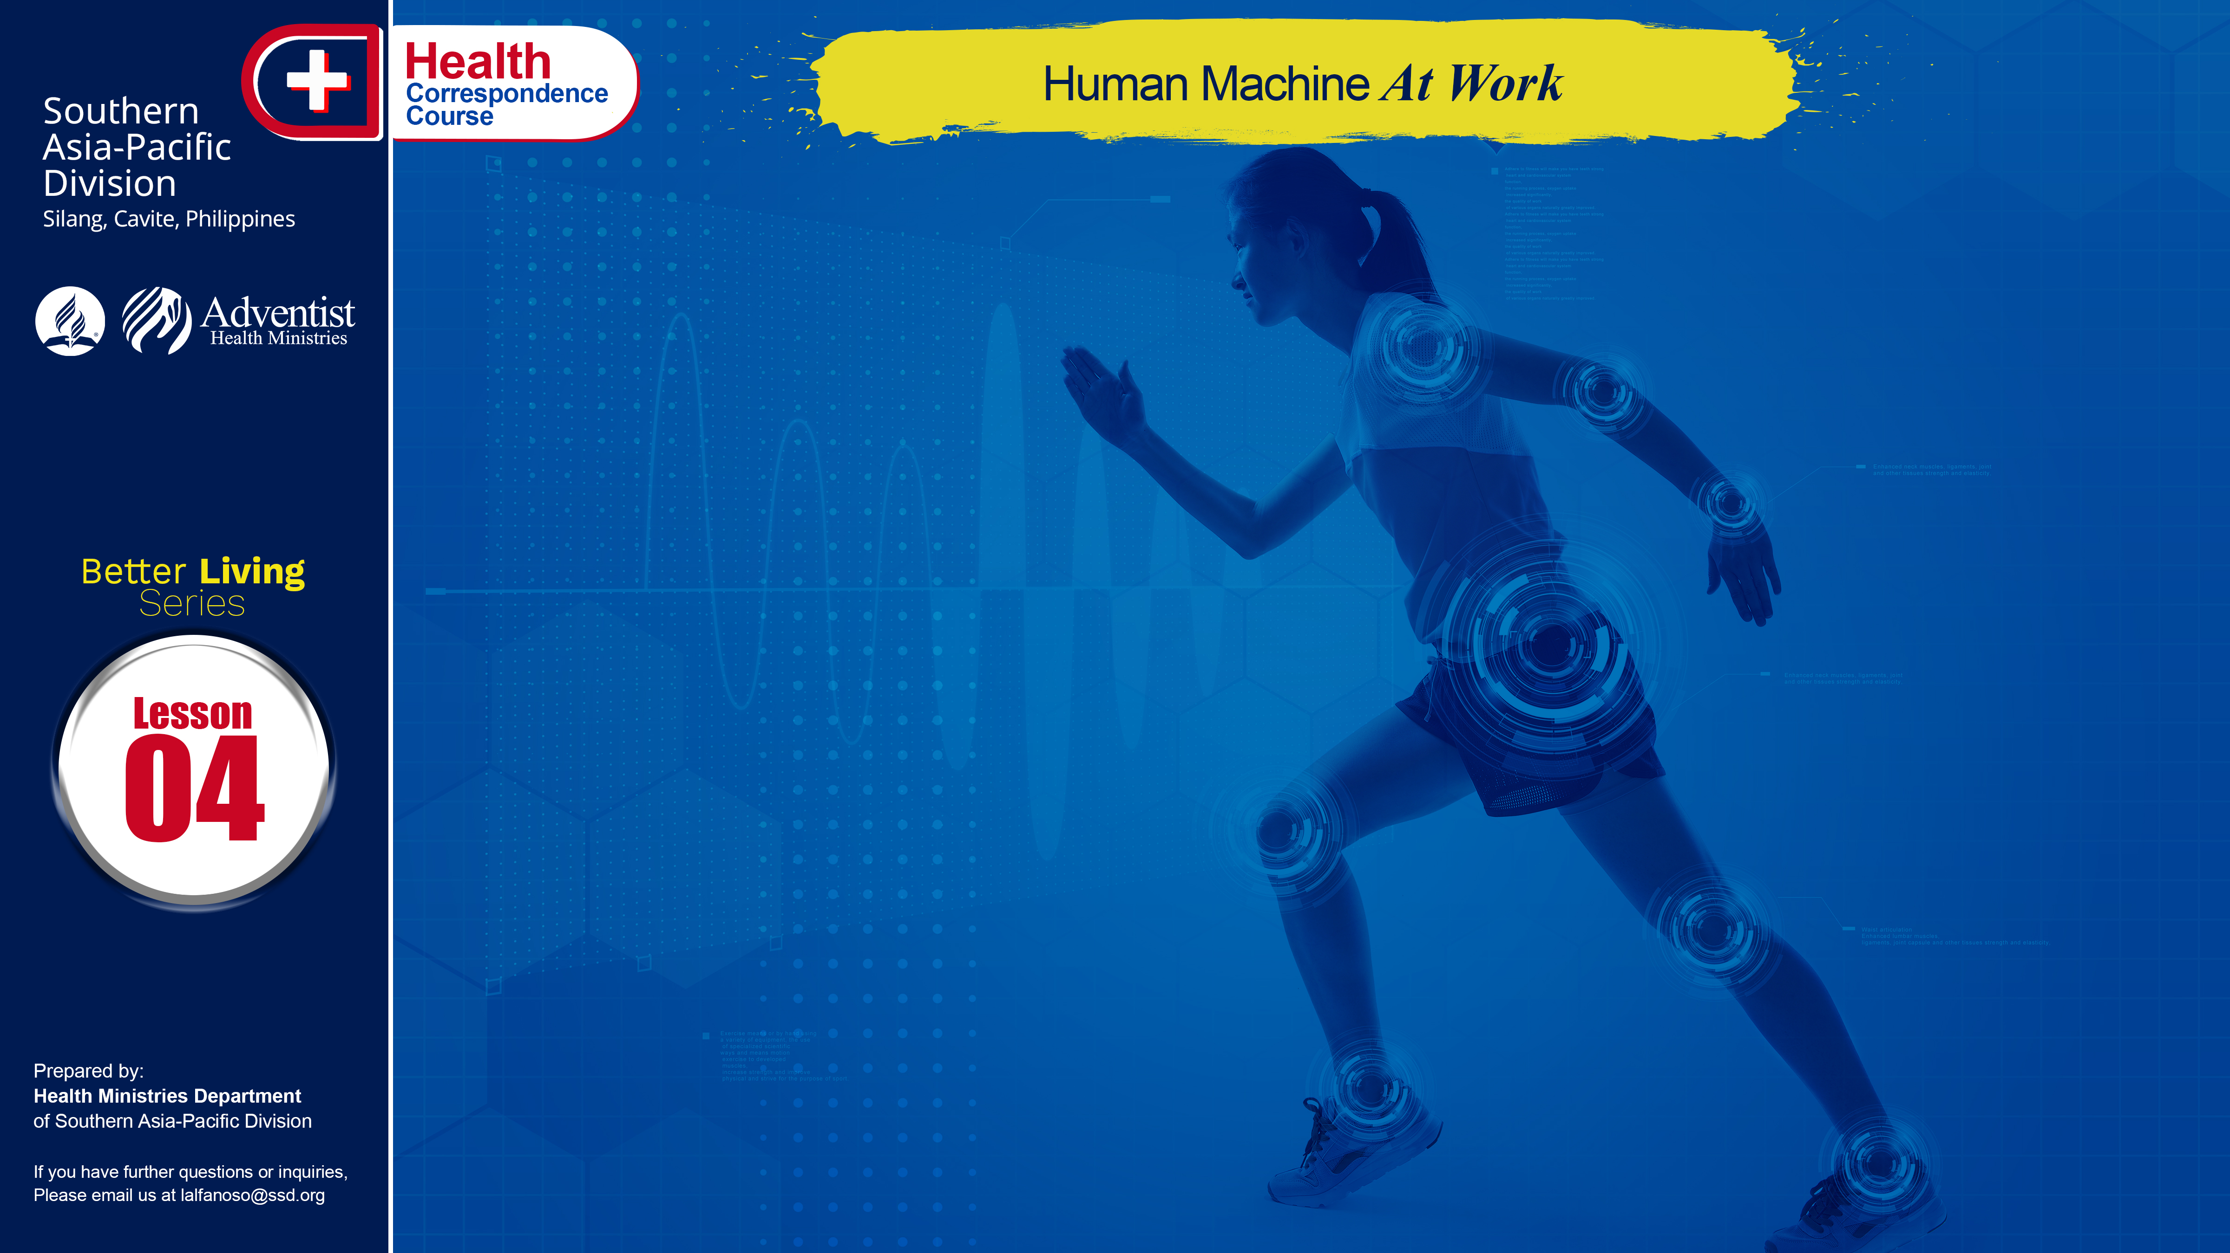

Slide 2
Have you ever wondered how our body works? What about the different organs we have, the importance of each function? Well, our human body is indeed a great miracle, each vital part performing each different function that contributes as well to others. If we were to collect all the materials of which the human body is composed we would be very surprised. None of these parts amount to very much worth in themselves. Yet, when combined in the human body, and moved by the spark of life, there is nothing in the entire world more valuable and important.

Slide 3
UNLIMITED HEAP OF CELLS
The human body itself is composed of untold millions of cells separated from one another by tiny spaces, so that the tissue fluids can pass freely on all sides of each cell. Thus every living cell in the body is constantly bathed in a stream of fluid. This is what keeps them alive. As this living stream moves through the various tissues and organs, each cell accepts that which it needs, and rejects the rest. Thus, each living cell has the power to choose what is best for its own particular needs.
. . .

Slide 4
UNLIMITED HEAP OF CELLS
. . .
In other words, each cell is alive. In addition to bringing food, oxygen, and chemicals to the cells, this wonderful stream has another very important function. It must carry away all the waste products that are given off by the cells. The waste products eventually find their way into the bloodstream and are finally eliminated through the lungs and kidneys. Both of these functions are absolutely essential to life.

Slide 5
HUMAN’S CROSS-BREEZE SYSTEM
As we breathe in, oxygen from the air is brought into direct contact with the bloodstream as it passes through the vessels of the lungs. But air passing through the lungs must first of all be purified. It also must be warmed and moistened; otherwise the windpipes would soon become dried out and irritated. This is what happens when you breathe with your mouth, therefore mouth breathing is not natural since it dries out the tissues in the throat, and often results in chronic bronchitis, particularly in elderly people.
. . .

Slide 6
HUMAN’S CROSS-BREEZE SYSTEM
. . .
The air around us contains large quantities of smoke and dust, as well as millions of germs. These must be screened out before the air reaches the lungs. It begins in the nose. Hairs at the entrance of the nose help to screen out large particles of dust. The deeper passages of the nose moisten and warm the air. In spite of the large hairs near the front of the nose, much of the air we breathe still contains considerable amounts of dust.
. . .

Slide 7
HUMAN’S CROSS-BREEZE SYSTEM
. . .
To help remove this potential cause of trouble, the whole respiratory tract has been lined with a special type of mucous membrane. As the air reaches the deeper parts of the lungs it quickly fills the tiny air sacs (or alveoli). The walls of these little air cells are literally covered with capillaries (smallest of all blood vessels). The oxygen from the inspired air rapidly passes through the thin walls of these tiny capillaries and right into the hemoglobin of the red blood cells.
. . .

Slide 8
HUMAN’S CROSS-BREEZE SYSTEM
. . .
During heavy exercise the needs of the body are very much greater than when it is at rest. To meet these needs, the circulation of the blood must be tremendously increased. At the same time the waste products must be removed that much more quickly. Sensible habits of living are essential if we are to stay well.

Slide 9
LOVE YOUR KIDNEYS
Not only must we have good lungs and an adequate circulation of the blood, but we must also have some way of eliminating the other poisons that arise from various parts of the body. Standing over-all this amazing system of living cells, are those two remarkable organs—your kidneys! They alone determine what materials are to be preserved and what must be eliminated. It is their job to keep the bloodstream pure and free from all harmful substances at all times.
. . .

Slide 10
LOVE YOUR KIDNEYS
. . .
Within the capsules of your kidneys, there are nearly 240 kilometers of tiny tubing, each with a tiny living filter whose job it is to filter out the vital chemicals that the body cannot afford to lose. Any chemicals not needed are rejected and eliminated as urine. Your kidneys are rather small, considering the amount of work for which they are responsible.
. . .

Slide 11
LOVE YOUR KIDNEYS
. . .
Normally you have two kidneys, one lying on each side of the spine in the back part of the abdomen. Each kidney weighs less than half a pound, yet ten times more blood flows through your kidneys each minute than through any other organs of similar size or weight.
. . .

Slide 12
LOVE YOUR KIDNEYS
. . .
Let us keep all the stream and vital organs in our body fresh and healthy. Such a program includes plenty of fresh air, good food, pure water, rest and exercise. It is important for all of us to develop better habits of breathing. Having good posture adds to it. Deep breathing is one of the finest forms of exercise. Let us each have the good sense to choose life and health and happiness, a coordination of mental, spiritual, and emotional factors – all of which are important.

Slide 13
GOD’S WAY TO ULTIMATE HEALTH
Kindly fill in the blanks with the right answers.
The human body is composed of millions of _______.
Each living cell has the power to _________ what is best for its own particular need.
Oxygen from the air is brought into direct contact with the __________________ as it passes through the vessels of the __________.
Any chemicals are eliminated and rejected as ___________.
______ ___________ is one of the finest forms of exercise.

Slide 14
NAME: ______________________________________
ADDRESS: ______________________________________
AGE: ______________________________________

