Slide 1
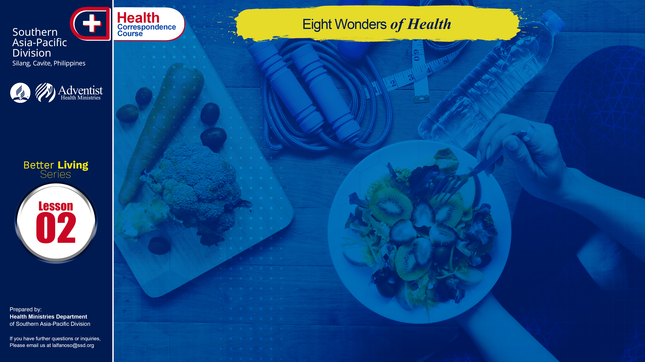

Slide 2
One hundred years ago, in the days of Dr. John Harvey Kellogg, people from all over the world came to Battle Creek Sanitarium. Many of these cases had been given up as hopeless – yet a surprisingly large proportion recovered at the Sanitarium. The reason the people kept the 1,200 bed institution filled was that the treatments encompassed the best of the several different schools of the healing arts and avoided the harmful aspects. Principally the battle Creek Sanitarium used enlightened diet therapy far in advance of that day, hydrotherapy, some manipulative therapy, along with the scientific use of all good medical procedures of the time.

Slide 3
God is really good. He didn’t only give us life but also provide us with natural remedies around us. These wonders of health or natural remedies are composed of eight elements:
Nutrition, Exercise, Water, Sunshine, Temperance, Air, Rest, Trust in God. The best time to use remedies is before you are sick! Prevention works.

Slide 4
NUTRITION
Nutrition involves every facet of our lives. It affects our spiritual and mental development as well as our physical well-being.
Our whole life – our very existence, health and ability to work and contribute to the society in which we live – depends upon adequate nutrition.
. . .

Slide 5
NUTRITION
. . .
Nutrition involves food, the nutrients food contains and the functions and requirements of these nutrients within the body. Man has always recognized the importance of food to his health and survival. The ultimate goal of nutrition is buoyant health. The length of our life and our freedom from disease center around good nutrition.
. . .

Slide 6
NUTRITION
. . .
By choosing our food wisely we can help our body and mind to remain active and useful. Choose from day to day and week to week a wide variety of wholesome foods, because each food contributes not one but several essential nutrients. Variety is needed to ensure good nutrition.

Slide 7
EXERCISE
Before, sports advertisements make you feel you have to look like Michael Jordan, with tongue sticking out and perspiring all over. That was considered the ideal picture of exercise. Not anymore! We know that the intensity of exercise does not have to go that high for health benefits. While one needs to be healthy to be physically fit, you can still be healthy even if you are not physically fit. That is an important distinction.

Slide 8
EXERCISE
. . .
To be fit means to be able to do a lot of more strenuous activities with the least amount of strain to you and at the least amount of fatigue — that would be fitness. Walking, climbing, up and down the stairs, cleaning the house, gardening, are other physical activities considered as exercises too. So one does not have to go to the gym to consider himself having an exercise. Ten minutes three times a day is fine.
. . .

Slide 9
EXERCISE
. . .
What is important is that at the end of the day you have at least 30 minutes of exercise. Exercise has a lot of benefits. Walking at least two miles a day can reduce the risk of dying of cancer by 50%. Walking briskly for at least 3 hours per week is associated with a 54% decrease in the risk of heart attack and stroke.
. . .

Slide 10
EXERCISE
. . .
Exercise is also good for persons with diabetes mellitus as it will burn the excess sugar in the blood. Men who burn 2,000 calories or more per week by walking or climbing or in sport activities were found to live longer by 1-2 years than those who burned less than 500 calories per week on similar activities. That means not only a difference between life and death but in the quality of life.

Slide 11
WATER
Seventy percent of a person’s weight is water. So, a person weighing 90 kg has 63 kg of water in his body. Water is a necessity in one’s body and life. Even other creatures need water in order to live. Every cell inside our body is filled with water. No other drink can be compared with water when it comes to importance and the benefits we can get from it.
. . .

Slide 12
WATER
. . .
Drinking more water decreases the risk of kidney stones. Consuming liberal amounts of water may also decrease the risk of urinary tract infections. Water drinking among smokers may also help to decrease the risk of cancer. The internal use of water can reduce suffering and save money as well as lives. In the external usage of it, it deals with a lot of physical problems. Drink at least 8-10 glasses of water or more a day. Avoid drinking water during mealtime, thus this will interrupts in the digestion of food.

Slide 13
SUNSHINE
Sunshine had gotten the bad rap, since that too much ultraviolet rays may lead to skin cancer —— but judicious amount of sunshine can be extremely beneficial. Sunshine helps in the prevention of osteoporosis, it helps one to have stronger bones. It helps in the conversion of cholesterol in our skin to vitamin D which is an essential factor in promoting good bones. It also lowers blood cholesterol levels and blood sugar. It kills germs and bacteria and helps in calcium production for more stronger bones.

Slide 14
TEMPERANCE
Temperance here means total abstinence from substances that are harmful and moderate use of substances that are helpful. This means like in the case of alcohol, caffeinated drinks, cigarette smoking, diet and the rest, that when consumption is high it might deteriorate our health.

Slide 15
AIR
It is the body’s most frequently needed resource. Living in an environment where the air quality is good greatly enhances our ability to fight disease. Breathing deeply of fresh, outdoor air promotes a good oxygen supply for the body cells. We needed air in order to live.
A person can live 7 weeks without food, 7 days without water, and only 7 minutes without air. The lungs uses these air, it inhales and exhales 20,000 liters of air everyday.

Slide 16
REST
Another winning natural remedy is rest. Two hours of deep sleep, blessing the brain with delta waves, is worth more than four hours of shallow sleep after midnight. Tonight’s sleep builds for tomorrow’s excellence. At least 8 hours of proper sleep is required so that our brain cells and vision won’t be affected.
With proper rest, productivity and disease resistance is increased. Rest is the great rejuvenator. We need quiet physical relaxation after active work, vigorous exercise after mental work and deep restorative sleep.

Slide 17
TRUST IN GOD
Trust in God is the most important healing component in these eight elements of natural healing power. Stress, fear and anxiety affect the chemistry and function of every body system. Becoming acquainted with and learning to trust the Creator God, enhances physical, emotional, and spiritual healing. Faith in God favors good health: they have higher levels of life satisfaction, greater personal happiness, and fewer negative psychosocial consequences of traumatic life events.

Slide 18
These eight natural remedies is an opportunity to maximize health by focusing on the changes that are calculated to promote health and happiness.

Slide 19
GOD’S WAY TO ULTIMATE HEALTH
Write X if the statement is wrong and O if the statement is right.
___ Nutrition involves food, the nutrients food contains and the functions and requirements of these nutrients within the body
___ Keeping one’s body fit or having an exercise had lots of benefits.
___ We need air in order to live
___ Temperance means total abstinence from harmful substances.
A person can only live 10 minutes without air.

Slide 20
Write the correct answer on the blank provided.
At least ____ hours of deep sleep is needed to sustain the brain cells
A person can only live 7 days without ________.
The ultimate goal of nutrition is __________ _________.
A person should have at least ____ ______ of exercise a day.
Avoid drinking water during _____________.
NAME: ______________________________________
ADDRESS: ______________________________________
AGE: ______________________________________

